Slide 1




autoGEMM: Pushing the Limits of Irregular Matrix Multiplication on Arm Architectures
Du Wu^{2,3}, Jintao Meng¹, Wenxi Zhu⁴, Minwen Deng⁴, Xiao Wang⁵, Tao Luo⁶, Mohamed Wahib³, Yanjie Wei¹
1 - Shenzhen Institute of Advanced Technology, Chinese Academy of Sciences, China
2 - Tokyo Institute of Technology, Japan
3 - RIKEN Center for Computational Science, Japan
4 - Tencent AI Lab, China
5 - Oak Ridge National Laboratory, USA
6 - Institute of High Performance Computing, A*STAR, Singapore
2024.11.19
Notes:
This is the work I completed during my master degree in Shenzhen Institute of Advanced Technology and internship at Tencent AI Lab.
Now I am a second year Phd student in Tokyo Institute of Technology and I am also a Junior Research Associate in RIKEN Center for Computational Science.

Slide 2
Content
Background & Challenges
Motivation
Related Works
Methods
Performance Analysis

Slide 3
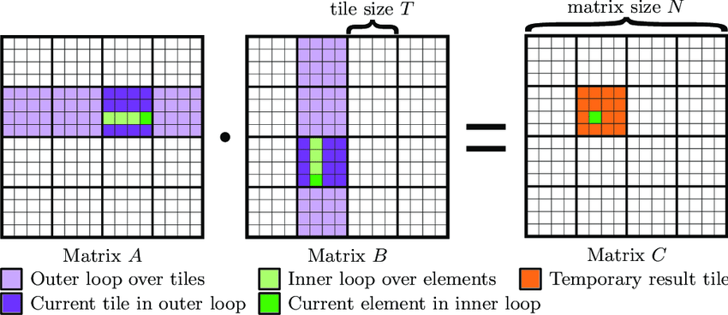
Background & Challenges
About GEMM
General matrix multiplication(GEMM) has been studied intensively for years
Get near-optimal performance on large and regular-shaped matrices

Slide 4
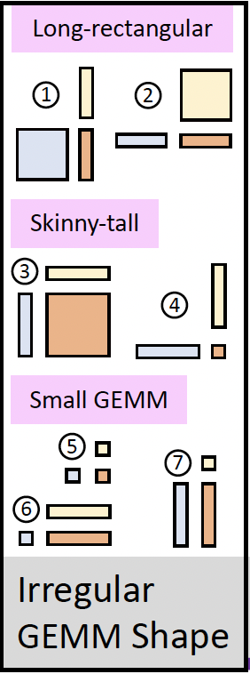
Background & Challenges
Low Performance Irregular GEMM (First Challenge)
Irregular GEMM : one of input matrix dimensions is extreme imbalance
small GEMM : one of input matrices is small
Traditional science program：
High-order solver for CFD heavily rely on GEMM 8 × 8
Molecular dynamics simulator extensively use GEMM 23 × 23
X-ray imaging reconstruction require GEMMs K dimension fixed at 4
Deep learning programs：
The first layer of ResNet50 compute on GEMM 64 × 12,544
The Winograd algorithm is highly dependent on GEMM 8 × 8
The AI model for MOBA game rely on GEMMs M dimension fixed at 5

Slide 5

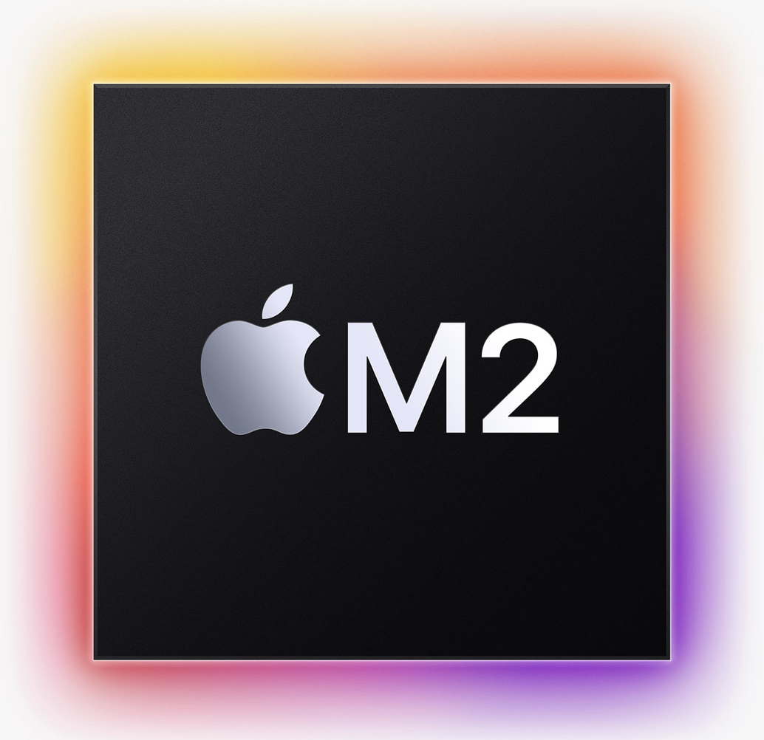
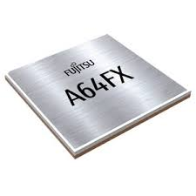
Background & Challenges
About ARM Architecture
personal computers
mobile phones
embedded devices
accelerators (FPGAs, ASICs)
large CPU clusters
GPU clusters
TPU clusters
Deep learning
used for training
inference on
More PC, server and supercomputer are based ARM
Device CPUs are dominated by ARM
and upgrade speed extremely fast
mobile CPU
consumer PC CPU
server CPU
Supercomputer
Apple M1/M2
Huawei KP920
AWS Graviton2
Ampere Altra
Fujitsu A64FX

Slide 6
Background & Challenges
Coding Difficulties with ARM (Second Challenge)
 | instruction length | addressing mode | coding scheme | read-write operation | Micro-Ops
X86 (CISC) | variable | more | long and complex | register-memory | yes
ARM (RISC) | fixed | less | simple | load-store | no
Without Micro-Ops ARM architecture needs better orchestration assembly instructions
Load-store data from cache/memory is the key technology for ARM optimization

Slide 7
Background & Challenges
Hardware Diversity (Third Challenge)
CPU Name | Cores | CPUs (GHz) | L1 Cache (Bytes) | L2 Cache (Bytes) | L3 Cache (Bytes) | Type
Snapdragon 855 | 4 + 4 | (1@2.84+3@2.42) +4@1.80 | - | (1@512K+3@256K) +4@128K | 4M-share | mobile
Snapdragon 888 | 4 + 4 | (1@2.84+3@2.42) +4@1.80 | - | (1@1M+3@512K) +4@128K | 4M-share | mobile
Apple M1 | 4 + 4 | 4@3.20 +4@2.06 | 4@128K +4@64K | 12M-share +4M-share | None | Consumer PC
Apple M2 | 4 + 4 | 4@3.49 +4@2.06 | 4@128K +4@64K | 16M-share +4M-share | None | Consumer PC
Huawei KP920 | 8 | 8@2.60 | 8@64K | 8@512K | 32M-share | server
AWS Graviton2 | 16 | 16@2.50 | 16@64K | 16@1M | 32M-share | server
Ampere Altra | 70 | 70@3.00 | 70@64K | 70@1M | 32M-share | server
Different Arm SoC varies widely - Huge portability efforts

Slide 8
Content
Background & Challenges
Motivation
Related Works
Methods
Performance Analysis

Slide 9
Motivation
Challenges
Low performance on small GEMM
Low performance on irregular GEMM
We want to develop an framework that provides high-performance GEMM, is compatible with small/irregular GEMM, and is easily ported to cover all ARM architectures.
Not perform well on ARM architecture
Huge Portability efforts

Slide 10
Content
Background & Challenges
Motivation
Related Works
Methods
Performance Analysis

Slide 11
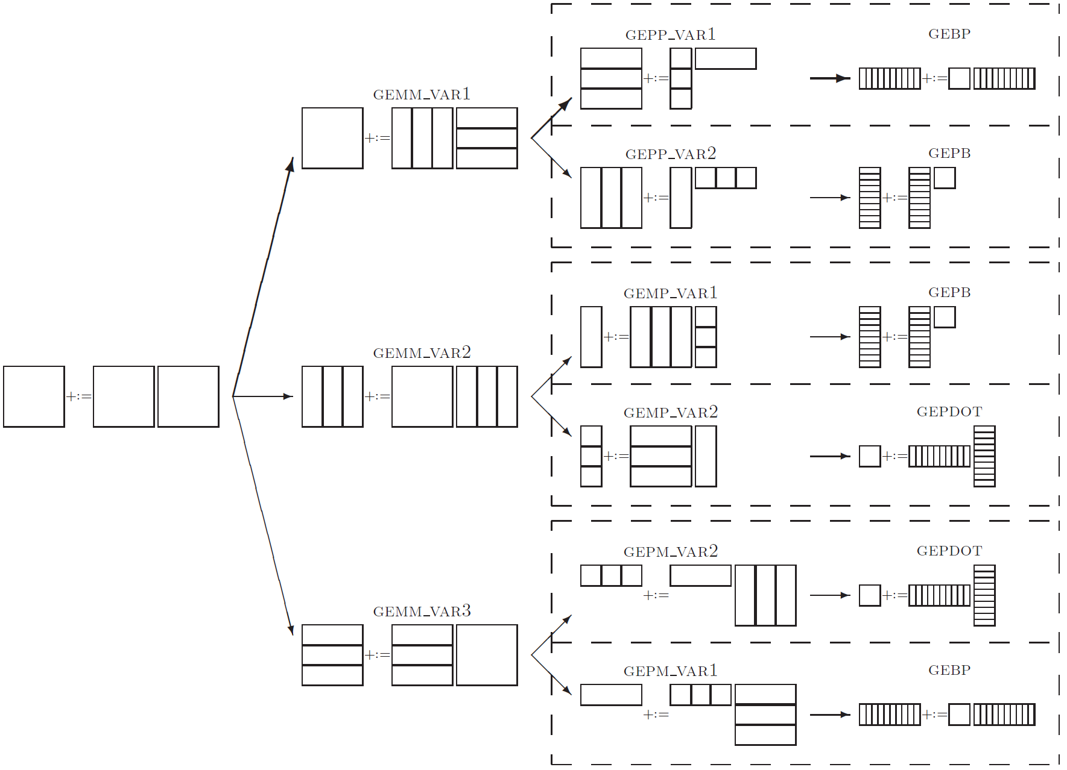
Manual tuning by experts - Related Works
Basic linear algebra library
Eigen
BLIS
OpenBLAS
Inference framework library
NNPACK
MNN
FeatherCNN
NCNN
TNN
Vendor's computing library
Intel oneDNN
AOCL
ARM Computing Library (ACL)
Based on Goto's six block strategy
Focus on large and regular-shaped GEMM

Slide 12
Manual tuning by experts - Related Works
The latest manual tuning work on ARM in recent years:
LibShalom (SC’21): it is the first work push the micro-kernel performance up to 90% efficiency on ARM Architecture, and provide an additional micro-kernel to handle irregular GEMM. But it mainly focus on Huawei KP920.
FastConv (TPDS’22): Our previous work, implemente 7 micro-kernels and use a search approach to find strategies that fit irregular GEMM.
Irregular GEMM is optimized to some extent
Small GEMM are still not the focus of manual tuning
The biggest problem with manual tuning by experts is the portability

Slide 13
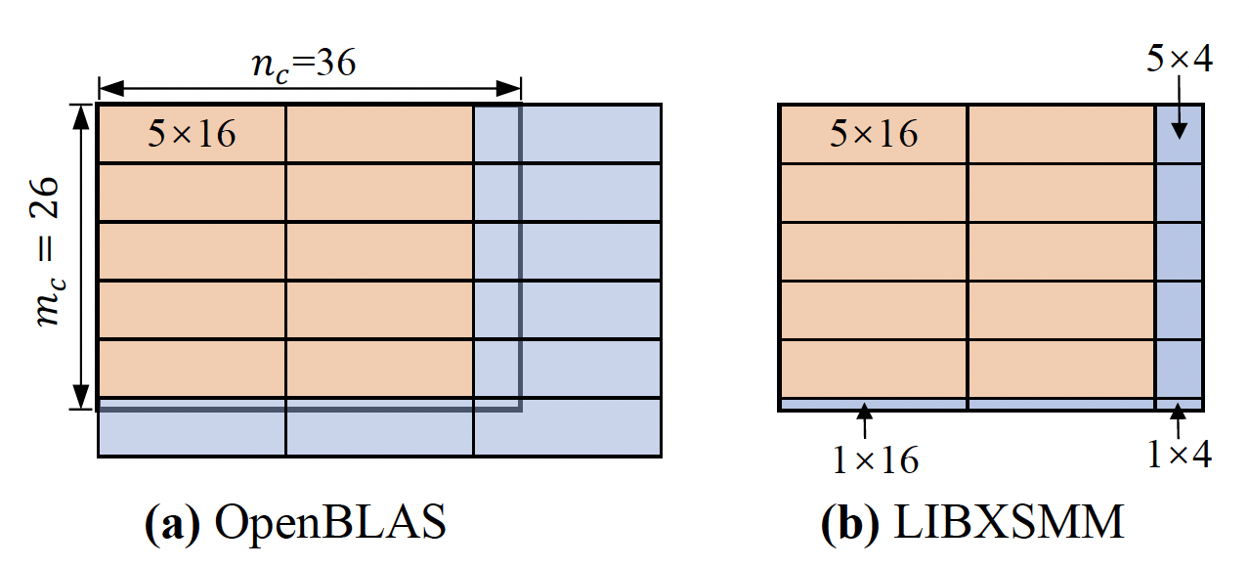
Runtime technology - Related Works
To solve the problem of small GEMM
Runtime technology like Just-in-time(JIT) compilation and Code generation helps
LIBXSMM (SC’16) is the first effort to optimize small GEMM.
It uses JIT to tile edge columns and rows with different tile size other than padding.
But LIBXSMM (Intel’s) works for the x86
Performance is not good porting to ARM

Slide 14
Tensor program compiler - Related Works
Domain-specific compilers begin to appear
Reduce the labor required for high-performance computing across disparate hardware backends.
Provide auto-tuning method to find the optimal configuration in parameter space.
State-of-the-art works include
MLIR（Google / LLVM）
Tensor Comprehensions（Facebook）
XLA (Google)
TVM（OSDI’18）
Halide（MIT）
Tiramisu（CGO’19）
TVM is the first effort to address the problems arising from deep learning
Support Ahead-of-time(AOT) tuning
Solve portability issue

Slide 15
Tensor program compiler - Related Works
But TVM cannot get a kernel with excellent performance (performance issue)
TVM's kernel can be called in three ways:
by the default compiler (LLVM)
by the intermediate expression (TIR) (Still depends on compiler）
by the external libraries (e.g. LIBXSMM, OpenBLAS)
Performance gap between compiler(①②) and expert manual tuning kernel
Calling external libraries(③) has additional overhead

Slide 16
Summary - Related Works
Challenges
Related Works
Methods
Low performance on small GEMM
Manual tuning by experts
autoGEMM:
auto-generate micro-kernels (Runtime technology)
optimize micro-kernels pipeline (Manual tuning)
apply dynamic micro-tiling
build performance model
tune parameters with TVM (Tensor program compiler)
Low performance on irregular GEMM
Runtime technology
Not perform well on ARM architecture
Tensor program compiler
Huge Portability efforts

Slide 17
Summary - Related Works
 |  | Hand-Tuning Kernel | Code Generation | Auto-Tuning | Loop-Scheduling | Small GEMM efficiency m=64 n=64 k=64 | Irregular GEMM efficiency m=256 n=3136 k=64
Manual tuning by experts | OpenBLAS | √ |  |  |  | 34.84% | 47.41%
 | Eigen | √ |  |  |  | 49.60% | 49.00%
 | LibShalom(SC’21) | √ |  |  |  | 94.57% | 85.70%
 | FastConv(TPDS’22) | √ |  | √ |  | 58.42% | 79.46%
Runtime technology | LIBXSMM(SC’16) | √ | √ |  |  | 67.70% | N/A
Tensor compiler | TVM(OSDI’18) |  | √ | √ | √ | 77.53% | 72.23%
 | autoGEMM | √ | √ | √ | √ | 97.64% | 91.37%
Combines manual tuning (to ensure near-optimal performance)
and auto-tuning (to ensure high portability)

Slide 18
Content
Background & Challenges
Motivation
Related Works
Methods
Performance Analysis

Slide 19
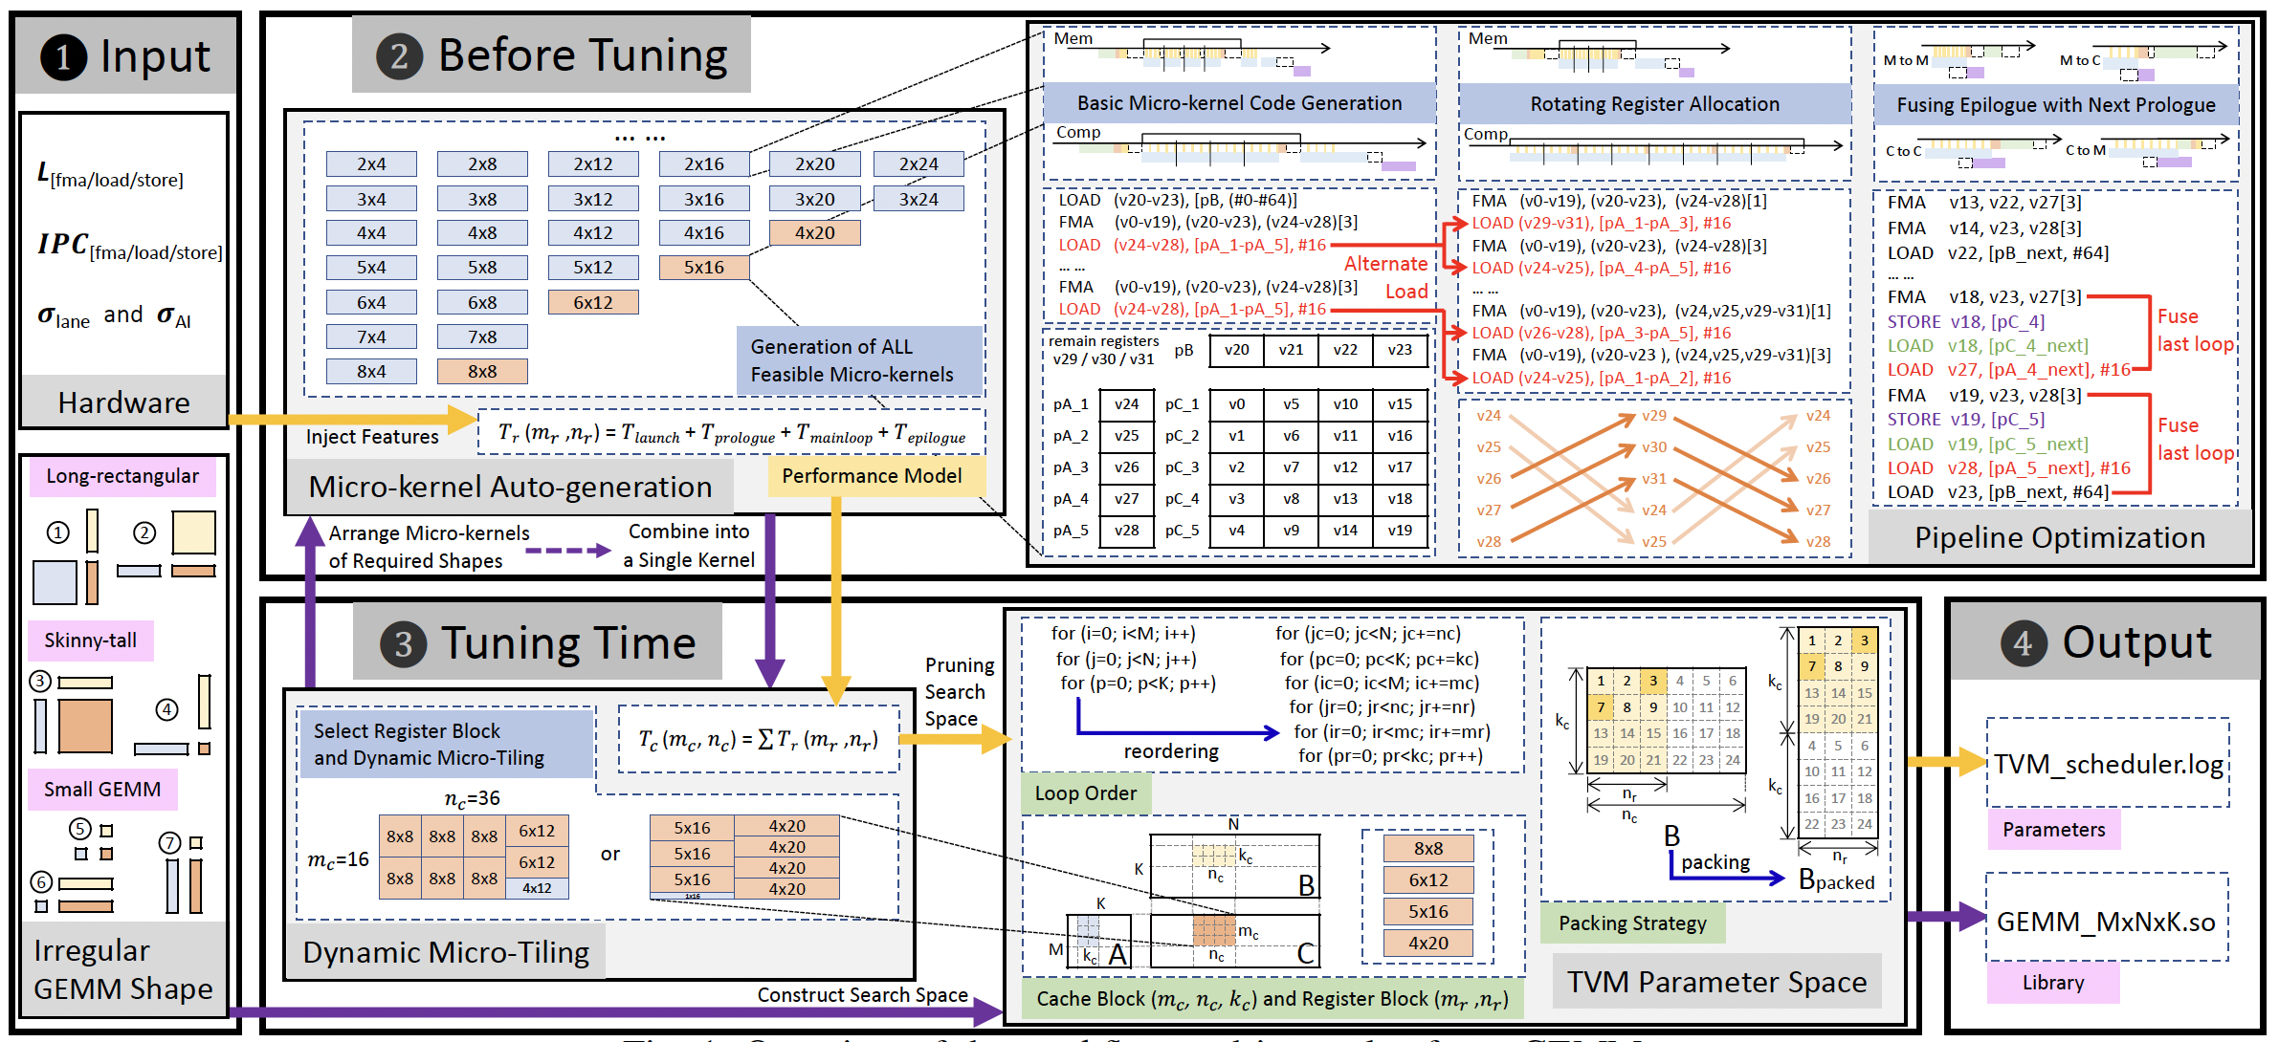
Overview - Methods
Notes:
autoGEMM is a systematic framework.
For better presentation, We divided into the following 4 parts.

Slide 20
1) Auto-generate micro-kernels - Methods
2)Optimize micro-kernels pipeline
with a performance model
1)Auto-generate
micro-kernels
4)Tune parameters with TVM
Register block
Cache block
Loop order
Packing strategy
3)Dynamic
micro-tiling

Slide 21
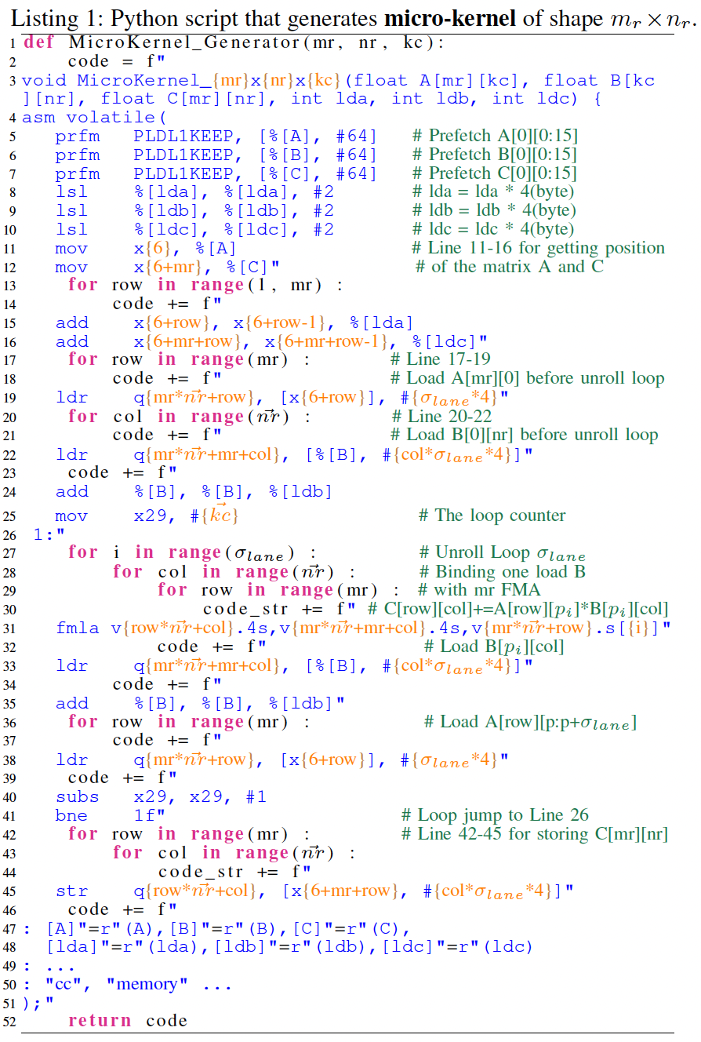
Micro-kernel Generater - Methods
Code generation
Python concat C code as string, inline assembly in C code.
m_{r}, n_{r}, and k_{c} as Python input to generate arbitrary shapes.
Three code blocks:
prologue: define all of the needed scalar/vector registers and first load matrix A, B and C.
mainloop: calculate m_{r} x n_{r} Fused Multiply-Add (FMA) operations iteratively.
epilogue: calculate remain operations and store the accumulated results.
The Generater in only 200 Python code lines.
Notes:
It is very light compared to thousands of lines of assembly code

Slide 22

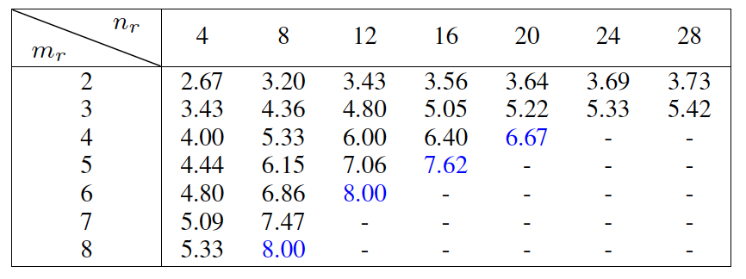
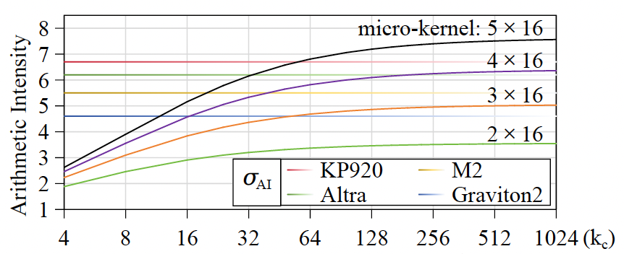
Select micro-kernels - Methods
Arithmetic Intensity (AI) will guide the selection of micro-kernels.
For regular GEMM, a default assumption is : k_{c} ≫ m_{r}(n_{r}) and micro-kernels can always reach AI_{max}.
But for irregular GEMM, when k_{c} is small, the bottleneck of micro-kernels are prologue and epilogue.
Note that larger AI micro-kernel is not necessarily better. There is a threshold σ_{AI} on different hardware.
If AI ≥ σ_{AI}, the micro-kernel performance does not increase (have potential to achieve peak performance)
If AI < σ_{AI}, the micro-kernel performance deteriorates
Notes:
Taking the 4x16 micro-kernel (the purple one) in the right figure as an example,
it is impossible to achieve close-to-peak performance on KP920 (red line),
but it have potential to achieve close-to-peak performance on M2/Altra/Graviton2.

Slide 23
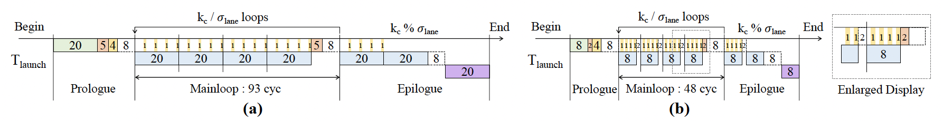
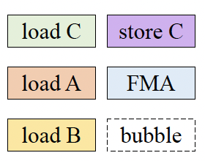
Evaluate micro-kernels - Methods
Use performance model to evaluate the micro-kernel, be that compute or memory bound.
Leverage the concepts of instructions per cycle (IPC) and instruction cycles (latency).
No data dependencies: IPC# instructions issued each clock cycle.
Data dependencies: wait L# latency cycles before executing subsequent dependent instruction.
Notes:
The figure is the performance model of generated 5x16 and 2x16 micro-kernel (understand as pipeline).
The upper is 5x16 micro-kernel, and is in compute bound, you can see in mainloop the FMA (blue) cover all load B (yellow).
The lower is 2x16 micro-kernel in memory bound, in mainloop the FMA can not cover all load B latency, there are bubbles between 2 load instructions use the same register.

Slide 24
2) Optimize micro-kernels pipeline - Methods
2)Optimize micro-kernels pipeline
with a performance model
4)Tune parameters with TVM
Register block
Cache block
Loop order
Packing strategy
3)Dynamic
micro-tiling
Notes:
Next, follow the previous performance model, we optimize micro-kernels pipeline.

Slide 25
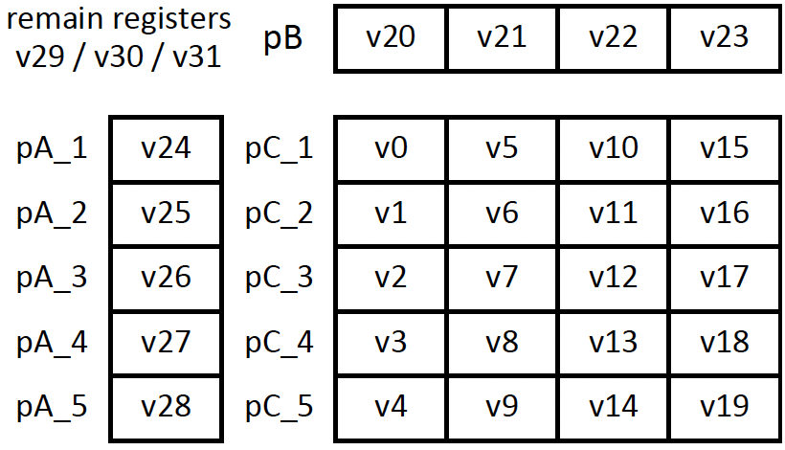
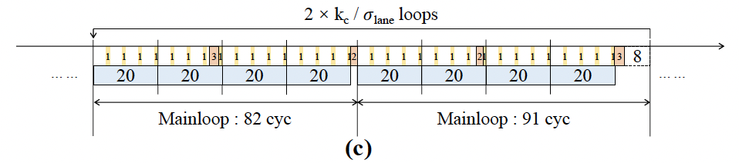
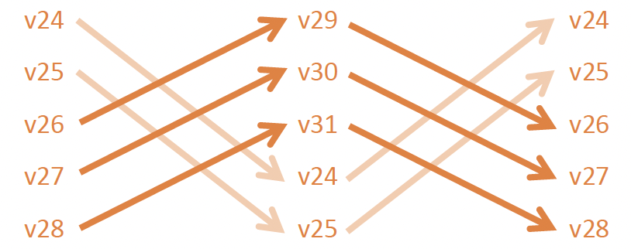
Rotating Register Allocation - Methods
Rotating Register Allocation
Use hardware redundant registers to increase the volume of overlap between FMA and load.
For compute-bound micro-kernels: help in overlapping the FMA and load instructions of sub-matrices A(m_{r}, k_{c}).
For memory-bound micro-kernels: allow to overlap the FMA and the load instructions of sub-matrices B(k_{c}, n_{r}).
Notes:
The goal of rotating register allocation in micro-kernel is to use redundant hardware registers to increase the volume of overlap between the FMA and load instructions.
Also take 5x16 micro-kernel as example, after allocating the registers for matrices A, B and C, there are still 3 registers left.
With Rotating Register Allocation, for every 2 iterations, the load instructions of submatrices A(mr, kc) can be completely overlapped by the FMA instructions once.

Slide 26
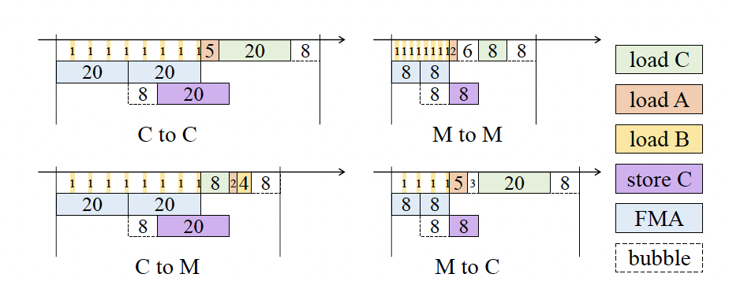
Fusing the Epilogue with Prologue - Methods
We fuse the epilogue FMA with the ending store operations and load instructions in the next loop prologue.
The traditional method of manually implementing the above optimizations on all chips, micro-kernel sizes and different numbers of epilogue iterations is not practical.
Micro-kernel Generater with above optimization is the practical solution.

Slide 27
3) Dynamic Micro-Tiling - Methods
4)Tune parameters with TVM
Register block
Cache block
Loop order
Packing strategy
3)Dynamic
micro-tiling
Notes:
Till now, we have generated and optimized all micro-kernels and completed the work before tuning.
And next introduce our Dynamic Micro-Tiling mothed.

Slide 28
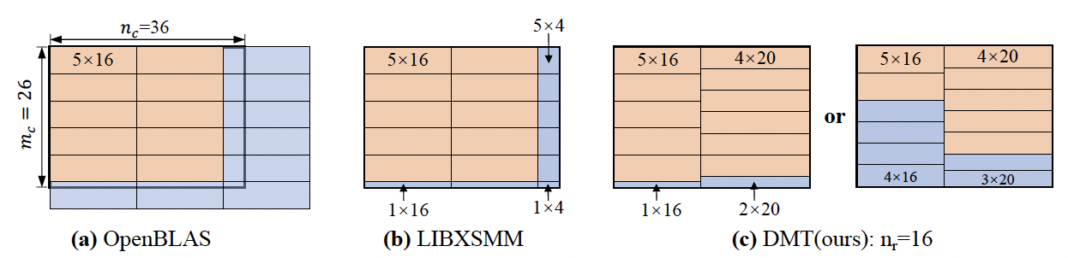
Dynamic Micro-Tiling - Methods
OpenBLAS and LIBXSMM use static micro-tiling : padding or tiling edge columns and rows
Our Dynamic Micro-Tilling (DMT) show two possible tilings:
For hardware with high σ_{AI} (left): DMT generate the fewest low arithmetic intensity tiles.
For hardware with low σ_{AI} (right): micro-kernels of shapes 4×16 and 3×20 can also achieve close-to-peak performance, and is a preferable solution.
Notes:
Take sub-matrix mc = 26, nc = 36 as example.
performance degradation can be significant for both redundant works due to padding and edge tiles with low arithmetic intensity.

Slide 29
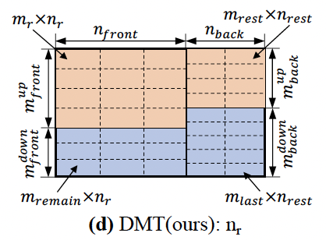
Dynamic Micro-Tiling - Methods
For general case, DMT use dynamic programming algorithm to find the optimal solution.
Three steps:
divide sub-matrix into 4 parts using three parameters
for each divided part, traverse all micro-kernel shapes
accumulate four parts, and record the minimum
For a given sub-matrix shape, the total number of FMA instructions used is fixed.
Large and Regular-shaped GEMM: If load/store can be fully overlapped with the FMA, the best performance can be achieved regardless of the micro-tiling chosen.
Small and Irregular GEMM: the performance of edge tiles is much lower than the non-edge tiles,
dynamic micro-tiling as an essential solution.

Slide 30
4) Tuning with TVM - Methods
4)Tune parameters with TVM
Register block
Cache block
Loop order
Packing strategy

Slide 31
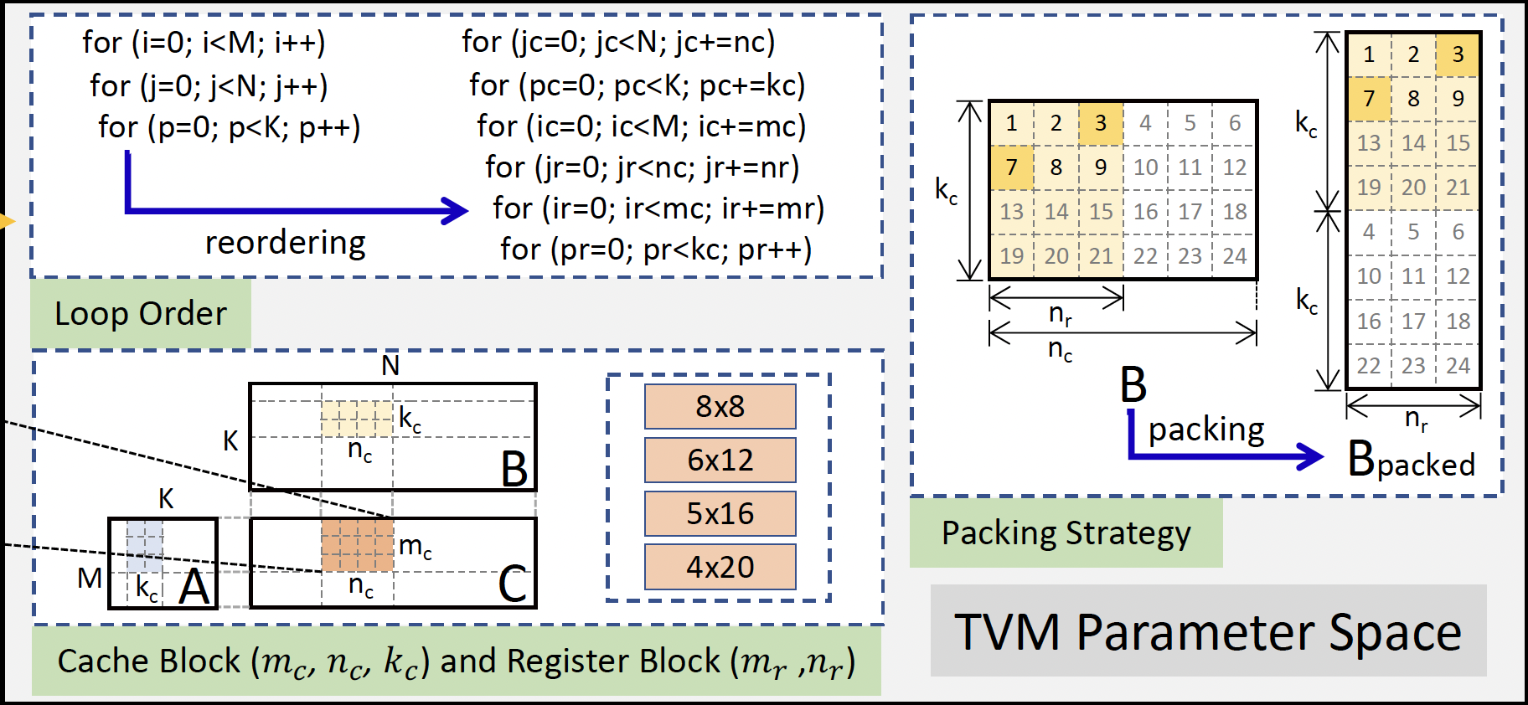
Tuning with TVM - Methods
Common optimization as Parameters Space:
Register block
Cache block
Loop order
Packing strategy
The generated kernel appears as an external library to TVM.
Ahead-of-time tuning + code generation + assembly = Tuning parameters directly into the assembly.

Slide 32
Content
Background & Challenges
Motivation
Related Works
Methods
Performance Analysis

Slide 33
Hardware configuration - Performance Analysis
CPU Name | Cores | #CPUs (GHz) | L1 Cache (Bytes) | L2 Cache (Bytes) | L3 Cache (Bytes) | Type
Huawei KP920 | 8 | 8@2.60 | 8@64K | 8@512K | 32M-share | SoC
AWS Graviton2 | 16 | 16@2.50 | 16@64K | 16@1M | 32M-share | server
Ampere Altra | 70 | 70@3.00 | 70@64K | 70@1M | 32M-share | server
Apple M2 | 4(+ 4) | 4@3.49 | 4@192K | 16M-share | none | Consumer PC
Fujitsu A64FX | 48(+2) | 48@2.20 | 48@64K | 4@8M-share | none | Supercomputer

Slide 34
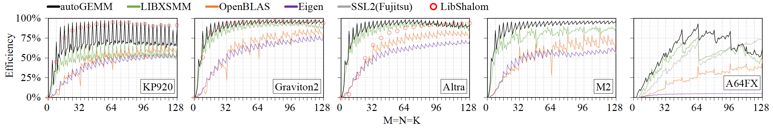
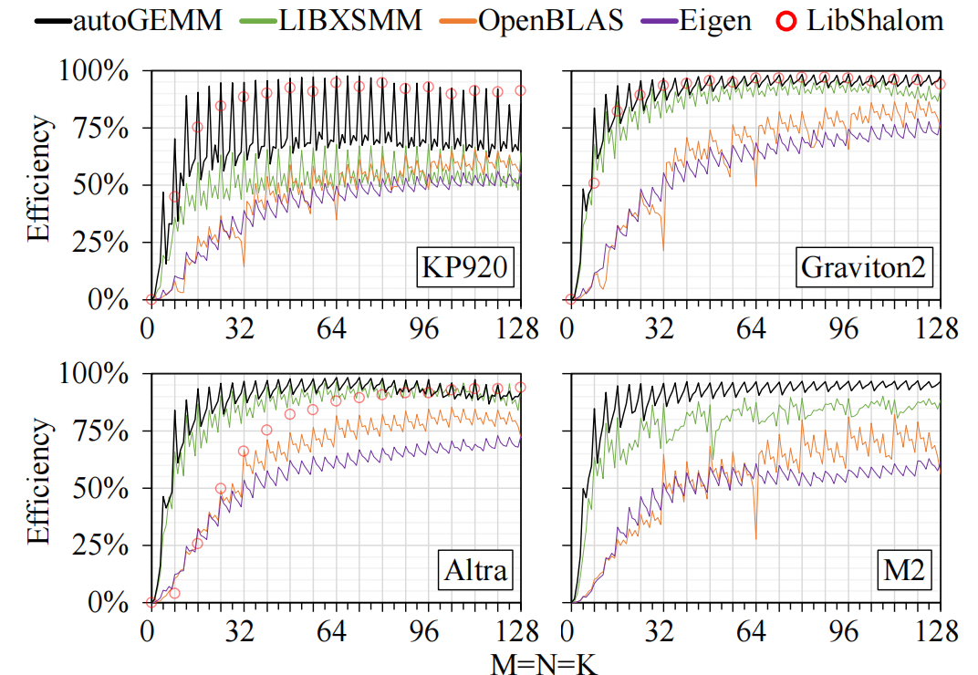
Small GEMM performance - Performance Analysis
When M=N=K=64, autoGEMM reaches 97.6%, 98.3%, 98.4%, 96.5%, and 93.2% of the theoretical peak efficiency on five hardware.
At least 5% performance advantage over the second-ranked library.

Slide 35
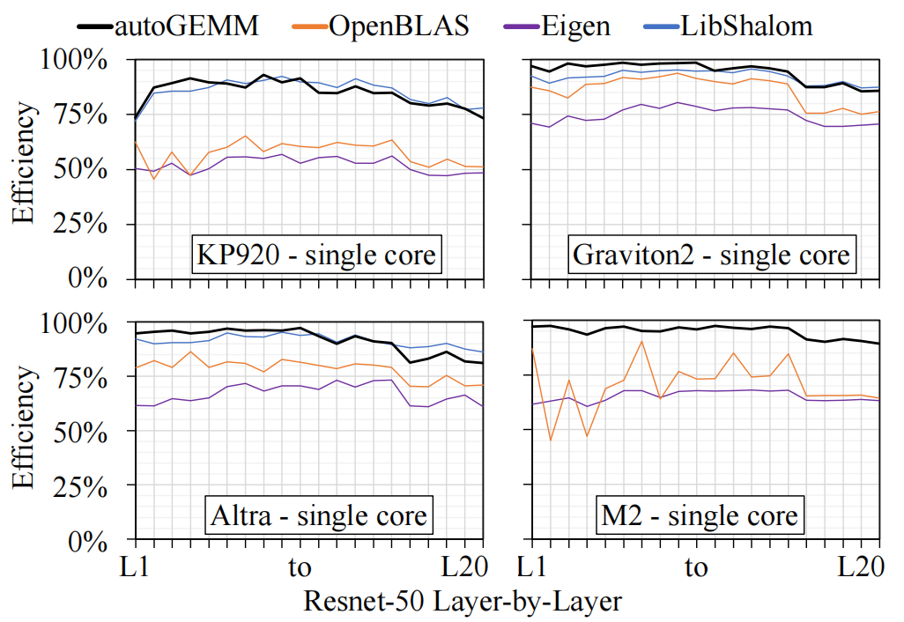
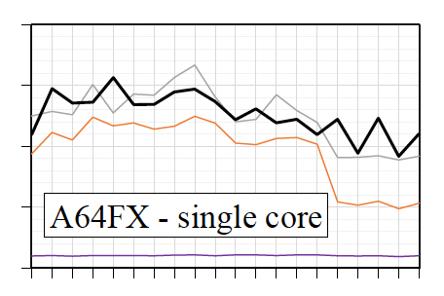
Irregular GEMM performance (1) - Performance Analysis
autoGEMM single-core performance on five hardware
- Average performance improved by 1.3x (up to 1.9x) compared to OpenBLAS.
- Average performance improved by 1.5x (up to 2.0x) compared to Eigen.

Slide 36
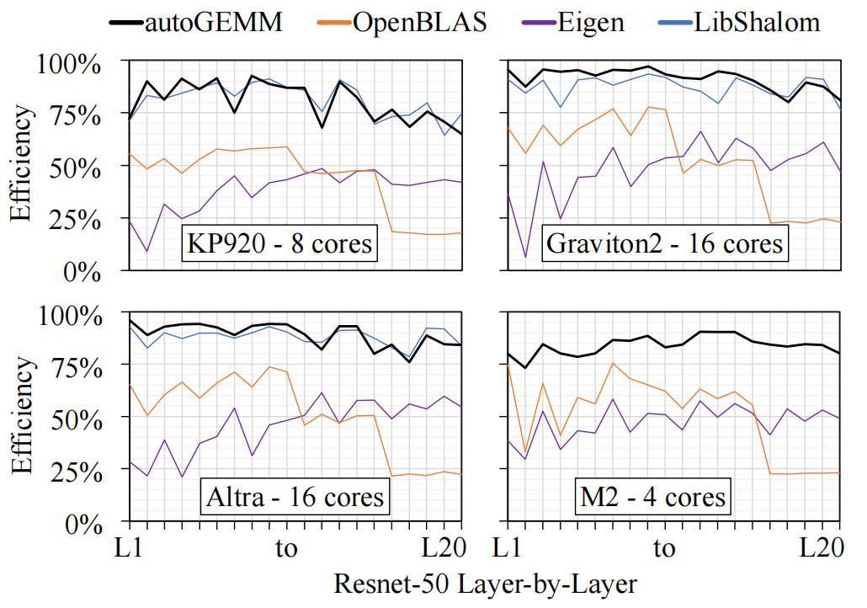
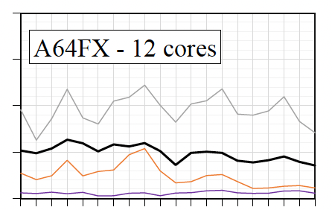
Irregular GEMM performance (2) - Performance Analysis
autoGEMM multi-core performance on five hardware
- Average performance improved by 1.8x (up to 3.4x) compared to OpenBLAS.
- Average performance improved by 2.0x (up to 4.0x) compared to Eigen.

Slide 37
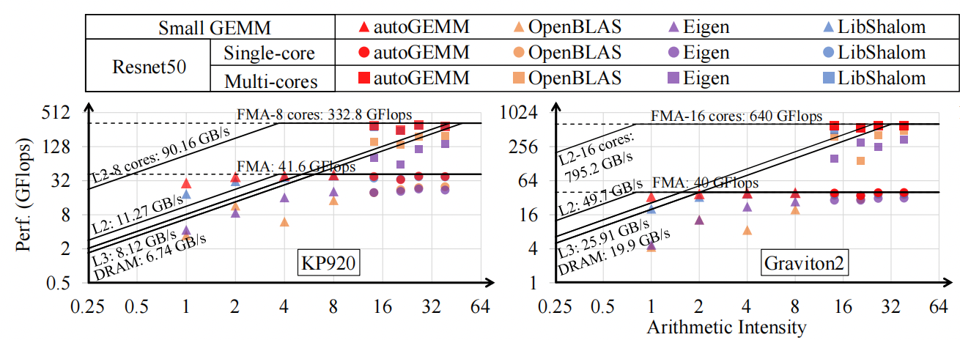
Roofline model analysis - Performance Analysis
autoGEMM can approach the peak performance of the hardware.

Slide 38
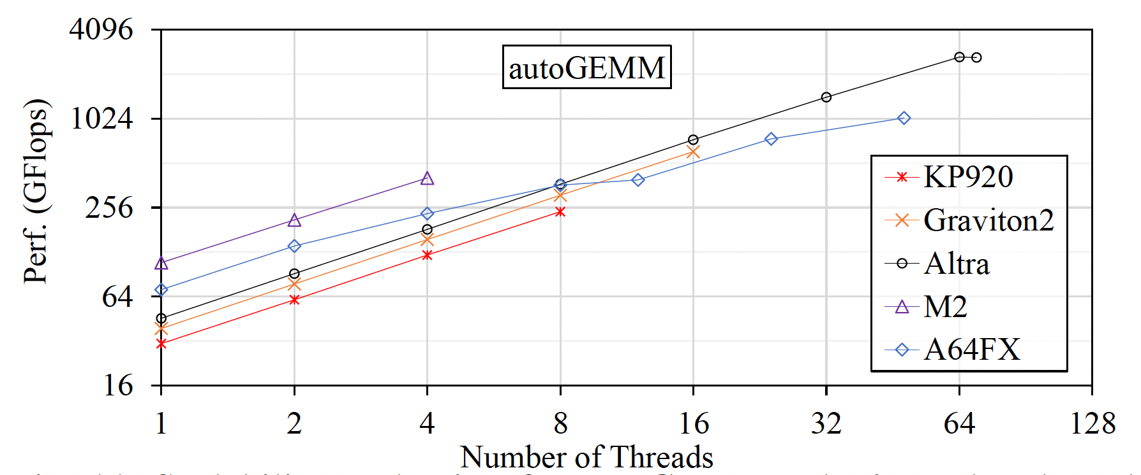
Scalability analysis - Performance Analysis
autoGEMM achieves almost linear expansion on five hardware, with parallel efficiency reaching 98%, 98.2%, 83.2%, 93.5%, and 30.3%.

Slide 39
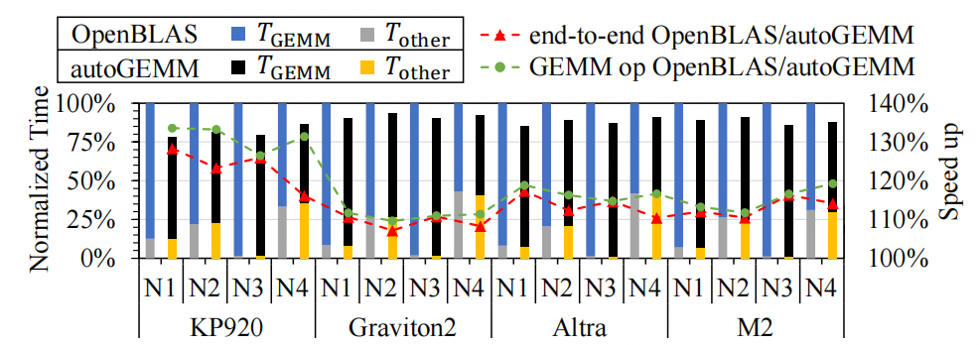
End-to-end analysis - Performance Analysis
Integrated autoGEMM into the Tencent TNN framework and tested four deep learning models:
ResNet50 (N1), Inception-V3 (N2), Mobilenet-V1 (N3) and Squeezenet (N4)
The end-to-end deep learning model acceleration ratio is between 1.08x and 1.30x.

Slide 40
Q & A
Open source: https://github.com/wudu98/autoGEMM
Contact information: du.wu@riken.jp

