Slide 1

Autozen Valuation Guru -Project Proposal DSCI 591 Capstone Project University of British Columbia Mentor: Dr. Gittu George
Mengjun Chen
Dhruvi Nishar
HanChen Wang
Tony Zoght
Notes:
Slide assignment
2-3 and Demo Dhruvi
4-5 HanChen
6, 10 Mengjun (Daniel)
7-9 Tony

Slide 2


What is Autozen?
Managed marketplace.
Connects private car sellers and dealers.
Makes the entire car selling experience easy, fast, and fair.

Slide 3
Four simple steps to sell a car the Zen way
Online valuation
inspection
Auction
Offer and pickup

Slide 4

Current challenge
Large discrepancies between the used car valuation (based on Canadian Black Book) and the final auctioned price.
In this project, we aim to help Autozen improve their used car price prediction.

Slide 5
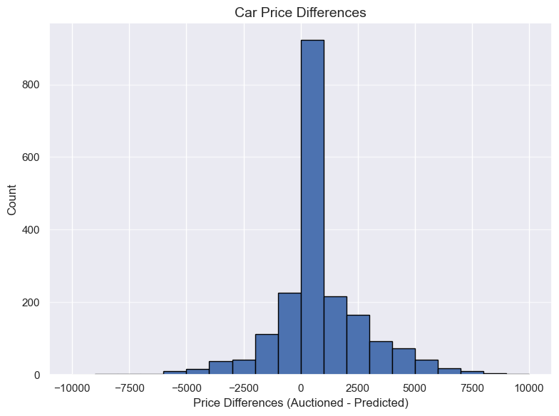
Current valuation method
Canadian Black Book (CBB)
Selected car features
Large discrepancies

Slide 6
Stakeholders
Accurate prediction to attract consumers.
Sellers
Maximize sale price.
Buyers (Dealers)
Find the best car deal.

Slide 7
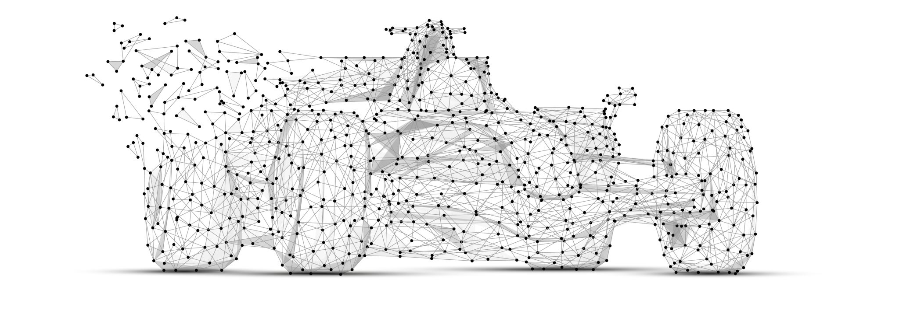
Objectives
Investigate how used cars features explain their final auctioned price.
Assess the accuracy of the current car valuation method (CBB) in predicting the final auctioned price.
Generate predictions of the final auctioned price using the car inspection data without relying on the CBB.

Slide 8



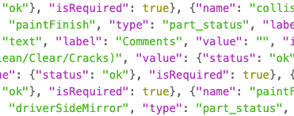
What are we working with ?
Users register their used cars
21,000
Inspected
11,000
Auctioned and Sold
2,000
Vehicle inspection
(10814 x 306)
Vehicle inventory
(21821 x 69)
Auction
(37719 x 39)
Notes:
Inspections
Vehicle inventory
Auctions

Slide 9
Proposed workflow (1)
1. Perform proper preprocessing.
2. Identify a suitable DS model.
3. Identify top car features.
4. Evaluate the current valuation method.

Slide 10
Proposed workflow (2)
5. Incorporate more relevant features.
6. Develop a prediction ML pipeline.
7. Evaluate the pipeline.

Slide 11

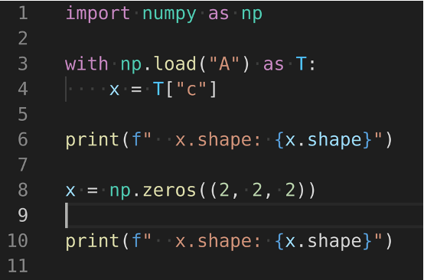
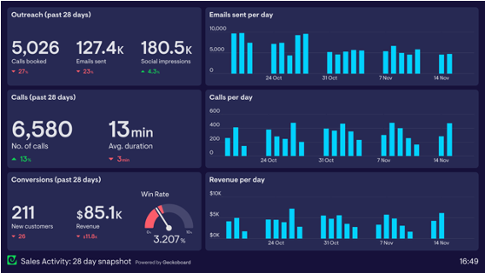
Final deliverables
Main: Notebook Report
(code + documentation)
Python pipeline
(Implementation)
Dashboard
(Visualization)

Slide 12
Milestones
Thu. 11 May
Milestone 1:
Baseline Model and Evaluation Metrics
Thu. 18 May
Milestone 2:
Initial Model Assessment
Thu. 25 May
Milestone 3:
Final Model Evaluation
Thu. 1 June
Milestone 4:
Assemble deliverables
Thu. 8 June
Milestone 5:
Final deliverables

Slide 13

Q & A

Slide 14
Data Science Technique (1)
Preprocessing and Wrangling
Data Cleaning, Imputing and removing null values
Normalization and Scaling Numerical Values
Converting all excel and json files to csv and parquet
Feature Engineering
Grouping of the ‘make’ for different cars listings
Latitude and Longitude values for the cities
Date and Time of the Year for seasonal trends
Selection of relevant features to include in the training

Slide 15
Data Science Technique (2)
Data Augmentation
Adding Local Gasoline Prices from Stats Canada
Car inventory - how many cars made in a year? Perhaps Images of the cars?
Supplemental Variables from the inspection reports and auction data
Data pipeline
Development of a pipeline to handle data loading, cleaning, preprocessing, modelling, and evaluation with automation
Evaluating the different models we train on with several metrics
Comparison of developed model with current pricing in use

Slide 16
Data Science Technique (3)
Modelling (baseline and modelling techniques)
Baseline Regressors
Decision Trees and Linear Regression
Naive LightGBM, XGBoost, Ensembles and pretrained models
Neural Networks with deep learning
Evaluation metrics
Using R2, RMSE, or MAPE values to interpret features
Compare the best performing model based on the performance on the test set and validation scores

Slide 17
