Slide 1
Math 680 Final Project
Reproduce Tweedie’s Compound Poisson Model With
Grouped Elastic Net
Mengtian Zhang & Menglan Pang

Slide 2

Statistical Model
Tweedie’s Compound Poisson Model:
$$Y=\sum_{i=1}^{N}{X_{i}}$$
where $N\sim Poisson(ξ)$, and $X_{i}$ are iid $Gamma\left(α, γ\right)$.
Highly right-skewed
Has probability mass at zero and nonnegative support.

Slide 3

Statistical Model
The probability density function:
$$f\left(y\right|μ, ρ, φ)=a\left(y, φ\right)exp⁡\{\frac{1}{φ}\left(\frac{yμ^{1−ρ}}{1−ρ}−\frac{μ^{2−ρ}}{2−ρ}\right)\}$$
where $ξ=\frac{μ^{2−ρ}}{φ(2−ρ)}$, $α=\frac{2−ρ}{ρ−1}$, and $γ=φ(ρ−1)μ^{ρ−1}$.

Slide 4
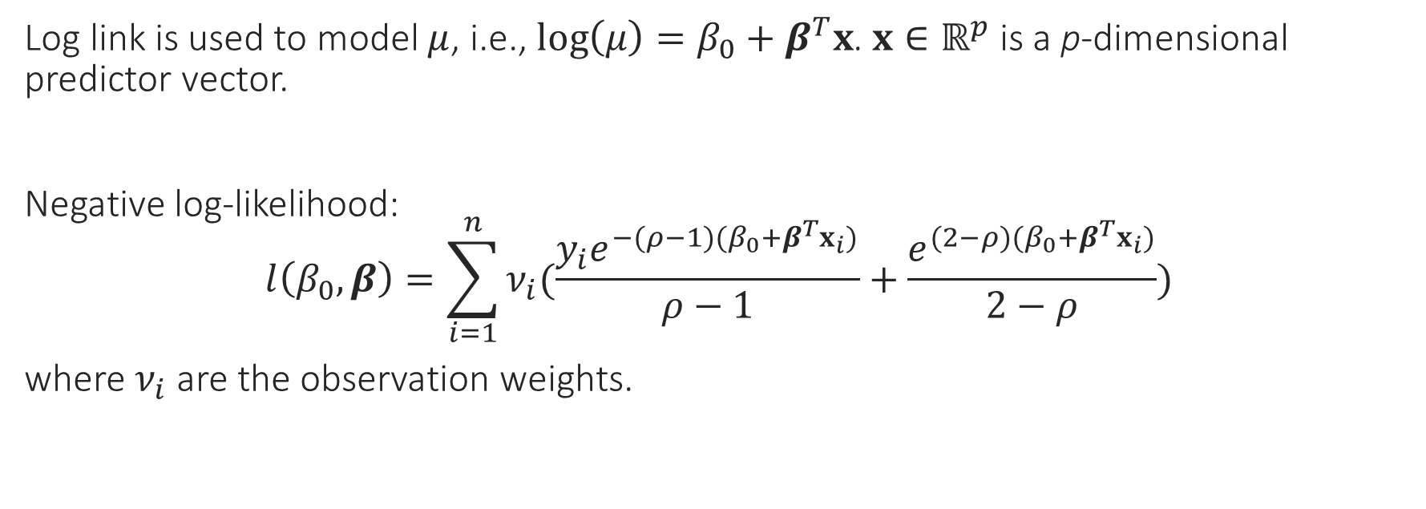
Statistical Model
Log link is used to model $μ$, i.e., $\log\left(μ\right)=β_{0}+β^{T}x$. $x∈ℝ^{p}$ is a p-dimensional predictor vector.
Negative log-likelihood:
$$l\left(β_{0},β\right)=\sum_{i=1}^{n}{ν_{i}(\frac{y_{i}e^{−(ρ−1)(β_{0}+β^{T}x_{i})}}{ρ−1}}+\frac{e^{(2−ρ)(β_{0}+β^{T}x_{i})}}{2−ρ})$$
where $ν_{i}$ are the observation weights.

Slide 5
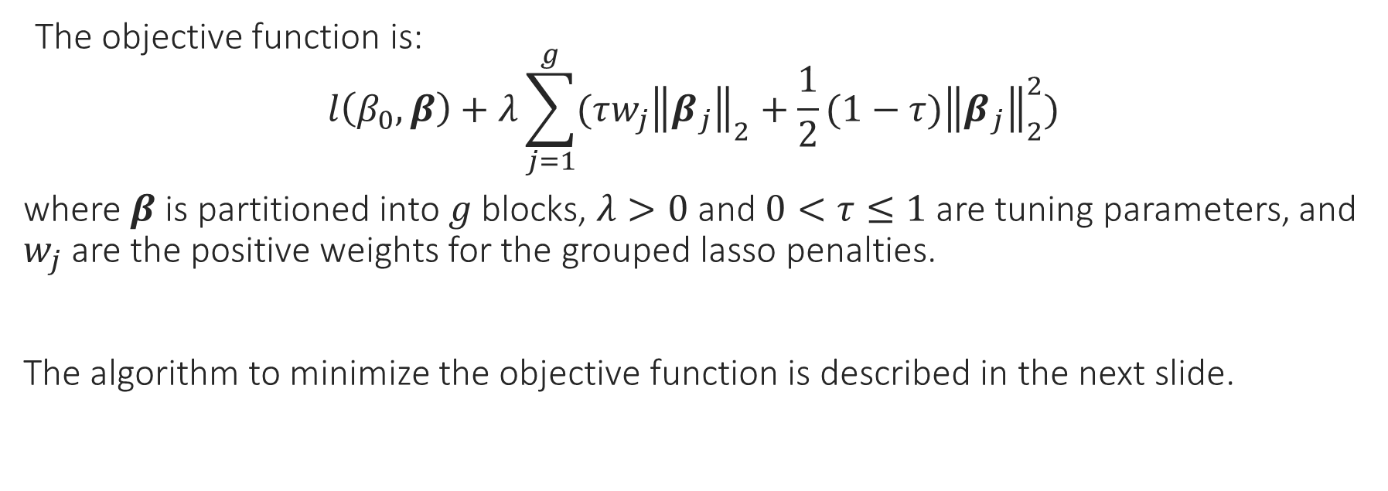
Algorithm
The objective function is:
$$l\left(β_{0},β\right)+λ\sum_{j=1}^{g}{(τw_{j}{\left\|\left.β_{j}\right\|\right.}_{2}+\frac{1}{2}(1−τ){\left\|\left.β_{j}\right\|\right.}_{2}^{2}})$$
where $β$ is partitioned into $g$ blocks, $λ>0$ and $0<τ≤1$ are tuning parameters, and $w_{j}$ are the positive weights for the grouped lasso penalties.
The algorithm to minimize the objective function is described in the next slide.

Slide 6
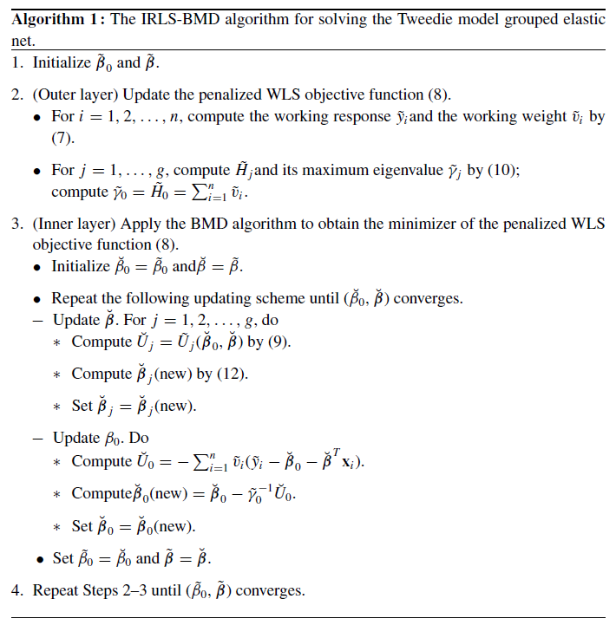

Slide 7
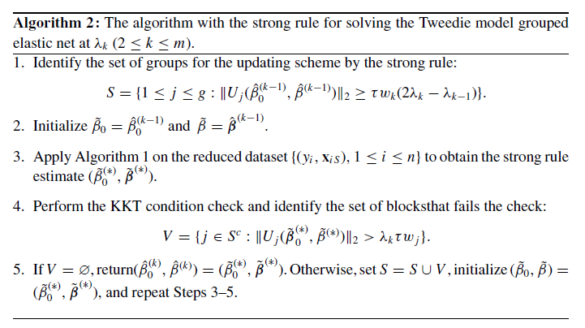
Solution Path

Slide 8
Simulation Studies
We will reproduce the simulation studies based on Example 1 in Qian, Yang & Zou (2016).
Case 1: 3 blocks and 9 predictors
Case 2: 3 blocks and 9 predictors (blocks are highly correlated with each other)
Case 3: 6 blocks and 6 predictors

Slide 9
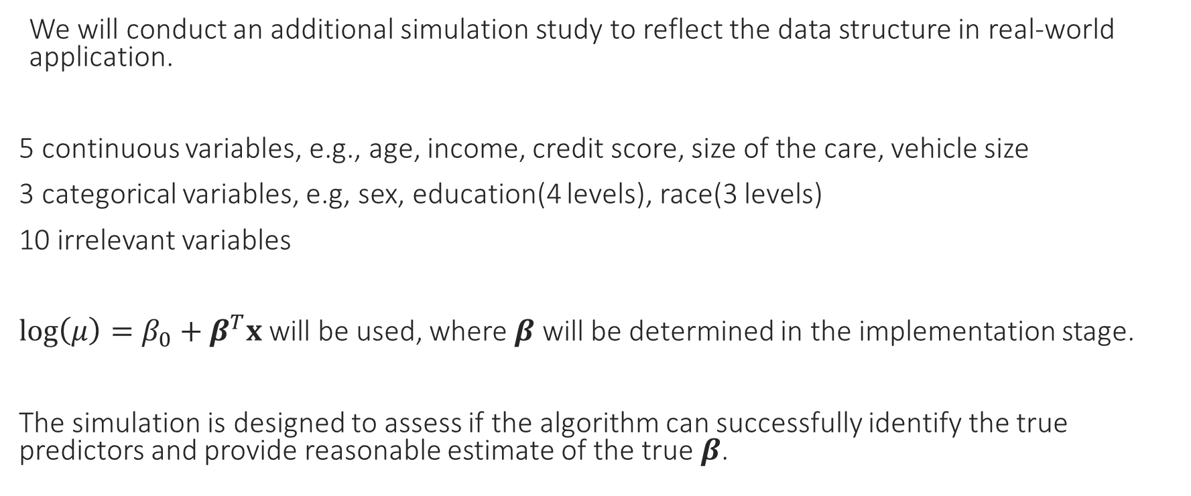
Simulation Studies
We will conduct an additional simulation study to reflect the data structure in real-world application.
5 continuous variables, e.g., age, income, credit score, size of the care, vehicle size
3 categorical variables, e.g, sex, education(4 levels), race(3 levels)
10 irrelevant variables
$\log\left(μ\right)=β_{0}+β^{T}x$ will be used, where $β$ will be determined in the implementation stage.
The simulation is designed to assess if the algorithm can successfully identify the true predictors and provide reasonable estimate of the true $β$.

