Slide 1
2017 Travelers Case Competition ML Group
Menglei Chen
Shuyi Liang
Haining Zhang
Yizhou Xie

Slide 2
Outline
Method Introduction
Variable Selection
Model Evaluation
Result
Q&A

Slide 3
Model Introduction

Slide 4
XGBoost:
A Scalable Tree Boosting System

Slide 5
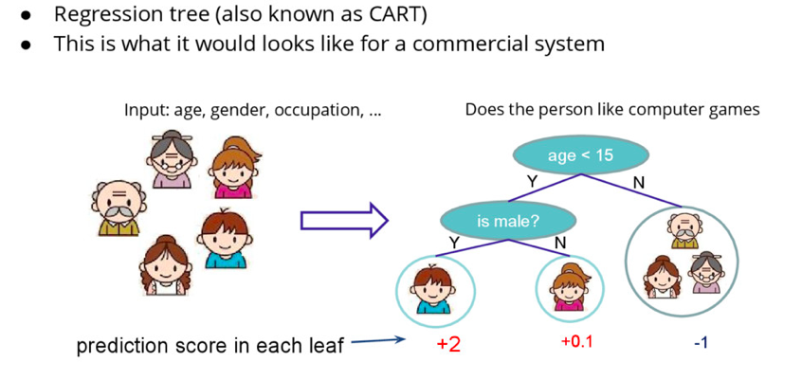
Regression Tree

Slide 6
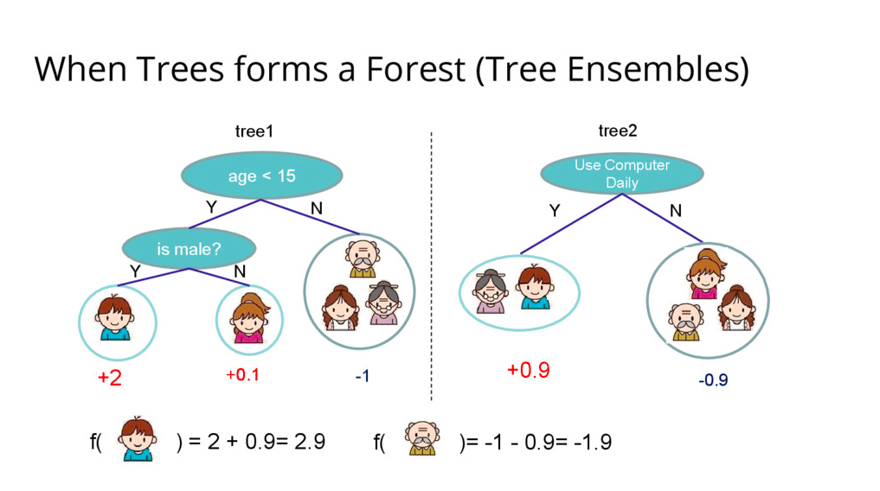

Slide 7
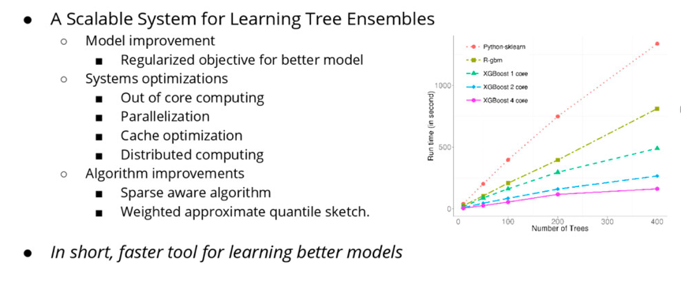
What is XGBoost

Slide 8
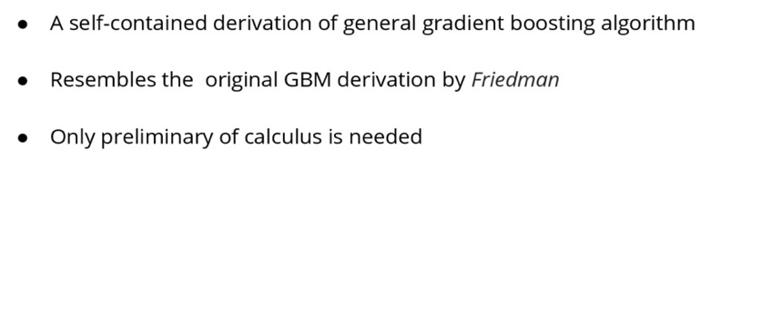
What does XGBoost learn

Slide 9
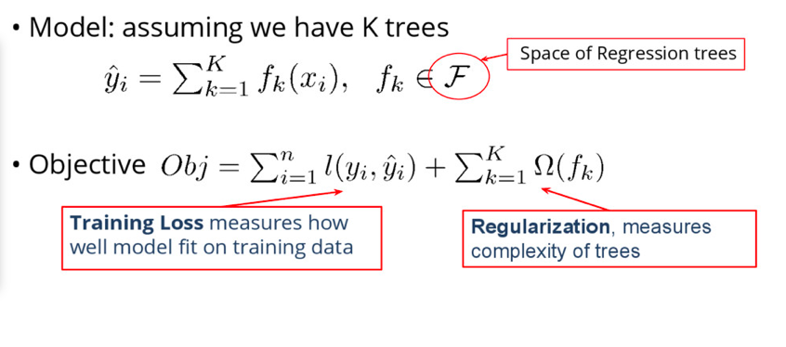
Elements of Tree Learning

Slide 10
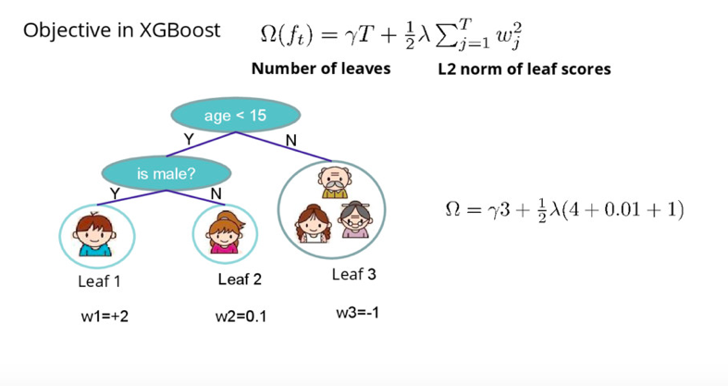
Define Complexity of a Tree

Slide 11
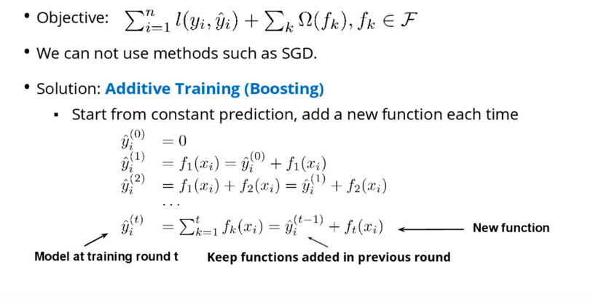
How Can We learn Tree Ensembles

Slide 12
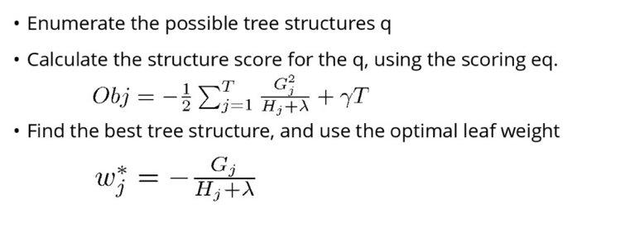
Searching Algorithm for Single tree

Slide 13
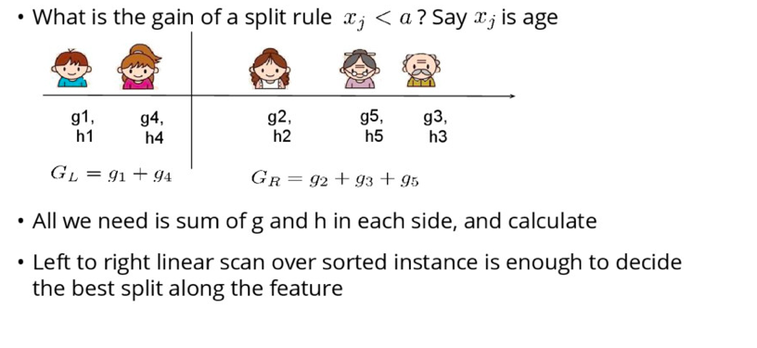
Efficient Finding of The Best Split

Slide 14
Variable Selection

Slide 15
Variable selection
year
Train data: from 2013-2016
Test data: only 2017. Based on our model, we dropped it.
2. zip.code
Use corresponding state and city instead of zip.code

Slide 16
New variables
1. age_old_young
If age<40, then age_old_yong = “young”, else age_old_young = “old”
age_round
Round age to nearest ten.
family_size
Size of a family; i.e., total number of people in a family

Slide 17
New variables (cont.)
4. ave_price
Average price of policy. (premium/n.adults)
5. age_tenure
Age when costumer joined Kangaroo. (ni.age-tenure)

Slide 18
Feature importance
Importance provides a score that indicates how useful or valuable each feature was in the construction of the boosted decision trees within the model.
The more an attribute is used to make key decisions with decision trees, the higher its relative importance.

Slide 19
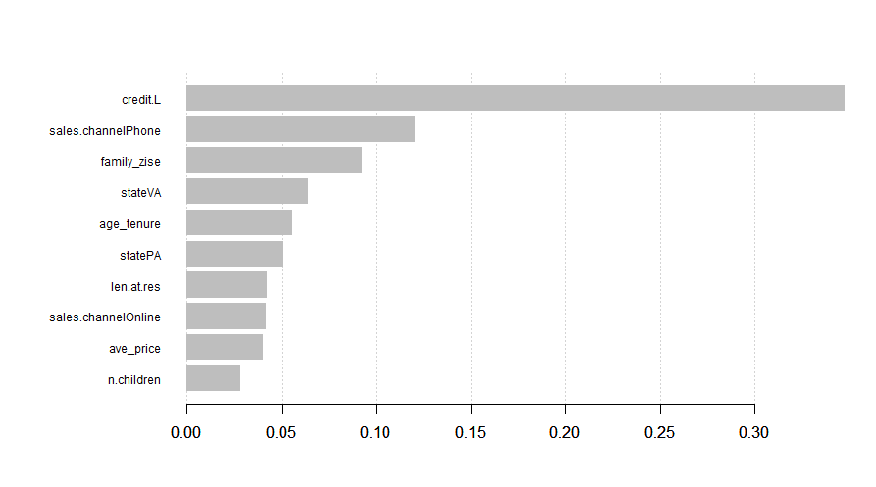
Feature importance (cont.)

Slide 20
Model Evaluation

Slide 21
Cross Validation
The samples are randomly partitioned into 5 sets (called folds) of roughly equal size.
A model is fit using all the samples except the first subset.
The prediction AUC of the fitted model is calculated using the first held-out samples.
The same operation is repeated for each fold and the model’s performance is calculated by averaging the AUCs across the different test sets.

Slide 22
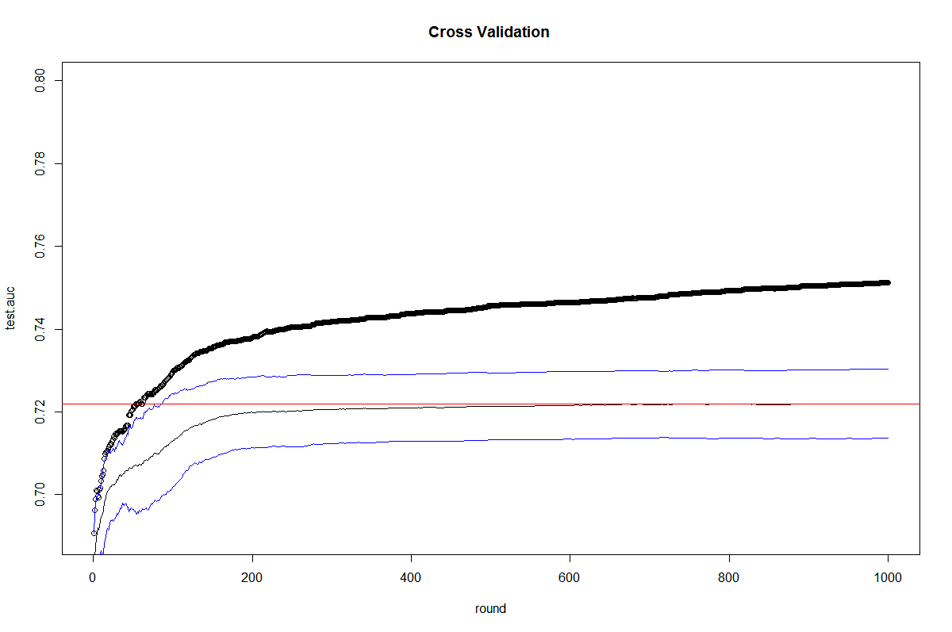
Cross Validation

Slide 23
Parameter Tuning
para<-list("eta"=0.02,
"gamma"=11,
"max_depth"=8,
"min_child_weight"=20,
"max_delt_step"=1,
"subsample"=0.9,
"objective"="binary:logistic",
"eval_metric"="auc","eval_metric"="error",
"set.seed"=940610,
"early.stop.round"=20
)
Notes:
eta [default=0.3, alias: learning_rate]
step size shrinkage used in update to prevents overfitting. After each boosting step, we can directly get the weights of new features. and eta actually shrinks the feature weights to make the boosting process more conservative.
range: [0,1]
gamma [default=0, alias: min_split_loss]
minimum loss reduction required to make a further partition on a leaf node of the tree. The larger, the more conservative the algorithm will be.
range: [0,∞]
max_depth [default=6]
maximum depth of a tree, increase this value will make the model more complex / likely to be overfitting. 0 indicates no limit, limit is required for depth-wise grow policy.
range: [0,∞]
min_child_weight [default=1]
minimum sum of instance weight (hessian) needed in a child. If the tree partition step results in a leaf node with the sum of instance weight less than min_child_weight, then the building process will give up further partitioning. In linear regression mode, this simply corresponds to minimum number of instances needed to be in each node. The larger, the more conservative the algorithm will be.
range: [0,∞]
max_delta_step [default=0]
Maximum delta step we allow each tree’s weight estimation to be. If the value is set to 0, it means there is no constraint. If it is set to a positive value, it can help making the update step more conservative. Usually this parameter is not needed, but it might help in logistic regression when class is extremely imbalanced. Set it to value of 1-10 might help control the update
range: [0,∞]
subsample [default=1]
subsample ratio of the training instance. Setting it to 0.5 means that XGBoost randomly collected half of the data instances to grow trees and this will prevent overfitting.
range: (0,1]

Slide 24
Result

Slide 25
Result
Financial credit level of policyholder (low)
Medium through which policy was purchased (Phone, Online)
Family size
State (Virginia, Pennsylvania)
Age when costumer joined Kangaroo
Length at residence
Average price of policy

Slide 26
Reference
[1] Tianqi Chen, Carlos Guestrin. XGBoost: A Scalable Tree Boosting System
[2] https://machinelearningmastery.com/gentle-introduction-xgboost-applied-machine-learning/
[3] http://www.milanor.net/blog/cross-validation-for-predictive-analytics-using-r/
[4] http://xgboost.readthedocs.io/en/latest/parameter.html

Slide 27
Q&A

