Slide 1
Predict the Emergency Diagnosis of Fever Disease Base on the First-Aid Big Data
First -Aid Big Data Conference and Datathon
Aerospace Center Hospital Wei Liu
301 hospital Yuan Zhang, Chao Li
Dalian university of Technology Jingfeng Chen, Menglin Lu

Slide 2
contents
Team introduction
1
2
Research Background
3
Study design
4
Result and Discussion

Slide 3

Team introduction
From: Department of Emergency
Aerospace Center Hospital
Major: Emergency Medicine
Direction: Acute and critical patients first-aid and treatment
Level: Master Degree
Team leader ：Wei Liu

Slide 4
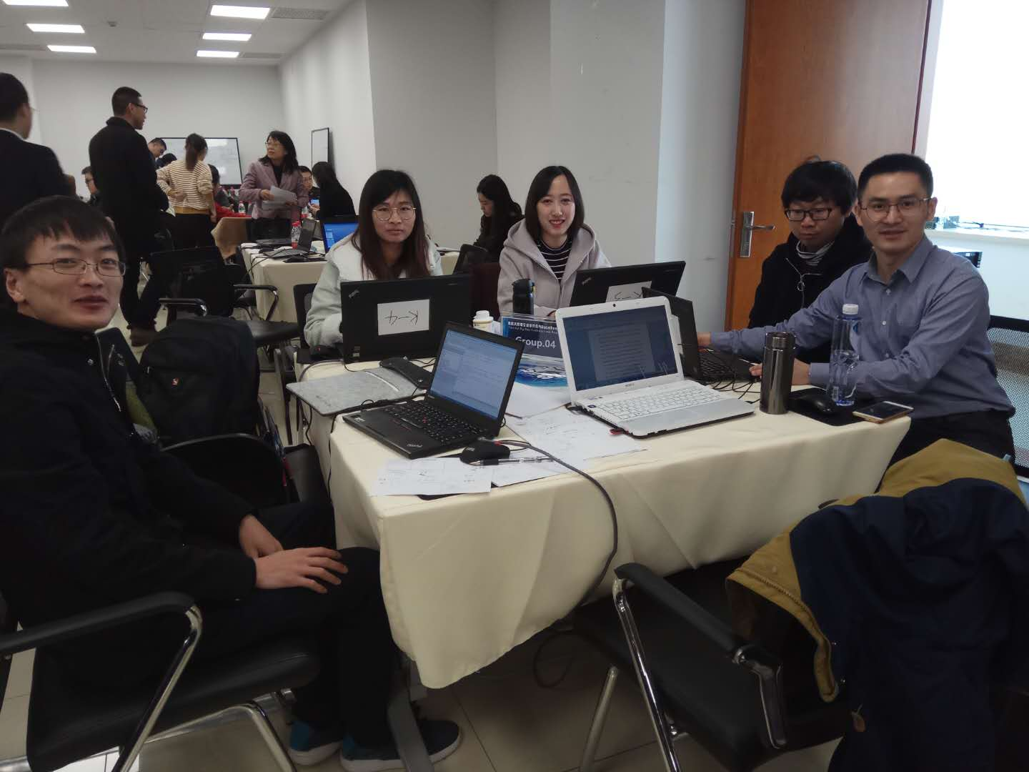

Team introduction
Our Team!

Slide 5
Research Background
Fever is one of the most common emergencies in the emergency room.
There are many causes of fever
The ability to quickly and accurately diagnose the cause of a patient can help improve the patient's condition and facilitate the prognosis

Slide 6
Research Objective
In the future, when patients with febrile diseases are encountered again in the clinic, the cause can be quickly predicted or determined.

Slide 7
Research Design
1
Study Cohort
Exposures
2
Outcome
3

Slide 8
Study Cohort
All fever patients in rescue room
(axillary temperature>37.2)
from the first-aid database, 301 hospital

Slide 9
Exposure Variables
Demographic information: age, gender
Lab test
Fever diagnosis

Slide 10
Outcome
Primary outcome: Infection or not
(from diagnose text in the database)
Secondary outcome: antibiotic use

Slide 11
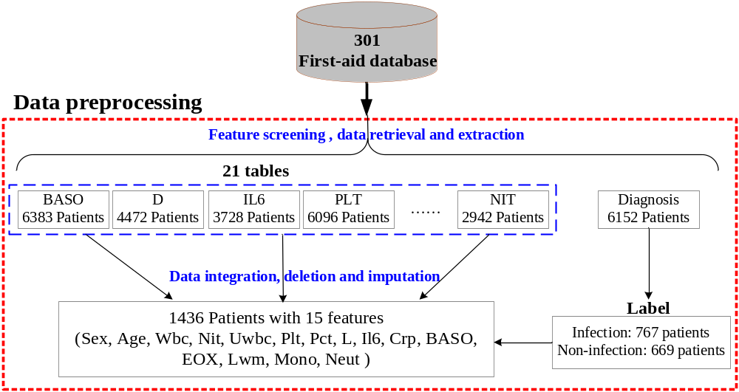
Data abtained

Slide 12
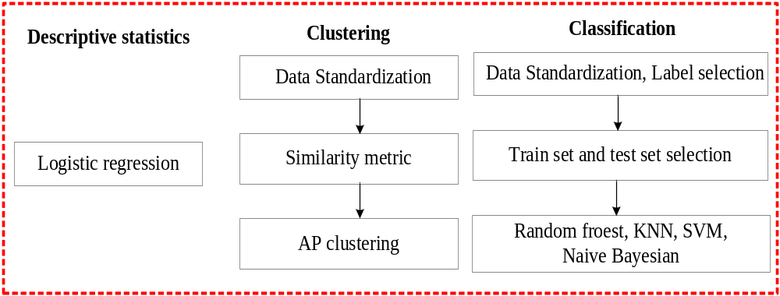
Research methods

Slide 13
Results
777 of 1436 patient were infectious fever (54.1%)
1365 of them used antibiotics(95.1%)

Slide 14
Results
Baseline charateristics
 | Non-infectious | infectious | p value
 | N = 659 | N = 777
gender = Male (%) | 422 (64.0) | 470 (60.5) | 0.185
age (mean (sd)) | 55.49 (19.49) | 61.88 (19.99) | <0.001
wbc (mean (sd)) | 14.24 (14.03) | 12.86 (7.85) | 0.019
nit (mean (sd)) | 0.09 (0.29) | 0.12 (0.32) | 0.089
uwbc (mean (sd)) | 184.87 (899.07) | 533.27 (3451.24) | 0.012
plt (mean (sd)) | 200.17 (106.27) | 202.29 (118.16) | 0.723
pct (mean (sd)) | 4.53 (15.47) | 10.32 (24.21) | <0.001
il6 (mean (sd)) | 346.07 (921.87) | 702.31 (1401.71) | <0.001
crp (mean (sd)) | 6.02 (7.79) | 10.02 (8.99) | <0.001
baso (mean (sd)) | 3.73 (3.71) | 3.37 (2.99) | 0.042
eos (mean (sd)) | 0.01 (0.03) | 0.01 (0.04) | 0.63
lym (mean (sd)) | 0.12 (0.11) | 0.10 (0.09) | 0.004
mono (mean (sd)) | 0.05 (0.03) | 0.05 (0.04) | 0.418
neut (mean (sd)) | 0.82 (0.13) | 0.84 (0.12) | 0.005
antibiotic use = Yes (%) | 593 (90.0) | 772 (99.4) | <0.001

Slide 15
Results
Logistic regression
 | OR(95% CI) | P_value
(Intercept) | 6.183 ( 0.001 , 2677.291 ) | 0.559
Gender = Male | 0.951 ( 0.756 , 1.196 ) | 0.665
age | 1.017 ( 1.011 , 1.023 ) | <0.001
wbc | 0.984 ( 0.97 , 0.996 ) | 0.015
nit | 1.001 ( 0.691 , 1.457 ) | 0.994
uwbc | 1 ( 1 , 1 ) | 0.097
plt | 1.001 ( 1 , 1.002 ) | 0.023
pct | 1.006 ( 0.999 , 1.013 ) | 0.126
il6 | 1 ( 1 , 1 ) | 0.006
crp | 1.057 ( 1.041 , 1.074 ) | <0.001
baso | 0.973 ( 0.934 , 1.013 ) | 0.178
eos | 0.308 ( 0 , 4225.977 ) | 0.737
lym | 0.029 ( 0 , 251.534 ) | 0.26
mono | 0.22 ( 0 , 2632.3 ) | 0.658
neut | 0.042 ( 0 , 365.088 ) | 0.309

Slide 16
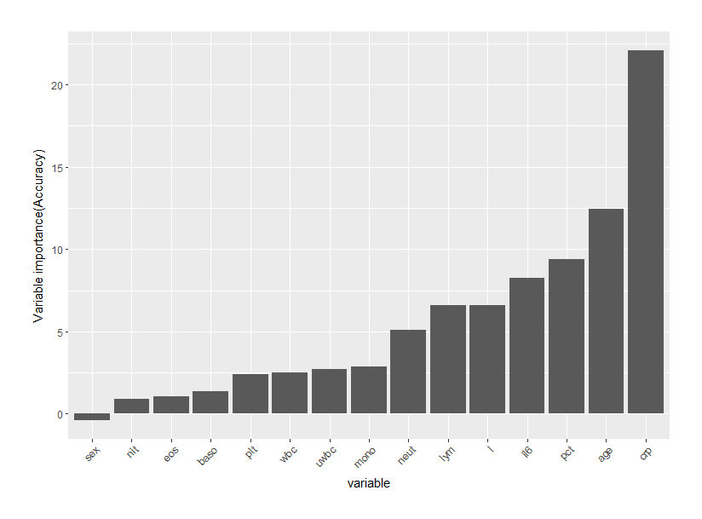
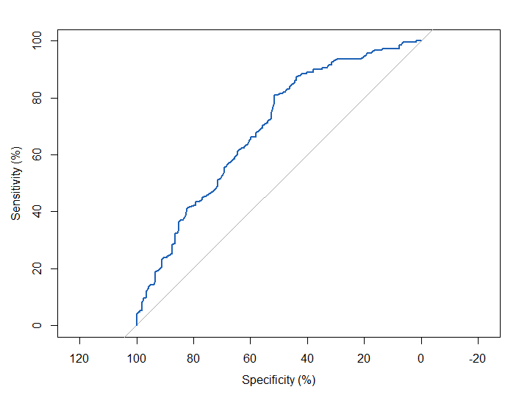
Results
69.09%
Random forest to predict infectious fever
AUC of predict model:
In training dataset: 70.8%
In validation dataset:
69.09%
(63.61%-74.57%)

Slide 17
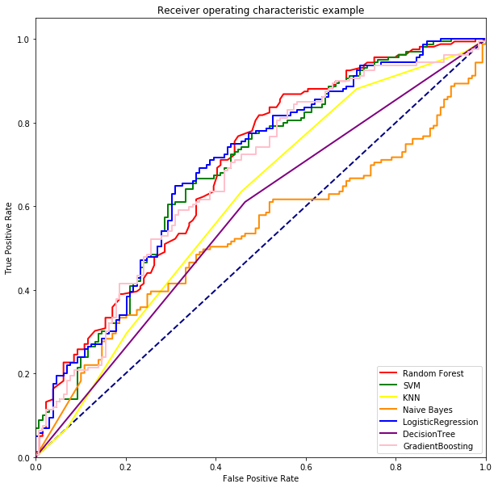
Results
69.09%
Different model to predict infectious fever
model | P | R | F1
RF | 66.15 | 65.5 | 65.57
SVM | 64.90 | 65.09 | 64.57
KNN | 58.91 | 58.89 | 58.9
Naïve Bayes | 57.38 | 54.42 | 47.27
Logistic Regression | 66.41 | 66.52 | 66.44
Decision Tree | 56.19 | 56.24 | 56.18
Gradient Boosting | 59.72 | 59.48 | 59.49
model | AUC
RF | 69.09
SVM | 69.01
KNN | 60.73
Naïve Bayes | 53.01
Logistic Regression | 69.18
Decision Tree | 56.24
Gradient Boosting | 64.49

Slide 18
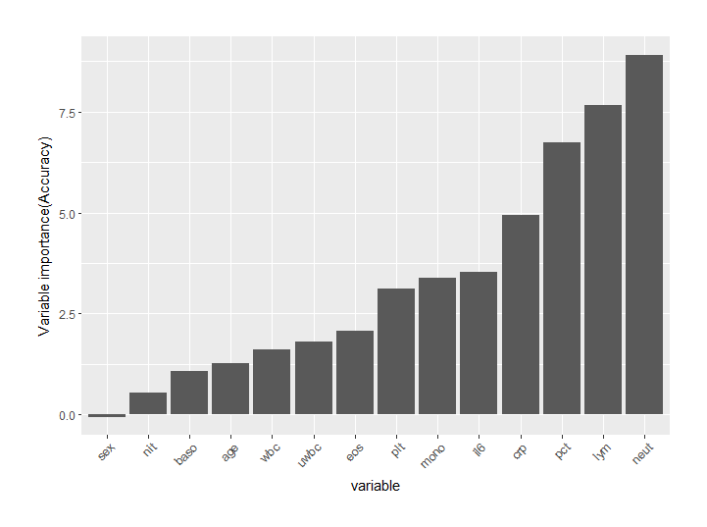
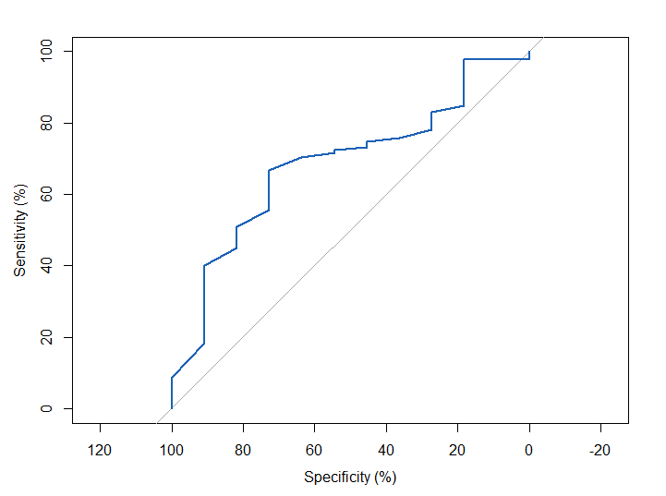
Results
Random forest to predict antibiotics use
AUC of predict model:
In training dataset: 72.22%
In validation dataset:
68.48%
(53.67%-83.29%)

Slide 19
Results
Clustering
 | cluster 1 | cluster 2 | P value
 | N = 807 | N = 629
age (mean (sd)) | 47.53 (16.58) | 73.60 (13.41) | <0.001
wbc (mean (sd)) | 14.73 (8.49) | 11.91 (13.65) | <0.001
nit (mean (sd)) | 0.10 (0.30) | 0.11 (0.31) | 0.69
uwbc (mean (sd)) | 237.63 (2286.69) | 547.56 (2978.07) | 0.026
plt (mean (sd)) | 216.28 (124.43) | 182.12 (92.53) | <0.001
pct (mean (sd)) | 11.02 (24.87) | 3.36 (12.92) | <0.001
l (mean (sd)) | 0.08 (0.05) | 0.15 (0.12) | <0.001
il6 (mean (sd)) | 678.97 (1366.17) | 359.03 (968.12) | <0.001
crp (mean (sd)) | 11.19 (9.69) | 4.33 (5.05) | <0.001
baso (mean (sd)) | 0.00 (0.01) | 0.01 (0.03) | 0.194
eos (mean (sd)) | 0.00 (0.02) | 0.01 (0.05) | <0.001
lym (mean (sd)) | 0.08 (0.05) | 0.15 (0.12) | <0.001
mono (mean (sd)) | 0.04 (0.02) | 0.06 (0.05) | <0.001
neut (mean (sd)) | 0.87 (0.07) | 0.78 (0.15) | <0.001
Evaluation:
Accuracy 60%

Slide 20
Discussion
We could identify the core features of infectious fever and use it to predict the diagnosis of similar diseases.
Age can greatly affect infectious fever diagnosis and antibiotic use.
Base on big data, we could find out the possiable basis for the use of antibiotics by emergency doctors
…

Slide 21
Thank You for Attention!

