Slide 1
程式架構說明
CHAPTER 6

Slide 2
程式流程
generator.py
(生成模型)
discrimator.py
(對抗模型)
gan.py
(主模模型)
save_to_npy.py
(儲存程式)
train.py
(核心程式)
run.py
(系統主程式)

Slide 3
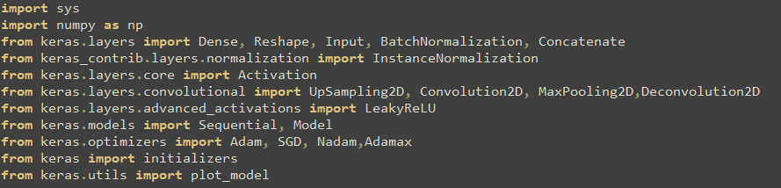
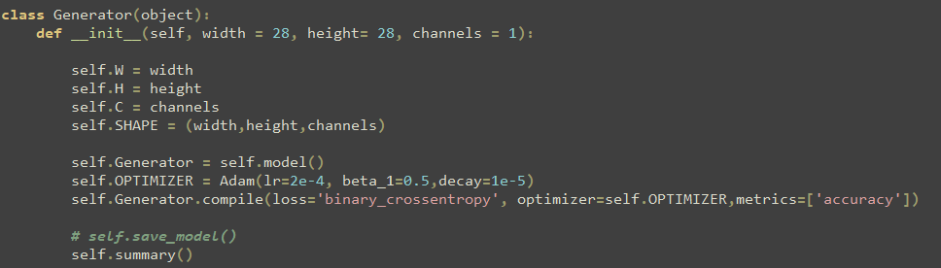
generator.py
1. 載入的需要的LIBRARY
2. 建立Generator

Slide 4
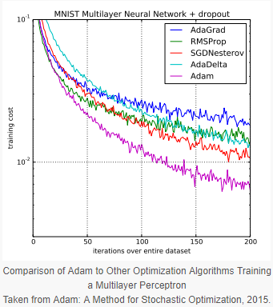
optimizer
Keras optimizers – SGD、RMSprop、Adagrad、Adadelta、Adam、Adamax、Nadam
keras.optimizers.Adam(lr=0.001(學習率), beta_1=0.9(估計指數衰減率),decay=0.0(每次參數更新後的學習率衰減值))
原文:Diederik Kingma, Jimmy Ba.Adam: A Method for Stochastic Optimization, ICLR 2015.
compile
compile(optimizer(優化器), loss=None(損失函數), metrics=None(訓練和測試期間透過模型評估數據的列表))
Available metrics
binary_accuracy: 預測所有值平均正確率(計算兩類)
categorical_accuracy:預測所有值平均正確率(計算多類)
sparse_categorical_accuracy: 相同的categorical_accuracyas, useful for predicting sparse target values
top_k_categorical_accracy: 計算top-k的正確率.如果如果在預測值的前k個值中存在目標類別，則認為預測是正確的。.
sparse_top_k_categorical_accuracy:相同的top_k_categorical_accracy, but for sparse cases

Slide 5
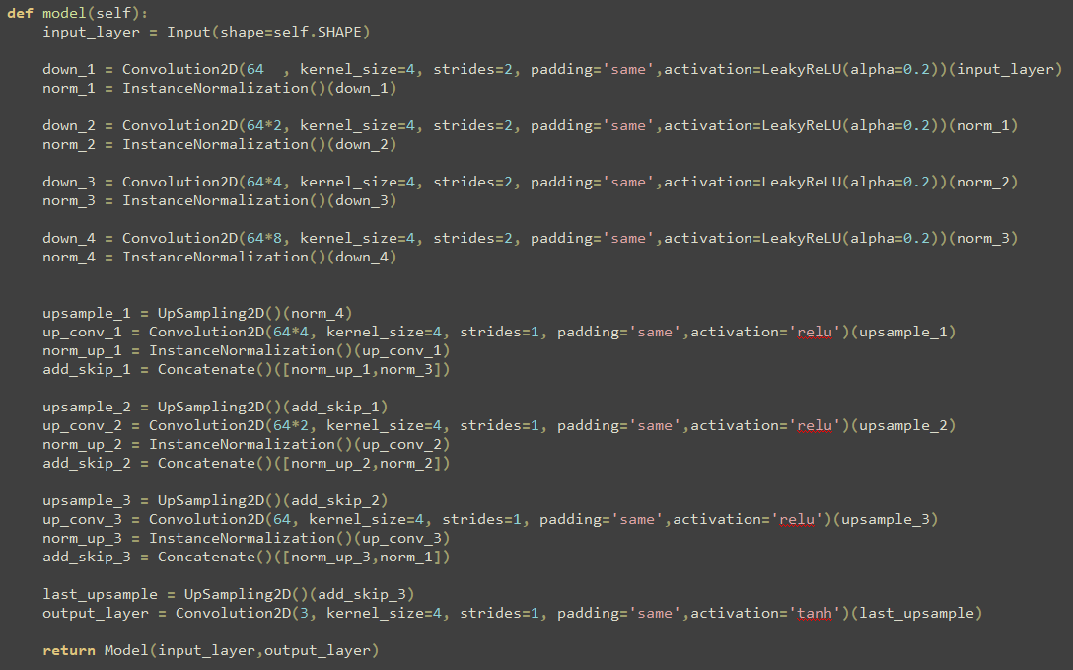
3. 生成Generator模型
The first part of the model involves 2D convolutions with this InstanceNormalization layer:
The upsample blocks are similar to the downsample but bring us back up to the original resolution of our images
The last piece of the generator model method is the output layer and the structure of this model:

Slide 6
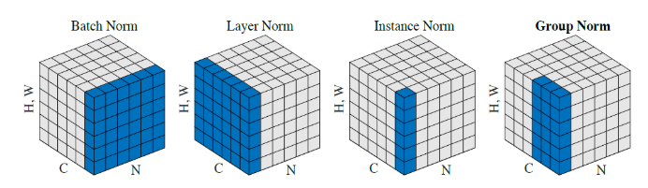
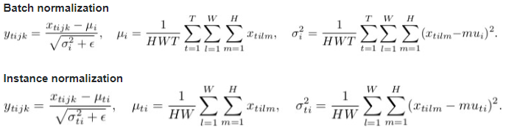
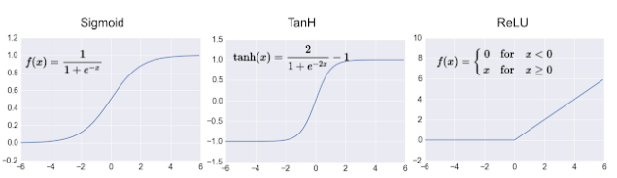
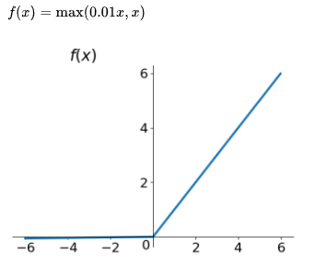
Batch normalization V.S. Instance normalization
activaion
LeakRelu

Slide 7
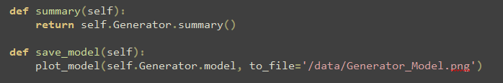
4. 儲存資料

Slide 8
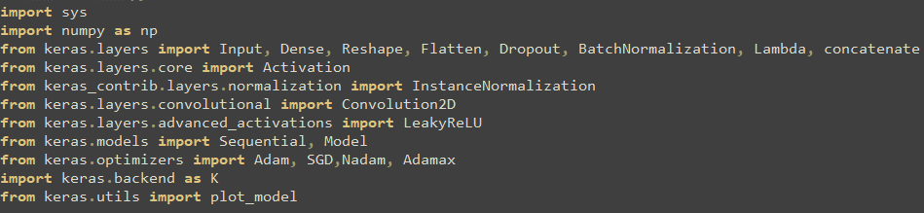
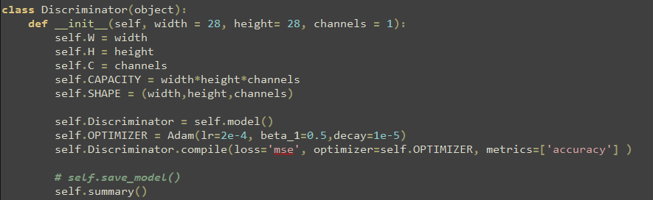
discrimator.py
1. 載入的需要的LIBRARY
2. 建立Discriminator
P.9有解釋

Slide 9
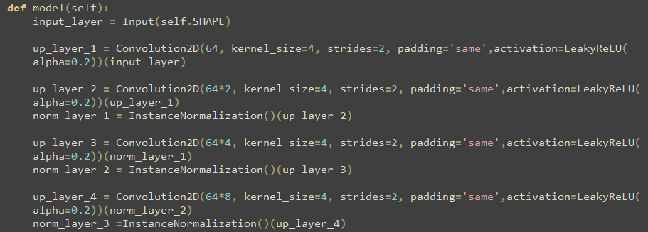
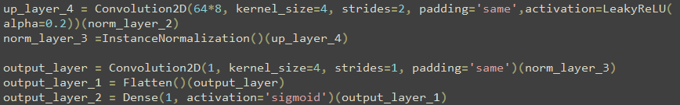
3. 生成discrimator模型
Just your regular densely-connected NN layer.

Slide 10
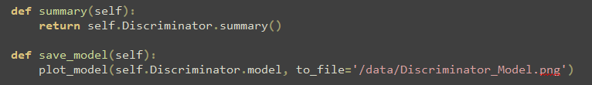
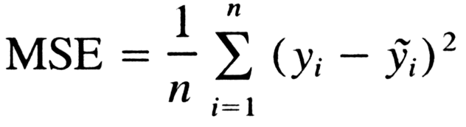
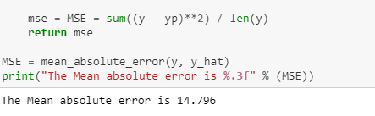


4. 儲存資料
線性回歸的損失函數[predict]
Mean Squared Error (MSE)
Mean Absolute Error(MAE)

Slide 11
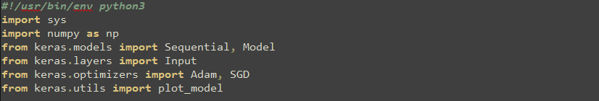
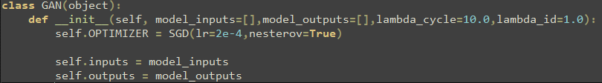
gan.py
1. 載入的需要的LIBRARY
2. 建立GAN [notice]lambda variables
lambda_cycle: refer to the values of the loss functions for the X to Y generation and X to Y to X reconstruction generation.
lambda_id: parameter should be 10% (according to the paper) of the lambda_cycle variable.

Slide 12
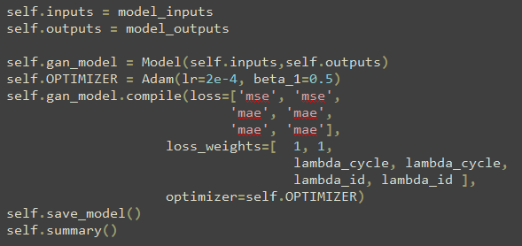
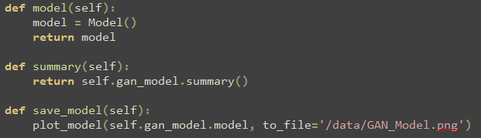
The output array is six models, four generators, and two discriminators in adversarial setup.
4. 儲存資料

Slide 13
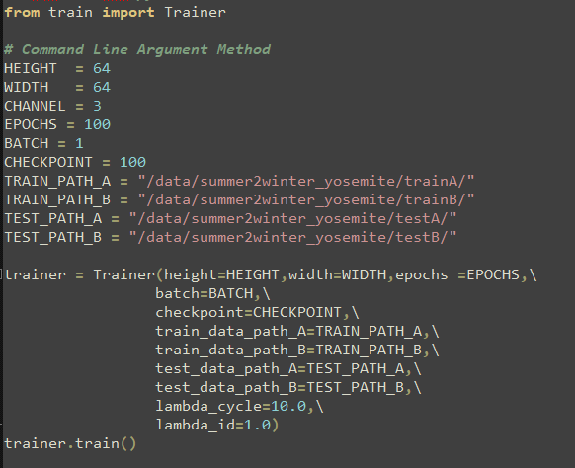
run.py

Slide 14
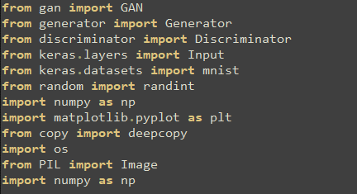
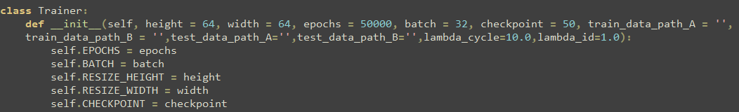
train.py
1. 載入的需要的LIBRARY
2.初始化輸入的數值

Slide 15
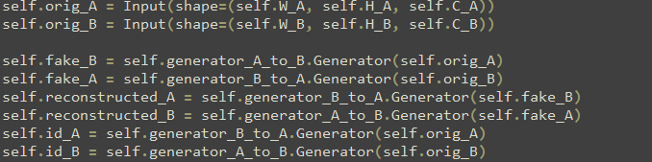
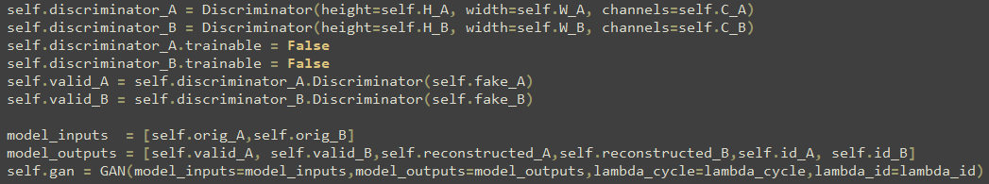
Load all of the data into its respective class variables—we've got some new helper functions that make this happen
The generators go from A to B and from B to A.
Add the following lines to instantiation in the class definition for training
We need our discriminators that evaluate both A and B images and need a validity discriminator that checks the fake_A and fake_B generators.
Set up our classes in a structured way.
We are able to simply pass all of the models to the GAN class and it will construct our adversarial model

Slide 16
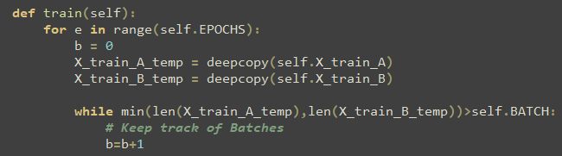
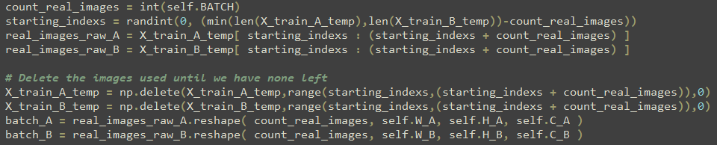
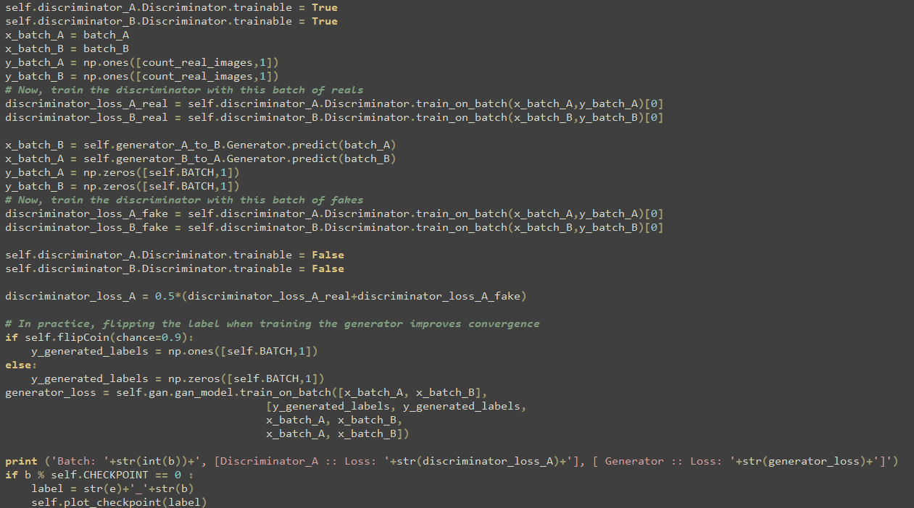
3.開始訓練(train)
The key difference is that we have now added an additional data source and therefore we need to have an A and B version of our batches

Slide 17
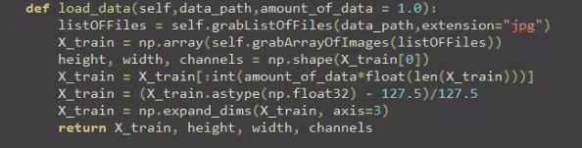
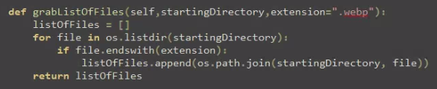
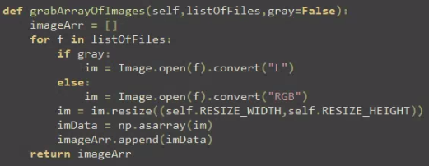
4.其他Function
Just a rehashing of our data loading from
Grabbing the list of files is a straightforward method using OS
Importing of images is merged in from the separate Python script introduced

Slide 18
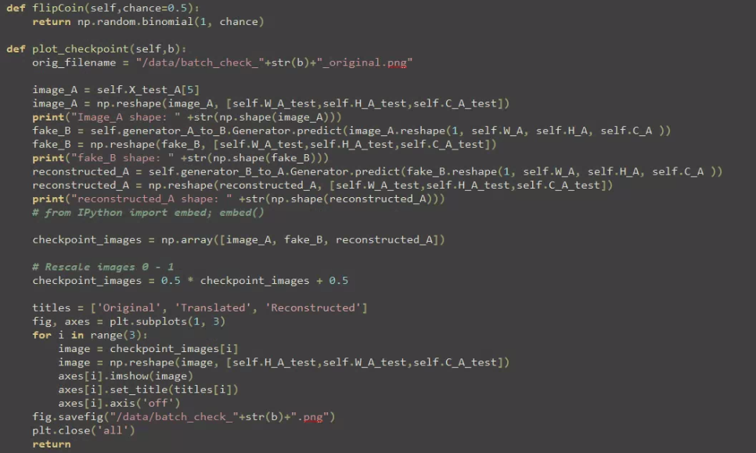
At each checkpoint, take an example from the test set and transfer style from A to B, then back to A

Slide 19
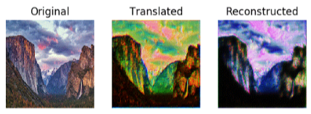
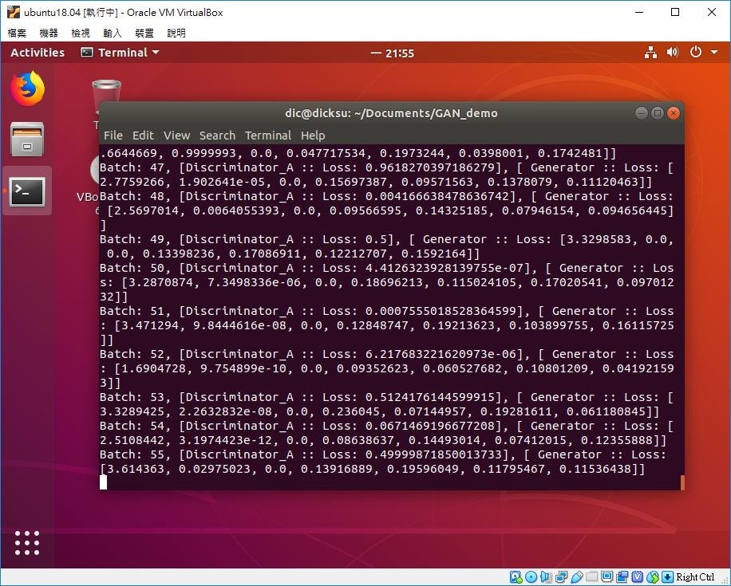
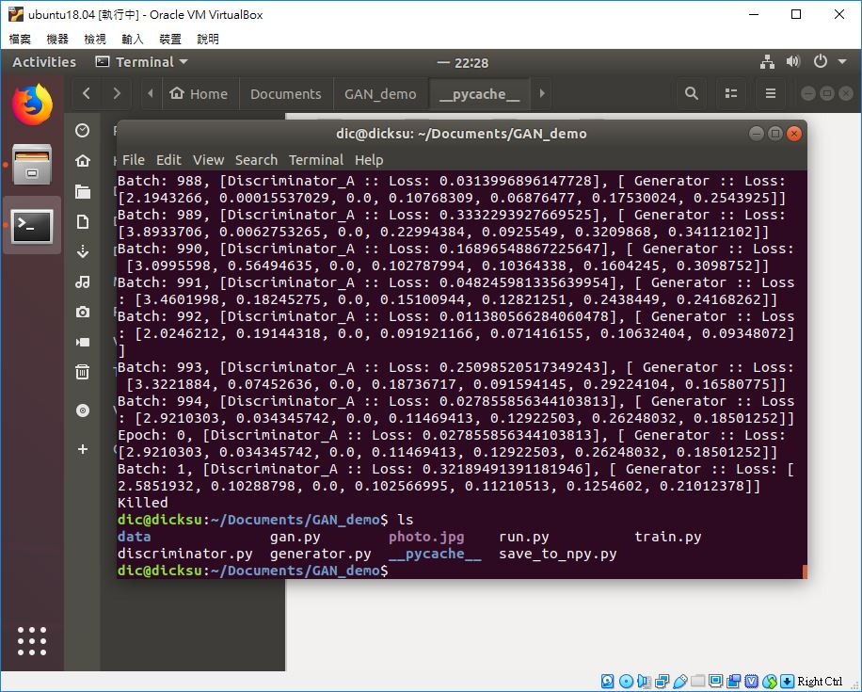
成果

Slide 20
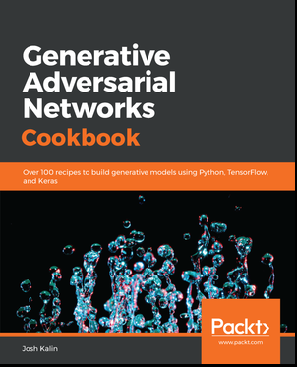
reference
https://github.com/PacktPublishing/Generative-Adversarial-Networks-Cookbook

Slide 21
THANK For listening

