Slide 1
My Security Practice

Slide 2
編碼

Slide 3
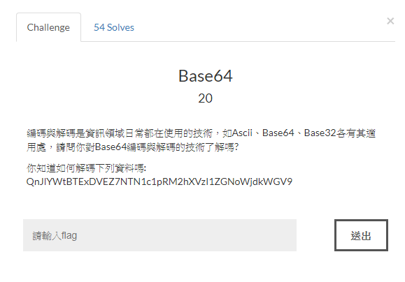
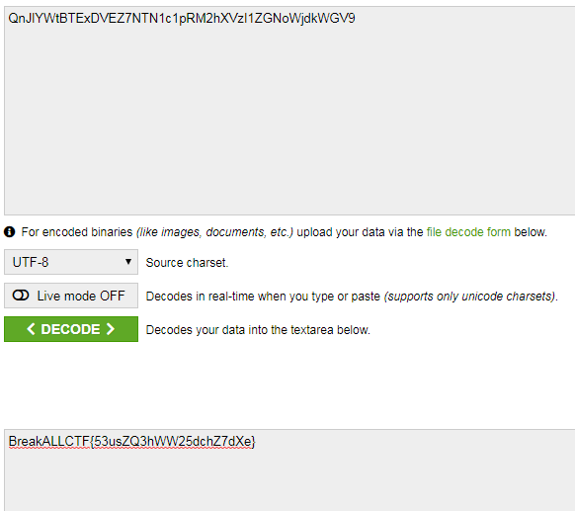
Base_64
Base_64解碼網站:https://www.base64decode.org/

Slide 4
Base_64
字元編碼(Character encoding)
MiMe格式的電子郵件

Slide 5
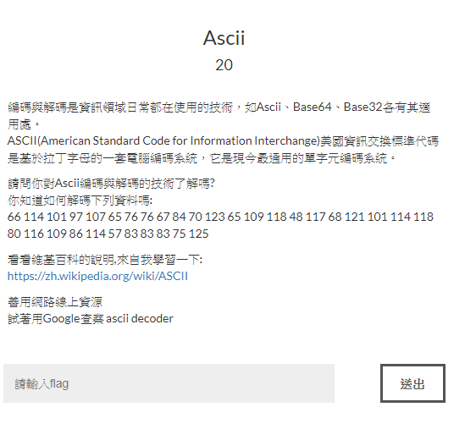
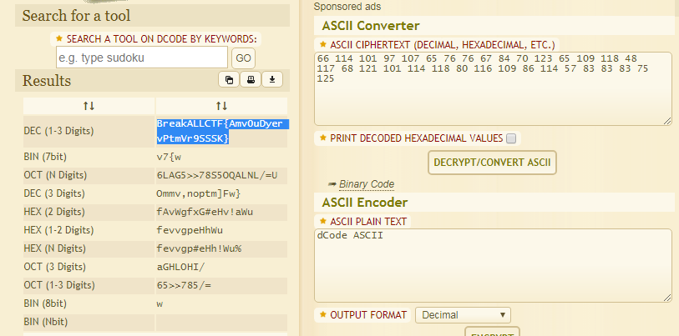
ASCII 20
解碼網站:https://www.dcode.fr/ascii-code

Slide 6
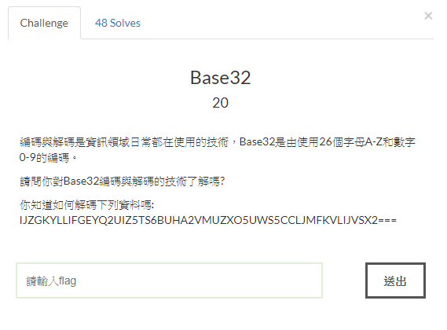
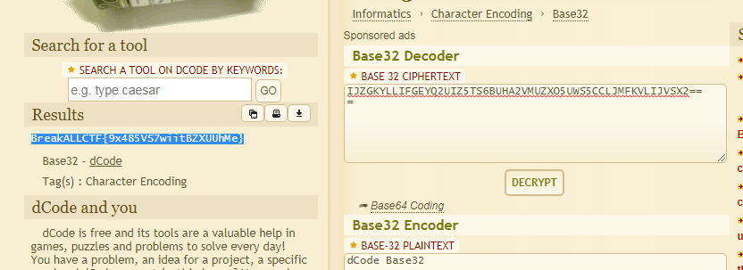
Base_32

Slide 7
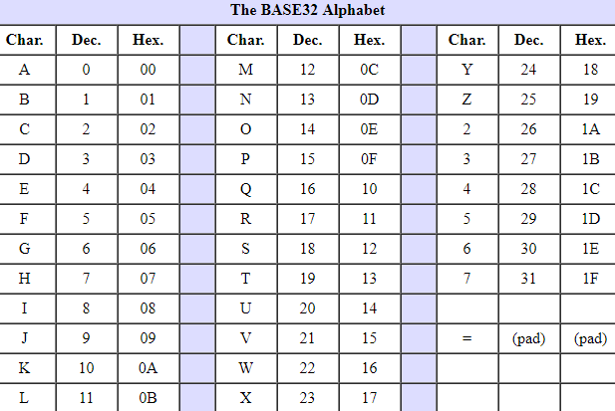
The BASE32 Alphabet
A從0開始
數字只有2-7

Slide 8
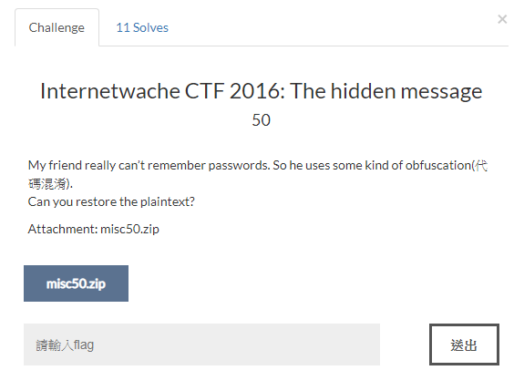
Internetwache CTF 2016: The hidden message 50
Notes:
OCTAL -> base64 ->

Slide 9
Crypto

Slide 10
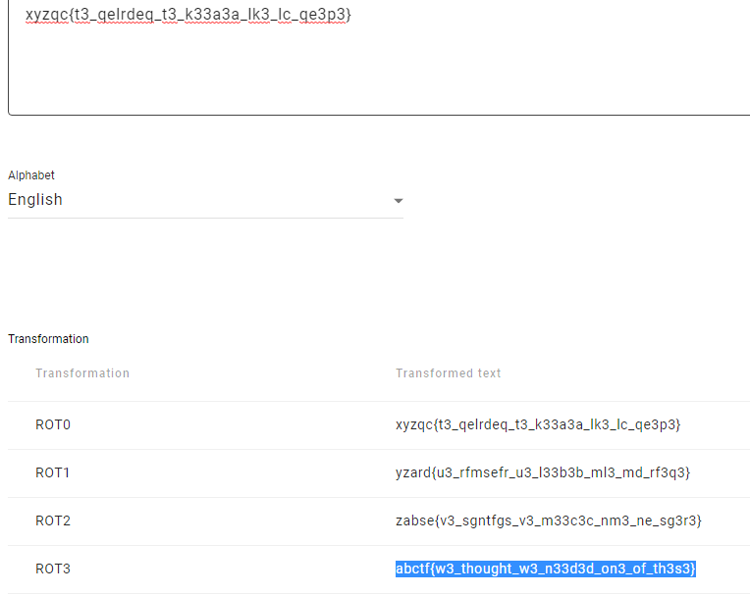
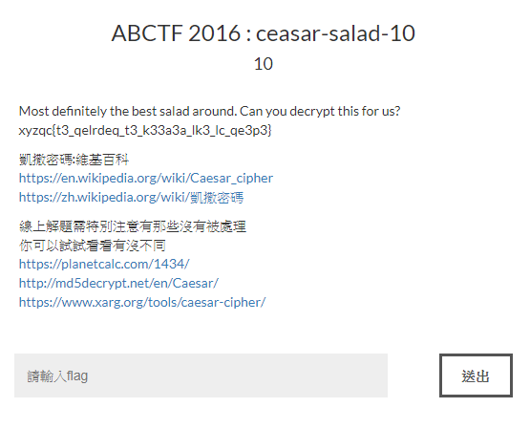
ABCTF 2016 : ceasar-salad-10 10
Notes:
https://planetcalc.com/1434/

Slide 11
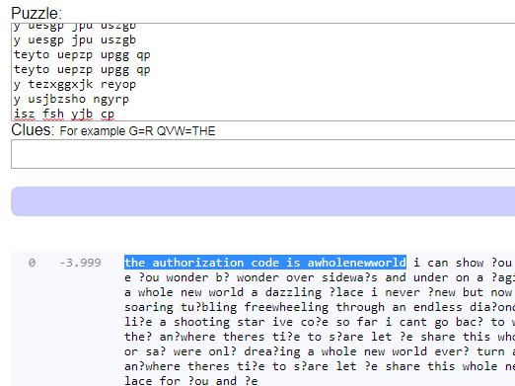
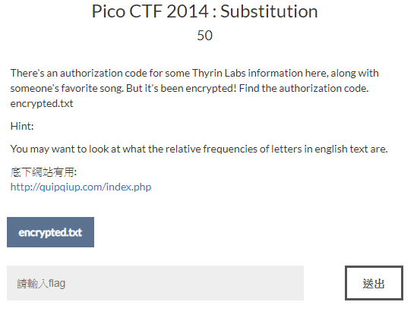
Pico CTF 2014 : Substitution 50

Slide 12
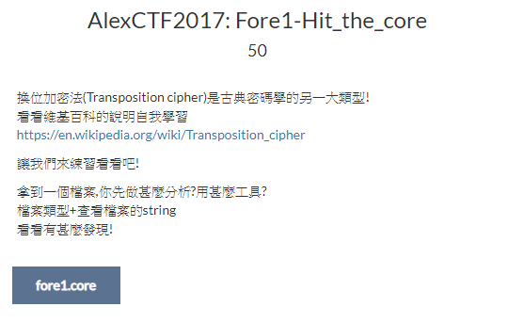

AlexCTF2017: Fore1-Hit_the_core 50

