Slide 1
Is Carmelo Anthony helping the Knicks?
How to evaluate one player’s value to a basketball team?
Mengqi Zong

Slide 2
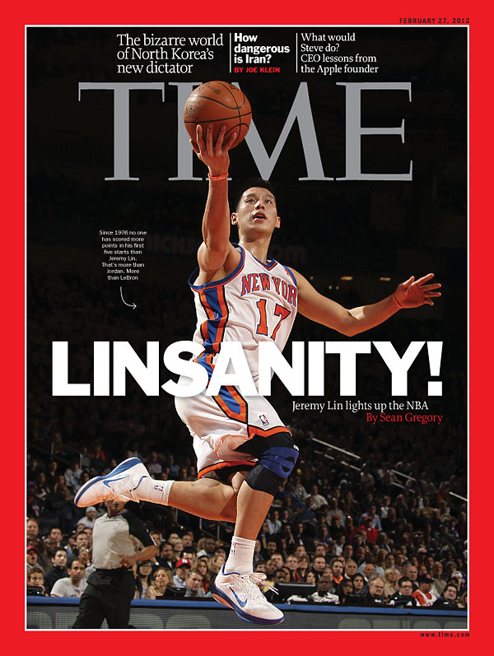

Slide 3
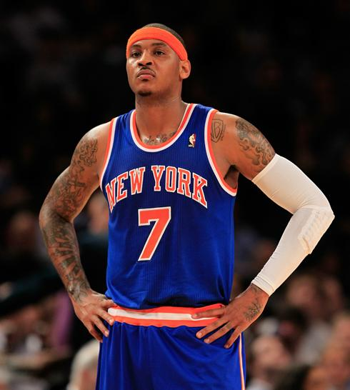
Carmelo Anthony: Good stats but no wins?

Slide 4
Background
Feb. 6th: Knicks vs. Utah Jazz (99 - 88)
Jeremy Lin’s first game as a starter.
Anthony got injured in the game and only played for 5 minutes.
From Feb. 6th to Feb. 19th: Knicks (W/L: 7-1)
--------------------------------------------------------------
Feb. 20th: Knicks vs. New Jersey (80 - 92)
Carmelo Anthony’s first game after the injury.
From Feb. 20th to Mar. 12th (W/L: 2-8)
On Mar. 14th, Knicks Fired its coach D'Anthony

Slide 5
Game Results
Feb 6th - Feb 19th (W/L: 7-1) | Feb. 20nd – Mar. 12th (W/L: 2-8)
Feb. 6th (H) vs. Utah 99-88 W | Feb. 20th (H) vs. New Jersey 92-100 L
Feb. 8th (A) vs. Washington 107-93 W | Feb. 22nd (H) vs. Atlanta 99-82 W
Feb. 10th (H) vs. LAL 92-85 W | Feb. 23rd (A) vs. Miami 88-102 L
Feb. 11th (A) vs. Minnesota 100-98 W | Feb. 29th (H) vs. Cleveland 120-103 W
Feb. 14th (A) vs. Toronto 90-87 W | Mar. 4th (A) vs. Boston 111-115 L
Feb. 15th (H) vs. Sacramento 100-85 W | Mar. 6th (A) vs. Dallas 85-95 L
Feb. 17th (H) vs. New Orleans 85-89 L | Mar. 7th (A) vs. San Antonio 105-118 L
Feb. 19th (H) vs. Dallas 104-97 W | Mar. 9th (A) vs. Milwaukee 114-119 L
 | Mar. 11th (H) vs. Philadelphia 94-106 L
 | Mar. 12th (A) vs. Chicago 99-104 L

Slide 6
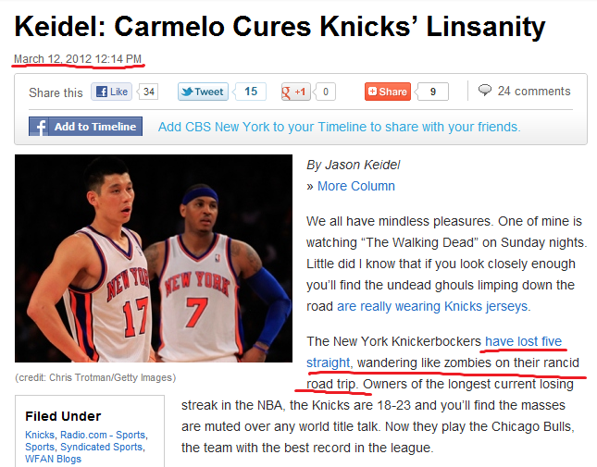

Slide 7
Question
Is that Carmelo Anthony’s fault?
A yes-no question. [Main focus]
Value = performance + influence on morale
Is Carmelo Anthony lowering Knicks’ morale (teammates’ performance)?
How to measure it? (a how-much question)

Slide 8
Part one
Is Carmelo Anthony helping the Knicks?

Slide 9
Model 1
 | Win | Lose
Anthony is absent | 7 | 1
Anthony is available | 2 | 8
Using Fisher’s Exact Test, we get p-value = 0.01522.
Does this imply that Carmelo Anthony is not helping Knicks?
Opponents
Home Court Advantage
Teammates’ performance (“their fault”)
…

Slide 10
Observation
Feb 6th - Feb 19th (W/L: 7-1) | Feb. 20th – Mar. 12th (W/L: 2-8)
Feb. 6th (H) vs. Utah 99-88 W | Feb. 20th (H) vs. New Jersey 92-100 L
Feb. 8th (A) vs. Washington 107-93 W | Feb. 22nd (H) vs. Atlanta 99-82 W
Feb. 10th (H) vs. LAL 92-85 W | Feb. 23rd (A) vs. Miami 88-102 L
Feb. 11th (A) vs. Minnesota 100-98 W | Feb. 29th (H) vs. Cleveland 120-103 W
Feb. 14th (A) vs. Toronto 90-87 W | Mar. 4th (A) vs. Boston 111-115 L
Feb. 15th (H) vs. Sacramento 100-85 W | Mar. 6th (A) vs. Dallas 85-95 L
Feb. 17th (H) vs. New Orleans 85-89 L | Mar. 7th (A) vs. San Antonio 105-118 L
Feb. 19th (H) vs. Dallas 104-97 W | Mar. 9th (A) vs. Milwaukee 114-119 L
 | Mar. 11th (H) vs. Philadelphia 94-106 L
 | Mar. 12th (A) vs. Chicago 99-104 L
It’s not fair to say that it’s purely Carmelo Anthony’s fault. We also have to consider factors like opponents and home court advantage.

Slide 11
How to model the opponents?
Feb 6th - Feb 19th (W/L: 7-1) | Feb. 20th – Mar. 12th (W/L: 2-8)
Feb. 6th (H) Utah (15-16) 0.48 W | Feb. 20th (H) New Jersey(17-36) 0.32L
Feb. 8th (A) Washington (9-32) 0.22 W | Feb. 22nd (H) Atlanta (29-23) 0.55 W
Feb. 10th (H) LAL (19-22) 0.46 W | Feb. 23rd (A) Miami (42-9) 0.82 L
Feb. 11th (A) Minnesota (20-25) 0.44 W | Feb. 29th (H) Cleveland (18-30) 0.38 W
Feb. 14th (A) Toronto (13-30) 0.30 W | Mar. 4th (A) Boston (33-25) 0.57 L
Feb. 15th (H) Sacramento (13-33) 0.28 W | Mar. 6th (A) Dallas (38-24) 0.61 L
Feb. 17th (H) New Orleans (11-32) 0.26 L | Mar. 7th (A) San Antonio (41-15) 0.73 L
Feb. 19th (H) vs. Dallas (28-19) 0.60 W | Mar. 9th (A) Milwaukee (26-33) 0.44 L
 | Mar. 11th (H) Philadelphia (42-31) 0.58 L
 | Mar. 12th (A) Chicago (36-12) 0.75 L

Slide 12
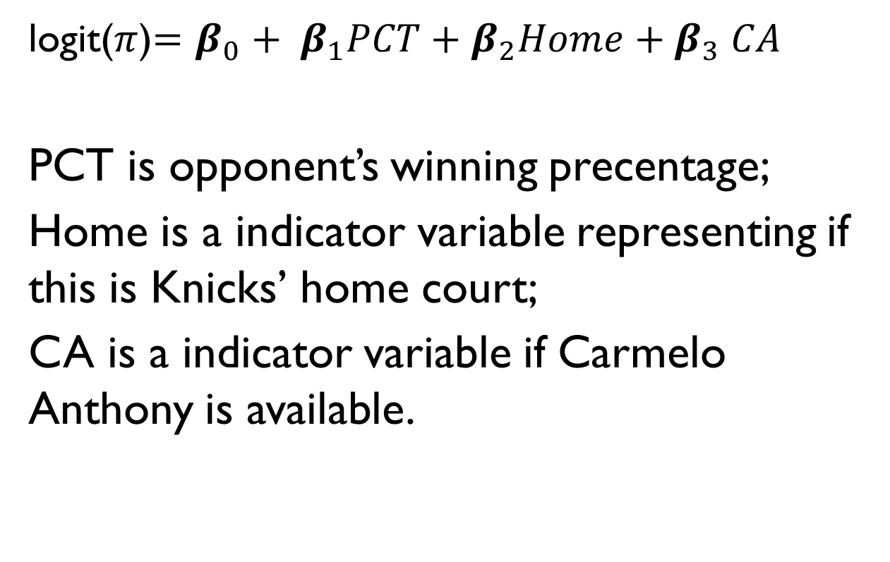
Model 1I Logistic Regression
win.data = matrix(c(7,1,2,8), 2, 2)
fisher = fisher.test(n.data)

Slide 13
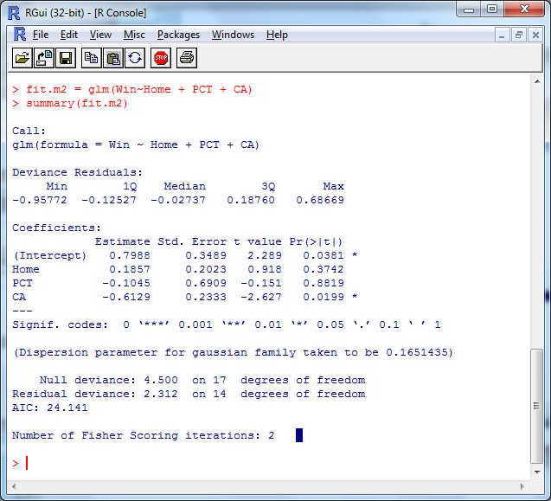
Model 1I Logistic Regression

Slide 14
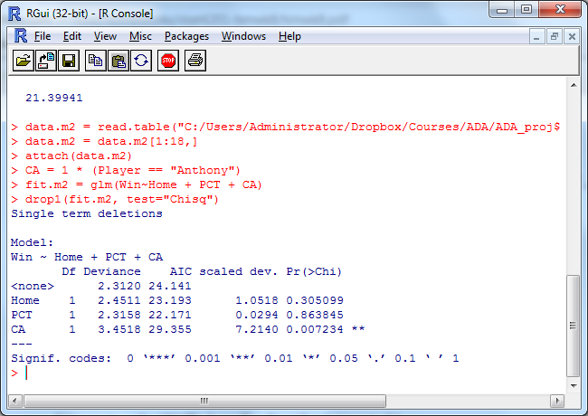
Drop-in-Deviance Test

Slide 15
Should I worry about the sample size?
Rule of Thumb: 1 variable needs 10 sample units.
There are 3 variables in the logistic regression model but I only have 18 sample units.

Slide 16
But there are tons of information out there remain unused.
We may build a better model based on more information.
How?

Slide 17
Part One Ends
The yes-no question:
Is Carmelo Anthony helping the Knicks?
Part Two:
The how-much question:
How to quantitatively measure a player’s value to a basketball team?

Slide 18
How to quantitatively measure Anthony’s value to the Knicks?
Value = performance + influence on morale
If value < 0, the player has a negative effect on the team (means he is NOT helping).
If value > 0, the player has a positive effect on the team (means he is helping).

Slide 19
If we can do this…
Then the team managers can know if the money they spent on the player worth it or not.
VS = value / salary
This can help the managers to decide which player to choose. (From experience to quantitative approach).

Slide 20
How to measure Anthony’s Performance?
Use his own stats.

Slide 21
Player Performance Variables
Statistics | Notation | Positive / Negative
Points | PT | Positive
Assists | AST | Positive
Rebound | RB | Positive
Steal | STL | Positive
Block shot | BLK | Positive
Turnover | TO | Negative
Personal Foul | PF | Negative
Field goal attempt | FGA | Negative
Time | TIME | N/A
Assist-turnover ratio | ASTO | Positive
Offensive Rebound | RBO | Positive
Defensive Rebound | RBD | Positive

Slide 22
How to measure Anthony’s Performance?
Points Made
It is OK since Anthony’s a lead scorer.
Efficiency
((Points + Rebounds + Assists + Steals + Blocks) - ((Field Goals Att. - Field Goals Made) + (Free Throws Att. - Free Throws Made) + Turnovers)

Slide 23
How to measure Anthony’s Influence on the team’s morale?
Use team’s stats
Anthony’s Influence on the team’s morale = The total change of his teammates’ performance (stats) when he’s available.
How?

Slide 24
A simple model
Performance: Anthony’s points made
Influence on morale: The average points from his teammates (when he is available) – The average points from his teammates (when he is not absent).
* When he is absent, the new starter will make more points (due to more time).
* Play style may change.
* Points is not everything. For example, the average points lost per game.

Slide 25
Anthony’s influence is NOT the only factor that affects other player’s performance (stats).
Player itself
Opponents
Home court advantage
Anthony’s performance (stats)
Other teammates’ influence to this player
…
Anthony’s influence is a trivial factor here
* similar to the e-book pricing problem

Slide 26
Performance and Influence on morale
Anthony’s performance will also affect the morale (other player’s stats).
Assist: an assist is attributed to a player who passes the ball to a teammate in a way that leads to a score by field goal.
1assist = a teammate’s 2 or 3 points
If the total number of filed goal attempts is fixed, then Anthony shoots more mean someone has to shoot less.

Slide 27
Thanks!

