Slide 1
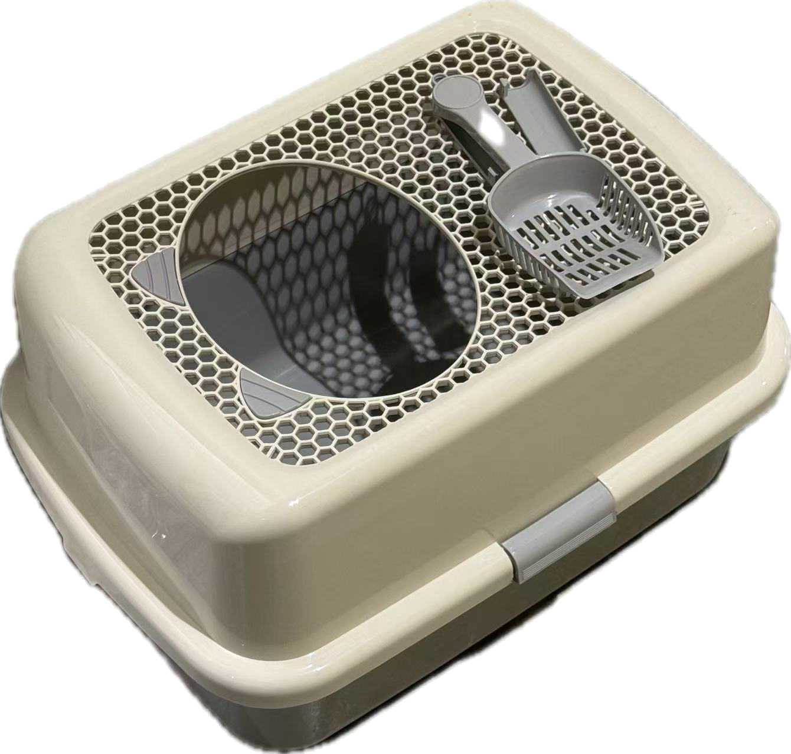
MILESTONE 2
TEAM PROJECT
Smart Cat Litter
Box Monitor
Passive health tracking for cats through visit, weight, and pattern monitoring.
TEAM
TEAM
GITHUB
Mengqi Shi Yuna Xiong Xin Luo
Team SmartLitterBox
https://github.com/MengqiS21/TECHIN515_final_project_smart_litter_box
Smart Cat Litter Box Monitor | Milestone 1
1 / 8

Slide 2
01 PROBLEM
The Problem & Who It Affects
THE PROBLEM
BY THE NUMBERS
Cat owners have no easy way to detect early signs of health issues from litter box behavior.
64.5%
of cats with urinary tract issues show no obvious symptoms until the condition becomes serious
Cats often hide symptoms of illness such as urinary blockages or weight loss. Subtle changes in litter box visit frequency, duration, and body weight are hard to notice without consistent tracking. By the time owners spot a problem, the condition may already be serious.
INTENDED USER GROUP
Cat owners who want passive, automatic monitoring of their cat's health through litter box usage patterns, without relying on manual observation or frequent vet visits.
Smart Cat Litter Box Monitor | Milestone 1
2 / 8

Slide 3
02 SOLUTION
Our Solution & Key Features
IN ONE SENTENCE
KEY FEATURES
Visit Detection
01
A litter box mounted edge device that uses a PIR sensor and load cell to track each visit's duration and weight, runs anomaly detection against a personalized baseline on the ESP32S3, and syncs logs to a cloud dashboard for long term trend viewing.
PIR sensor captures entry and exit automatically for every visit.
Weight Tracking
02
Load cell measures cat weight per visit and tracks long term trends.
On Device Anomaly
03
Rule based detector compares each visit to a personalized 7 day baseline.
HARDWARE STACK
Cloud Trends
04
XIAO ESP32S3 | Load cell + HX711 | PIR sensor
MQTT upload to a dashboard so owners can view history and alerts.
Smart Cat Litter Box Monitor | Milestone 1
3 / 8

Slide 4
03 ARCHITECTURE
Updated System Architecture
Proven
In progress
Blocked
NODE A: Sensor Unit
PIR Motion
Sensor
Signal
Processing
Cloud Upload
(MQTT)
ESP32S3
Node A
Frontend
UI
Anomaly
Detection
Cloud
Dashboard
ESP NOW
feedback: updated baseline
NODE B: Weight Unit
Load Cell
+ HX711
ESP32S3
Node B
Two ESP32S3 nodes communicate via ESP NOW. Solid lines mark tested interfaces. Dashed lines mark interfaces not yet verified.
Smart Cat Litter Box Monitor | Milestone 2
4 / 8

Slide 5
04 TRADE OFF
Trade Off Analysis
Sweeping system parameters to evaluate impact on performance metrics.
01
02
Stabilization Window
Communication Protocol
PARAMETER
PARAMETER
HX711 stabilization time controls how long the system waits after detecting a visit before recording a stable weight reading. Tested at 1s, 3s, 5s, and 7s windows to evaluate the trade off between reading accuracy and response speed.
Evaluated three options for communication between the sensor node (ESP32S3 + PIR) and the weight node (ESP32S3 + HX711): ESP NOW, Wi Fi, and BLE. Compared on latency, power consumption, and ease of implementation.
RESULT
RESULT
At 1s, readings showed high variance due to the cat's movement on the load cell. At 3s, standard deviation dropped significantly but occasional spikes remained. At 5s, mean error reached 0.11 g with 0.23 g standard deviation, providing stable readings with acceptable latency. At 7s, accuracy improved only marginally while adding unnecessary delay.
Wi Fi offers high throughput but requires a router and draws significantly more power, which is not ideal for a battery powered device. BLE is low power but introduces pairing complexity and higher latency for real time data transfer. ESP NOW enables direct peer to peer communication between two ESP32S3 boards with no router dependency, sub 10 ms latency, and minimal power overhead.
Smart Cat Litter Box Monitor | Milestone 2
5 / 8

Slide 6
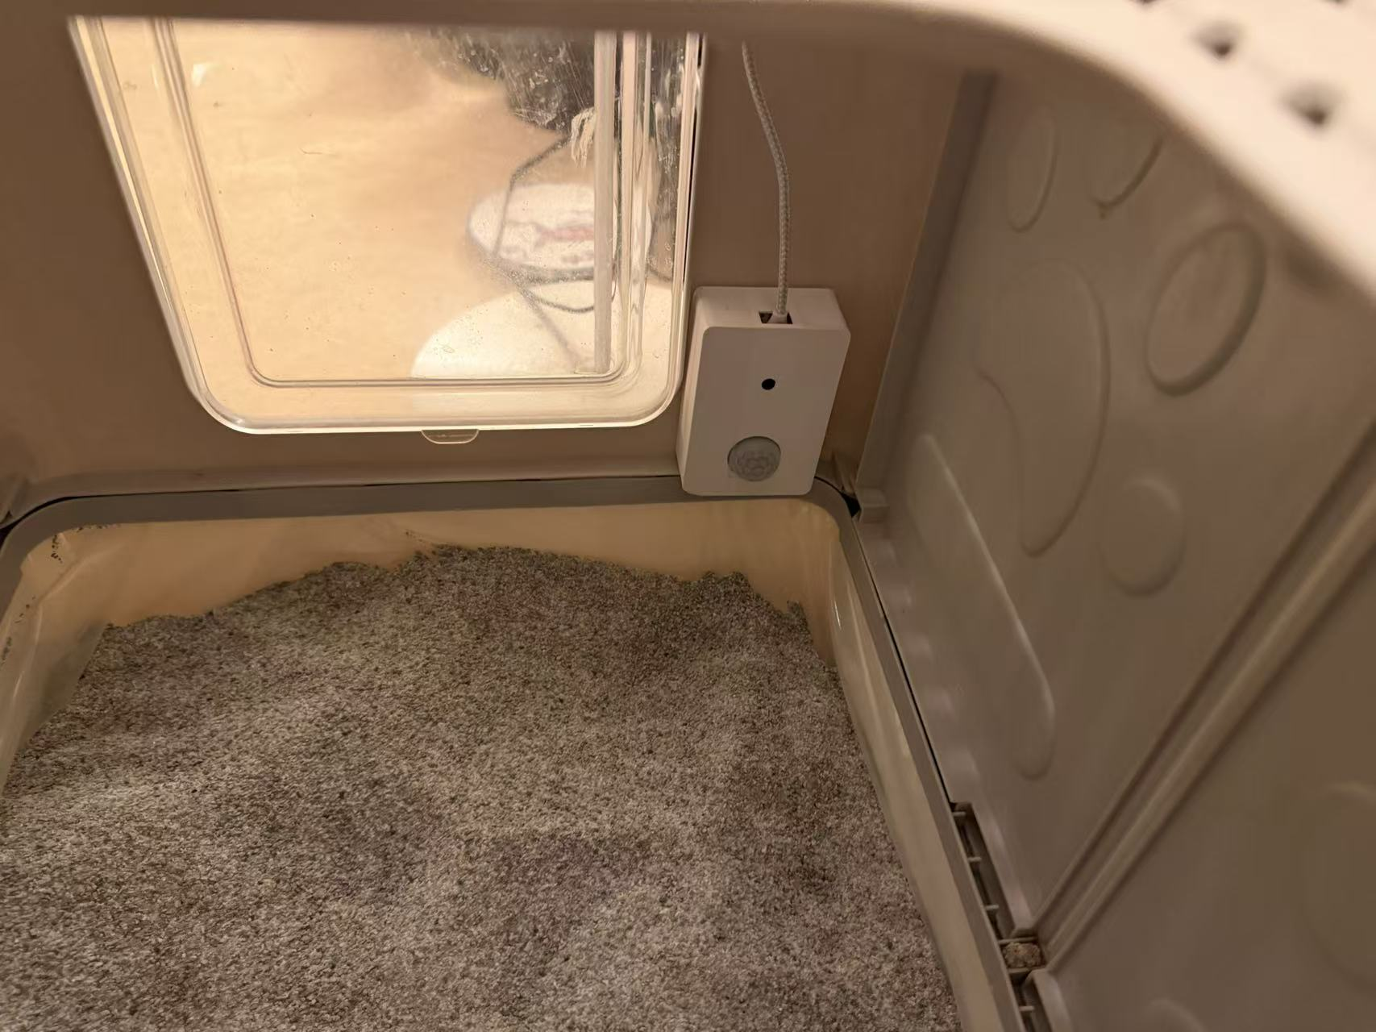
05 VALIDATION
Validation: Data Collection & Integration
Systematic validation of sensor integration, data pipeline, and model readiness.
1
Sensor Data Collection
2
Data Labeling
3
Feature Extraction
4
Model Training
PIR sensor detects motion and triggers the ESP32S3 camera module to capture an image.
▶
Collected images manually labeled into three categories: Cat A, Cat B, and Empty litter box.
▶
Image features extracted through the Edge Impulse DSP pipeline for input into the classification model.
▶
Classification model trained to identify which cat is visiting
Data Collected
Quantitative Results
Model / Next Steps
600 images total across three categories (Cat A, Cat B, Empty). All captured via PIR triggered camera on the ESP32S3. Insert sample images from each category and a photo of the hardware setup.
lassification model can distinguish between Cat A, Cat B, and Empty. Next step is integrating the classifier output with weight and visit duration data to build the full anomaly detection pipeline. Cloud upload and dashboard display to follow.
HX711 weight sensor validated with mean error 0.11 g and std dev 0.23 g over 20 trials. Image classification accuracy 89.8% on test set.
Smart Cat Litter Box Monitor | Milestone 2
6 / 8

Slide 7

Smart Cat Litter Box Monitor | Milestone 2
7/ 8

Slide 8
05 BUDGET
Budget Update
TOTAL BUDGET
SPENT SO FAR
REMAINING
$ 350
$ 57.38
$ 292.62
PURCHASES TO DATE
Item | Qty | Unit Cost | Total
[LiPo battery] | [1] | [$ 5.83] | [$ 5.83]
[LiPo charger module (TP4057, 5pcs)] | [1] | [$ 7.56] | [$ 7.56]
[Cat litter box(Smart Paws,enclosed)] | [1] | [$ 43.99] | [$ 43.99]
[XIAO ESP32S3] | [2] | [$ 0.00] | [$ 0.00]
[Load cell + HX711] | [1] | [$ 0.00] | [$ 0.00]
[PIR motion sensor] | [1] | [$ 0.00] | [$ 0.00]
Smart Cat Litter Box Monitor | Milestone 1
8 / 8

