Slide 1
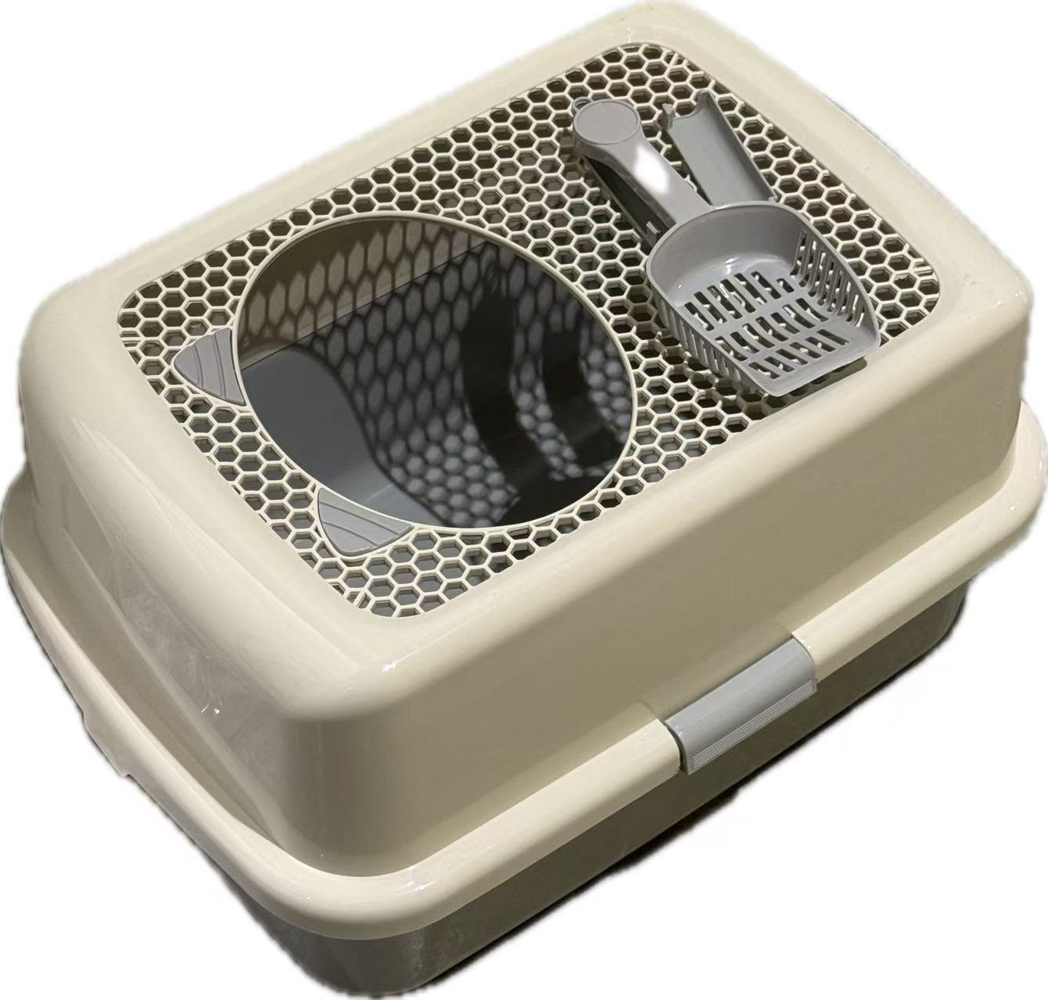
MILESTONE 1
TEAM PROJECT
Smart Cat Litter
Box Monitor
Passive health tracking for cats through visit, weight, and pattern monitoring.
TEAM
TEAM
GITHUB
Mengqi Shi Yuna Xiong Xin Luo
Team SmartLitterBox
[github.com/your repo link]
Smart Cat Litter Box Monitor | Milestone 1
1 / 6

Slide 2
01 PROBLEM
The Problem & Who It Affects
THE PROBLEM
BY THE NUMBERS
Cat owners have no easy way to detect early signs of health issues from litter box behavior.
64.5%
of cats with urinary tract issues show no obvious symptoms until the condition becomes serious
Cats often hide symptoms of illness such as urinary blockages or weight loss. Subtle changes in litter box visit frequency, duration, and body weight are hard to notice without consistent tracking. By the time owners spot a problem, the condition may already be serious.
INTENDED USER GROUP
Cat owners who want passive, automatic monitoring of their cat's health through litter box usage patterns, without relying on manual observation or frequent vet visits.
Smart Cat Litter Box Monitor | Milestone 1
2 / 6

Slide 3
02 SOLUTION
Our Solution & Key Features
IN ONE SENTENCE
KEY FEATURES
Visit Detection
01
A litter box mounted edge device that uses a PIR sensor and load cell to track each visit's duration and weight, runs anomaly detection against a personalized baseline on the ESP32S3, and syncs logs to a cloud dashboard for long term trend viewing.
PIR sensor captures entry and exit automatically for every visit.
Weight Tracking
02
Load cell measures cat weight per visit and tracks long term trends.
On Device Anomaly
03
Rule based detector compares each visit to a personalized 7 day baseline.
HARDWARE STACK
Cloud Trends
04
XIAO ESP32S3 | Load cell + HX711 | PIR sensor
MQTT upload to a dashboard so owners can view history and alerts.
Smart Cat Litter Box Monitor | Milestone 1
3 / 6

Slide 4
03 ARCHITECTURE
Updated System Architecture
Proven
In progress
Blocked
PIR Motion
Sensor
Load Cell
+ HX711
ESP32S3 MCU
Signal
Processing
feedback: updated baseline
Anomaly
Detection
Cloud
Upload (MQTT)
Cloud
Dashboard
Solid lines mark tested interfaces. Dashed lines mark interfaces not yet verified. Update block status as components move from in progress to proven.
Smart Cat Litter Box Monitor | Milestone 1
4 / 6

Slide 5
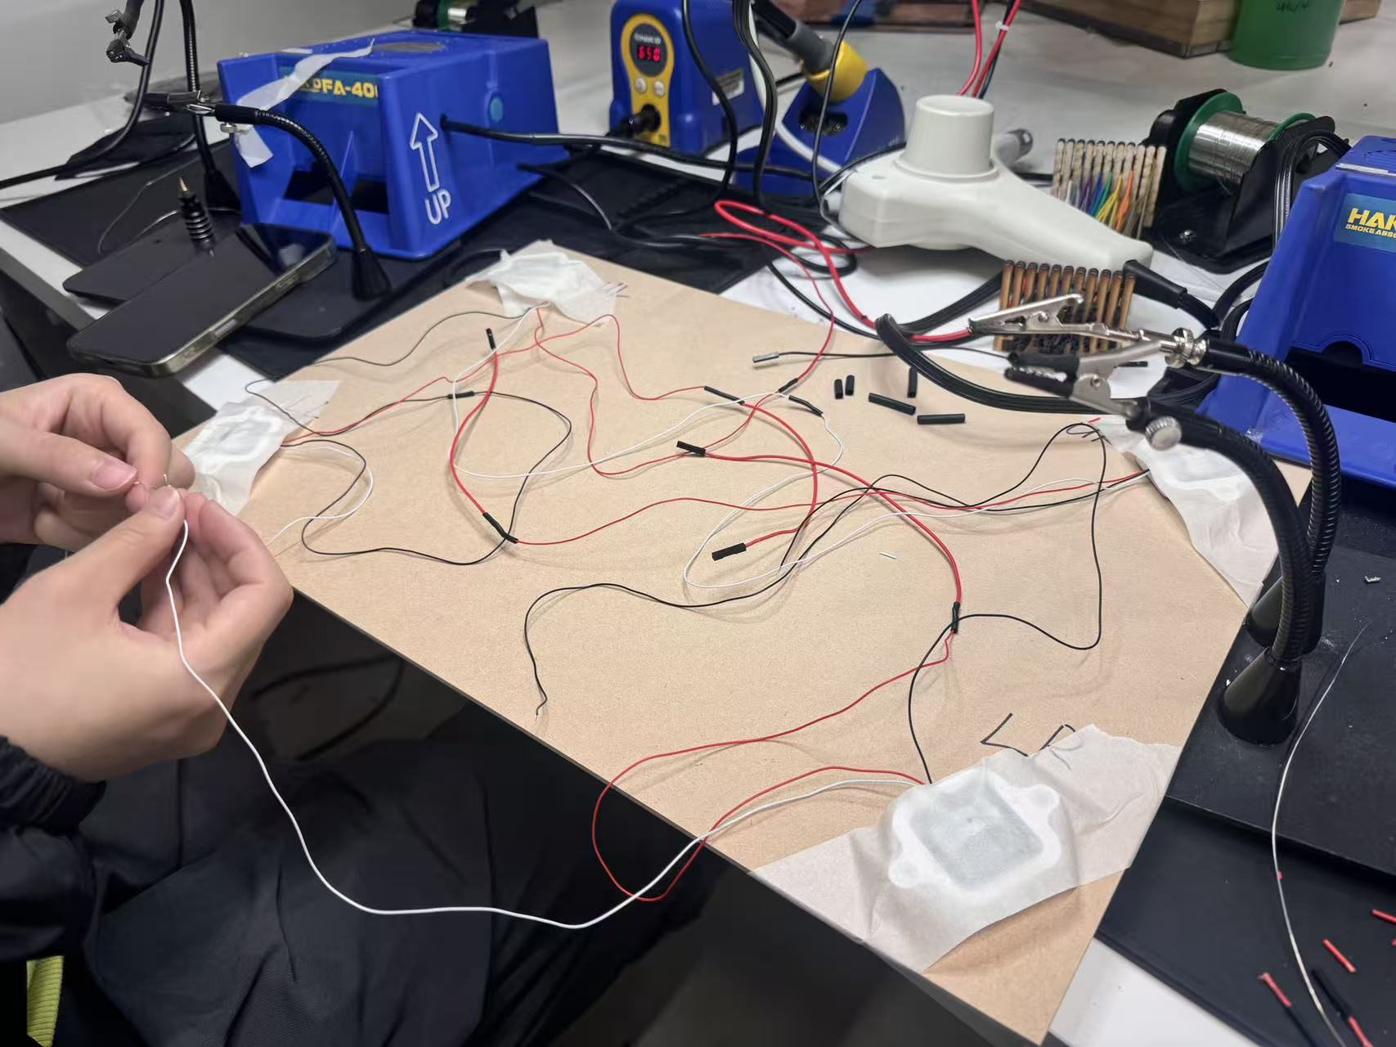
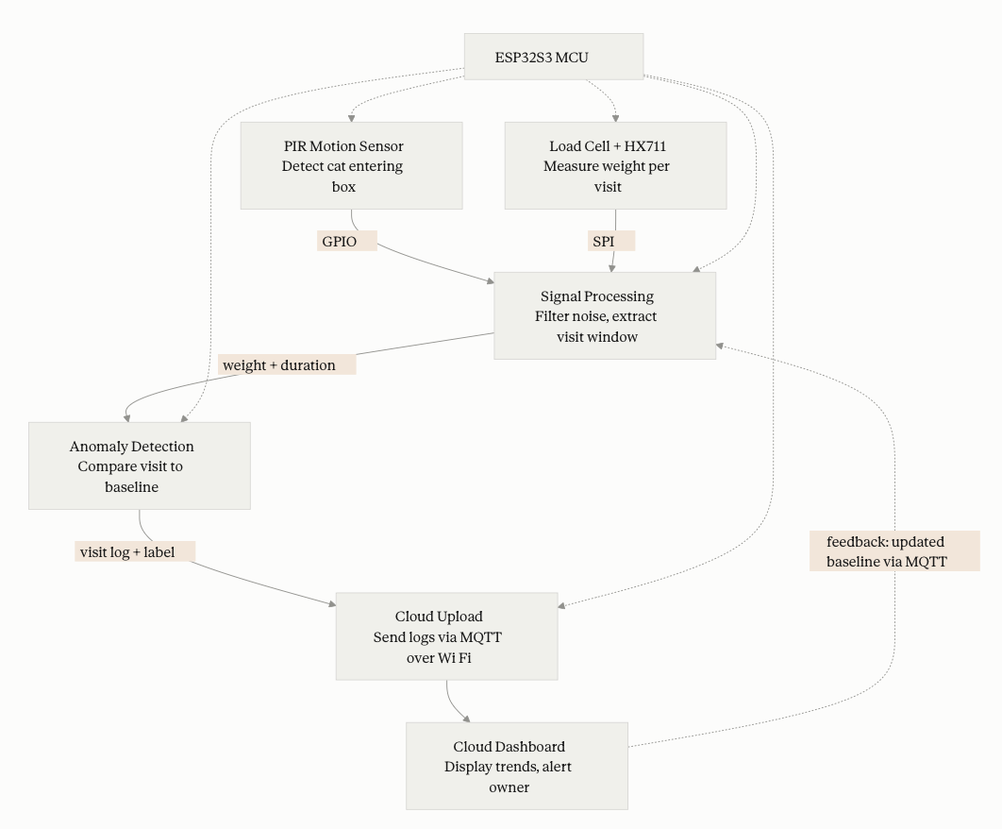
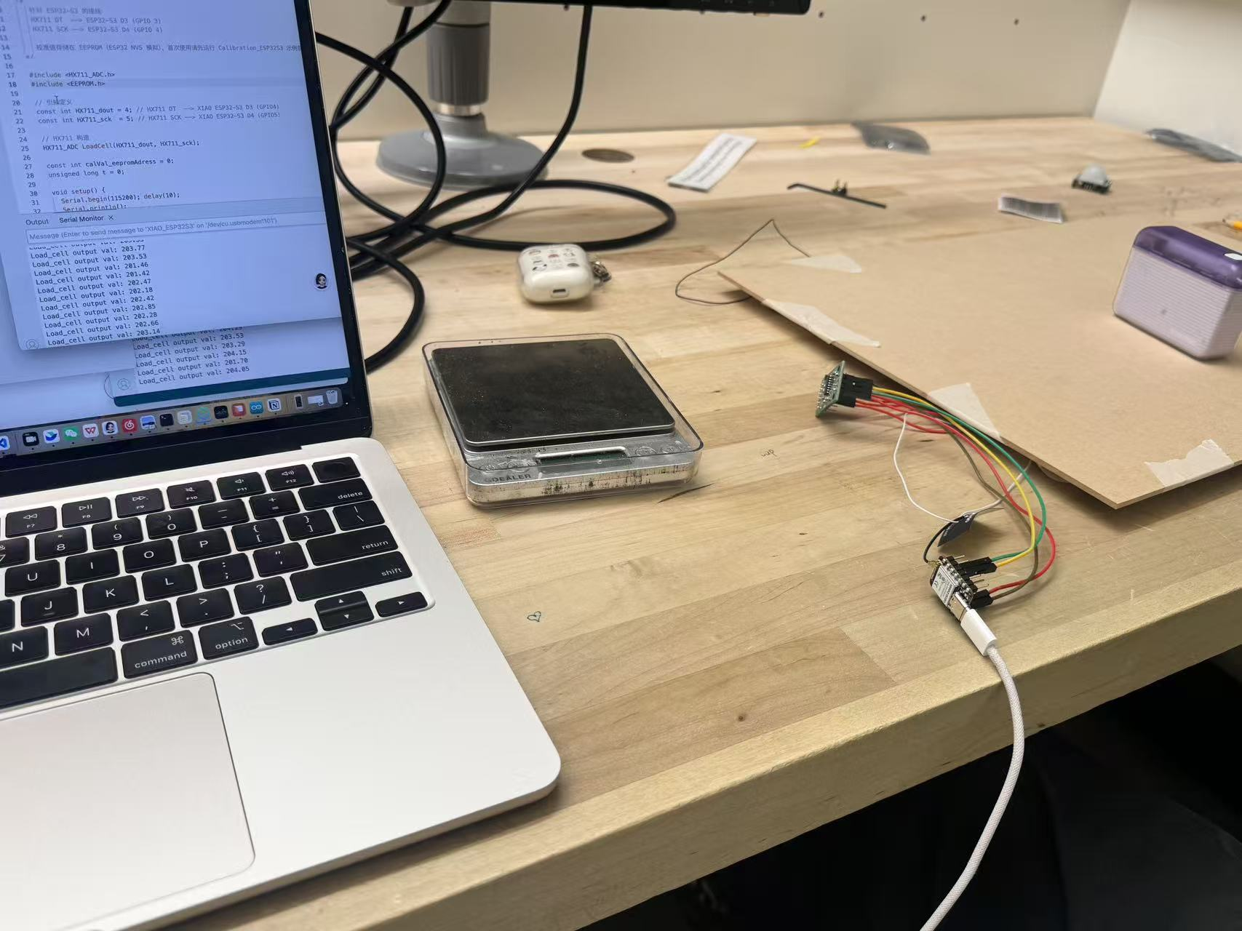
03 ARCHITECTURE
Updated System Architecture
Solid lines mark tested interfaces. Dashed lines mark interfaces not yet verified. Update block status as components move from in progress to proven.
Smart Cat Litter Box Monitor | Milestone 1
4 / 6

Slide 6
04 VALIDATION
Component Validation & Results
Each component validated with a quantitative test. Evidence: photos, plots, and commits.
01
02
03
YUNA XIONG
MENGQI SHI
XIN LUO
Sensor Hardware
Signal Stability
Data Logging and Transmission
METHOD
METHOD
METHOD
Connected the HX711 load cell to the XIAO ESP32S3 and placed a 201.56 g reference weight 20 times. Each reading was recorded after a 5000 ms stabilization window at 1000 ms intervals.
Analyzed the 20 trial weight readings from the HX711 sensor to evaluate signal noise and reading consistency. Computed error distribution, peak to peak range, and standard deviation across all trials.
Developed the ESP32S3 firmware (Read_ESP32S3.ino) to read and log weight data via serial output. Verified that all 20 readings were captured without data loss at 1000 ms intervals over the test session.
RESULT
RESULT
RESULT
Mean error 0.11 g, standard deviation 0.23 g. GO verdict, well within the 10 g accuracy threshold.
Peak to peak error range 0.72 g, max error 0.43 g, min error 0.29 g. Signal stable enough to serve as input for the anomaly detection pipeline.
20 out of 20 readings successfully captured with zero dropped samples. Firmware logging validated for future MQTT cloud upload integration.
Smart Cat Litter Box Monitor | Milestone 1
5 / 6

Slide 7
05 BUDGET
Budget Update
TOTAL BUDGET
SPENT SO FAR
REMAINING
$ 350
$ 57.38
$ 292.62
PURCHASES TO DATE
Item | Qty | Unit Cost | Total
[LiPo battery] | [1] | [$ 5.83] | [$ 5.83]
[LiPo charger module (TP4057, 5pcs)] | [1] | [$ 7.56] | [$ 7.56]
[Cat litter box(Smart Paws,enclosed)] | [1] | [$ 43.99] | [$ 43.99]
[XIAO ESP32S3] | [2] | [$ 0.00] | [$ 0.00]
[Load cell + HX711] | [1] | [$ 0.00] | [$ 0.00]
[PIR motion sensor] | [1] | [$ 0.00] | [$ 0.00]
Smart Cat Litter Box Monitor | Milestone 1
6 / 6

