Slide 1

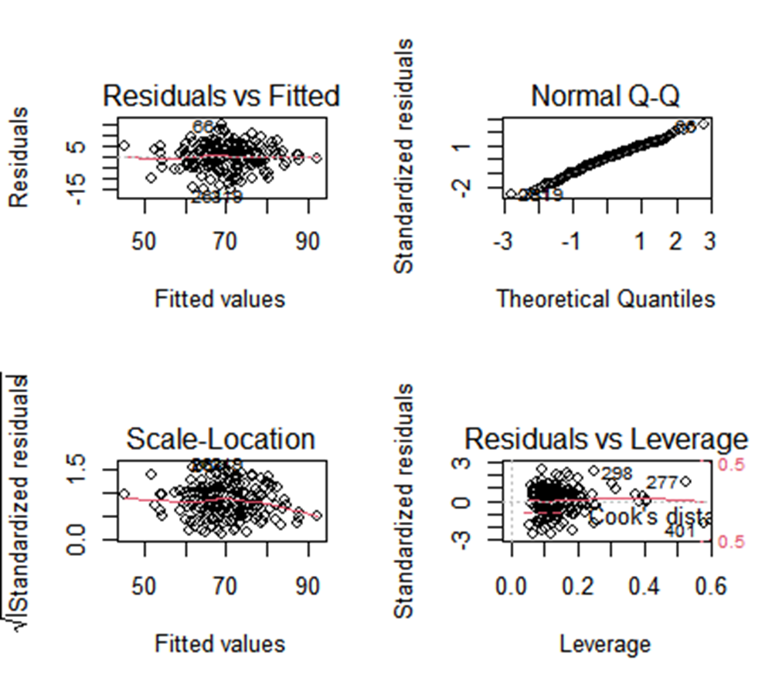
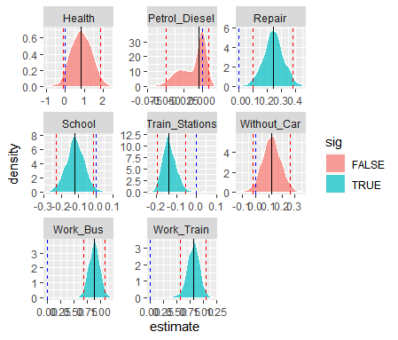
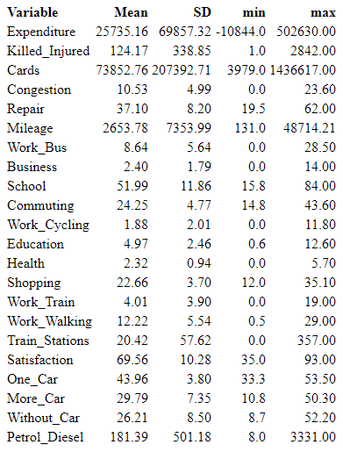


Factors influencing Scots' satisfaction with public transport
Group 28: Aishwin Tikku, Mengran Li, Steven Kwok, Shaoquan Li, Shuning Li
Purpose
Residuals and Q-Q plot to assess our assumptions.
Parameter estimation & distribution
We aim to find factors related to passengers' satisfaction with public transport to help operator to improve its service.
Using Bootstrap to select significant variables at 95% level and obtain its CI.
This process should be repeated 1000 times.
Data Summary
The dataset has 24 factors and 460 observations. And explanatory variables are as follow:
Table 1: Summary Statistic Table
Figure1: Assumption Checking Result
Methodology & Selection
A linear regression model is applied as follow:
Figure2:Bootstrap Result
Regress All the variables. Then remove the highly correlated factors. Finally obtain four models.
AIC and adjusted R square method are applied as a criterion for model selection.
Model 3 is the best choice.
Reference
Jim Hester and Hadley Wickham, (2020). fs: Cross-Platform File System Operations Based on 'libuv'. R package version 1.5.0
Kuhn et al., (2020). Tidymodels: a collection of packages for modeling and machine learning using tidyverse principles.
Wickham et al., (2019). Welcome to the tidyverse. Journal of Open Source Software, e, 4(43), 1686
Table2:Model Selection
Assumption Checking
Plot the Fitted values against

