Slide 1


Title: 85 pt Bold
Author: 56 pt
Headings 56 pt
content 36 pt example
The primary rule with fonts for your poster is to make sure they are easy to read. Beyond that, it’s up to your personal taste. A good design principle to follow is to use one font for titles and headings and another for the rest of your text. Although you may already have some good fonts on your computer, Google Fonts has a constantly-increasing collection of free fonts. Here are some good font combinations to get you started:

Slide 2
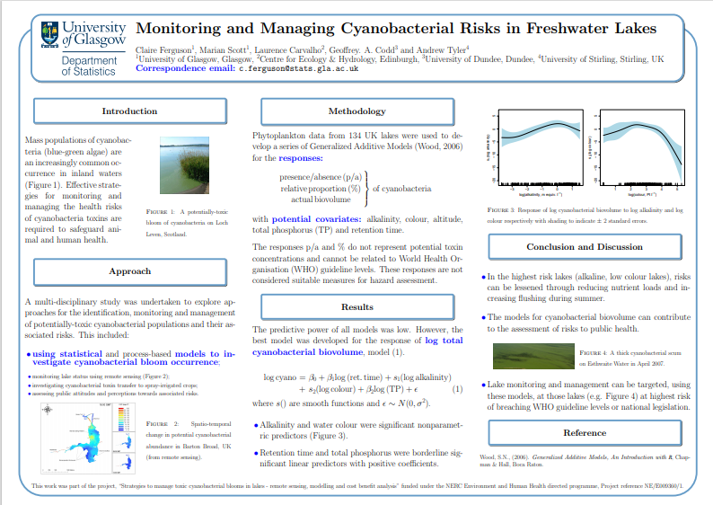

Slide 3
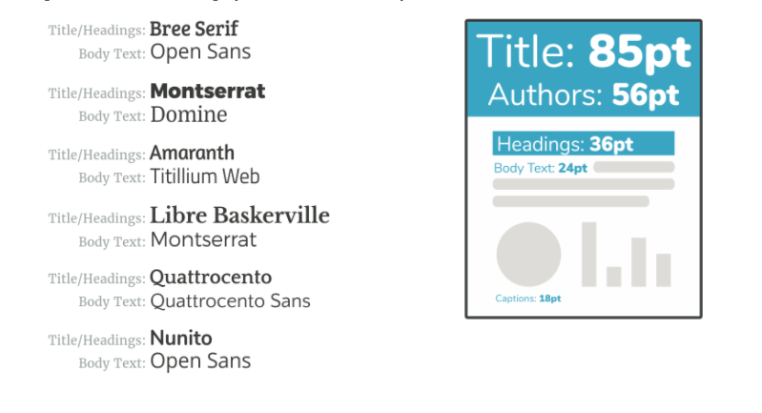
the line spacing : between 1.25 and 1.5

