Slide 1
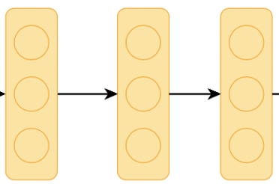
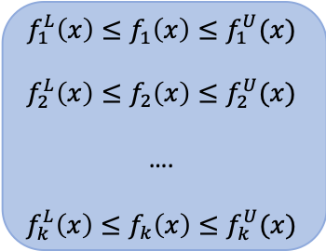

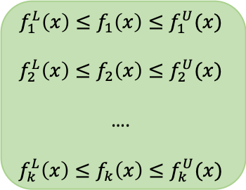

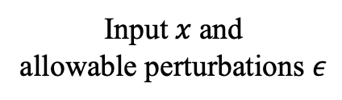
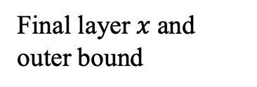

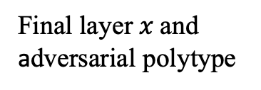




$$f_{1}^{L}\left(x\right)≤f_{1}\left(x\right)≤f_{1}^{U}(x)$$
$$f_{2}^{L}\left(x\right)≤f_{2}\left(x\right)≤f_{2}^{U}(x)$$
….
$${f_{k}^{L}\left(x\right)≤f}_{k}\left(x\right)≤f_{k}^{U}(x)$$
$$(b)$$
Input $x$ and
allowable perturbations $ε$
Deep Network $f$
Final layer $x$and adversarial polytype
Output probability
with exact low/up bound
With relaxation
$$f_{1}\left(x\right)$$
$$f_{2}(x)$$
….
$$f_{k}(x)$$
$$f_{1}^{L}\left(x\right)≤f_{1}\left(x\right)≤f_{1}^{U}(x)$$
$$f_{2}^{L}\left(x\right)≤f_{2}\left(x\right)≤f_{2}^{U}(x)$$
….
$${f_{k}^{L}\left(x\right)≤f}_{k}\left(x\right)≤f_{k}^{U}(x)$$
$$(c)$$
Input $x$
Deep Network $f$
Output
probability
Final layer $x$and outer bound
Output probability with lower/upper bound
$$(a)$$

