Slide 1
10-701 Basic Probability Recitation
Dan Schwartz
2017-01-19

Slide 2
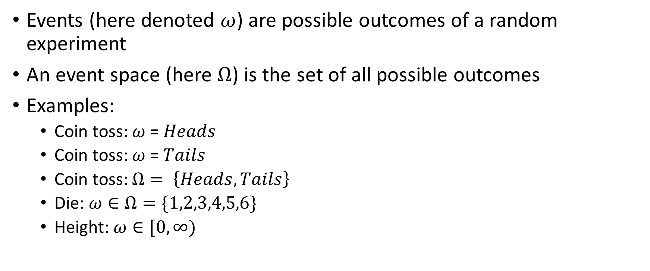
Events, Event Spaces
Events (here denoted $ω$) are possible outcomes of a random experiment
An event space (here $Ω$) is the set of all possible outcomes
Examples:
Coin toss: $ω$ = $Heads$
Coin toss: $ω$ = $Tails$
Coin toss: $Ω= \left\{Heads, Tails\right\}$
Die: $ω∈Ω=\{1,2,3,4,5,6\}$
Height: $ω∈[0,∞)$

Slide 3

Random Variables
Random variables are just functions from events to the real numbers:
$$X:Ω→ℝ$$
Examples:
$X\left(True\right)=1, X\left(False\right)=0$
$X\left(1\right)=1$
$X\left(h\right)≔ h^{2}$

Slide 4
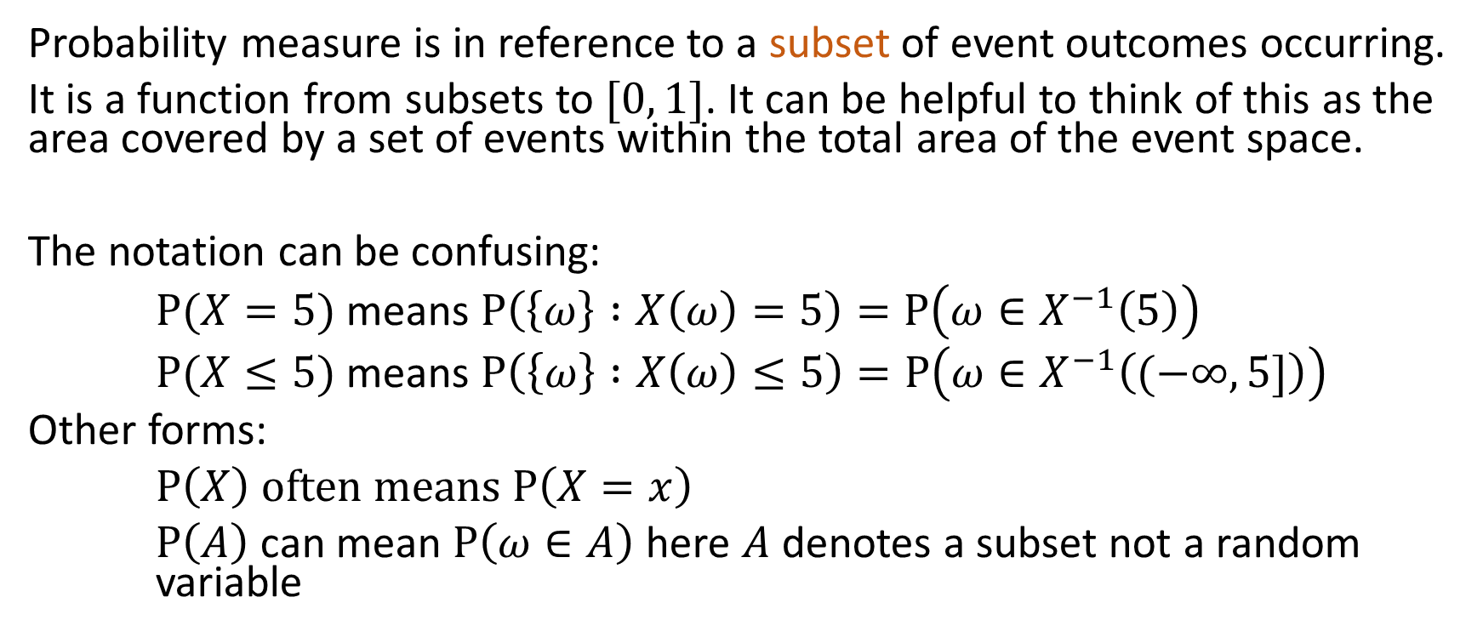
Probability
Probability measure is in reference to a subset of event outcomes occurring.
It is a function from subsets to $[0, 1]$. It can be helpful to think of this as the area covered by a set of events within the total area of the event space.
The notation can be confusing:
$P(X=5)$ means $P\left(\left\{ω\right\} :X\left(ω\right)=5\right)=P\left(ω∈X^{−1}\left(5\right)\right)$
$P(X≤5)$ means $P\left(\left\{ω\right\} :X\left(ω\right)≤5\right)=P\left(ω∈X^{−1}\left((−∞,5]\right)\right)$
Other forms:
$P\left(X\right) often means P\left(X=x\right)$
$P\left(A\right)$ can mean $P\left(ω∈A\right)$ here $A$ denotes a subset not a random variable

Slide 5

Axioms
$$P\left(Ω\right)=1$$
$$P\left(∅\right)=0$$
$$P\left(A∪B\right)=P\left(A\right)+P\left(B\right), for A disjoint from B$$

Slide 6
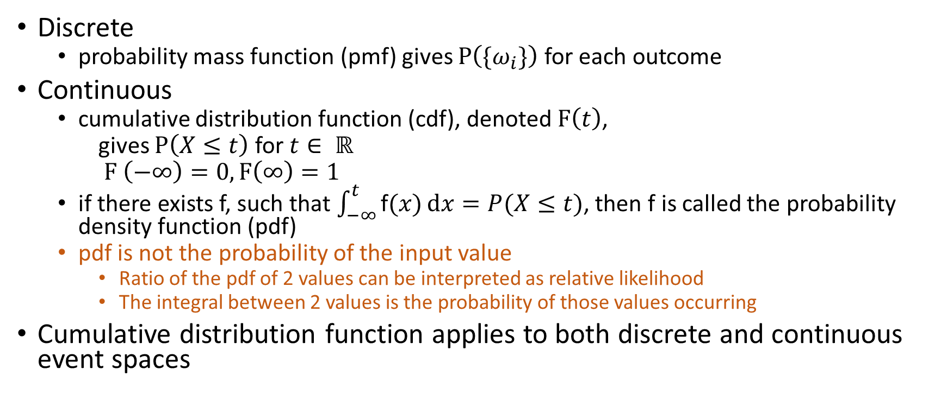
Distributions
Discrete
probability mass function (pmf) gives $P\left(\{ω_{i}\}\right)$ for each outcome
Continuous
cumulative distribution function (cdf), denoted $F\left(t\right)$,
gives $P\left(X≤t\right)$ for $t∈ ℝ$
$F \left(−∞\right)=0,F\left(∞\right)=1$
if there exists f, such that $\int_{−∞}^{t}{\text{f}(x)}\text{d}x=P(X≤t)$, then f is called the probability density function (pdf)
pdf is not the probability of the input value
Ratio of the pdf of 2 values can be interpreted as relative likelihood
The integral between 2 values is the probability of those values occurring
Cumulative distribution function applies to both discrete and continuous event spaces

Slide 7
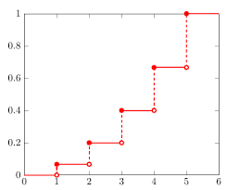
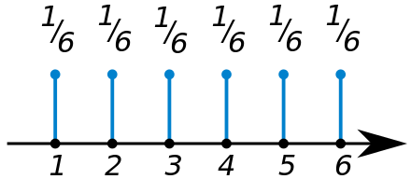
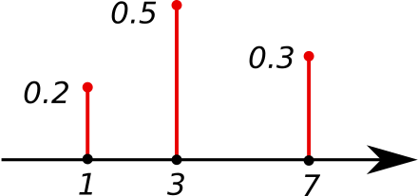
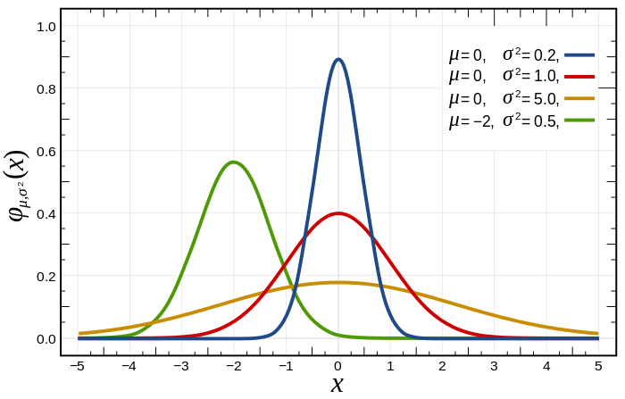
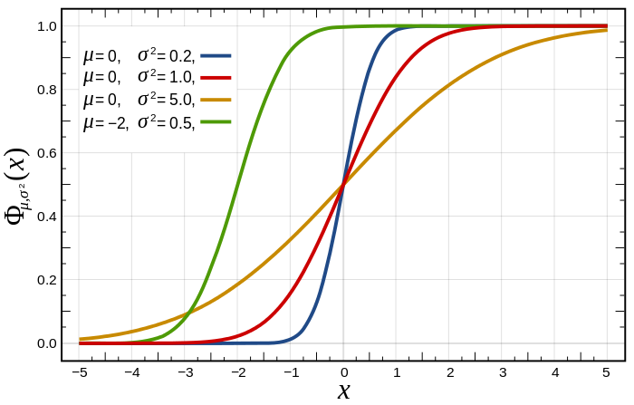
pmf, pdf, cdf examples

Slide 8

median, mode
Median
$t :F\left(t\right)=0.5, P\left(X≤t\right)=P(X>t)$
Mode
point where pmf or pdf is maximum

Slide 9
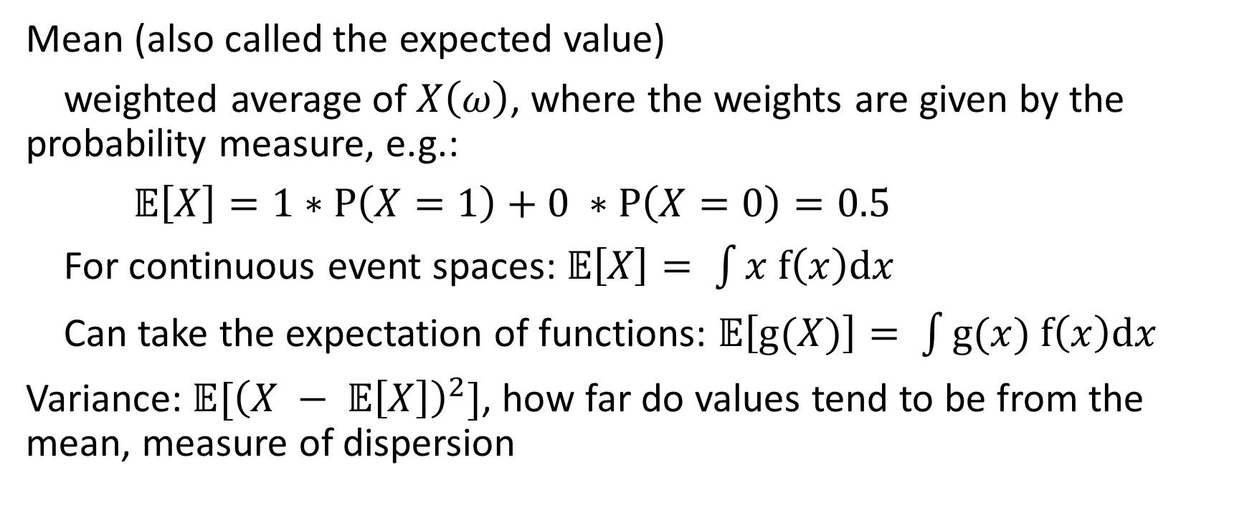
mean, variance
Mean (also called the expected value)
weighted average of $X\left(ω\right)$, where the weights are given by the probability measure, e.g.:
$𝔼\left[X\right]=1∗P\left(X=1\right)+0 ∗P\left(X=0\right)=0.5$
For continuous event spaces: $𝔼\left[X\right]= \int{x f\left(x\right)dx}$
Can take the expectation of functions: $𝔼\left[g(X)\right]= \int{g(x) f\left(x\right)dx}$
Variance: $𝔼[{\left(X − 𝔼\left[X\right]\right)}^{2}]$, how far do values tend to be from the mean, measure of dispersion

Slide 10


Joint distributions
$$P_{XY}(X=x, Y=y)$$
 | die 2 = 1 | die 2 = 2 | die 2 = 3 | die 2 = 4 | die 2 = 5 | die 2 = 6
die 1 = 1
die 1 = 2
die 1 = 3
die 1 = 4
die 1 = 5
die 1 = 6
Multidimensional event space, we consider an event to be an outcome for all of the variables jointly. $ω=(x, y)$ is a tuple, or vector.
cdf is also joint:
$$F_{XY}\left(x, y\right)=P(X≤x, Y≤y)$$
$$P_{XY}(X∈\left\{3, 4, 5\right\}, Y∈\left\{3\right\})$$

Slide 11



Marginal distributions
$$P_{X}\left(X=x\right)=\sum_{y}{P_{XY}(X=x, Y=y)}$$
 | die 2 = 1 | die 2 = 2 | die 2 = 3 | die 2 = 4 | die 2 = 5 | die 2 = 6
die 1 = 1
die 1 = 2
die 1 = 3
die 1 = 4
die 1 = 5
die 1 = 6
Continuous case:
$$f_{X}=\int_{y}{f_{XY}}\left(x, y\right)dy$$
Independence:
$X, Y$ are independent iff
$P_{XY}\left(X=x, Y=y\right)=$
$P_{X}\left(X=x\right)P_{Y}\left(Y=y\right) ∀ x,y$
$$P_{X}(X=2)$$

Slide 12
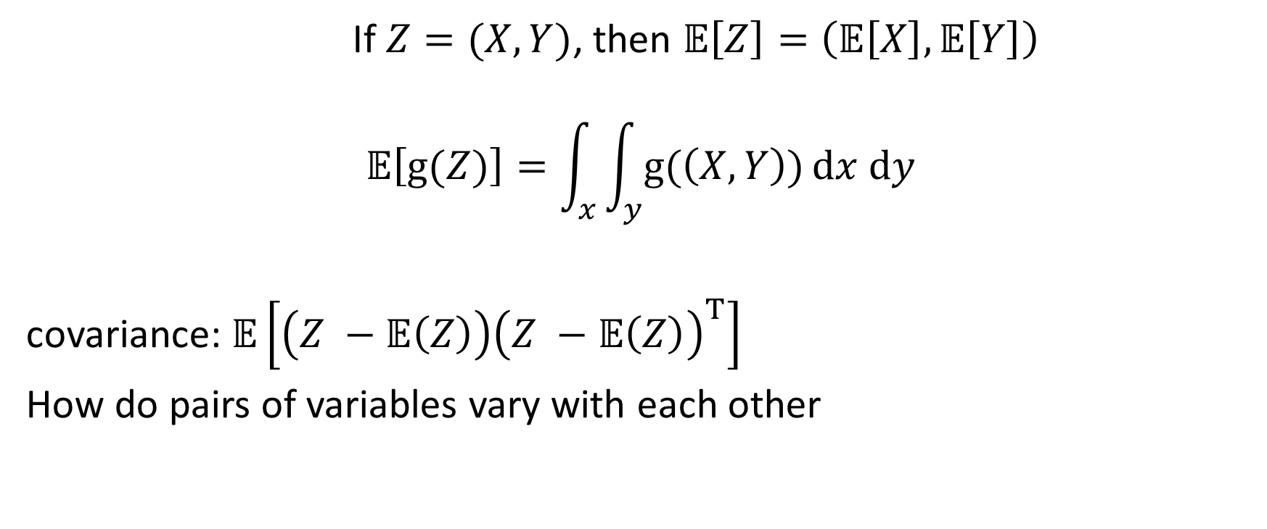
mean, covariance
If $Z=(X, Y)$, then $𝔼\left[Z\right]=\left(𝔼\left[X\right],𝔼\left[Y\right]\right)$
$$𝔼\left[g(Z)\right]=\int_{x}{\int_{y}{g(\left(X, Y\right))}dx dy}$$
covariance: $𝔼\left[\left(Z −𝔼\left(Z\right)\right){\left(Z −𝔼\left(Z\right)\right)}^{T}\right]$
How do pairs of variables vary with each other

Slide 13
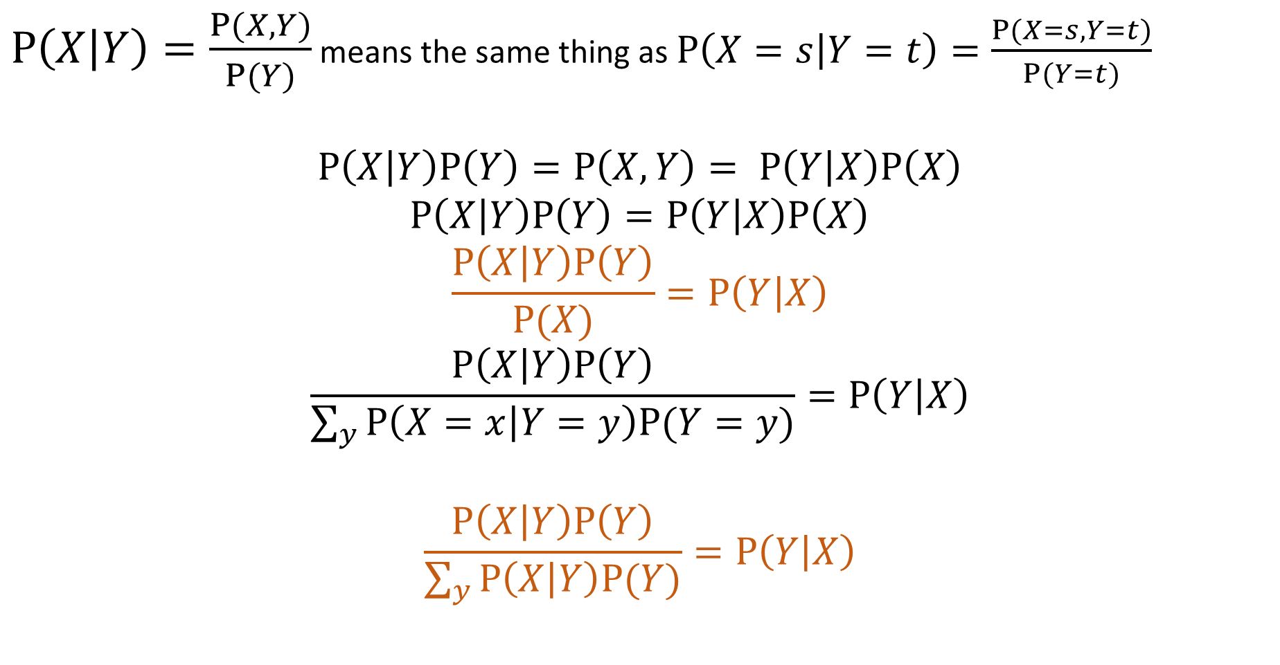

Conditional distributions, Bayes rule
$P\left(X | Y\right)=\frac{P(X, Y)}{P(Y)}$ means the same thing as $P\left(X=s | Y=t\right)=\frac{P(X=s, Y=t)}{P(Y=t)}$
$$P\left(X | Y\right)P\left(Y\right)=P\left(X, Y\right)= P\left(Y | X\right)P\left(X\right)$$
$$P\left(X | Y\right)P\left(Y\right)=P\left(Y | X\right)P\left(X\right)$$
$$\frac{P\left(X | Y\right)P\left(Y\right)}{P(X)}=P\left(Y | X\right)$$
$$\frac{P\left(X | Y\right)P\left(Y\right)}{\sum_{y}{P\left(X=x | Y=y\right)P(Y=y)}}=P\left(Y | X\right)$$
$$\frac{P\left(X | Y\right)P\left(Y\right)}{\sum_{y}{P\left(X | Y\right)P(Y)}}=P\left(Y | X\right)$$
 | die 2 = 3
die 1 = 1
die 1 = 2
die 1 = 3
die 1 = 4
die 1 = 5
die 1 = 6
$$P_{XY}\left(X≥4 \right|Y=3)$$

Slide 14

Continuous case, conditional independence
$$f_{X}\left(x | Y=y\right)=\frac{f_{Y}\left(y | X=x\right)f_{X}(x)}{f_{Y}(y)}$$
Two variables $X$, $Y$ are conditionally independent given $Z$ iff:
$P\left(X,Y | Z\right)=P\left(X | Z\right)P\left(Y | Z\right) ∀ x, y$

Slide 15
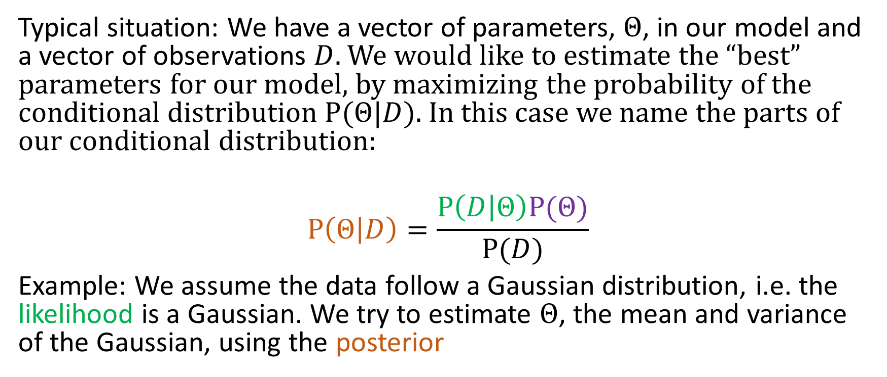
Prior, Likelihood, Posterior
Typical situation: We have a vector of parameters, $Θ$, in our model and a vector of observations $D$. We would like to estimate the “best” parameters for our model, by maximizing the probability of the conditional distribution $P(Θ|D)$. In this case we name the parts of our conditional distribution:
$$P\left(Θ | D\right)=\frac{P\left(D | Θ\right)P(Θ)}{P(D)}$$
Example: We assume the data follow a Gaussian distribution, i.e. the likelihood is a Gaussian. We try to estimate $Θ$, the mean and variance of the Gaussian, using the posterior

Slide 16
Distribution Families
We often assume various families to keep the math tractable:
Gaussian for regression, Gaussian mixtures, etc.
Categorical/Multinomial for discrete data

