Slide 1
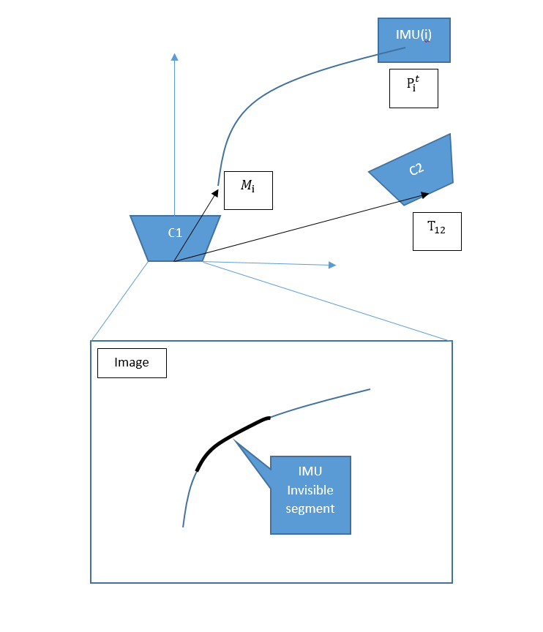

Slide 2



IMU(i)
$$P_{i}^{t}$$
$$M_{i}$$
C1
$$T_{12}$$
Image
IMU Invisible segment

