Slide 1
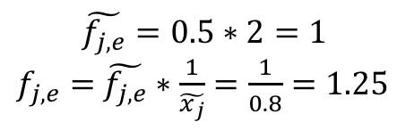
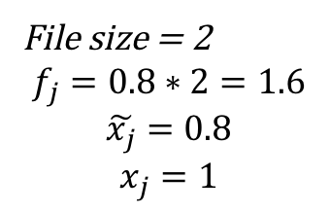
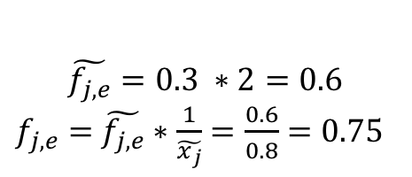
File size = 2
$$f_{j}=0.8∗2=1.6$$
$$\tilde{x_{j}}=0.8$$
$$x_{j}=1$$
$$\tilde{f_{j,e}}=0.3 ∗2=0.6$$
$f_{j,e}=$ $\tilde{f_{j,e}}∗\frac{1}{\tilde{x_{j}}}=\frac{0.6}{0.8}=0.75$
A
B
$$\tilde{f_{j,e}}=0.5∗2=1$$
$f_{j,e}=$ $\tilde{f_{j,e}}∗\frac{1}{\tilde{x_{j}}}=\frac{1}{0.8}=1.25$

