Slide 1
Final Project
Project A
Timothy Shepard

Slide 2
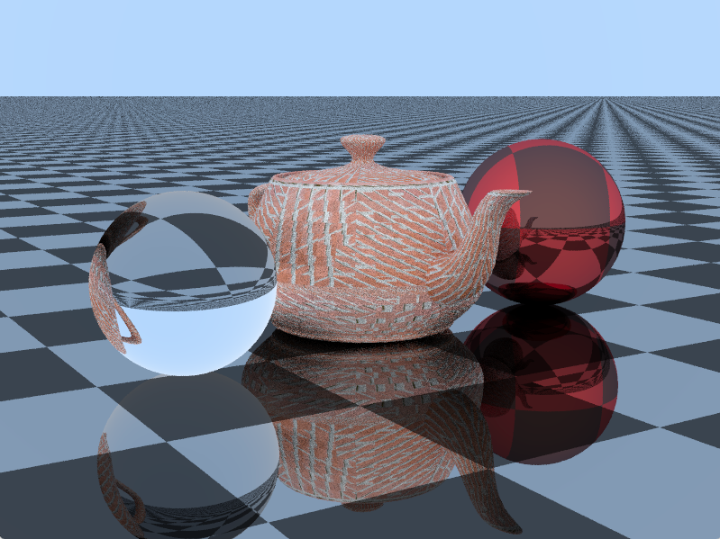
Final Results

Slide 3
Sources
Raytracing in One Weekend, Book, Peter Shirley
Raytracing the Next Week, Book, Peter Shirley
Raytracer from Scratch in C++, Youtube, Caleb Piercy

Slide 4
Main Loop for each Pixel: from Peter Shirley
camera cam(lookfrom2, lookat2, up2, fov2, float(nx)/float(ny));
for (int j = ny-1; j >= 0; j--) {
for (int i = 0; i < nx; i++) {
vec3 col(0, 0, 0);
for (int s=0; s < ns; s++) {
float u = float(i + drand48()) / float(nx);
float v = float(j + drand48()) / float(ny);
ray r = cam.get_ray_simple(u, v);
vec3 p = r.point_at_parameter(2.0);
col += color(r, world,0);
}
col /= float(ns);
col = vec3( sqrt(col[0]), sqrt(col[1]), sqrt(col[2]) );
int ir = int(255.99*col[0]);
int ig = int(255.99*col[1]);
int ib = int(255.99*col[2]);
outFile << ir << " " << ig << " " << ib << "\n";
}
}

Slide 5
Color Function: from Peter Shirley
// Original color function
vec3 color(const ray& r, hitable *world, int depth) {
hit_record rec;
if (world->hit(r, 0.001, MAXFLOAT, rec))
{
ray scattered;
vec3 attenuation;
if (depth < 50 && rec.mat_ptr->scatter(r, rec, attenuation, scattered))
{
return attenuation*color(scattered, world, depth+1);
//return attenuation;
}
else
{
return vec3(0,0,0);
}
}
else
{
vec3 unit_direction = unit_vector(r.direction());
float t = 0.5*(unit_direction.y() + 1.0);
return (1.0-t)*vec3(1.0, 1.0, 1.0) + t*vec3(0.5, 0.7, 1.0);
//return vec3(1.0, 1.0, 1.0);
}
}

Slide 6
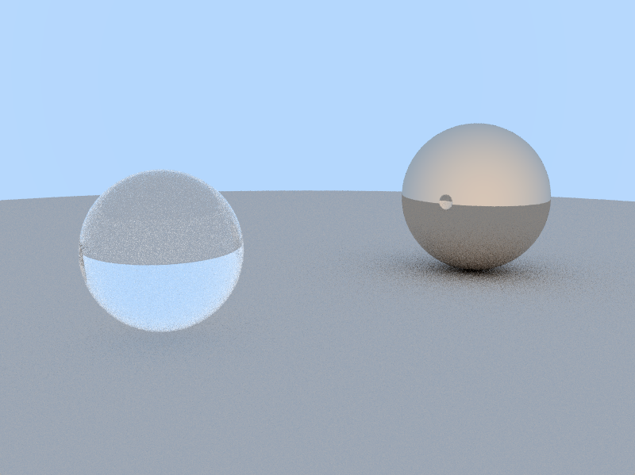
Earlier Image Examples: 1

Slide 7
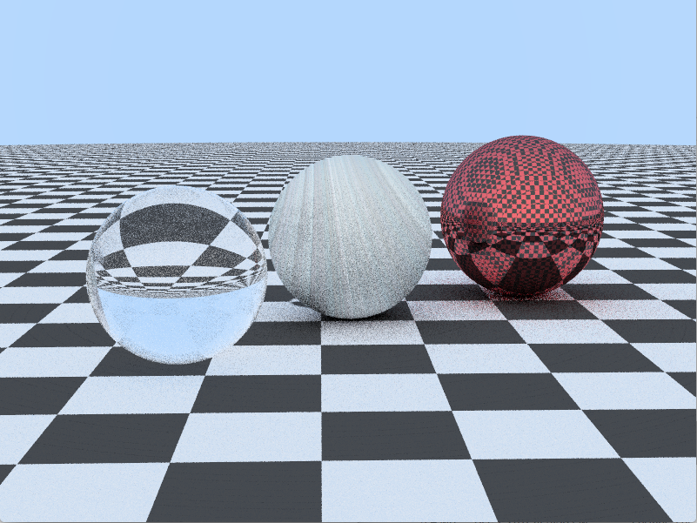
Earlier Image Examples: 2

Slide 8
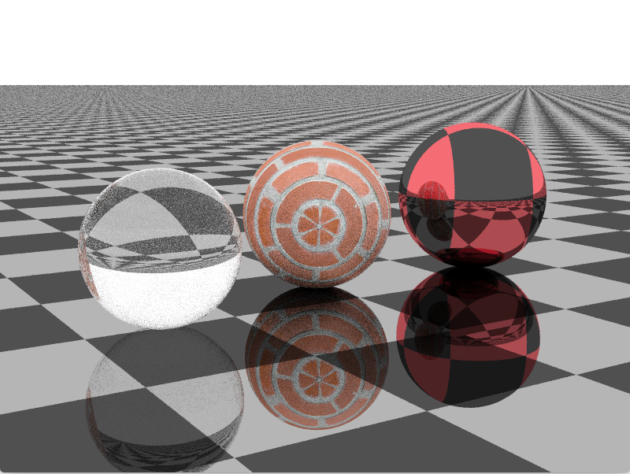
Earlier Image Examples: 3

Slide 9
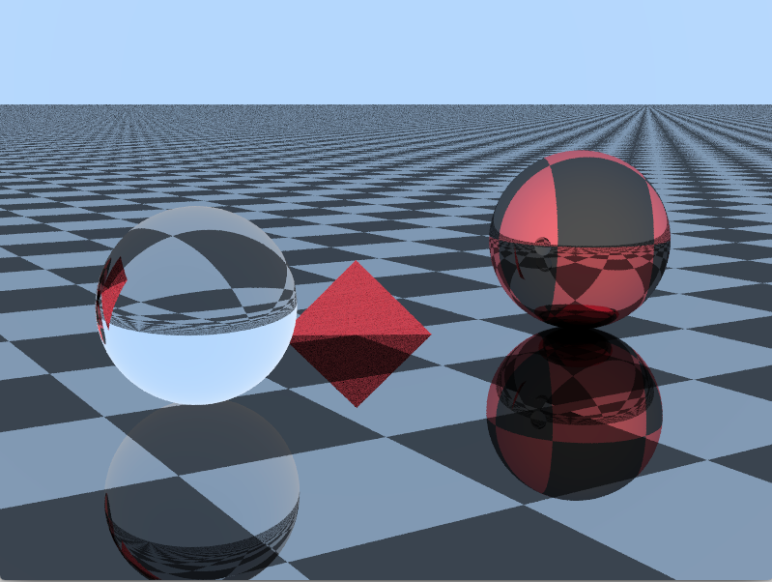
Earlier Image Examples: 4

Slide 10
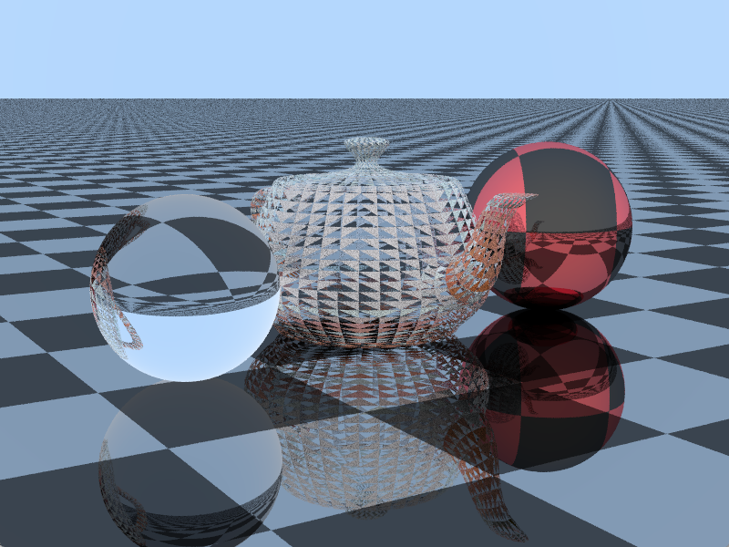
Earlier Image Examples: 5

Slide 11
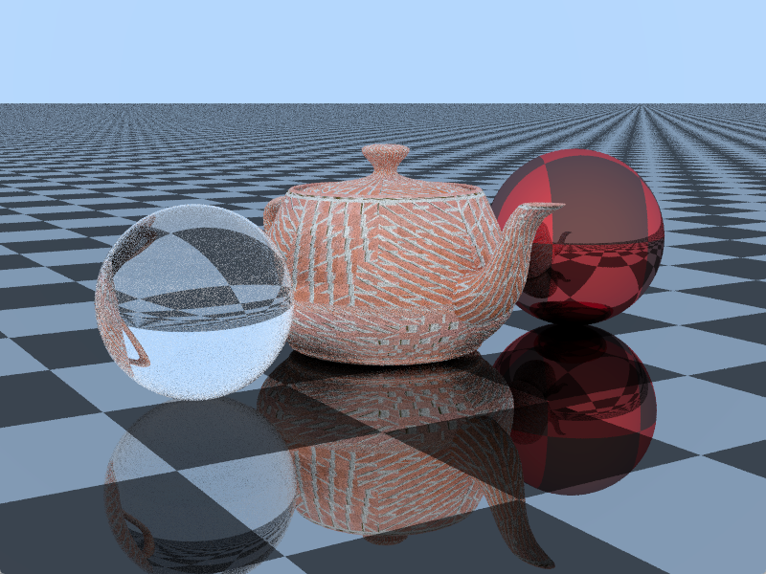
Final Results: 3 hours running time

Slide 12
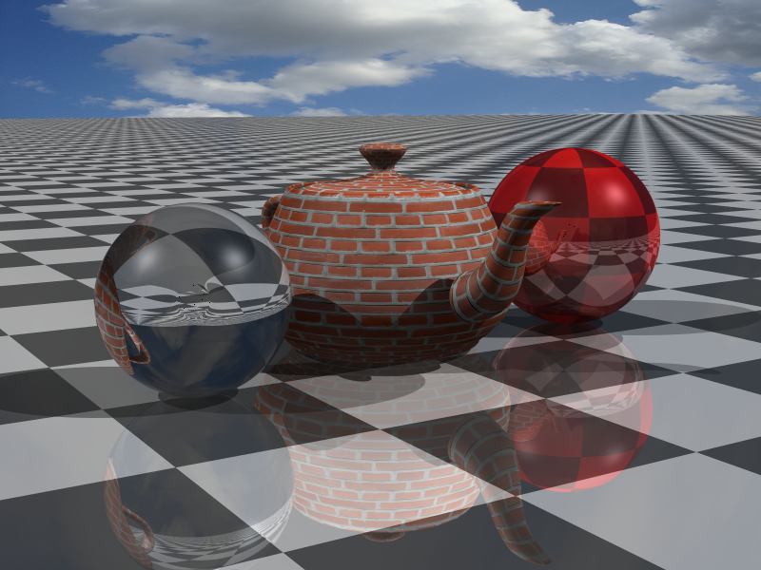
Final Results Comparison

Slide 13
Thank you

