Slide 1
Bayesian modelling of hurricane trajectories
Sitong Cui
Zongchao Liu
Yuanzhi Yu
Mengyu Zhang

Slide 2
Objectives
Predict hurricane based on its year-day, calendar year and the type

Slide 3

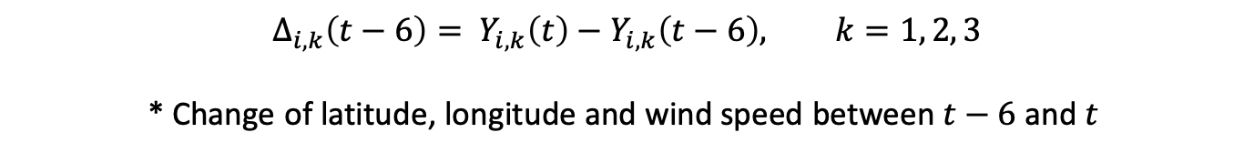
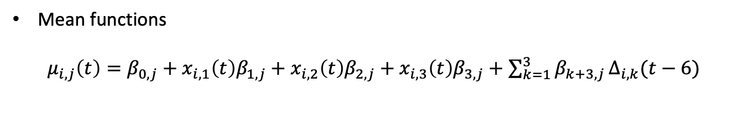
Statistical method
Bayesian model (simplified)
$$Y_{i,j}\left(t+6\right)=μ_{i,j}\left(t\right)+ρ_{j}Y_{i,j}\left(t\right)+ε_{i,j}(t)$$
Latitude, longitude, wind speed
Mean functions
$μ_{i,j}\left(t\right)=β_{0,j}+x_{i, 1}\left(t\right)β_{1,j}+$ $x_{i, 2}\left(t\right)β_{2,j}+x_{i, 3}\left(t\right)β_{3,j}+$ ${\sum_{k=1}^{3}{β_{k+3,j}}Δ}_{i,k}(t−6)$
Year-day
Year
Type
$$Δ_{i,k}\left(t−6\right)= Y_{i,k}\left(t\right)−Y_{i,k}\left(t−6\right), k=1, 2, 3$$
* Change of latitude, longitude and wind speed between $t−6$ and $t$

Slide 4
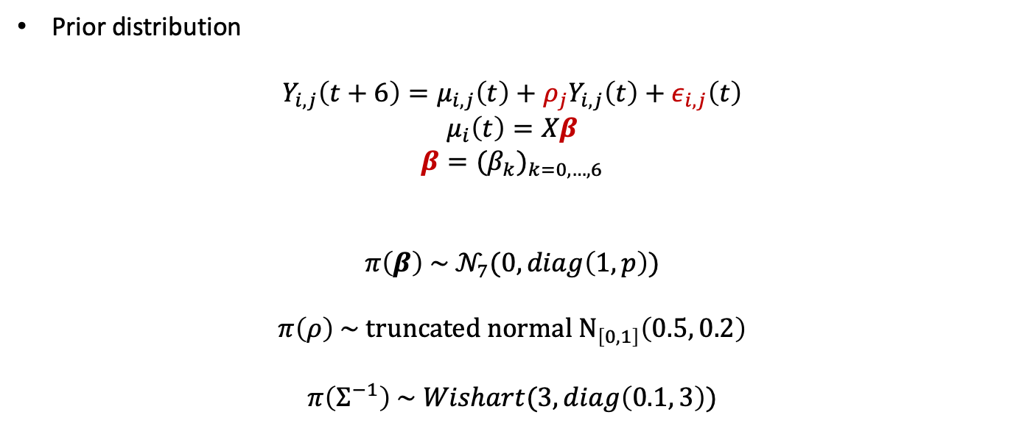
Statistical method
Prior distribution
$$Y_{i,j}\left(t+6\right)=μ_{i,j}\left(t\right)+ρ_{j}Y_{i,j}\left(t\right)+ε_{i,j}\left(t\right)$$
$$μ_{i}\left(t\right)=Xβ$$
$$β={{(β}_{k})}_{k=0,…,6}$$
$$π\left(β\right) \sim 𝒩_{7}(0, diag\left(1, p\right))$$
$$π\left(ρ\right) \sim truncated normal N_{\left[0, 1\right]}\left(0.5, 0.2\right)$$
$$π\left(Σ^{−1}\right) \sim Wishart(3, diag\left(0.1, 3\right))$$
Notes:
Invgamma(shape = 0.001, scale = 0.001, scale = 1/ rate)

Slide 5
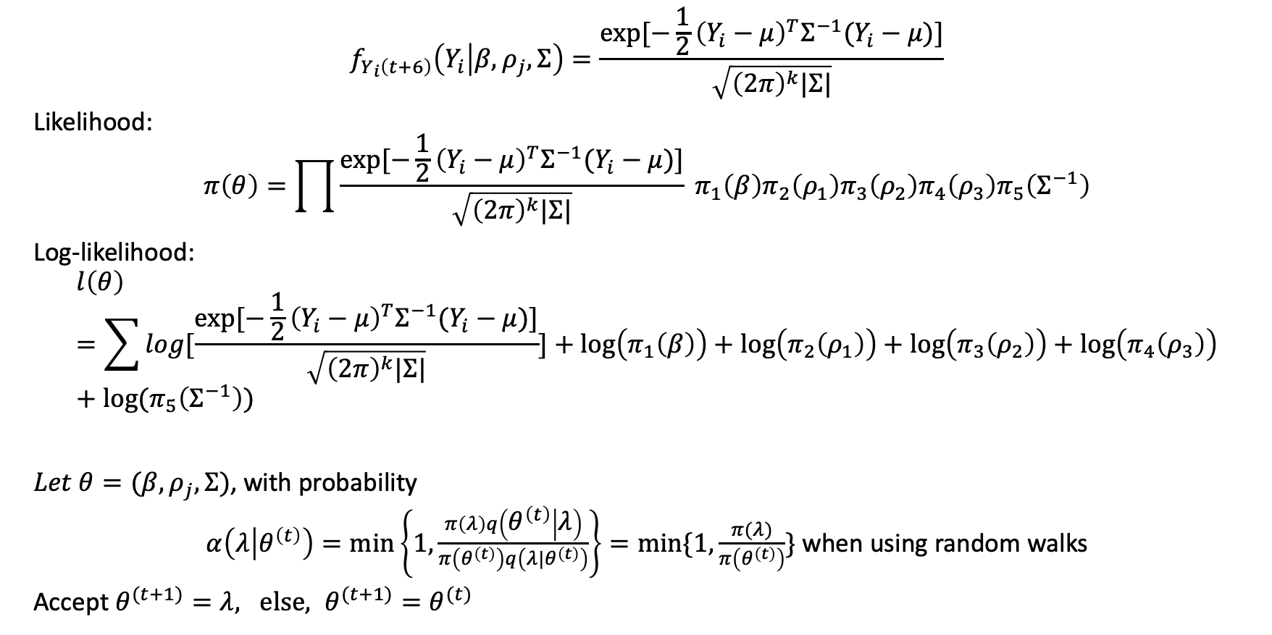
Statistical method
$$f_{Y_{i}\left(t+6\right)}\left(Y_{i} | β, ρ_{j},Σ\right)=\frac{exp⁡[−\frac{1}{2}{\left(Y_{i}−μ\right)}^{T}Σ^{−1}(Y_{i}−μ)]}{\sqrt{{\left(2π\right)}^{k}|Σ|}}$$
Likelihood:
$$π\left(θ\right)=\prod{\frac{exp⁡[−\frac{1}{2}{\left(Y_{i}−μ\right)}^{T}Σ^{−1}(Y_{i}−μ)]}{\sqrt{{\left(2π\right)}^{k}|Σ|}}} π_{1}\left(β\right){π_{2}\left(ρ_{1}\right)π_{3}\left(ρ_{2}\right)π_{4}\left(ρ_{3}\right)π}_{5}\left(Σ^{−1}\right)$$
Log-likelihood:
$$l\left(θ\right)=\sum{log[\frac{exp⁡[−\frac{1}{2}{\left(Y_{i}−μ\right)}^{T}Σ^{−1}(Y_{i}−μ)]}{\sqrt{{\left(2π\right)}^{k}|Σ|}}]}+log\left(π_{1}\left(β\right)\right)+log\left(π_{2}\left(ρ_{1}\right)\right)+log\left(π_{3}\left(ρ_{2}\right)\right)+log\left(π_{4}\left(ρ_{3}\right)\right)+log(π_{5}\left(Σ^{−1}\right))$$
$Let θ=(β, ρ_{j}, Σ)$, with probability
$α\left(λ | θ^{\left(t\right)}\right)=\min\left\{1, \frac{π\left(λ\right)q\left(θ^{\left(t\right)} | λ\right)}{π\left(θ^{\left(t\right)}\right)q\left({λ|θ}^{\left(t\right)}\right)}\right\}=min⁡\{1, \frac{π(λ)}{π\left(θ^{\left(t\right)}\right)}\}$ when using random walks
Accept $θ^{(t+1)}=λ, else, θ^{(t+1)}=θ^{(t)}$

Slide 6
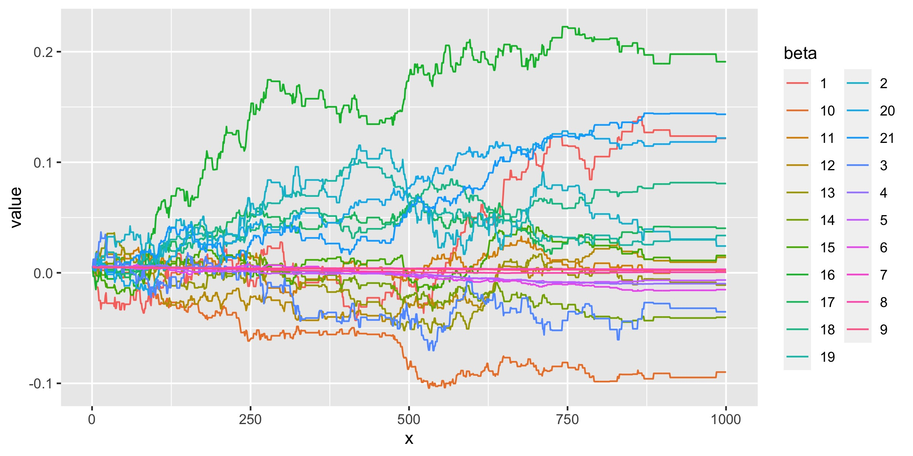
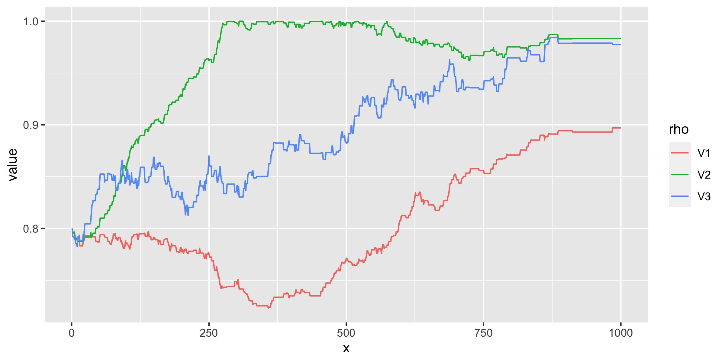
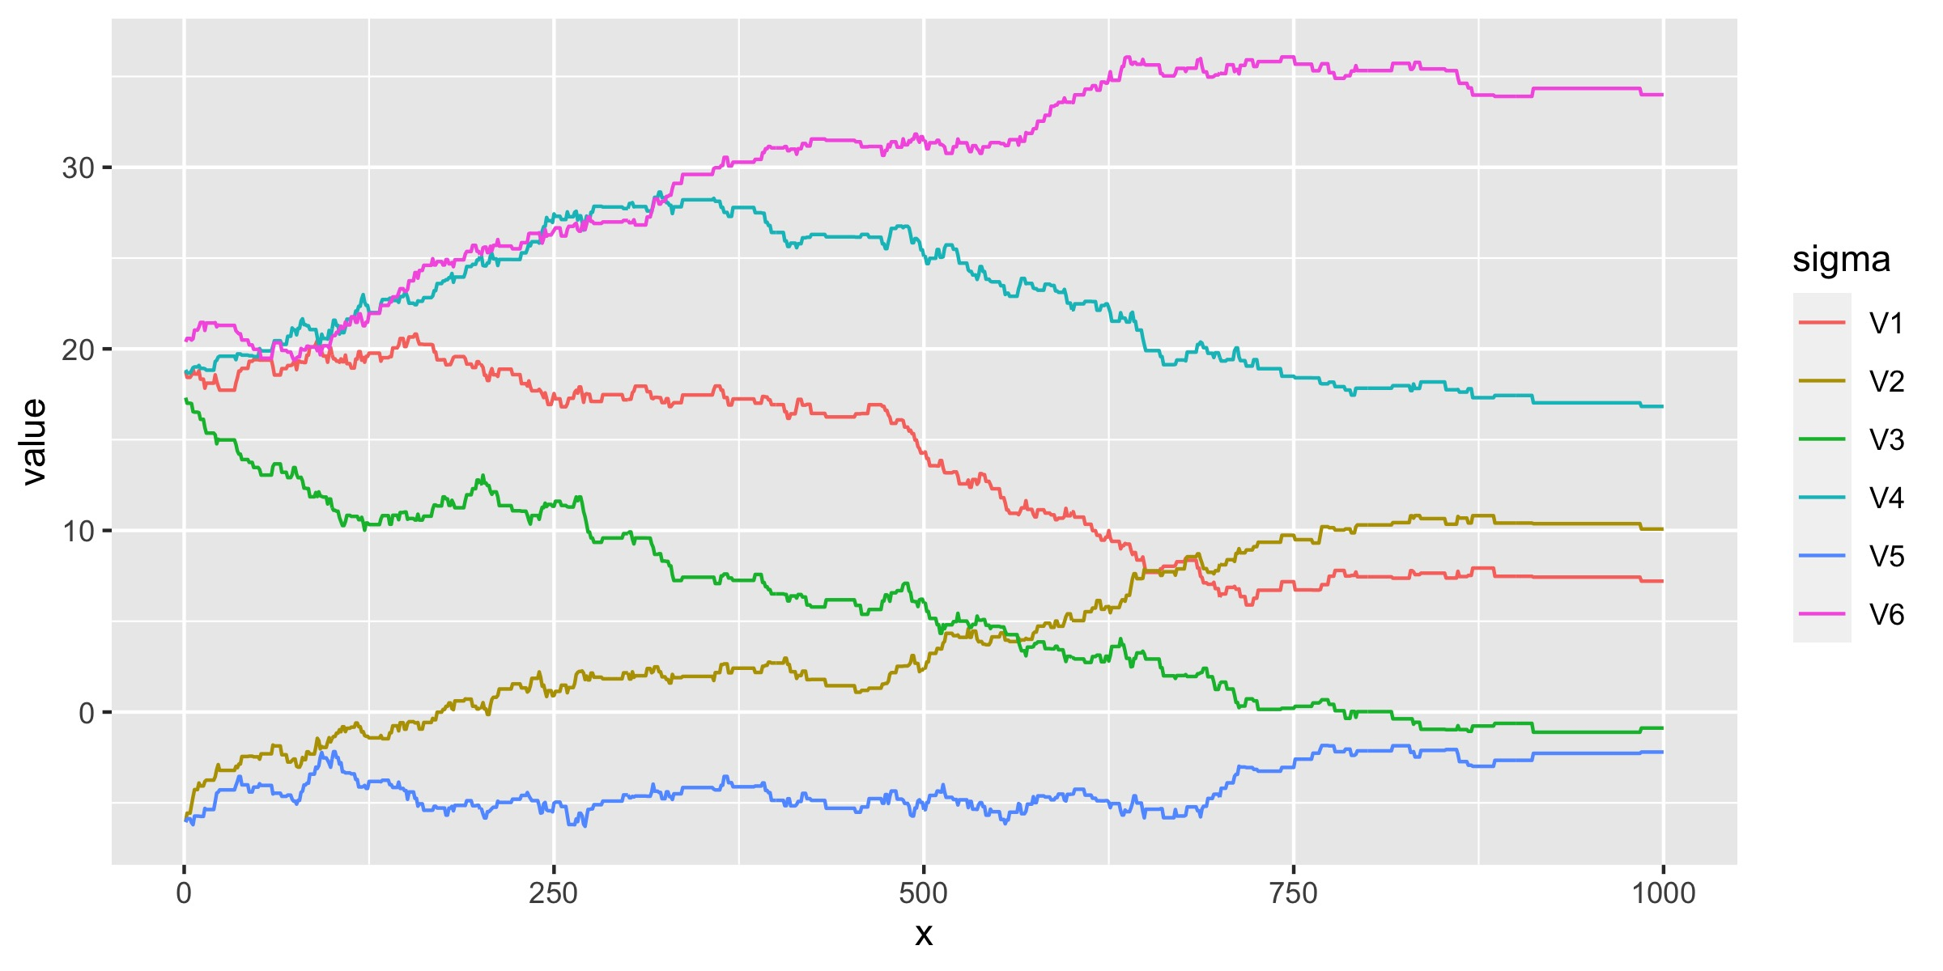
Results
i = 875, all parameters converge.
Accept rate is 0.287.

Slide 7
Results
estimates of ρ (the effect of previous value)
 | Latitude | Longitude | Speed
hat_rho | 0.8937 | 0.9836 | 0.9791
2.5% | 0.8911 | 0.9830 | 0.9774
97.5% | 0.8970 | 0.9871 | 0.9842
estimates of σ
 | 1 | 2 | 3 | 4 | 5 | 6
hat_sigma | 7.4551 | 10.3815 | -0.9514 | 17.1120 | -2.4063 | 34.1761
2.5% | 7.2092 | 10.0787 | -1.1111 | 16.8307 | -2.9886 | 33.9040
97.5% | 7.9295 | 10.8143 | -0.6238 | 17.4344 | -2.2021 | 34.3421

Slide 8
Results
estimates of β
Latitude | Intercept | Beta1 (DOY) | Beta2 (year) | Beta3 (type) | change of latitude | change of longitude | change of speed
hat_beta | 0.1248 | 0.0319 | -0.0311 | -0.0098 | -0.0069 | -0.0158 | 0.0031
2.5% | 0.1215 | 0.0242 | -0.0353 | -0.0100 | -0.0070 | -0.0161 | 0.0031
97.5% | 0.1291 | 0.0395 | -0.0269 | -0.0098 | -0.0065 | -0.0152 | 0.0032
Longitude
hat_beta | 0.0004 | 0.0023 | -0.0934 | 0.0016 | 0.0107 | -0.0081 | -0.0408
2.5% | 0.0004 | 0.0023 | -0.0959 | -0.0004 | 0.0096 | -0.0111 | -0.0432
97.5% | 0.0005 | 0.0023 | -0.0898 | 0.0025 | 0.0140 | -0.0056 | -0.0400
Speed
hat_beta | 0.0124 | 0.1951 | 0.0409 | 0.0808 | 0.0297 | 0.1181 | 0.1440
2.5% | 0.0112 | 0.1892 | 0.0372 | 0.0765 | 0.0254 | 0.1147 | 0.1434
97.5% | 0.0156 | 0.1978 | 0.0418 | 0.0816 | 0.0337 | 0.1219 | 0.1443
ET: Extra Tropical DS: Disturbance
SS: Sub Tropical TS: Tropical Storm
Levels: DS ET SS TS (1-4)

Slide 9
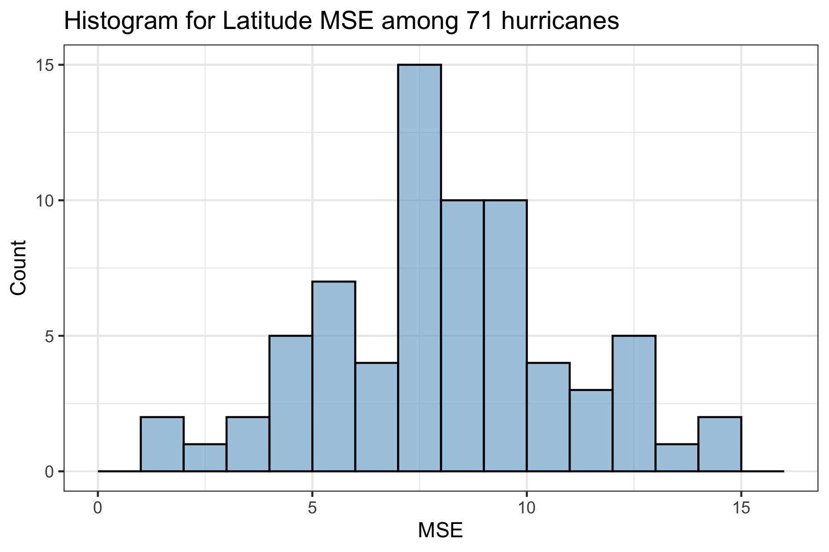
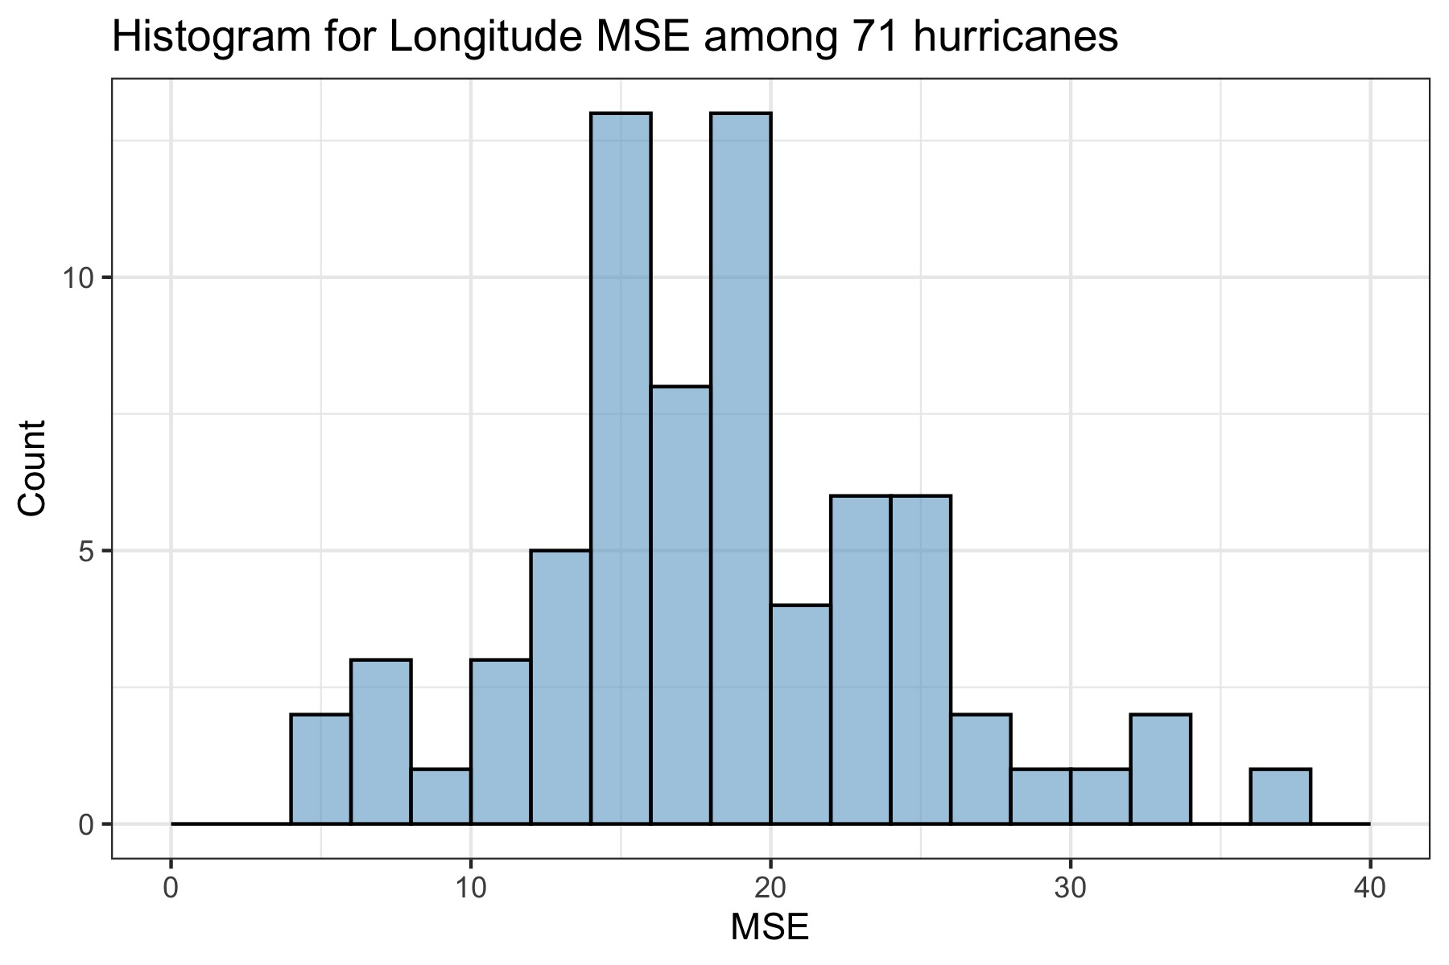
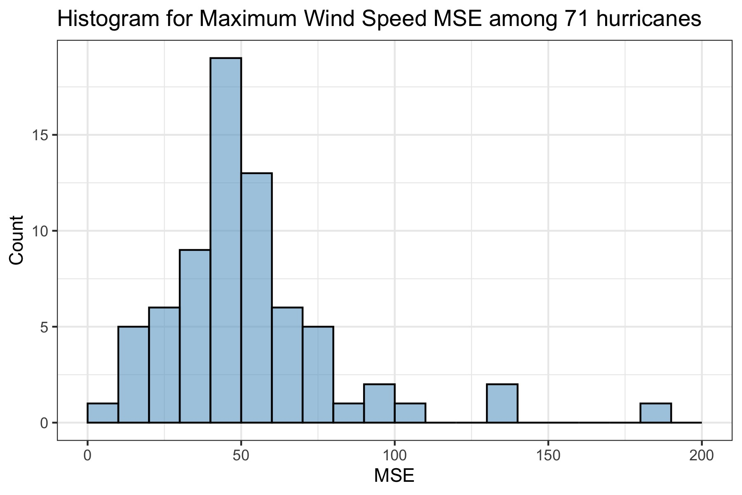
Results
Performance of prediction is not very well especially for speed prediction.

Slide 10
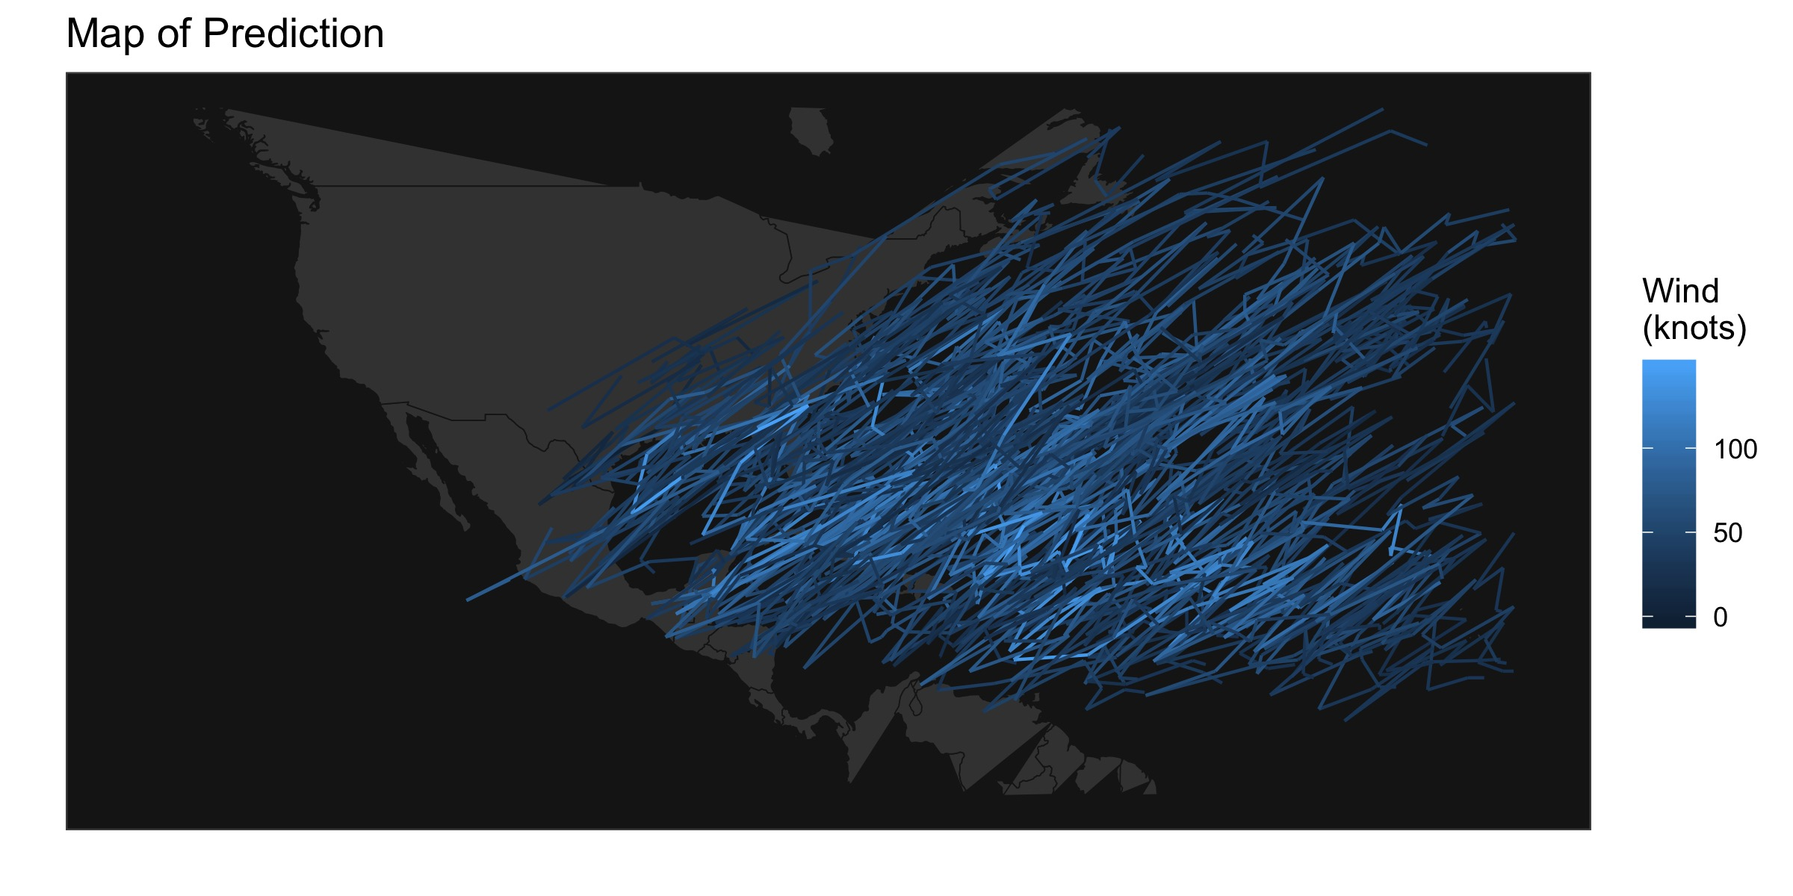
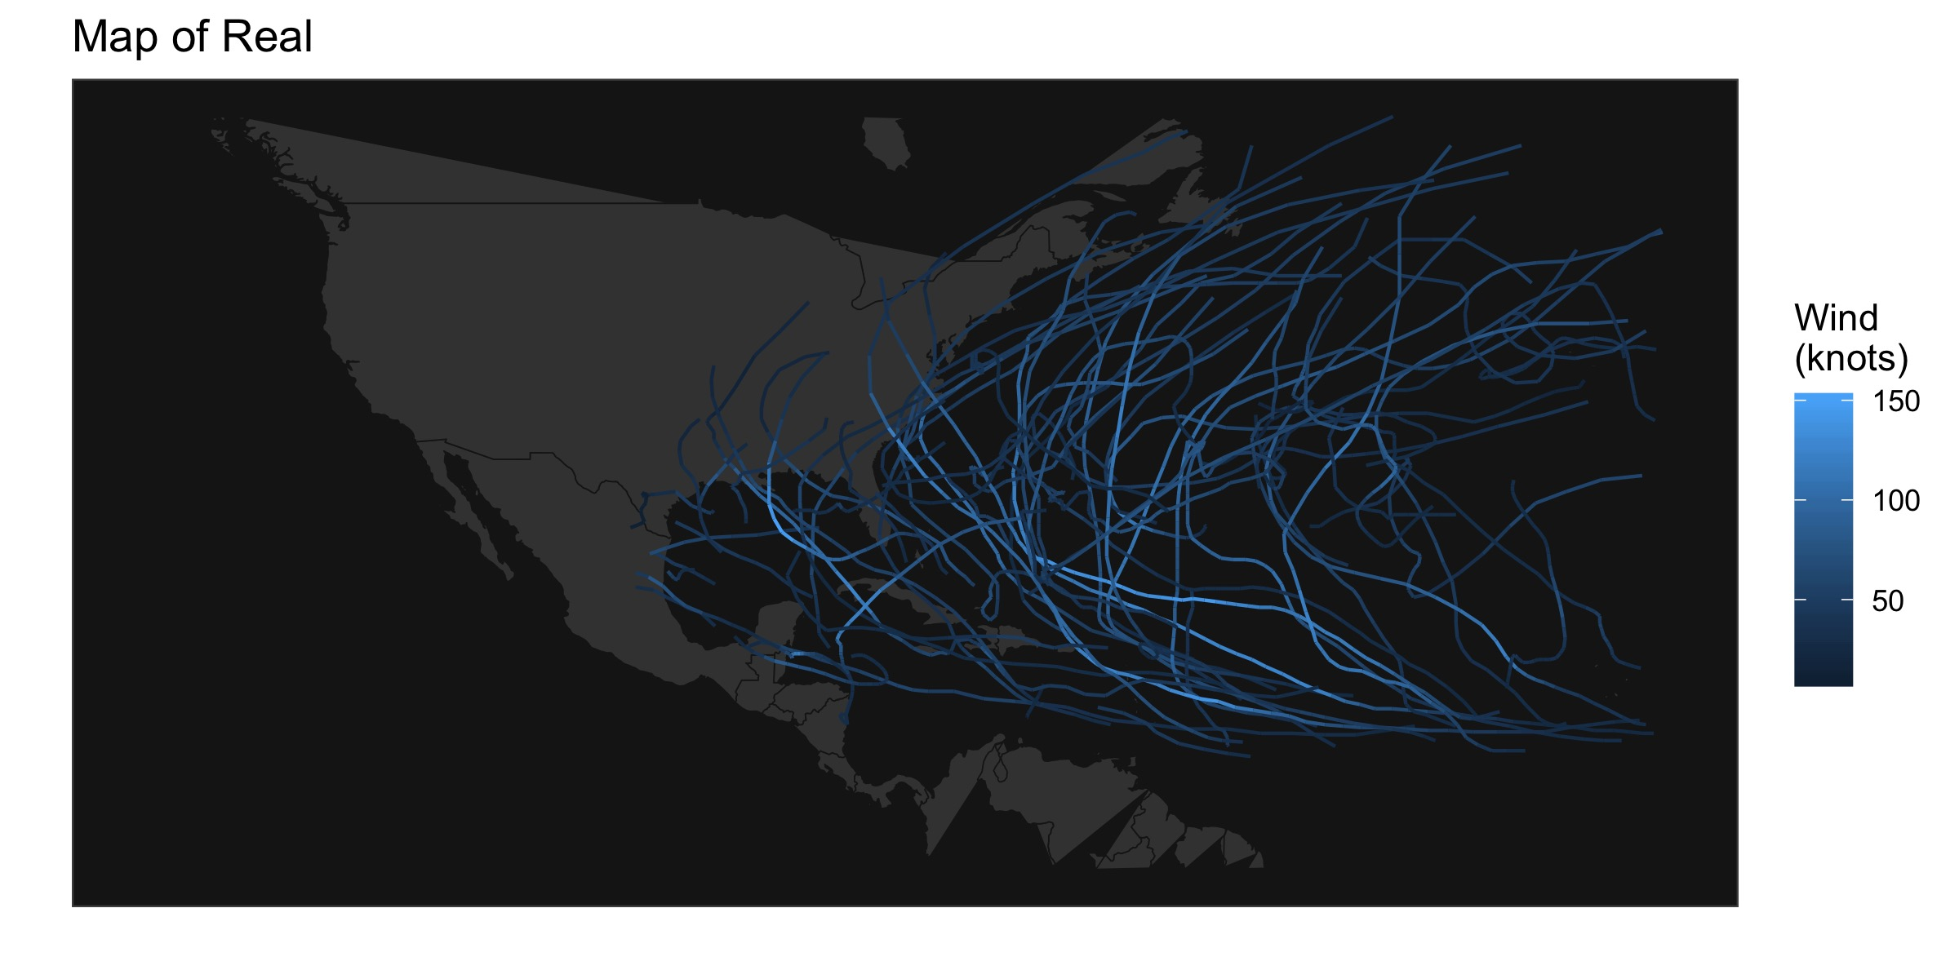
Results

Slide 11
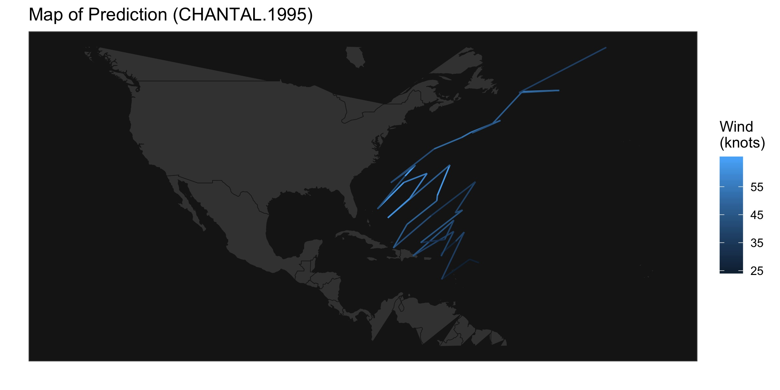
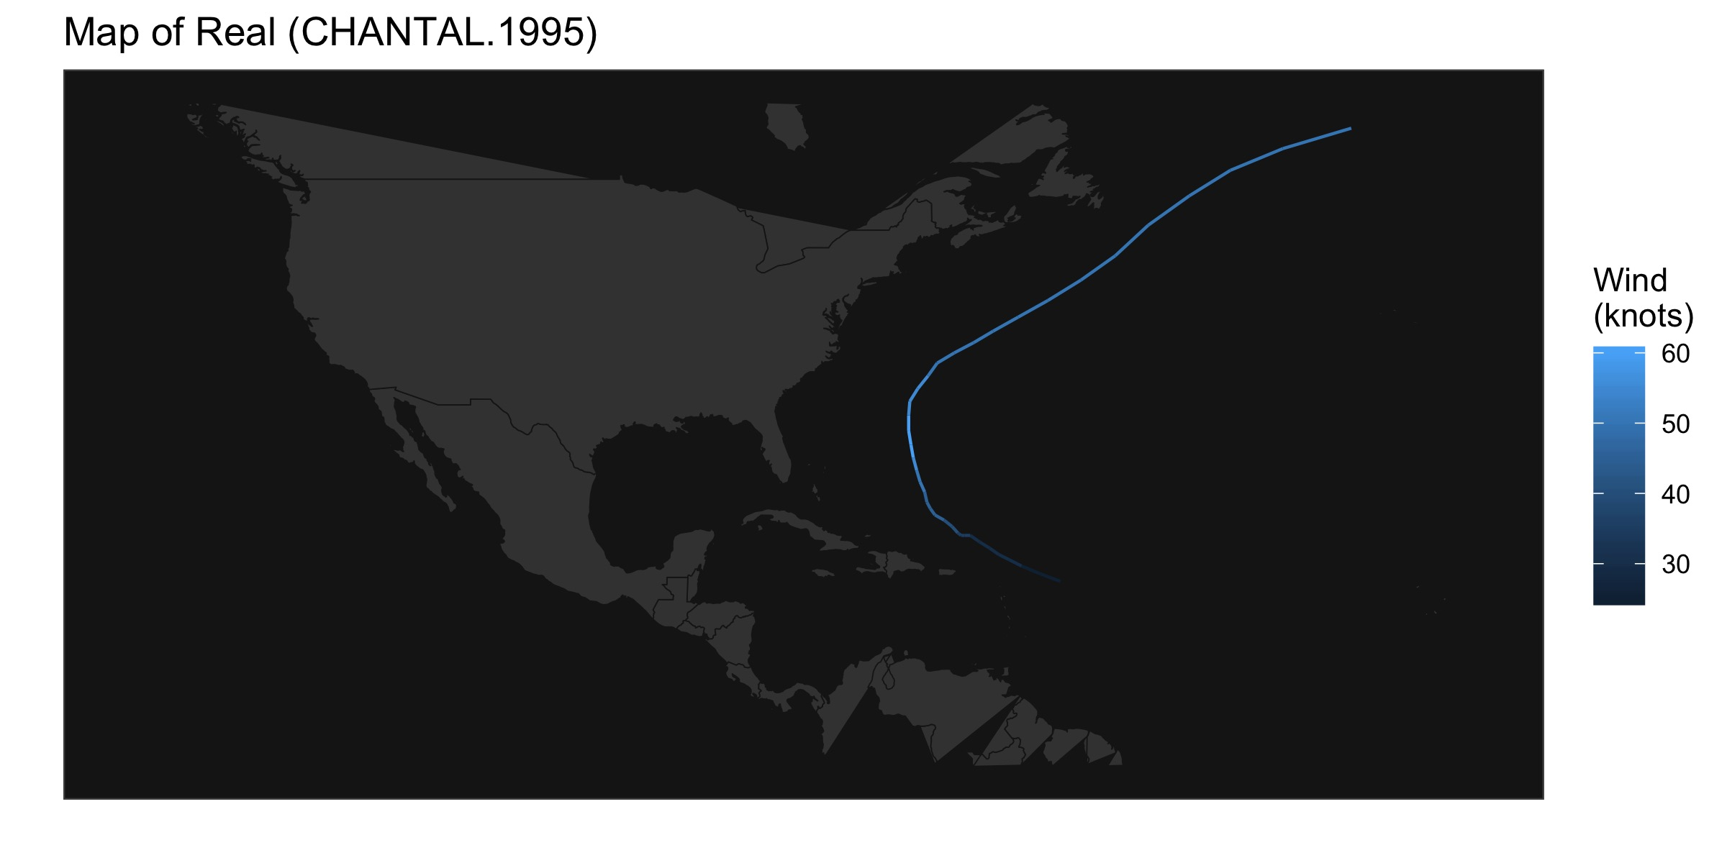
Discussion
How well did the full model perform?
Why did we run only 1000 iters?
Why is the predicted plot so different from the original plot?
What can we do to improve the results?
1. Try the component MH algorithm
2. Try the simplified model
3. Check the values of the parameters
4. More iterations
5. “Not Rated” wind type

Slide 12
Q & A

