Slide 1
Bayesian modelling of hurricane trajectories
Sitong Cui
Zongchao Liu
Yuanzhi Yu
Mengyu Zhang

Slide 2
Objectives
Predict hurricane based on its year-day, calendar year and the type

Slide 3


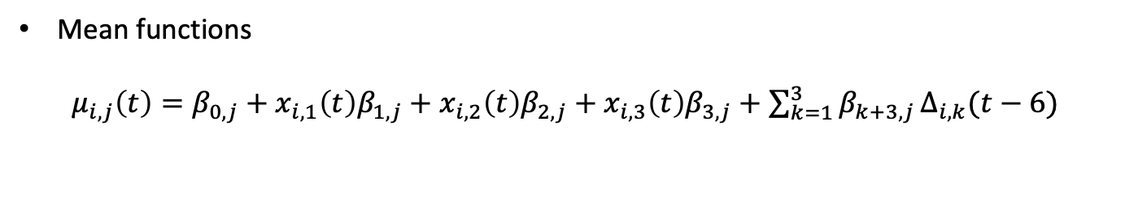
Statistical method
Bayesian model (simplified)
$$Y_{i,j}\left(t+6\right)=μ_{i,j}\left(t\right)+ρ_{j}Y_{i,j}\left(t\right)+ε_{i,j}(t)$$
Latitude, longitude, wind speed
Mean functions
$μ_{i,j}\left(t\right)=β_{0,j}+x_{i, 1}\left(t\right)β_{1,j}+$ $x_{i, 2}\left(t\right)β_{2,j}+x_{i, 3}\left(t\right)β_{3,j}+$ ${\sum_{k=1}^{3}{β_{k+3,j}}Δ}_{i,k}(t−6)$
Year-day
Year
Type
$$Δ_{i,k}\left(t−6\right)= Y_{i,k}\left(t\right)−Y_{i,k}\left(t−6\right), k=1, 2, 3$$
* Change of latitude, longitude and wind speed between $t−6$ and $t$

Slide 4
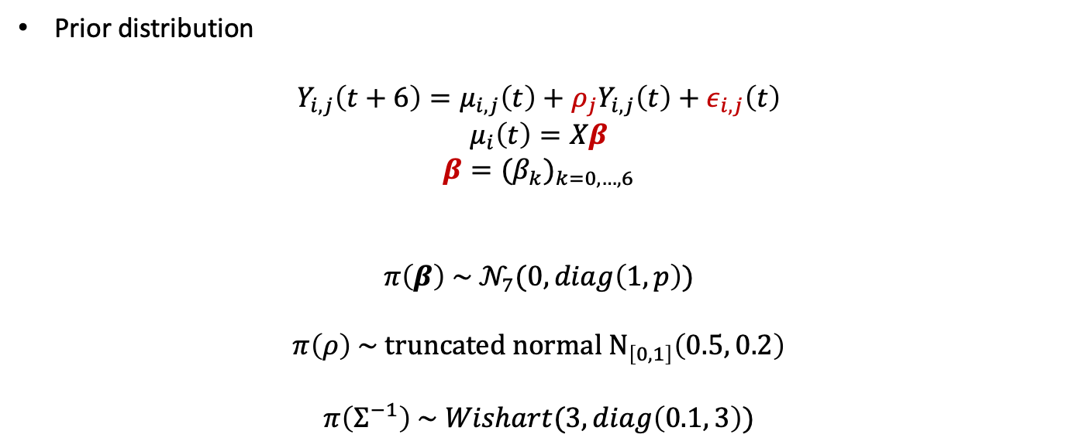
Statistical method
Prior distribution
$$Y_{i,j}\left(t+6\right)=μ_{i,j}\left(t\right)+ρ_{j}Y_{i,j}\left(t\right)+ε_{i,j}\left(t\right)$$
$$μ_{i}\left(t\right)=Xβ$$
$$β={{(β}_{k})}_{k=0,…,6}$$
$$π\left(β\right) \sim 𝒩_{7}(0, diag\left(1, p\right))$$
$$π\left(ρ\right) \sim truncated normal N_{\left[0, 1\right]}\left(0.5, 0.2\right)$$
$$π\left(Σ^{−1}\right) \sim Wishart(3, diag\left(0.1, 3\right))$$
Notes:
Invgamma(shape = 0.001, scale = 0.001, scale = 1/ rate)

Slide 5
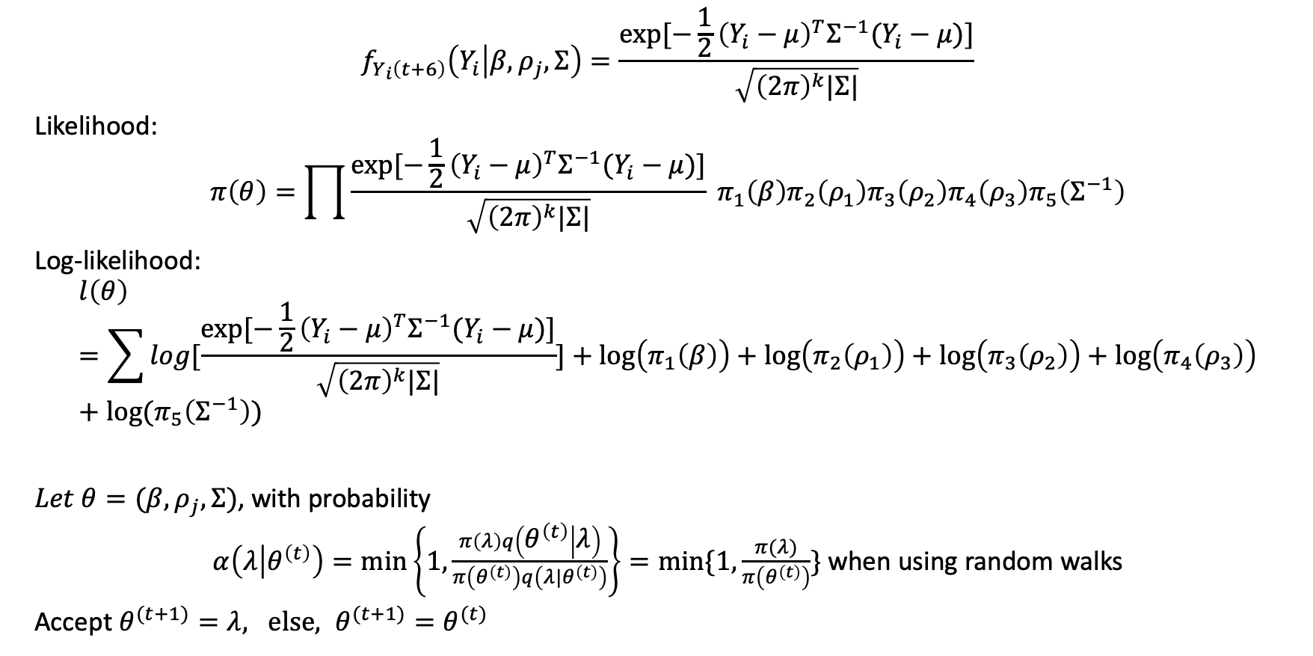
Statistical method
$$f_{Y_{i}\left(t+6\right)}\left(Y_{i} | β, ρ_{j},Σ\right)=\frac{exp⁡[−\frac{1}{2}{\left(Y_{i}−μ\right)}^{T}Σ^{−1}(Y_{i}−μ)]}{\sqrt{{\left(2π\right)}^{k}|Σ|}}$$
Likelihood:
$$π\left(θ\right)=\prod{\frac{exp⁡[−\frac{1}{2}{\left(Y_{i}−μ\right)}^{T}Σ^{−1}(Y_{i}−μ)]}{\sqrt{{\left(2π\right)}^{k}|Σ|}}} π_{1}\left(β\right){π_{2}\left(ρ_{1}\right)π_{3}\left(ρ_{2}\right)π_{4}\left(ρ_{3}\right)π}_{5}\left(Σ^{−1}\right)$$
Log-likelihood:
$$l\left(θ\right)=\sum{log[\frac{exp⁡[−\frac{1}{2}{\left(Y_{i}−μ\right)}^{T}Σ^{−1}(Y_{i}−μ)]}{\sqrt{{\left(2π\right)}^{k}|Σ|}}]}+log\left(π_{1}\left(β\right)\right)+log\left(π_{2}\left(ρ_{1}\right)\right)+log\left(π_{3}\left(ρ_{2}\right)\right)+log\left(π_{4}\left(ρ_{3}\right)\right)+log(π_{5}\left(Σ^{−1}\right))$$
$Let θ=(β, ρ_{j}, Σ)$, with probability
$α\left(λ | θ^{\left(t\right)}\right)=\min\left\{1, \frac{π\left(λ\right)q\left(θ^{\left(t\right)} | λ\right)}{π\left(θ^{\left(t\right)}\right)q\left({λ|θ}^{\left(t\right)}\right)}\right\}=min⁡\{1, \frac{π(λ)}{π\left(θ^{\left(t\right)}\right)}\}$ when using random walks
Accept $θ^{(t+1)}=λ, else, θ^{(t+1)}=θ^{(t)}$

Slide 6
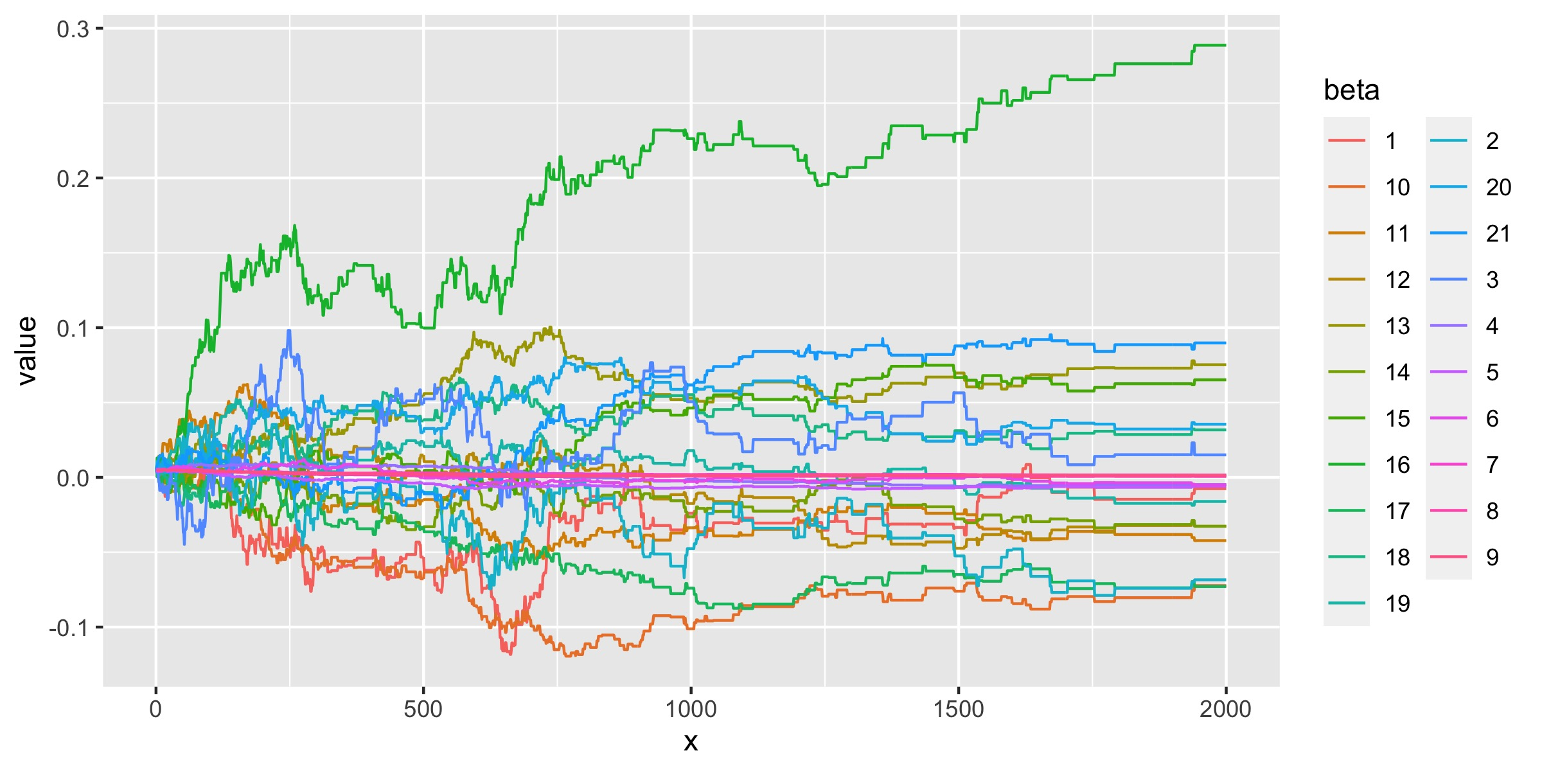
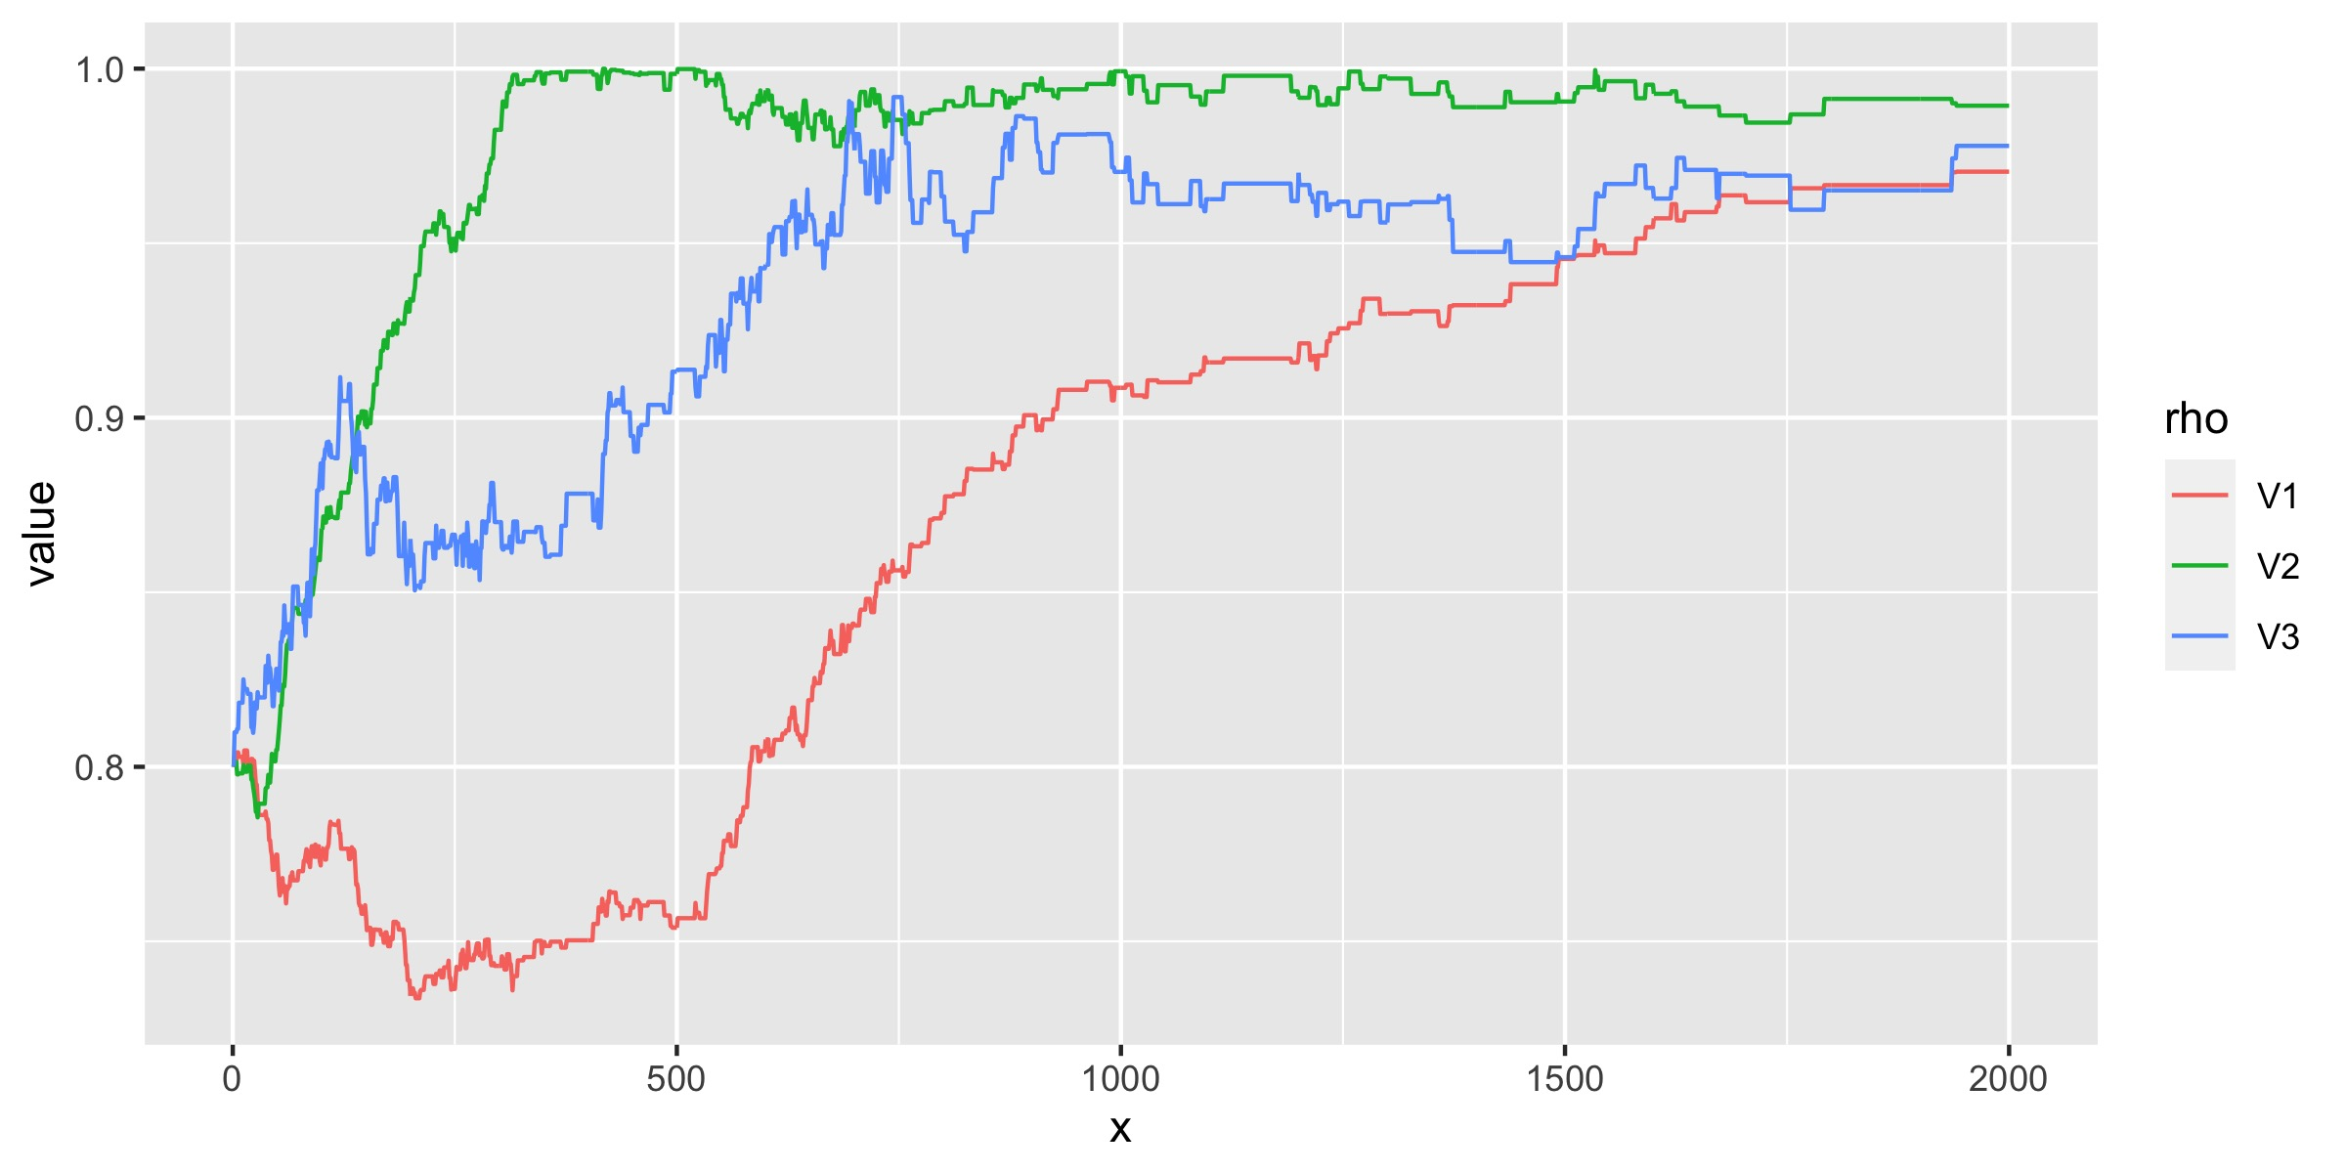
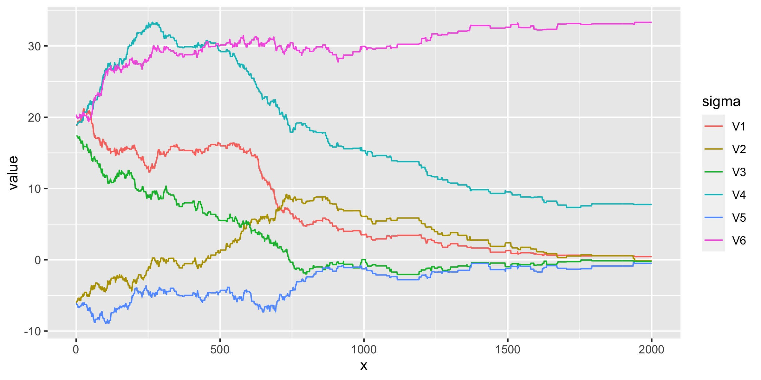
Results
i = 1500, almost every parameters converge.
Accept rate is 0.1845.
First 1000 iterations: 0.314.

Slide 7
Results
estimates of ρ (the effect of previous value)
 | Latitude | Longitude | Speed
hat_rho | 0.9614943 | 0.9903406 | 0.9668154
2.5% | 0.9464416 | 0.9845419 | 0.9490907
97.5% | 0.9704868 | 0.9964050 | 0.9778794
estimates of σ
 | 1 | 2 | 3 | 4 | 5 | 6
hat_sigma | 0.6576545 | 0.7579753 | -0.33818305 | 8.059497 | -0.9951816 | 32.92763
2.5% | 0.4477015 | -0.1334950 | -0.76655036 | 7.346311 | -1.7217128 | 32.24200
97.5% | 0.9854668 | 1.8933031 | -0.03957947 | 9.396446 | -0.5057832 | 33.30908

Slide 8
Results
estimates of β
Latitude | Intercept | Beta1 (DOY) | Beta2 (year) | Beta3 (type) | change of latitude | change of longitude | change of speed
hat_beta | -0.0112 | -0.00522 | 0.001605 | -0.07987 | 0.069805 | 0.266253 | -0.01219
2.5% | -0.03343 | -0.00599 | 0.001416 | -0.08801 | 0.059528 | 0.229819 | -0.01734
97.5% | 0.005824 | -0.00483 | 0.001911 | -0.07062 | 0.075242 | 0.288659 | -0.00359
Longitude
hat_beta | -0.06836 | -0.0065 | 0.000695 | -0.03755 | -0.03006 | -0.07 | 0.033202
2.5% | -0.07881 | -0.00725 | 0.000628 | -0.04224 | -0.03374 | -0.07426 | 0.022098
97.5% | -0.04786 | -0.00593 | 0.000874 | -0.02442 | -0.02511 | -0.05893 | 0.038102
Speed
hat_beta | 0.020024 | -0.0029 | 0.001492 | -0.03534 | 0.063296 | 0.028025 | 0.088863
2.5% | 0.008445 | -0.00502 | 0.001444 | -0.04628 | 0.057695 | 0.01909 | 0.08412
97.5% | 0.047308 | 0.000403 | 0.00157 | -0.03211 | 0.06801 | 0.031751 | 0.092058

Slide 9
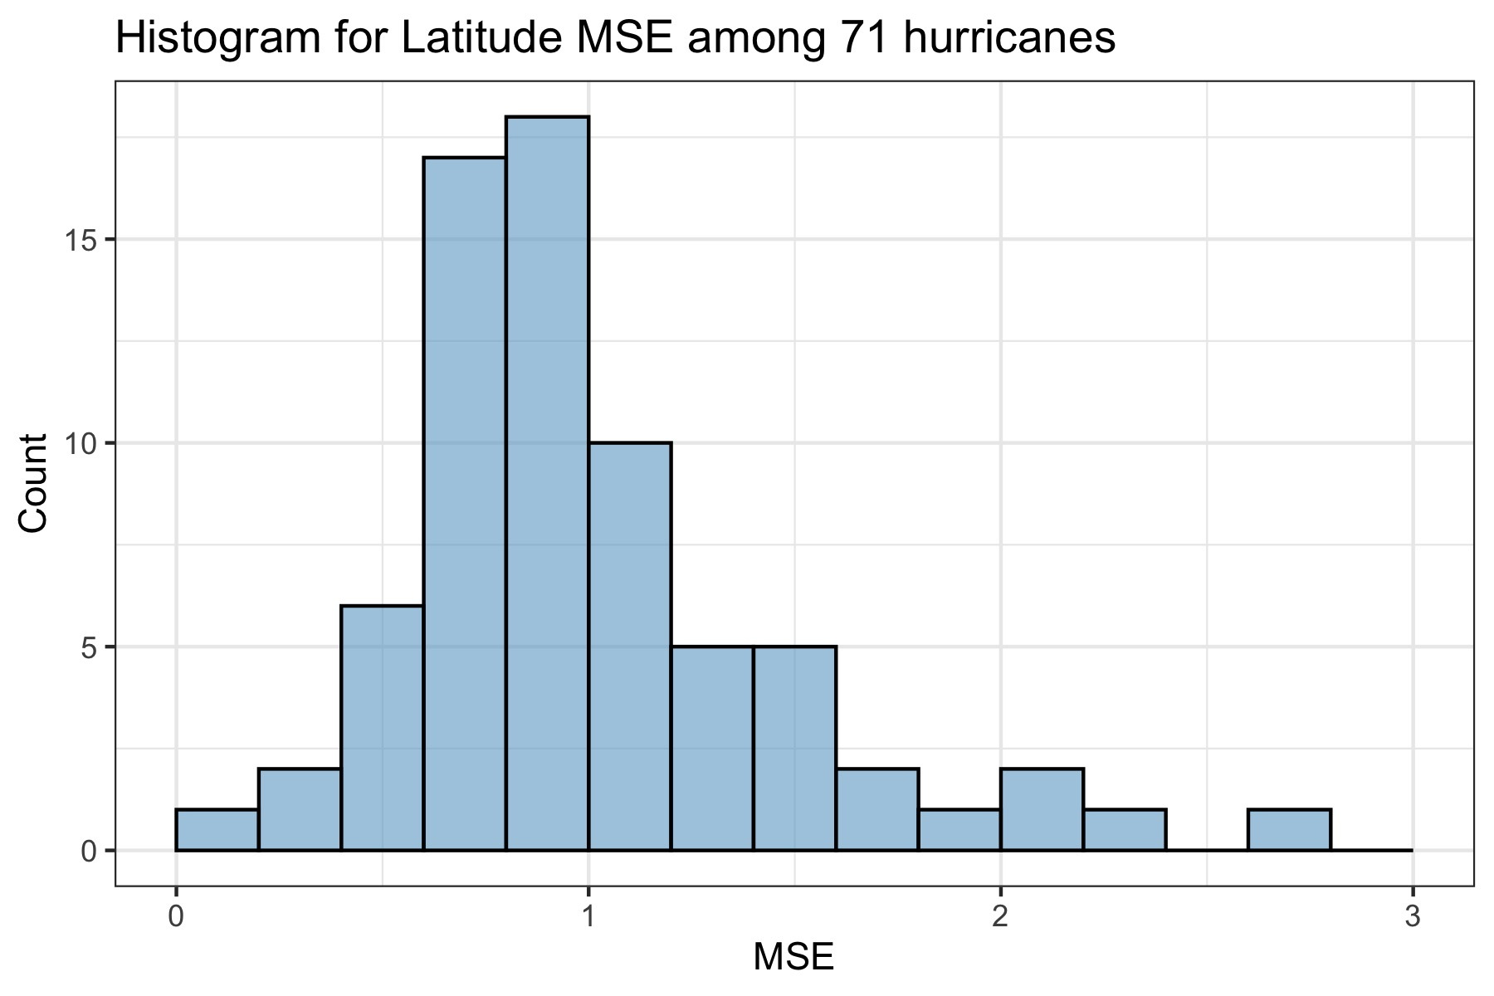
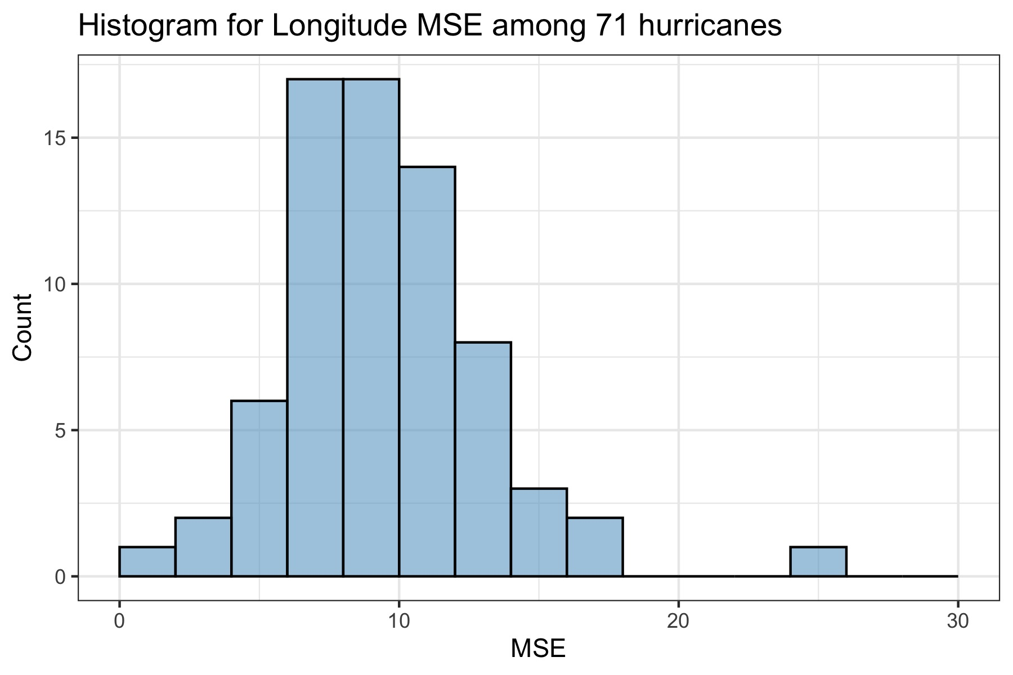
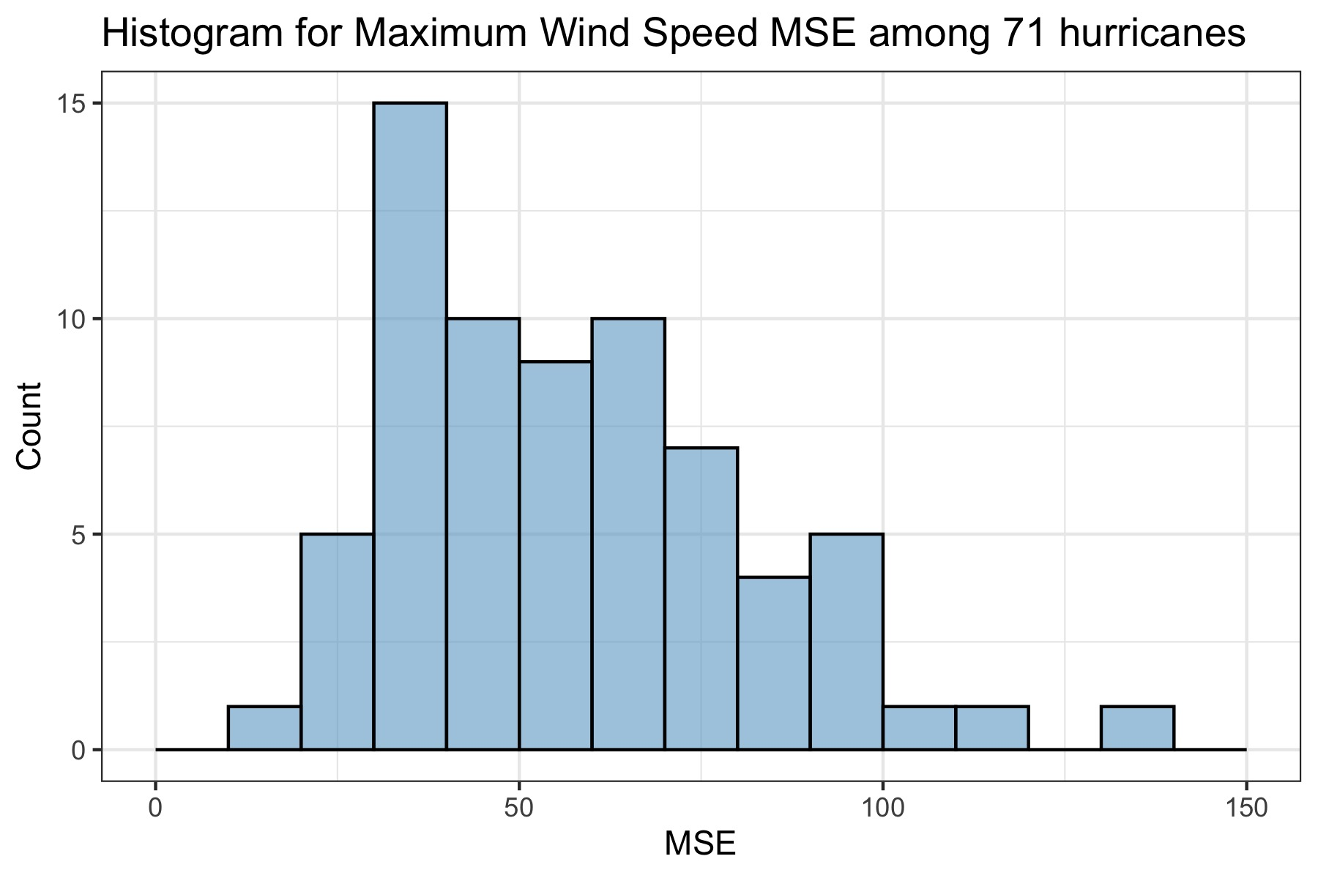
Results
Performance of prediction is not very well especially for speed prediction.

Slide 10
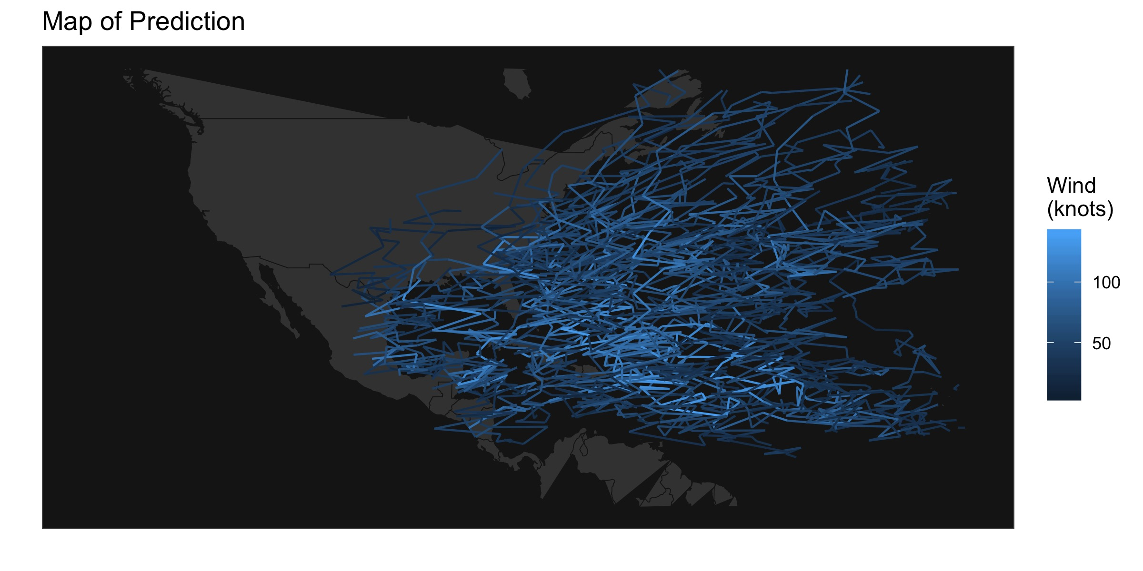
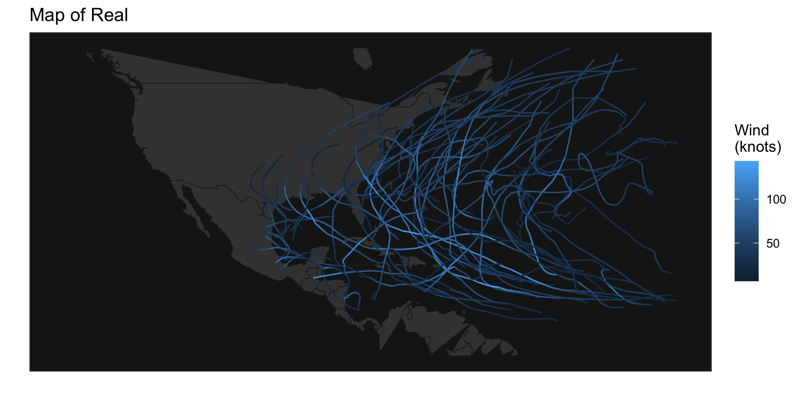
Results

Slide 11
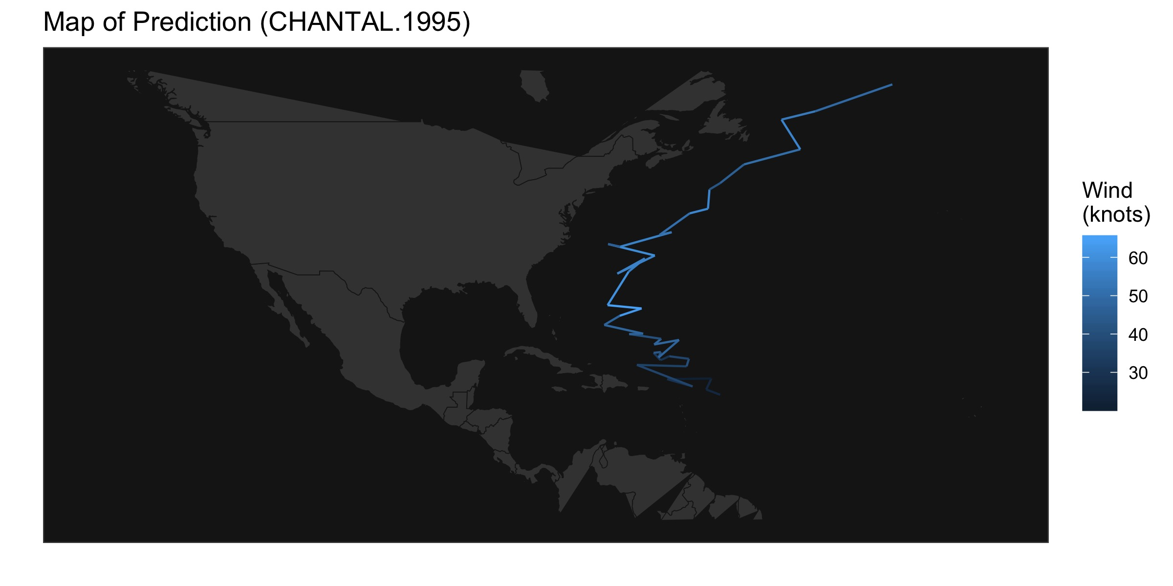
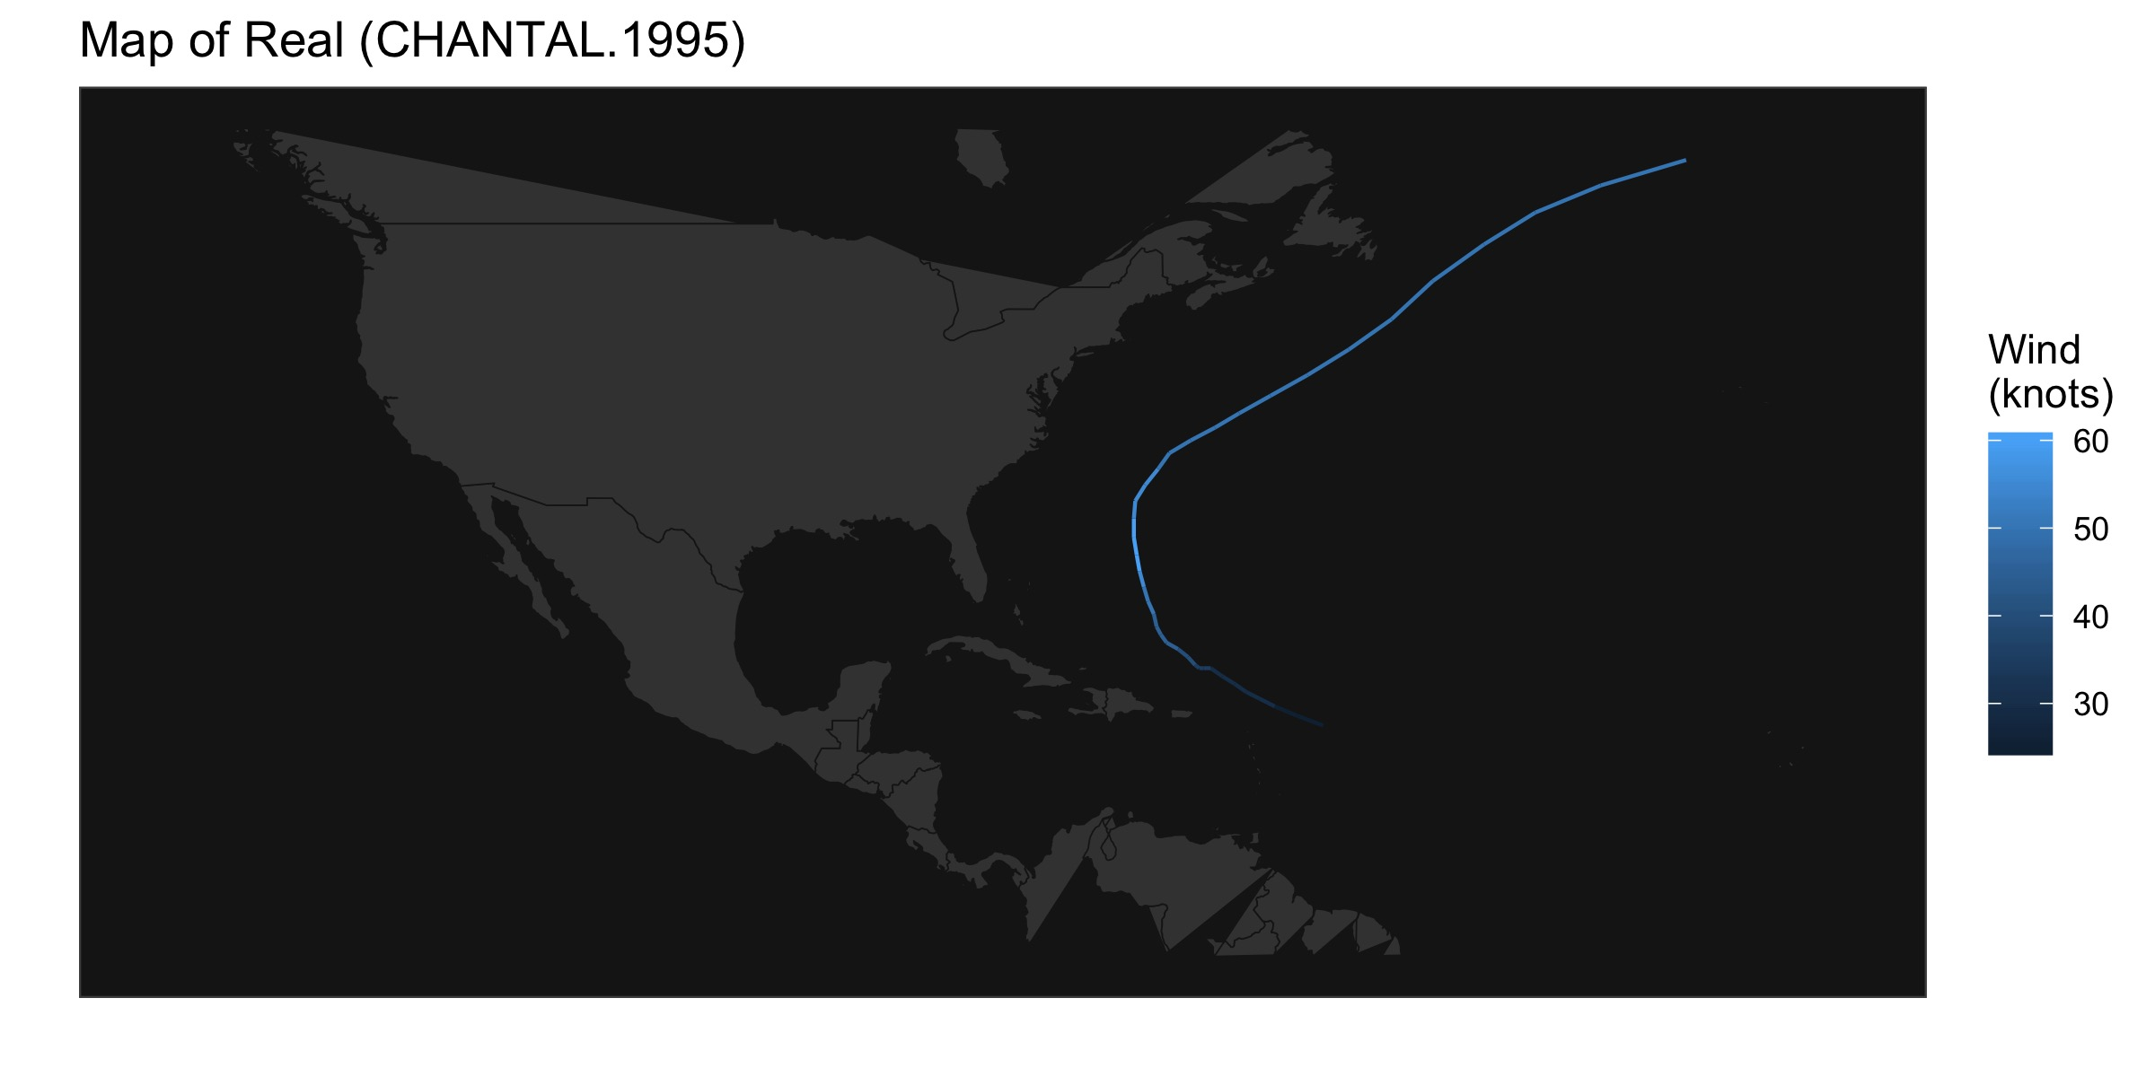
Discussion
How well did the full model perform?
Why is the predicted plot so different from the original plot?
What can we do to improve the results?
1. Try the component MH algorithm
2. Try the simplified model
3. Check the values of the parameters
4. More iterations
5. “Not Rated” wind type

Slide 12
Q & A

