Slide 1
Keras: a tutorial in Deep learning (part III of “Computation in chemistry”)
Mengyuan Zhu
Georgia State University

Slide 2
Deep learning methods
Supervised learning
Classification
Unsupervised learning
Clustering
Reinforcement learning
Atari games, AlphaGo

Slide 3
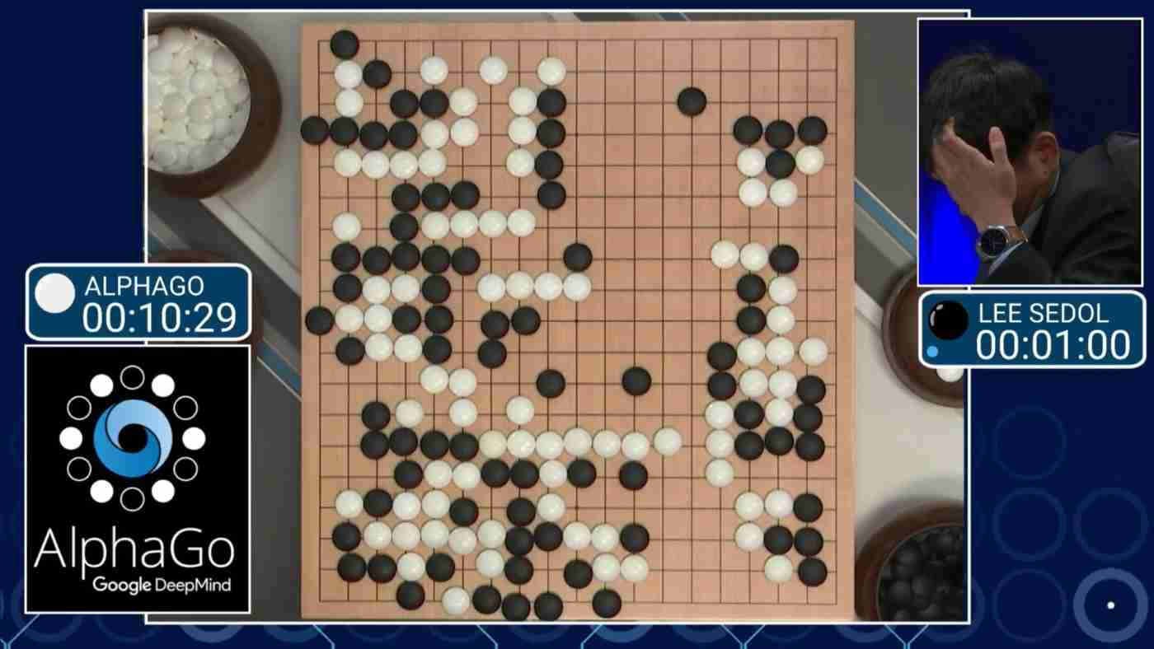
Supervised+reinforcement learning
Go – an ancient board game

Slide 4

Reinforcement learning
Build your own Atari game bot: https://github.com/openai/gym

Slide 5
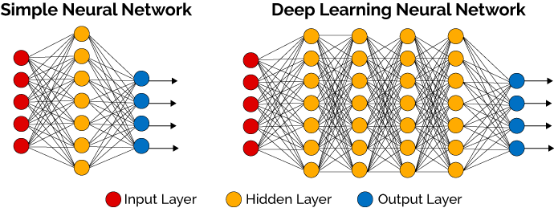
deep learning
sum(wx)+b
w: weight; x: input; b: bias

Slide 6





Deep learning framework
Keras

Slide 7
Hands-on
Download python3 and pip
Windows:
Download https://www.python.org/downloads/
Ubuntu 16.04:
$sudo apt install python3-pip
Other:
https://www.python.org/downloads/
Download https://bootstrap.pypa.io/get-pip.py
$python3 get-pip.py

Slide 8
Install library
Windows command or Linux shell
$sudo pip3 install jupyter
$sudo pip3 install keras
$sudo pip3 install numpy
$sudo pip3 install sklearn
$sudo pip3 install matplotlib
Install in your home folder:
$pip3 install jupyter --user

Slide 9
Use Tensorflow as a backend
CPU version:
$sudo apt install tensorflow
GPU version:
$sudo apt install tensorflow-gpu

Slide 10
3 tutorials
1. A simple neural network (4 lines of code)
Fully connected layer
2. A Kaggle competition (10 lines of code)
Fully connected layer
Activation layer
Dropout layer
3. A research problem (20 lines of code)
Fully connected layer
Activation layer
Dropout layer
Convolution layer
Pooling layer
…

Slide 11
1. A simple neural network
Input layer
Output layer
Hidden layer

Slide 12
Repository
https://github.com/MengyuanZhu/Deep-SMILES
File:
tapia-1.ipynb

Slide 13
Start Jupyter
$jupyter notebook
https://localhost:8888
Open Github file or
Click [New]-[Python3]

Slide 14
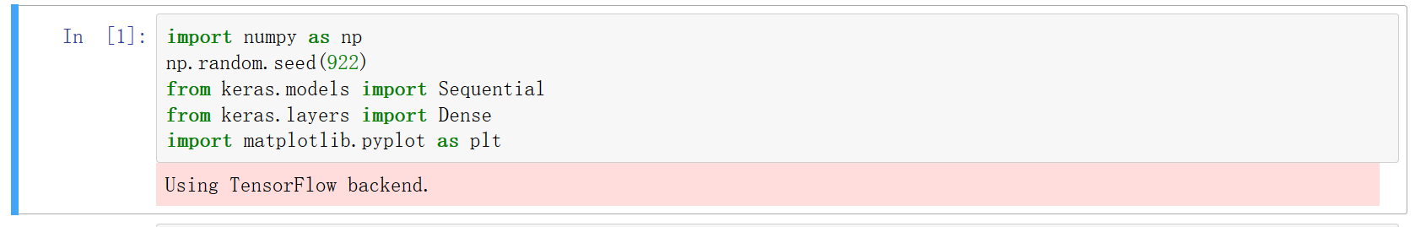
Jupyter
Shift-Enter : run cell, select below
Ctrl-Enter : run selected cells
Alt-Enter : run cell, insert below

Slide 15
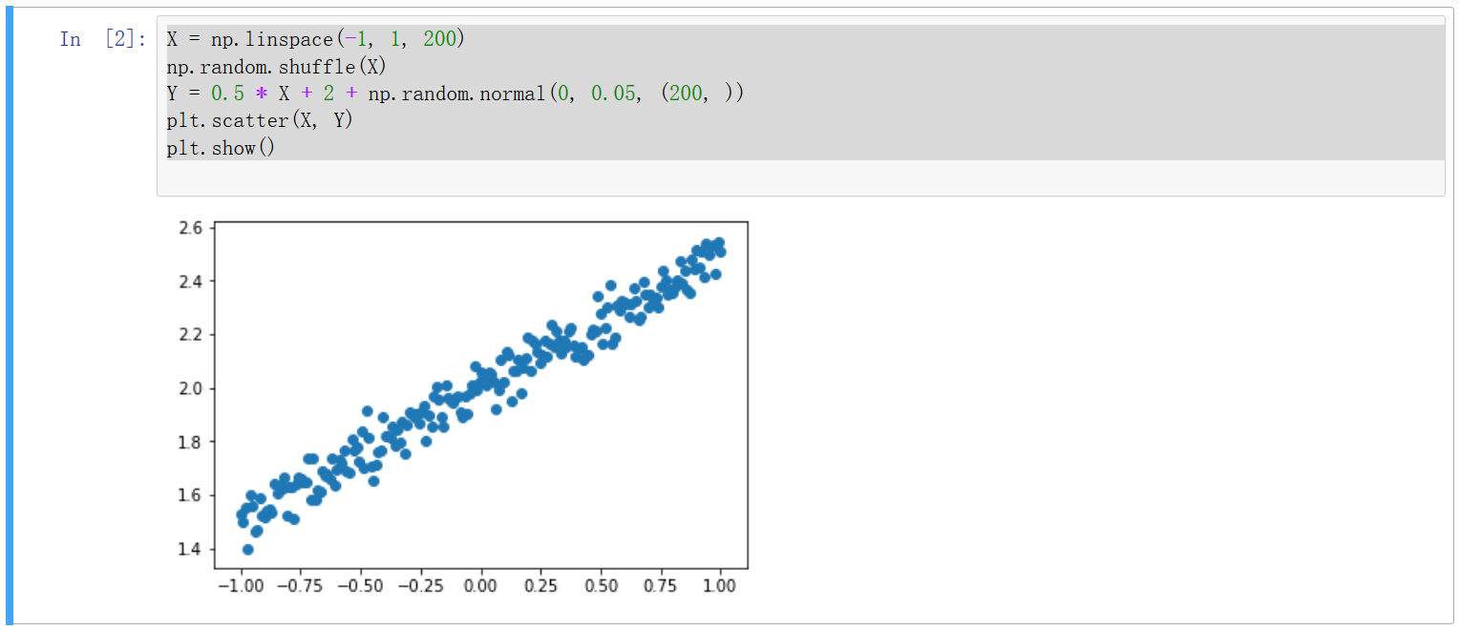
Generate Data

Slide 16
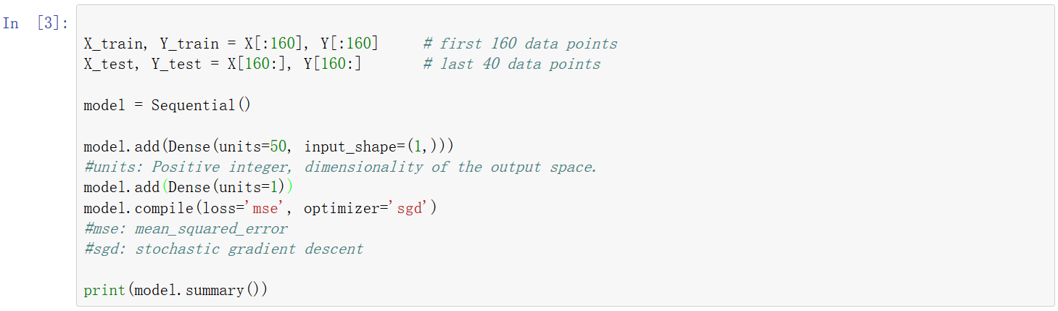
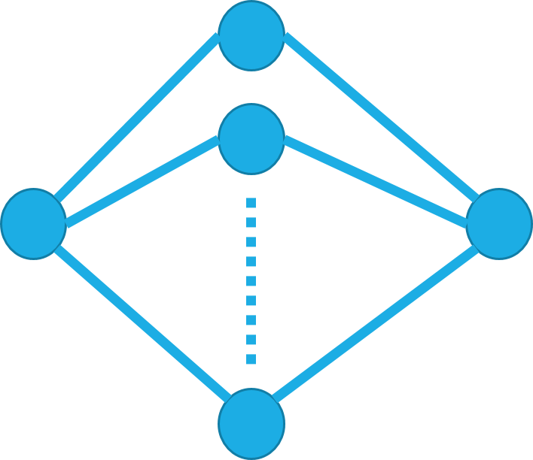
Build Model
Input layer
Output layer
hidden layer (50 neurons)

Slide 17
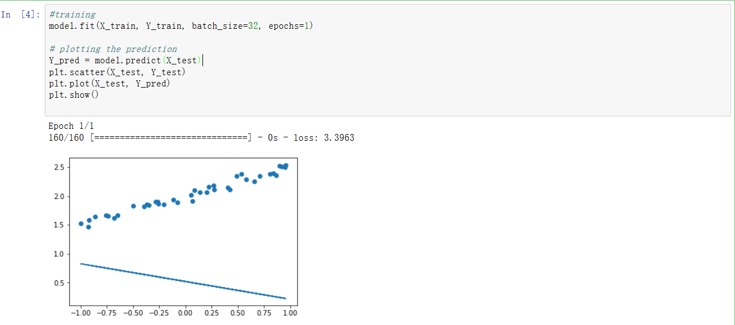
Train

Slide 18

A Kaggle Competition

Slide 19
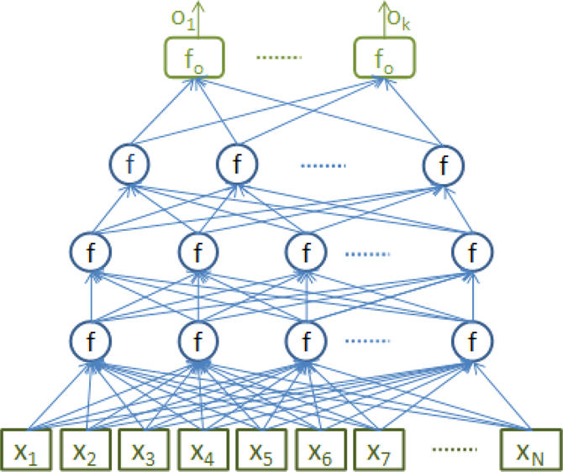
Deep neural networks
Ma, Junshui, et al. "Deep neural nets as a method for quantitative structure–activity relationships." Journal of chemical information and modeling 55.2 (2015): 263-274.

Slide 20
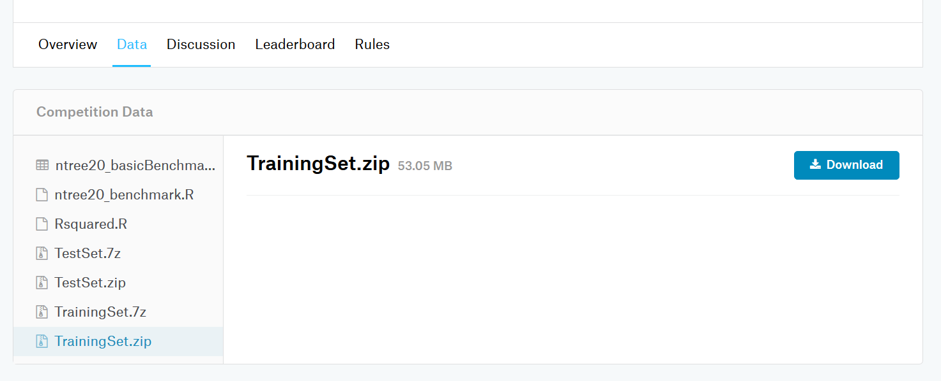
Download datasets
https://www.kaggle.com/c/MerckActivity/data

Slide 21
Script
https://github.com/MengyuanZhu/Deep-SMILES
tapia-2.ipynb

Slide 22
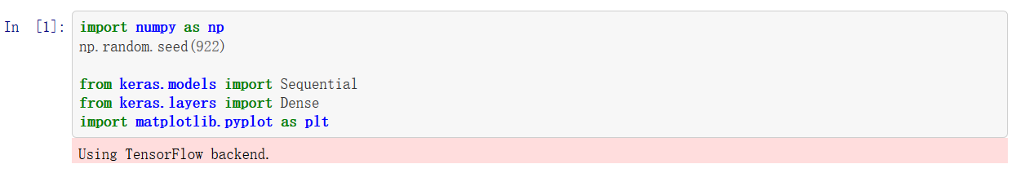
Import module

Slide 23
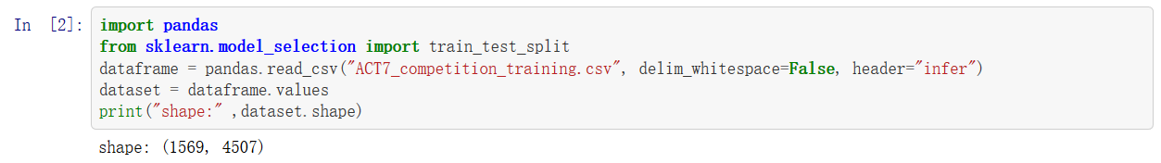
Read data

Slide 24
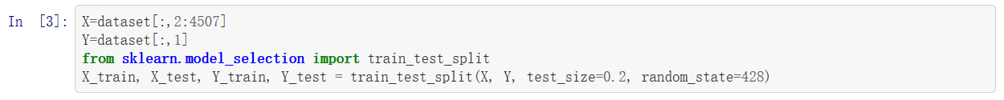
Split Data

Slide 25
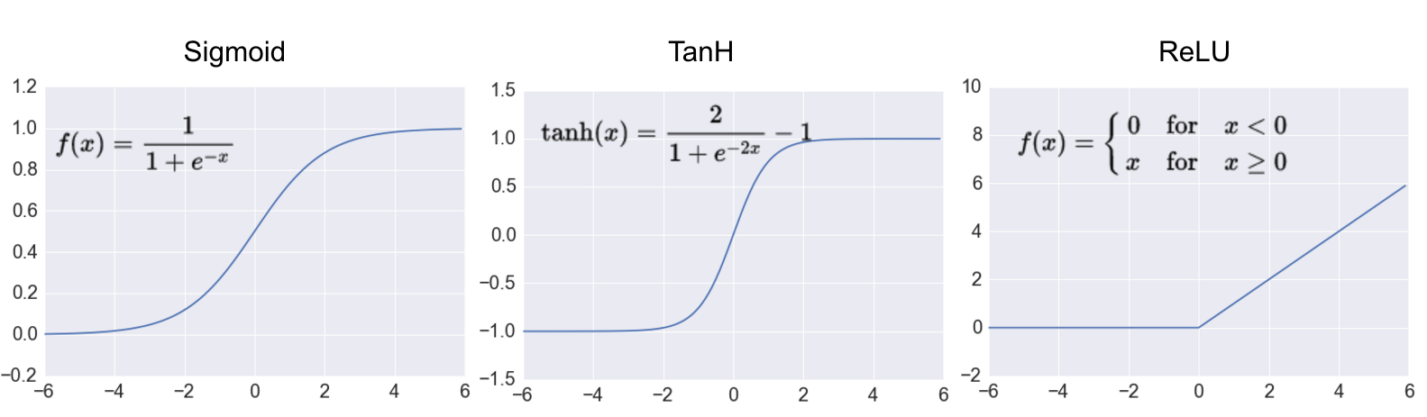
Activation Layer
Activation function: to introduce non-linearity
from keras.layers import Activation
model.add(Activation(“sigmoid”)
model.add(Activation(“tanh”)
model.add(Activation(“relu”)

Slide 26
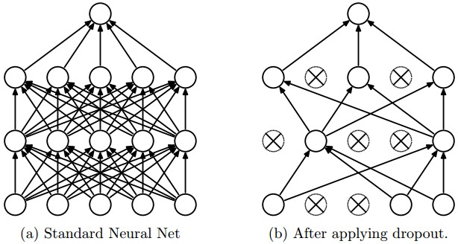
Dropout layer
Dropout: reduce overfitting
from keras.layers import Dropout
model.add(Dropout)

Slide 27
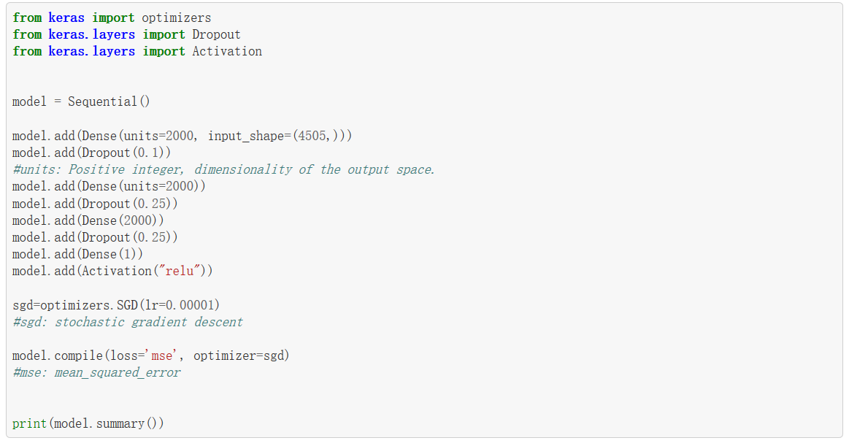
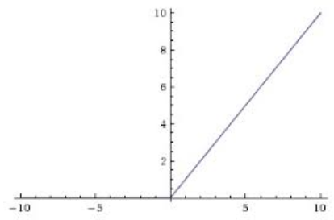
Build Model
Input
Input
Input

Slide 28
A research Problem
https://github.com/MengyuanZhu/Deep-SMILES
conv1d.ipynb

Slide 29
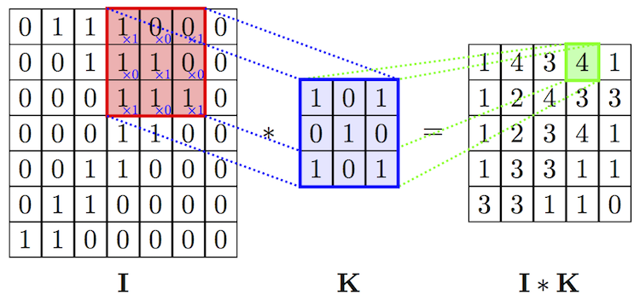
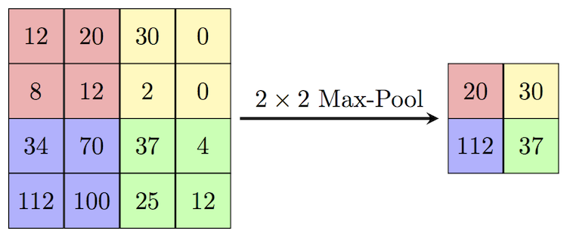
DEEP-SMILES
Convolution layer
Pooling layer

Slide 30
Thank you
Keras documentation
https://keras.io/
My webpage
https://mengyuanzhu.github.io/

