Slide 1
BATMAN: Virtual Stock
Mengyuan Zhu, Sungjae Kim, Sharon Kim, Hyeun Kang, Jakub Pietrasik

Slide 2
Batman
Mengyuan Zhu
Sungjae Kim
Sharon Kim
Hyeun Kang
Coordinator
Documents handler
Java coder
Problem Statement
Requirements Traceability Matrix
User Guide
Finalize code documentation
Java coder
Requirements Traceability Matrix
Gannt Chart
Category Interaction Diagram
Function Point Cost Analysis.
Program tester
Rationale
Program tester
Javadoc
Comments
Java coder
Other
Jakub Pietrasik
Legacy

Slide 3
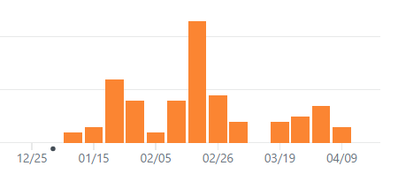

Github (commits)
https://github.com/MengyuanZhu/SoftwareEngineering

Slide 4
Overview/Purpose
We developed a PC software with a user-friendly GUI. The software is for virtual stock trading. The price is real-time while the exchange is virtual. It’s easy to use for stock market beginners.
1. Access market quotes and data in real-time
2. View detailed charts of historical market data
3. Transfer money from/to a virtual bank
4. View User history

Slide 5
Background
Google Finance API
http://finance.google.com/finance
Yahoo Finance API
http://chartapi.finance.yahoo.com

Slide 6
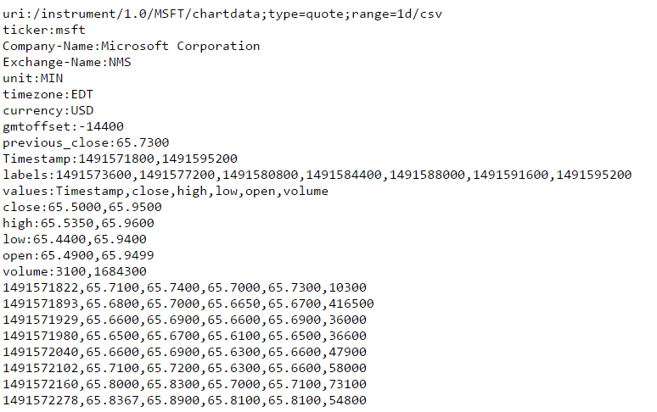
Background Yahoo API
Used in getting basic information
Used in plot

Slide 7
Third party library
gson
To parse JSON
https://repo1.maven.org/maven2/com/google/code/gson/gson/2.6.2/
sqlite
To process SQL
https://mvnrepository.com/artifact/org.xerial/sqlite-jdbc/3.16.1

Slide 8
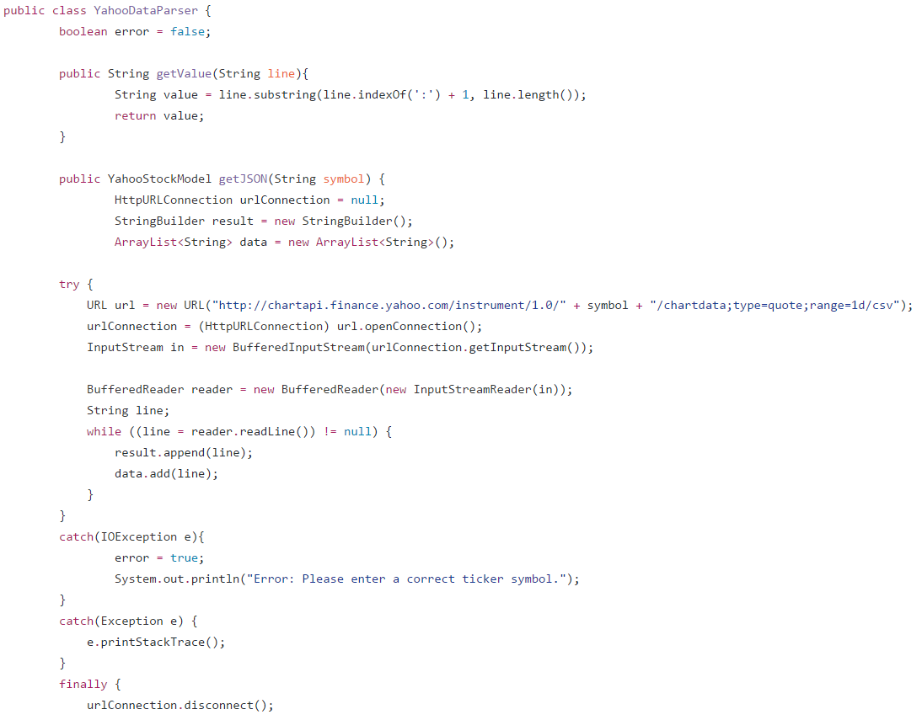
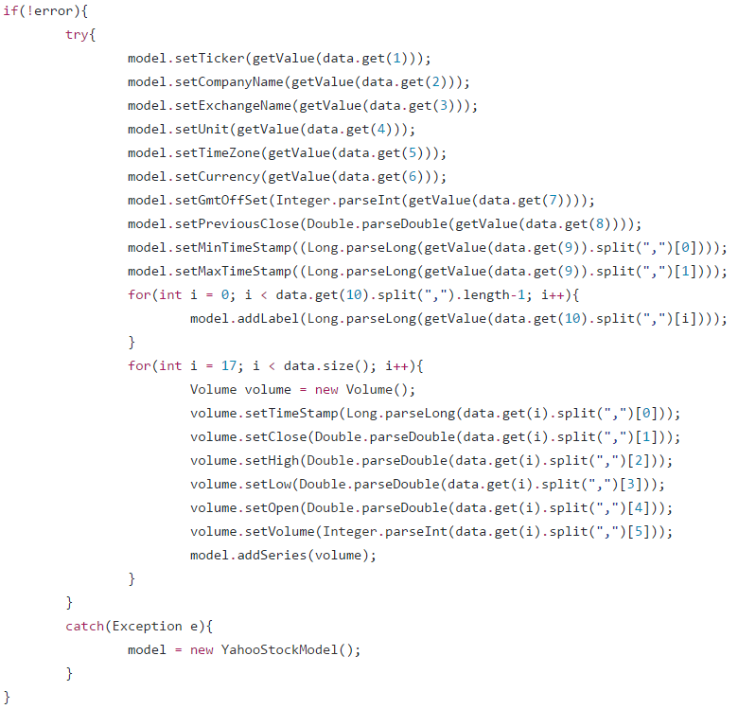
JSON for Yahoo Data

Slide 9
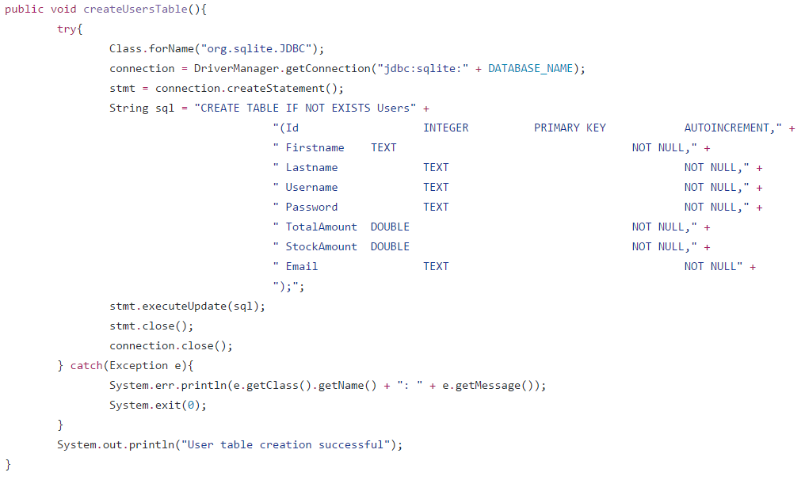
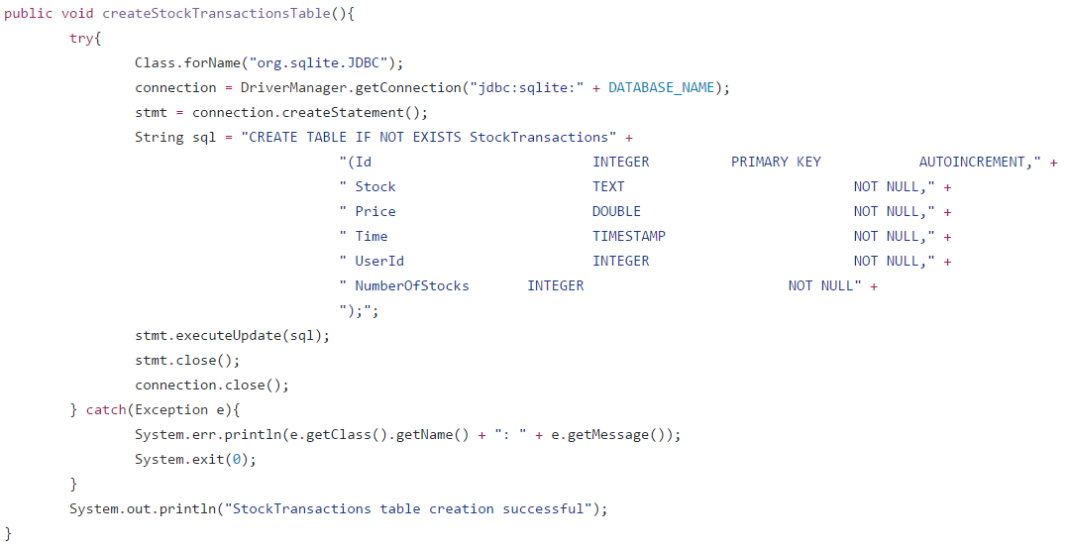
SQLITE for USER and transactions

Slide 10
System Model (MVC)
Model
TransactionModel.java
View
BankAccountView.fxml
EditAccountView.fxml
Controller
AccountController.java
EditAccountController.java
UserModel.java
Volume.java
YahooStockModel.java
BankAccountController.java
HistoryController.java
LoginController.java
MainController.java
PortfolioController.java
SignupController.java
StockController.java
History.fxml
LoginView.fxml
MainView.fxml
Portfolio.fxml
PortfolioView.fxml
RootLayout.fxml
SignupView.fxml
StockView.fxml

Slide 11
Metrics (lines of code)
Source code + GUI + Javadoc = ~6000 lines
Calculated using Github graphs

Slide 12
Metrics (Pages of Report)
Topic | Pages
Topic description | 1
Requirements traceability matrix | 1
Use cases | 8
Interaction diagram | 5
Software architecture | 1
Database | 1
Work structure document | 1
Dictionary | 1
Object design | 2
Topic | Pages
Test cases | 1
Rationale | 2
Function point cost analysis | 2
Construction cost model | 2
Source code link to Github | 1
Resumes | 7
User Guide | 3
Gannt Chart | 1
Category Interaction diagram | 1

Slide 13
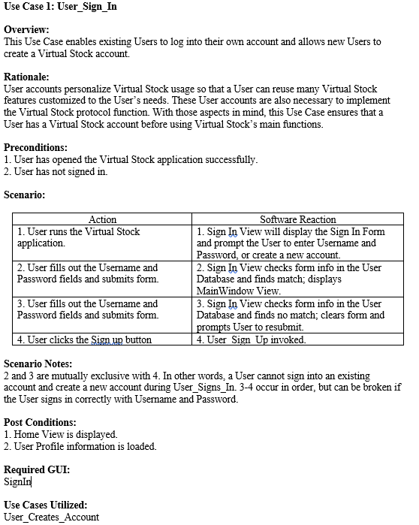
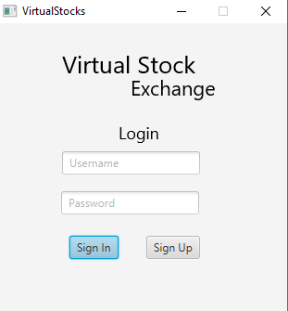
use cases 1. Sign IN

Slide 14
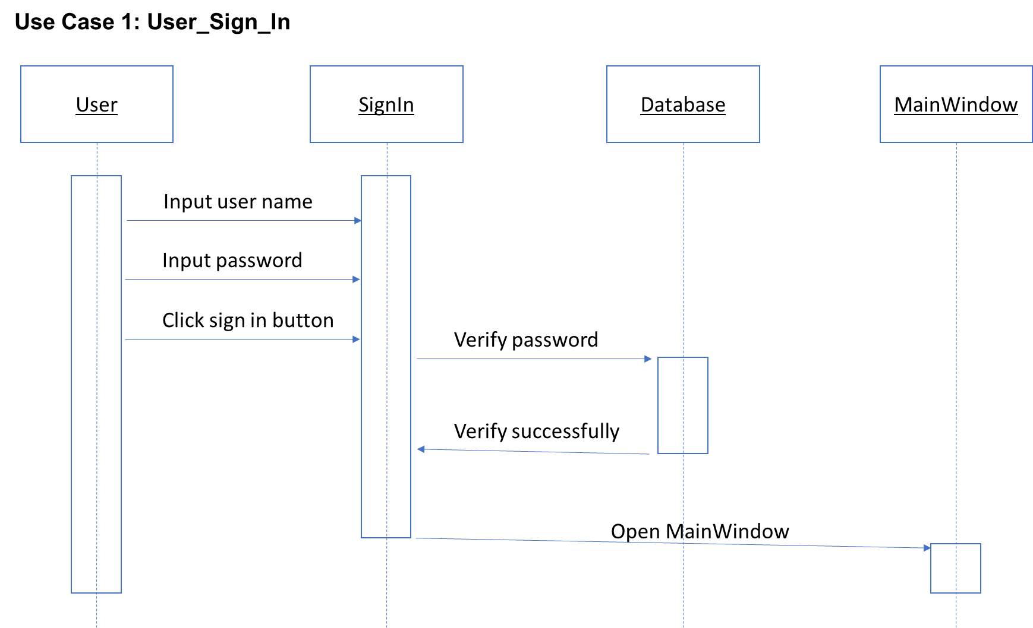
use cases 1. Sign IN

Slide 15
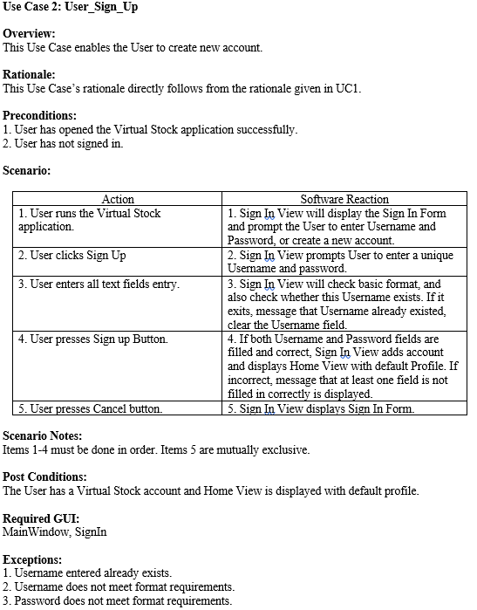
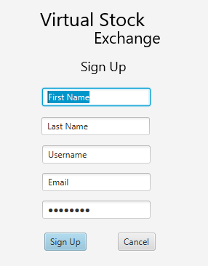
use cases 2. Sign up

Slide 16
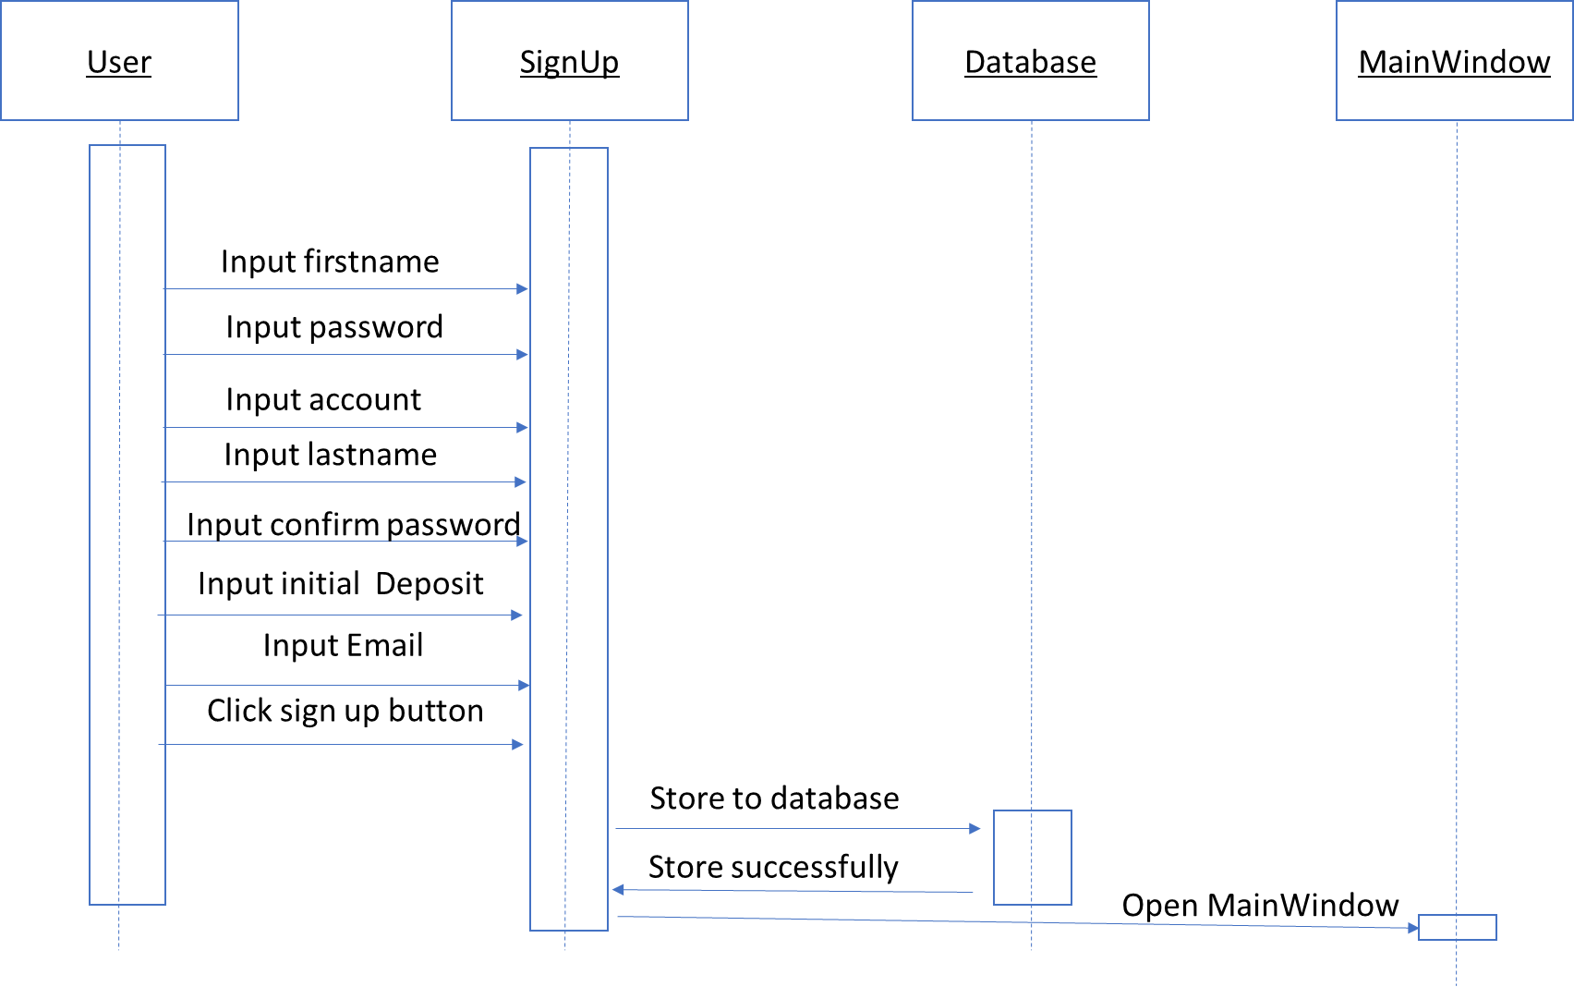
use cases 2. Sign up

Slide 17
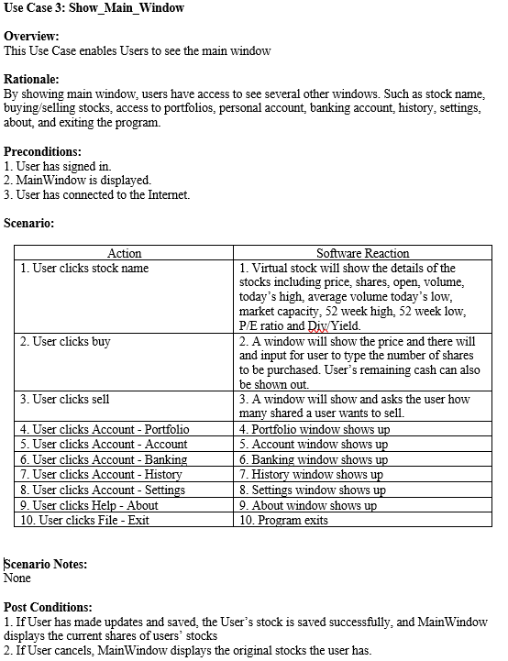
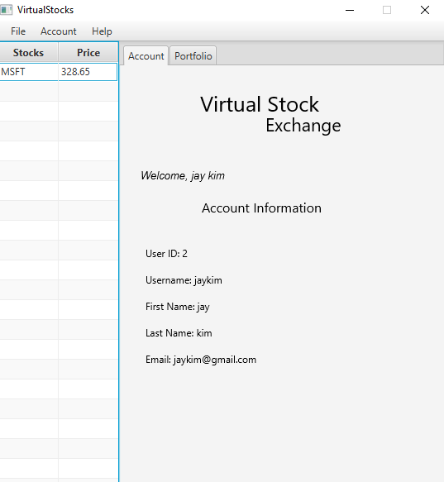
use cases 3. SHOW_MAIN_Window

Slide 18
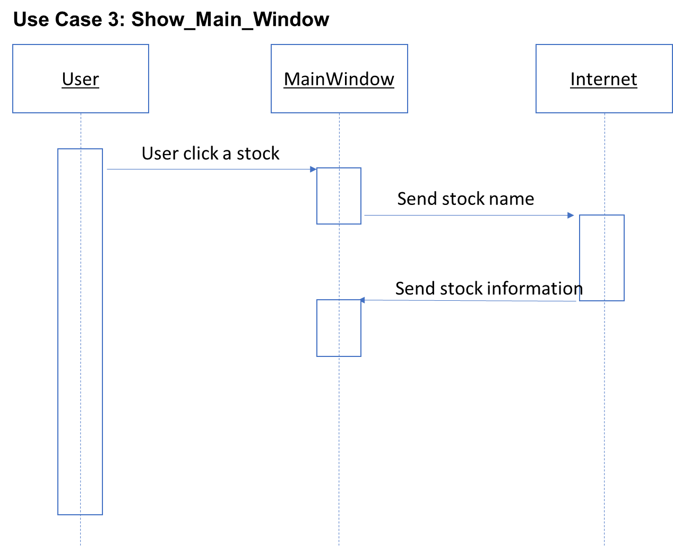
use cases 3. SHOW_MAIN_Window

Slide 19
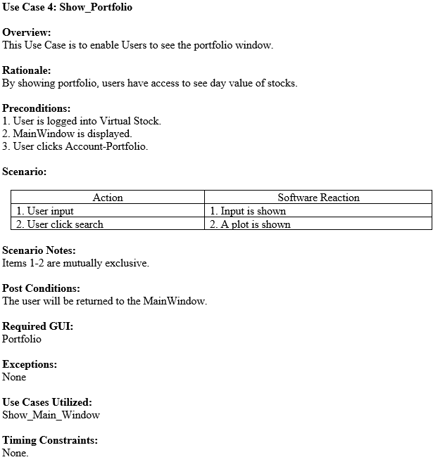
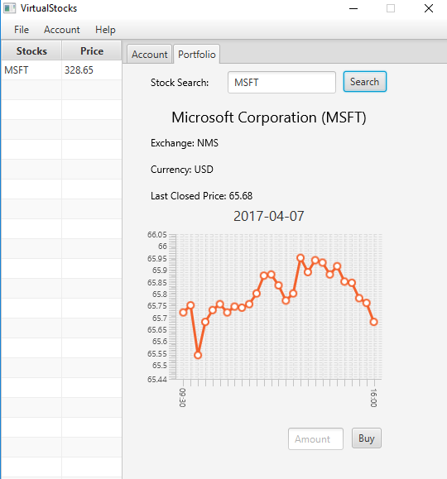
use cases 4. SHOW_Portfolio

Slide 20
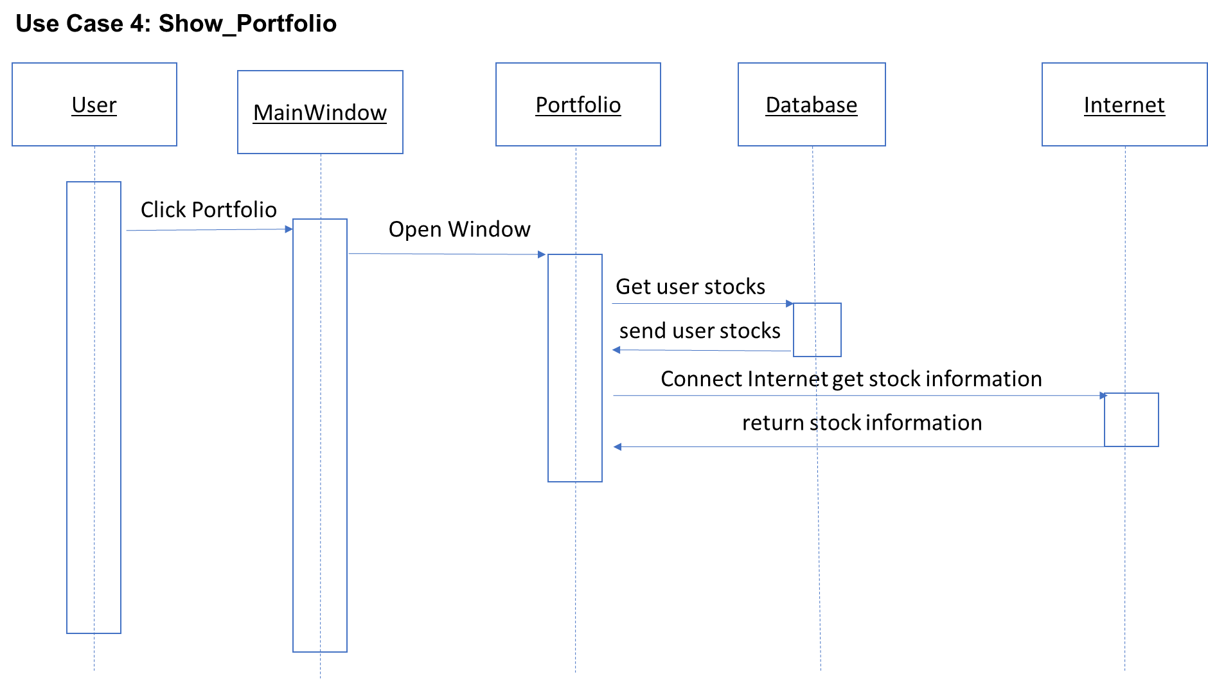
use cases 4. SHOW_Portfolio

Slide 21
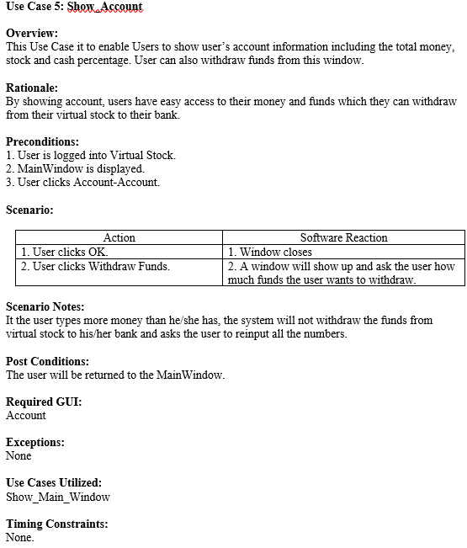
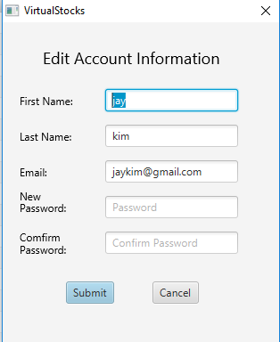
use cases 5. Show_account

Slide 22
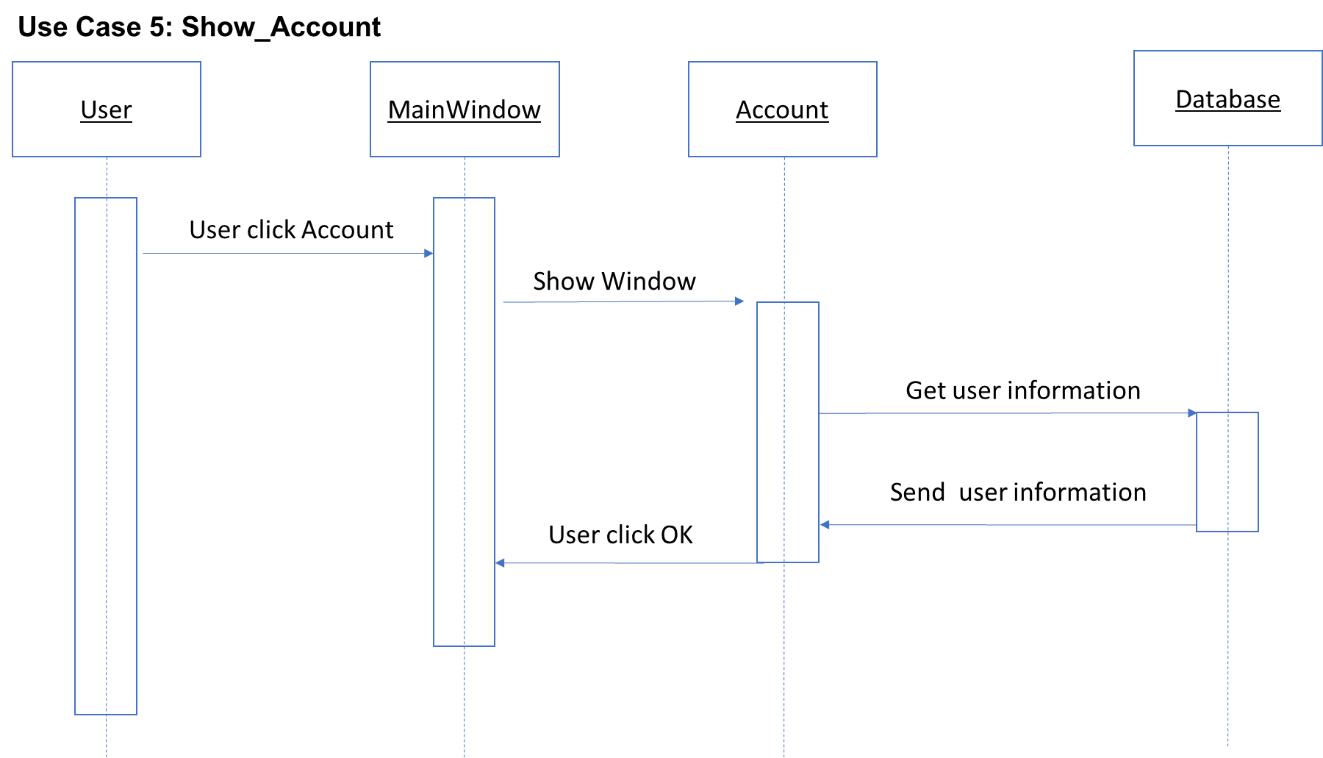
use cases 5. Show_account

Slide 23
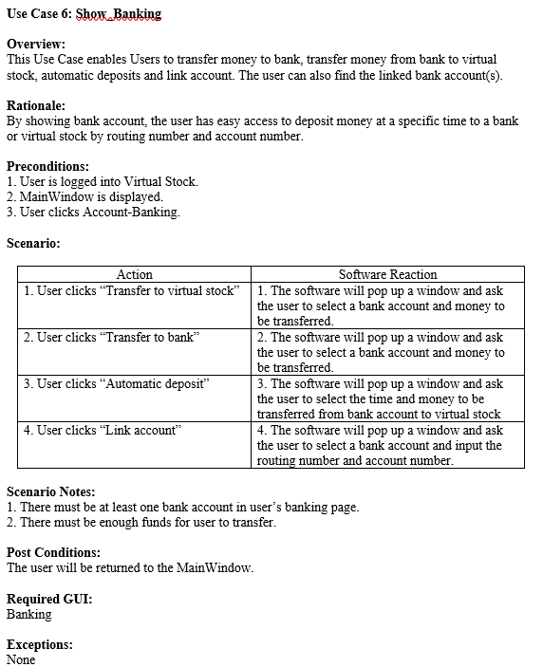
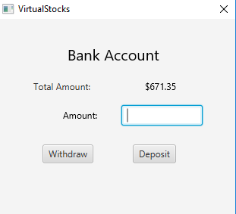
use cases 6. Show_banking

Slide 24
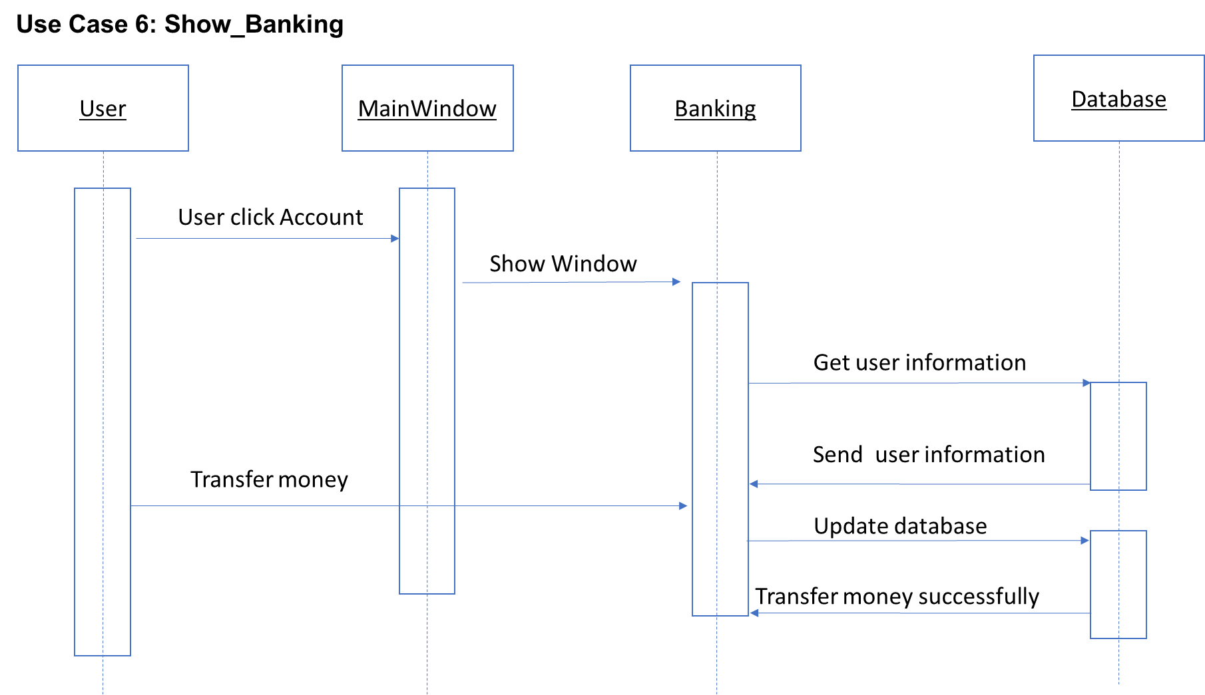
use cases 6. Show_banking

Slide 25
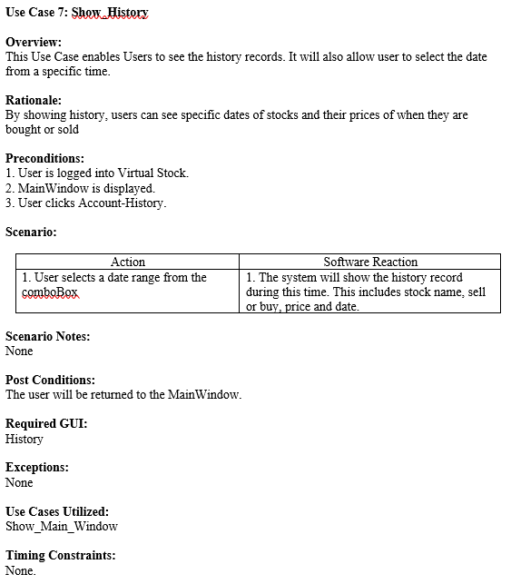
use cases 7. Show_HISTORY

Slide 26
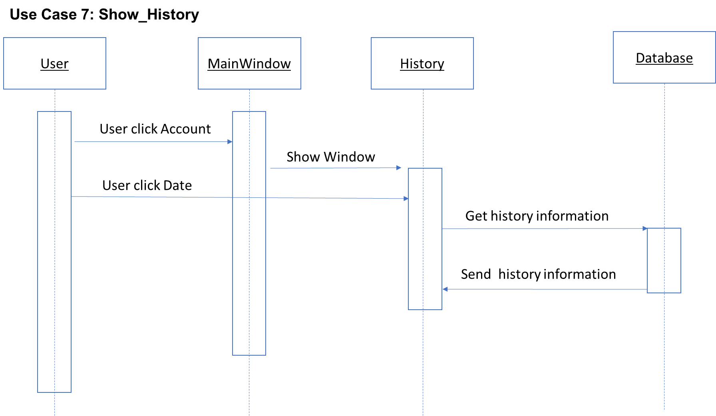
use cases 7. Show_HISTORY

Slide 27
legacy
Organization is a task in itself.
Understand each group member to understand the project.
Communication becomes increasingly important.
Documentation helpful for everyone.
Take into account possible setbacks in scheduling.

Slide 28
Software Implementation
Eclipse
Scene Builder
JavaFX
SQL
Javadoc
Git

Slide 29
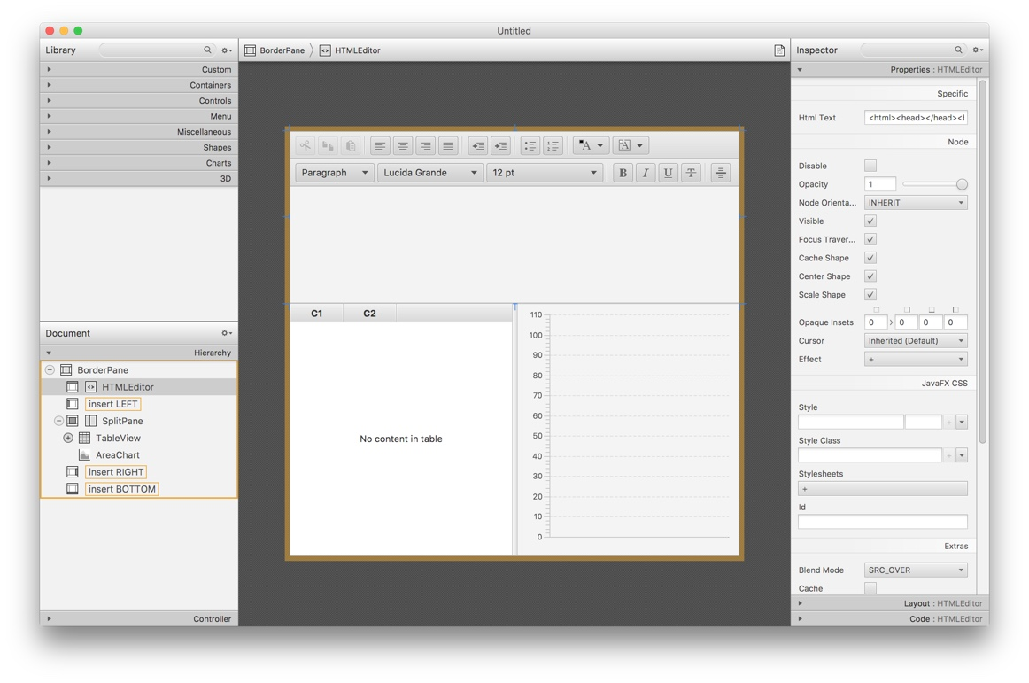
Scene Builder
Drag & Drop user interface design allows for rapid iteration. Separation of design and logic files allows for team members to quickly and easily focus on their specific layer of application development.

Slide 30

GUI (JavaFX)
JavaFX is a software platform for creating and delivering desktop applications, as well as rich internet applications (RIAs) that can run across a wide variety of devices. JavaFX is intended to replace Swing as the standard GUI library for Java SE, but both will be included for the foreseeable future. JavaFX has support for desktop computers and web browsers on Microsoft Windows, Linux, and macOS.

Slide 31

Eclipse
Eclipse is an integrated development environment (IDE) used in computer programming, and is the most widely used Java IDE.[6] It contains a base workspace and an extensible plug-in system for customizing the environment. Eclipse is written mostly in Java and its primary use is for developing Java applications, but it may also be used to develop applications in other programming languages via plug-ins.

Slide 32
JAVAdoc
Javadoc (originally cased as JavaDoc) is a documentation generator created by Sun Microsystems for the Java language (now owned by Oracle Corporation) for generating API documentation in HTML format from Java source code. The HTML format is used to add the convenience of being able to hyperlink related documents together.

Slide 33
Git
Git is a version control system (VCS) for tracking changes in computer files and coordinating work on those files among multiple people. It is primarily used for software development, but it can be used to keep track of changes in any files. As a distributed revision control system it is aimed at speed, data integrity, and support for distributed, non-linear workflows.

Slide 34
SQL
SQL Structured Query Language is a domain-specific language used in programming and designed for managing data held in a relational database management system (RDBMS), or for stream processing in a relational data stream management system (RDSMS).

Slide 35
Summary
1. A PC Java program was designed
2. JavaFX was used to build GUI
3. Most of functions are implemented

Slide 36
DEMO

