Slide 1

Review of computational algorithms for solving optical inverse design problems
Sourangsu Banerji
Department of Electrical & Computer Engineering
University of Utah, Salt Lake City, Utah, USA.
08/17/2020
The University of Utah
Electrical and Computer Engineering

Slide 2
Outline
Background
Review of Computational Optimization Algorithms:
Gradient Based Optimization Techniques
Gradient Free Optimization Techniques
Inverse Design using Machine Learning (Artificial Neural Networks)
Does Machine Learning really have an advantage?
Conclusion
The University of Utah
Electrical and Computer Engineering

Slide 3
Outline
Background
Review of Computational Algorithms:
Gradient Based Optimization Techniques
Gradient Free Optimization Techniques
Inverse Design using Machine Learning (Artificial Neural Networks)
Does Machine Learning really have an advantage?
Conclusion
The University of Utah
Electrical and Computer Engineering

Slide 4
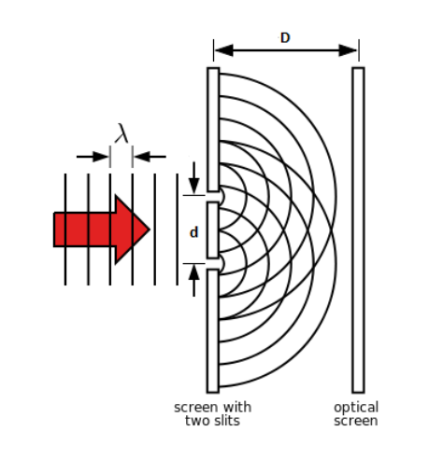
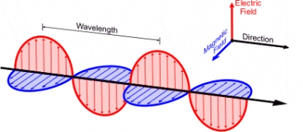
Light Waves
Scalar (far-field)
Vector(near-field)
Light is a vector wave, but it can also be described as a scalar wave in some cases, for example when you have translational invariance along one of your dimensions: Transverse Electric (TE) or Transverse Magnetic (TM) diffraction. So it is possible to use scalar wave arguments to explain diffraction of full vectorial EM-waves under certain conditions.
The University of Utah
Electrical and Computer Engineering

Slide 5
Light Waves
Scalar
Vector(near-field)
Light is a vector wave, but it can also be described as a scalar wave in some cases, for example when you have translational invariance along one of your dimensions: Transverse Electric (TE) or Transverse Magnetic (TM) diffraction. So it is possible to use scalar wave arguments to explain diffraction of full vectorial EM-waves under certain conditions.
The University of Utah
Electrical and Computer Engineering

Slide 6
Manipulating vectorial nature of light
The light–matter interactions in the near field are mediated by ensembles of subwavelength “meta” structures, made of plasmonic or high dielectric refractive index materials, which have thicknesses “much less” than of the operating wave- length.
The design of metasurfaces is generally achieved using the following two approaches:
Direct Design Approach:
rigorous full wave electromagnetic solver is used to study different classes of meta-atoms/structures.
Extract the response and design our structures
The biggest drawback is that it only works for known structures and certain applications
It does not incorporate near-ﬁeld electromagnetic coupling effects between neighboring meta-atoms and does not generalize to large area, freeform devices
Inverse Design Approach:
With this approach, the desired optical response is deﬁned as an objective cost function.
The inverse problem solves for the shape and dimensions of the metasurface in a manner that maximizes the cost function value.
The University of Utah
Electrical and Computer Engineering

Slide 7
Manipulating vectorial nature of light
But why?
The inverse design approach can account for near-ﬁeld interactions by optimizing relatively large metasurface regions at a time
Can produce freeform structures which are foundry compatible.
The light–matter interactions in the near field are mediated by ensembles of subwavelength “meta” structures, made of plasmonic or high dielectric refractive index materials, which have thicknesses “much less” than of the operating wave- length.
The design of metasurfaces is generally achieved using the following two approaches:
Direct Design Approach:
rigorous full wave electromagnetic solver is used to study different classes of meta-atoms/structures.
Extract the response and design our structures
The biggest drawback is that it only works for known structures and certain applications
It does not incorporate near-ﬁeld electromagnetic coupling effects between neighboring meta-atoms and does not generalize to large area, freeform devices
Inverse Design Approach:
With this approach, the desired optical response is deﬁned as an objective cost function.
The inverse problem solves for the shape and dimensions of the metasurface in a manner that maximizes the cost function value.
The University of Utah
Electrical and Computer Engineering

Slide 8
Manipulating vectorial nature of light
But how?
Optimization Algorithms
The light–matter interactions in the near field are mediated by ensembles of subwavelength “meta” structures, made of plasmonic or high dielectric refractive index materials, which have thicknesses “much less” than of the operating wave- length.
The design of metasurfaces is generally achieved using the following two approaches:
Direct Design Approach:
rigorous full wave electromagnetic solver is used to study different classes of meta-atoms/structures.
Extract the response and design our structures
The biggest drawback is that it only works for known structures and certain applications
It does not incorporate near-ﬁeld electromagnetic coupling effects between neighboring meta-atoms and does not generalize to large area, freeform devices
Inverse Design Approach:
With this approach, the desired optical response is deﬁned as an objective cost function.
The inverse problem solves for the shape and dimensions of the metasurface in a manner that maximizes the cost function value.
The University of Utah
Electrical and Computer Engineering

Slide 9
Outline
Background
Review of Computational Algorithms:
Gradient Based Optimization Techniques
Gradient Free Optimization Techniques
Inverse Design using Machine Learning (Artificial Neural Networks)
Does Machine Learning really have an advantage?
Conclusion
The University of Utah
Electrical and Computer Engineering

Slide 10
Gradient Based Optimization Techniques
Pros
1. They are the most efficient in ﬁnding local optima
2. Can be applied to both constrained and unconstrained problems
Examples: Objective First, Topology optimization
Cons
1. Depend strongly on the initial guess of the solution
2. Require the knowledge of the derivatives of the cost function which can be difficult
3. Hard to deal with discrete optimization parameters and non-differentiable
objective functions
The University of Utah
Electrical and Computer Engineering

Slide 11
Gradient Free Optimization Techniques
Pros
1. They are the most efficient in ﬁnding global minima (local minima trapping issue)
2. Not influenced by the initialization of the optimizer
3. Easy to deal with discrete optimization parameters and non-differentiable
objective functions
Examples: Genetic Algorithms, Particle Swarm Optimization
Cons
1. “Extremely slow”
2. Lower parameter space
The University of Utah
Electrical and Computer Engineering

Slide 12
Outline
Background
Review of Computational Optimization Algorithms:
Gradient Based Optimization Techniques
Gradient Free Optimization Techniques
Inverse Design using Machine Learning (Artificial Neural Networks)
Does Machine Learning really have an advantage?
Conclusion
The University of Utah
Electrical and Computer Engineering

Slide 13
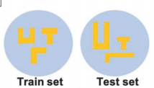
Inverse Design using Machine Learning
The major contributions to date that have been published to design nanostructures by utilizing machine learning techniques can be categorized into three categories:
The first, and the most fundamental one, is obtaining a model that is capable of designing nanostructures from the same shape and material it was trained on, but with different properties, such as sizes, angles, and host material.
The University of Utah
Electrical and Computer Engineering

Slide 14
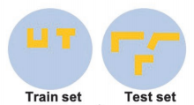
Inverse Design using Machine Learning
The second category incorporates models that are able to generalize and design geometries with shapes that differ from the set of shapes used during training, but are still considered to be in the same family (i.e., the model can generalize to other shapes that are similar, but not identical, to the set of shapes it was trained on)
The University of Utah
Electrical and Computer Engineering

Slide 15
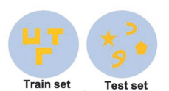
Inverse Design using Machine Learning
The third category is a model that is able to design any geometry, with any shape, achieving what the deep learning community calls the generalization capability. The generalization ability of such models needs to be verified via a proper holdout test set (i.e., a test set) comprising structures sampled from a completely different distribution than the set the model was trained on.
The University of Utah
Electrical and Computer Engineering

Slide 16
Outline
Background
Review of Computational Optimization Algorithms:
Gradient Based Optimization Techniques
Gradient Free Optimization Techniques
Inverse Design using Machine Learning (Artificial Neural Networks)
Does Machine Learning really have an advantage?
Conclusion
The University of Utah
Electrical and Computer Engineering

Slide 17
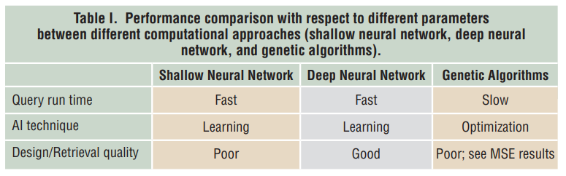
Does Machine Learning really have an advantage?
Quite application specific
For the nanophotonic structures: yes!
For scalar based modelling: no!
Capable of handling a large parameter space and searching for the global minima
The University of Utah
Electrical and Computer Engineering

Slide 18
Outline
Background
Review of Computational Optimization Algorithms:
Gradient Based Optimization Techniques
Gradient Free Optimization Techniques
Inverse Design using Machine Learning (Artificial Neural Networks)
Does Machine Learning really have an advantage?
Conclusion
The University of Utah
Electrical and Computer Engineering

Slide 19
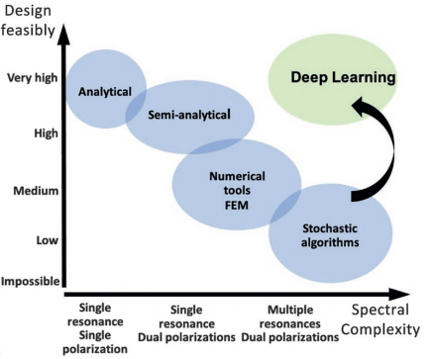
Conclusion
The University of Utah
Electrical and Computer Engineering

