Slide 1

INFO6105
Trending YouTube Video Statistics
Team 11:
001443861 Hao Wu
001305642 Fangqing Wu
001082876 Yangyang Liu
001405396 Mengzhe Zhang
001302072 Lihang Zhou

Slide 2

Content
Project Introduction & Background
Objectives & Motivations
Methodology
Introduction of the dataset
Data cleaning & preparation
Analysis, Result and Visualization
Natural Language Processing
Machine Learning
Prediction
Model Evaluation
Recommendation
Conclusion
Reference

Slide 3
Project Introduction & Background
YouTube is the world’s largest platform for creating, sharing and discovering video content. As the world-famous video website, YouTube maintains an enormous large scale dataset, and the recommendation system is responsible for helping more than a billion users discover personalized content from an ever-growing corpus of videos.
To determine the year’s top-trending videos, YouTube uses a combination of factors including measuring users interactions(number of views, shares, comments and likes).
Therefore, this project is based on dataset for recording daily record of the top-trending YouTube videos, which is aiming to perform analysis, visualization, prediction and recommendation.
Based on the result, we could plan to be extracted about personal preferences of users from all over the world in this dataset, which will contribute to the training of several prediction models.

Slide 4
Objectives & Motivations
Online video website and SNS have changed the way of society about how to get information, entertain, build relationship, business marketing and daily life style.
YouTube is one of the most important components in this visual community. It has huge influence on every user, especially the millennials (Gen Y), and it is also the platform for commercial companies, traditional & streaming media platforms, self-media (such as K.O.L, influencer, independent YouTuber), to interact with their target market, potential customers and followers..
Understand the data logic, relationship and patterns behind YouTube trending videos, will help all the creators, users and commercial activities maximize the utilization of resources.

Slide 5
Methodology
Programming language :Python
Basic tools :numpy, pandas, seaborn, matplotlib, json, datetime, IPython, glob
Data Visualization: Bar chart, Scatter plot, Heat map, WordCloud, Box plot, Distribution diagram
Machine Learning tools: train_test_split, LinearRegression, PolynomialFeatures, r2_scores
Advanced Tools: nltk, WordCloud, spacy, TextBlob
Algorithm: Machine Learning (Linear Regression, Random Forest, K-fold training, r2_score), Natural Language Processing(Word frequency statistic, Sentiment recognition)

Slide 6
Introduction of the dataset
Dataset Kaggle: Trending YouTube Video Statistics
Contains daily top-trending videos’ information from 10 regions (up to 200 per day)*
US, GB, DE, CA, FR, RU, MX, KR, JP, IN
(USA, Great Britain, Germany, Canada, France,Russia, Mexico, South Korea, Japan and India )
Each region’s data is in a separate file. Data includes the video title, channel title, publish time, tags, views, likes and dislikes, description, and comment count(16 columns)
video_id, trending_date, title, channel_title, category_id, publish_time, tags, views, likes, dislikes, comment_count, thumbnail_link, comments_disabled, ratings_disabled, video_error_or_removed, description

Slide 7
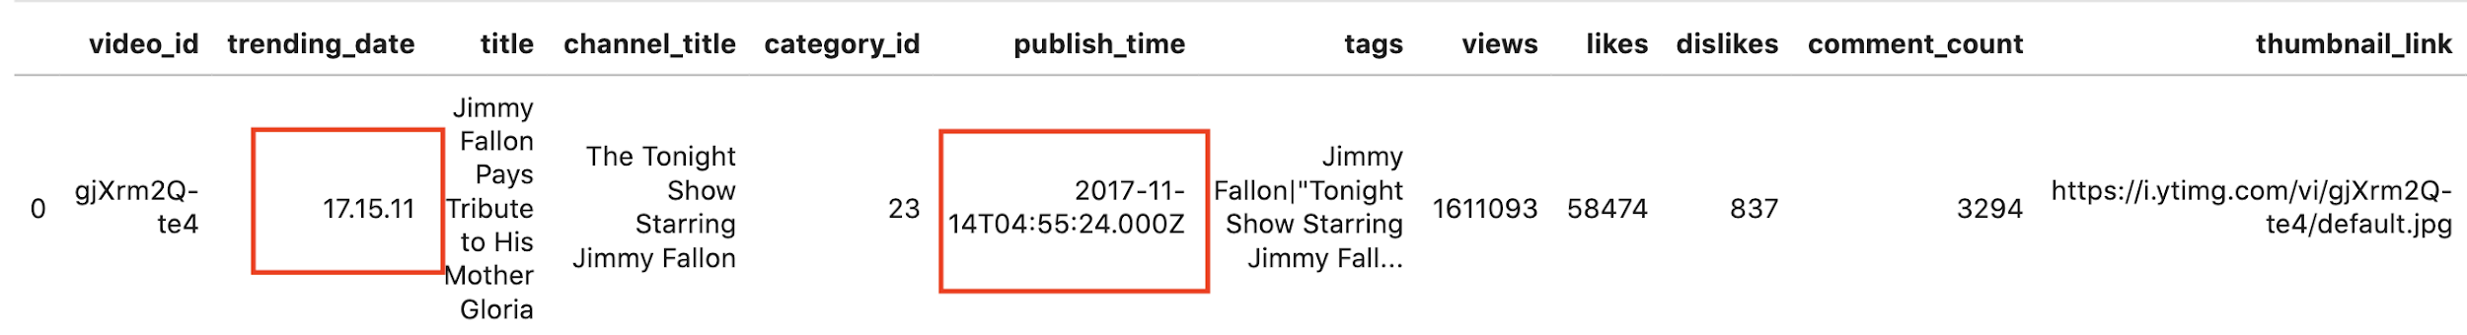
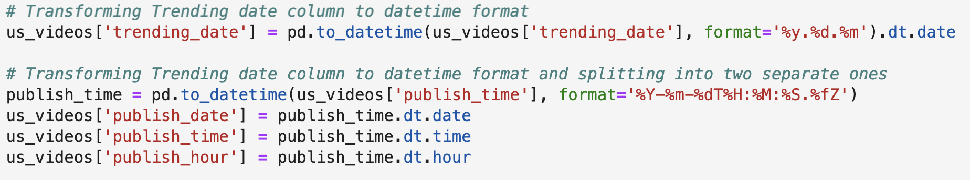
Data Cleaning and preparation
Datetime format of Trending date and Publish time

Slide 8
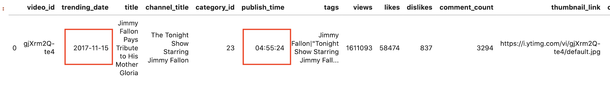
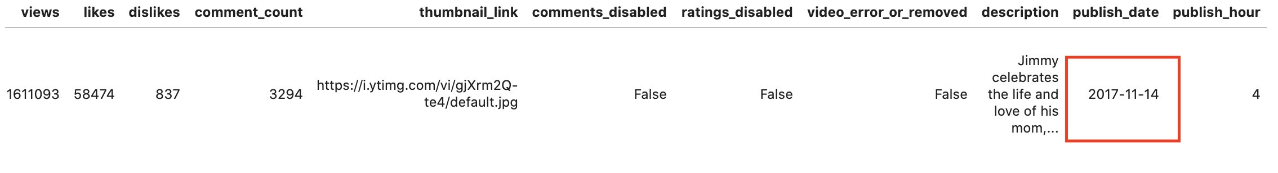
Data Cleaning and preparation

Slide 9
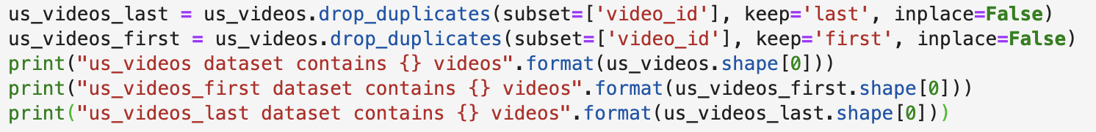
Data Cleaning and preparation
Assignment of the film category
connect the films with the categories they belong to
associate the information in two files: USvideos.csv and US_category_id.json
Duplicate Data

Slide 10
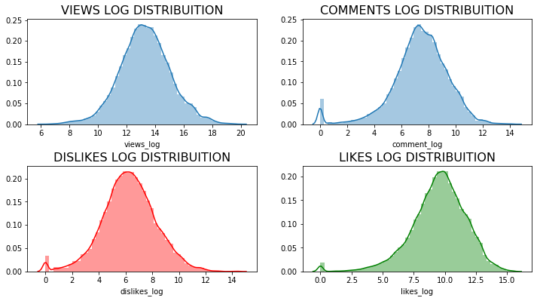
Distribution of basic parameters
Basic parameters:
(View, Comment, Dislikes, Likes)
Normal distribution
Dataset is reasonable, and ready for further analysis.

Slide 11
Analysis, Result & Visualization
Task description: Investigate and understand YouTube platform general situations and figure out the influence elements behind trending videos. Meanwhile, observe the original data to discover the relationship among different parameters for defining a trending video, such as, categories, channels, creators, titles, views, comments, likes and dislikes etc.
Contents
Best Time period to upload videos
Most popular categories,channels and publishers (Trending videos )
Relationship between view, comments, likes
Views/Likes/Dislike/Comments distributions
Like/Dislike/Comment rate distributions by categories
Most Common keywords in titles

Slide 12
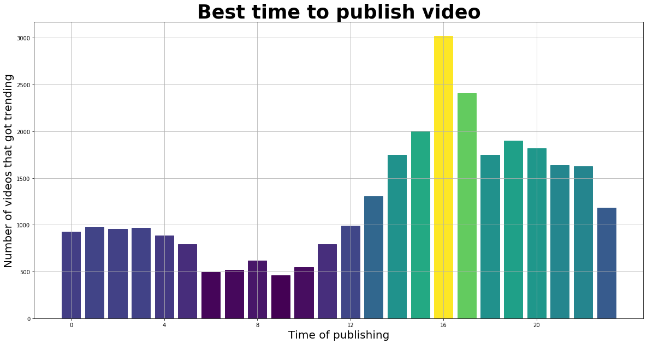
Relationship between uploading time & the number of trending videos
The best time period is everyday’s afternoon. Video will have larger chance to be trending.

Slide 13
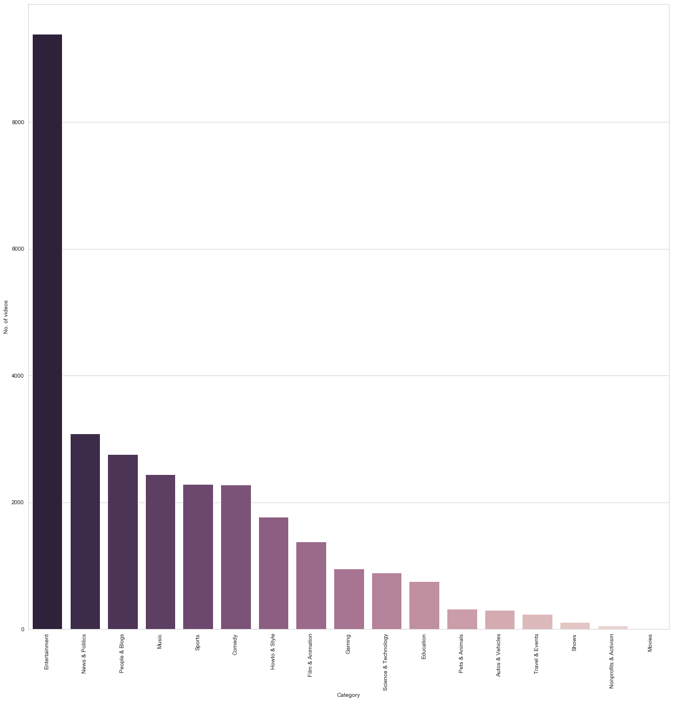
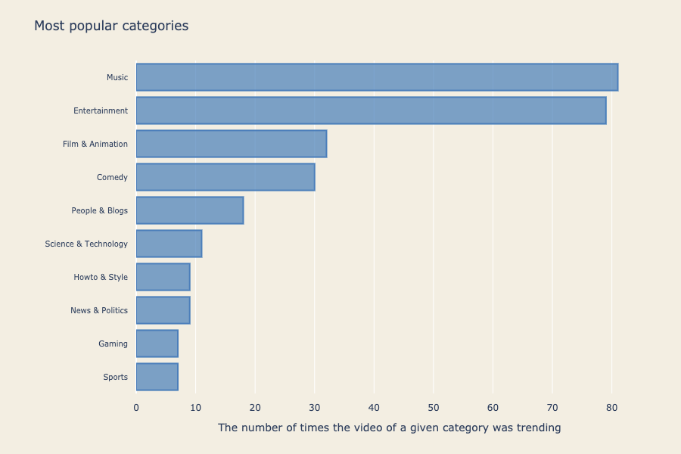
Most Popular Categories

Slide 14
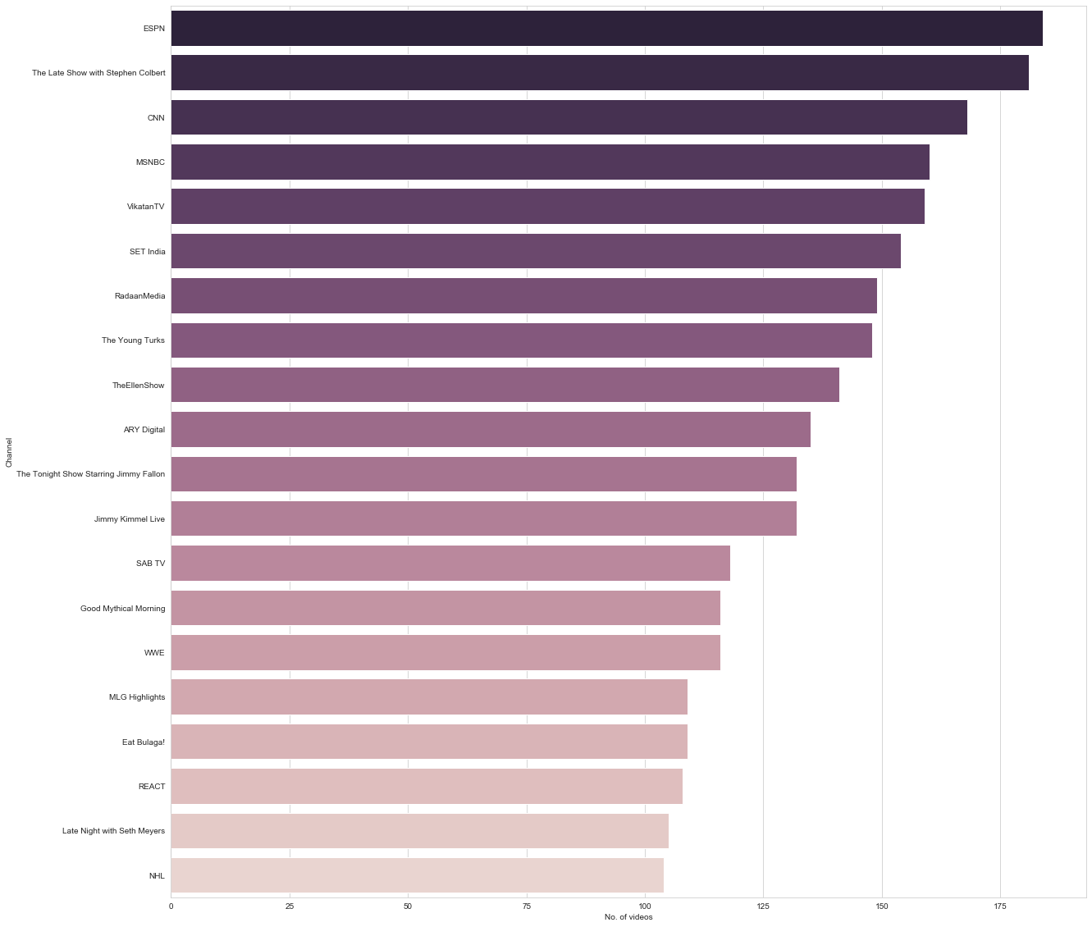
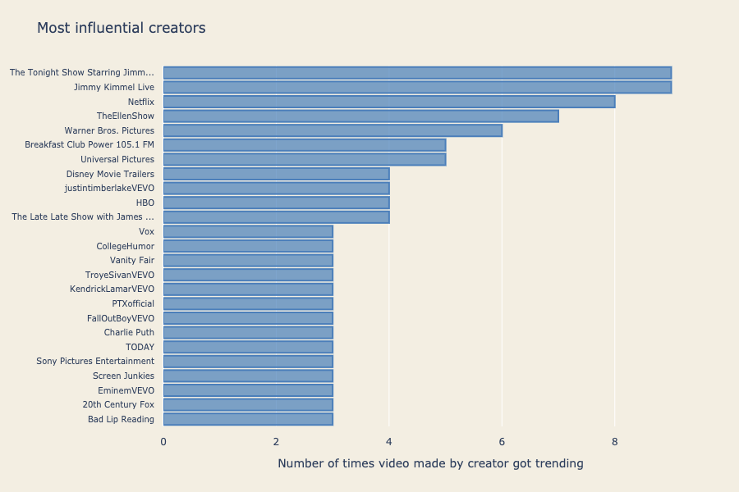
Most Popular Channels

Slide 15
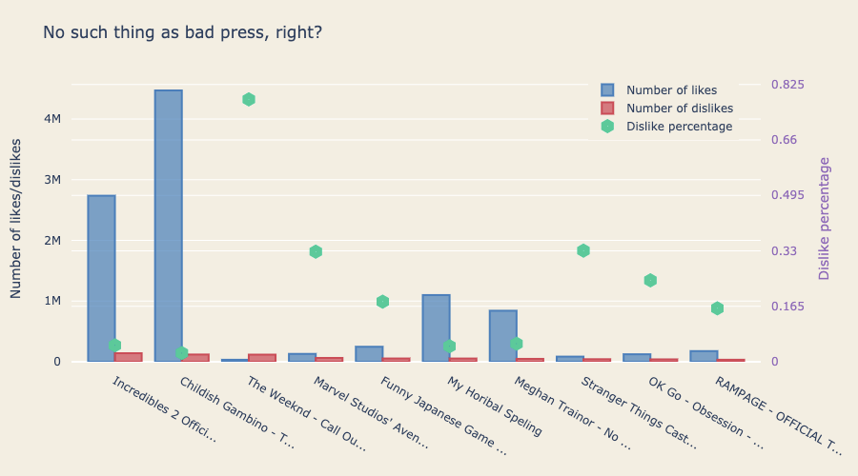
Videos with most dislikes

Slide 16
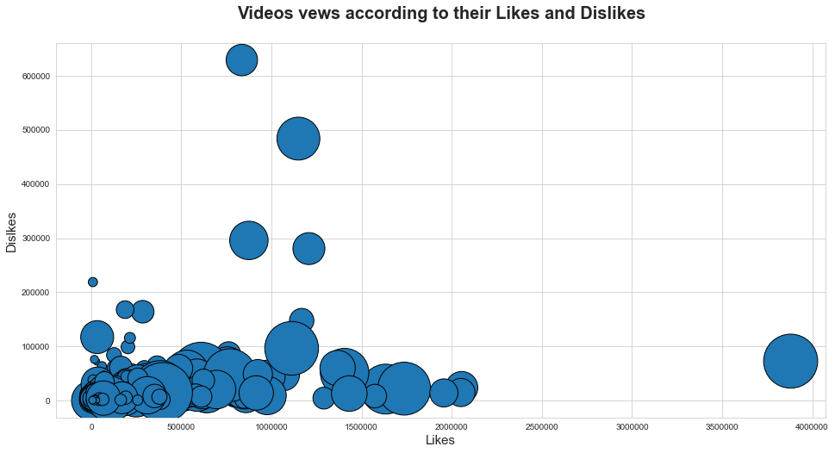
Views

Slide 17
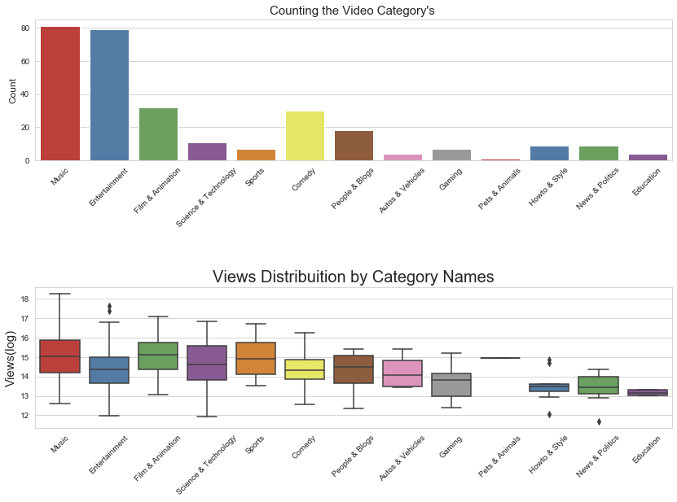
Music categories have the largest number of videos.
Likes, Dislikes and Comments Distribution by different Category Names.

Slide 18
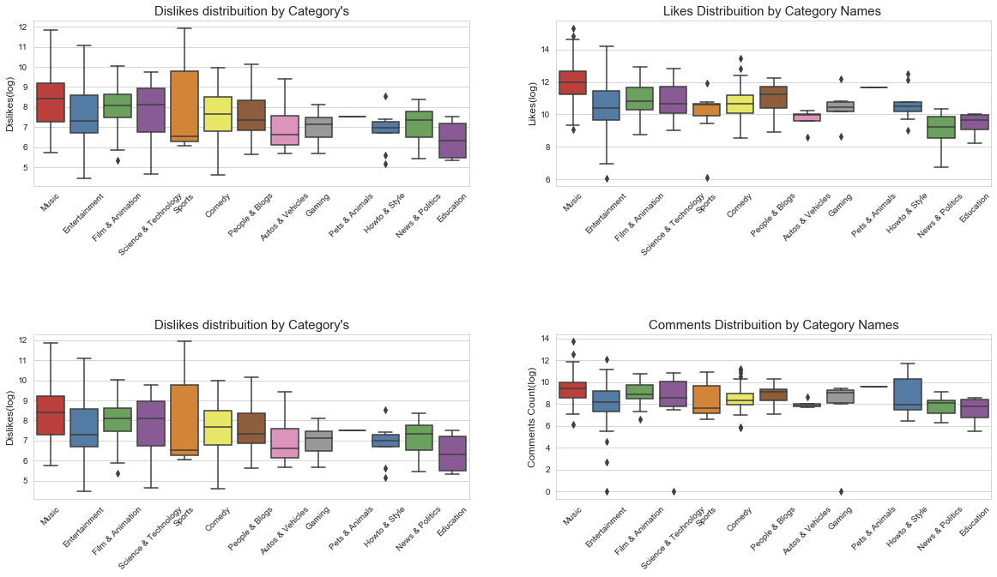

Slide 19
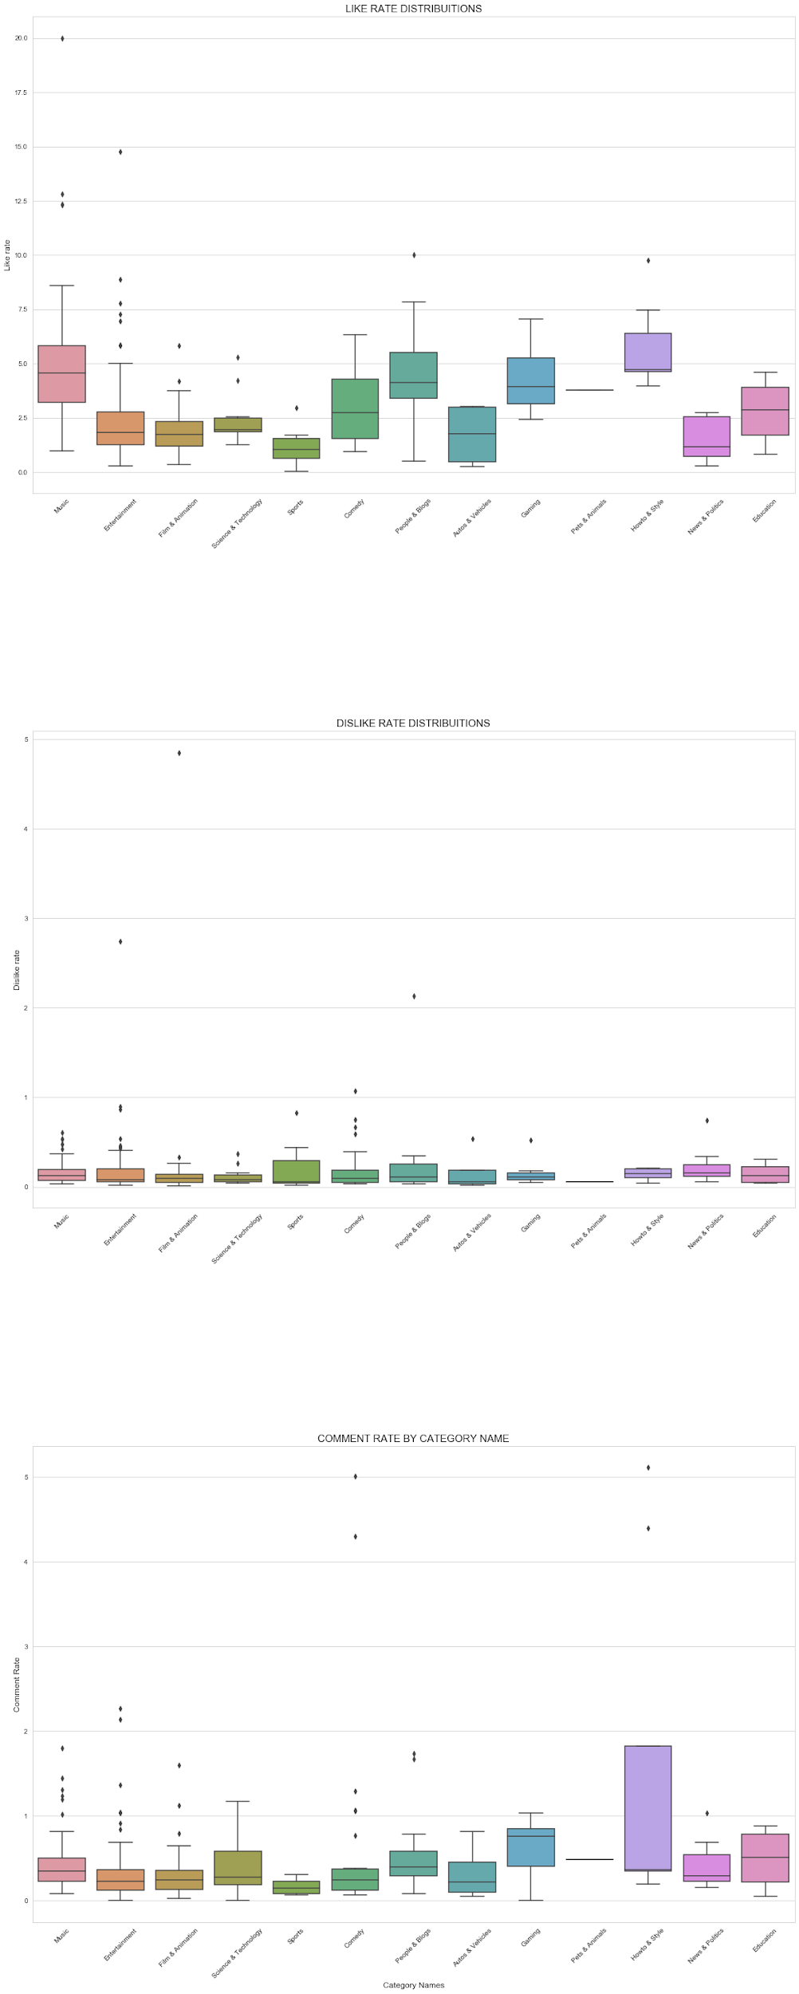
Like, Dislike and Comment Rate Distribution

Slide 20
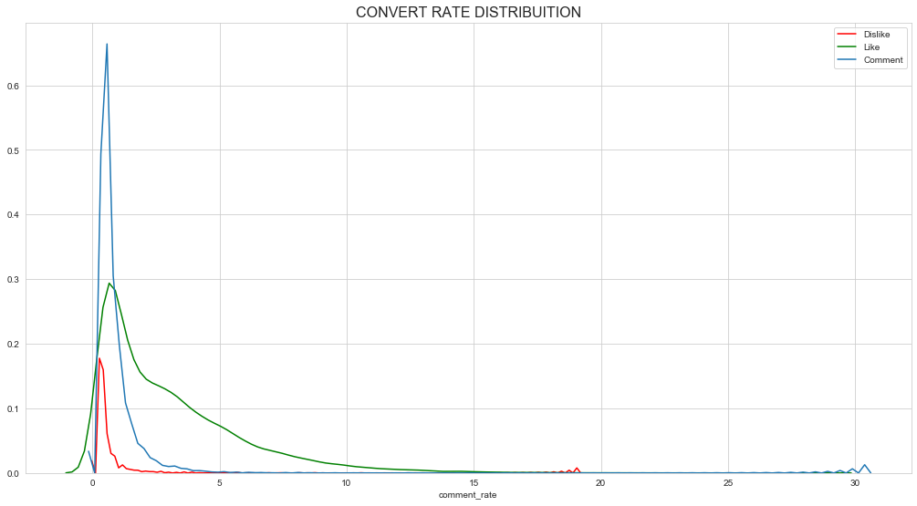
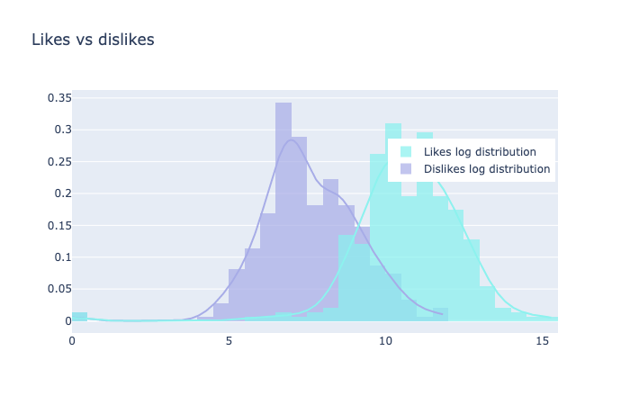
Relationship between Dislikes, Likes, and comments

Slide 21
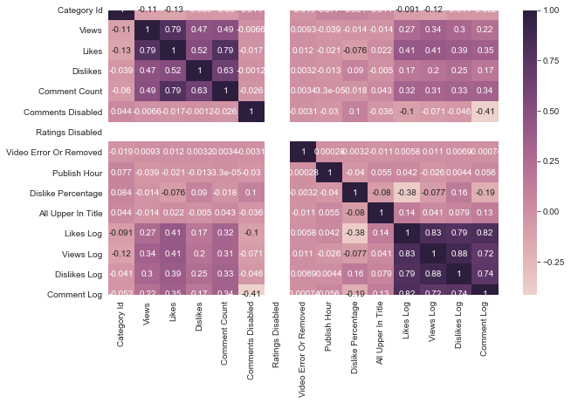
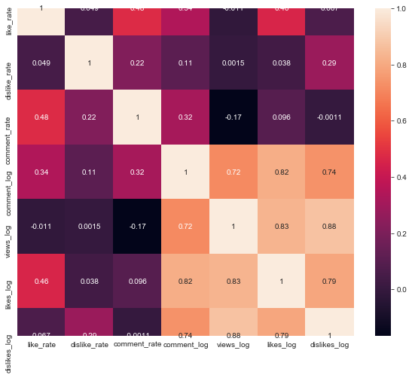
Correlation between dataset variables

Slide 22
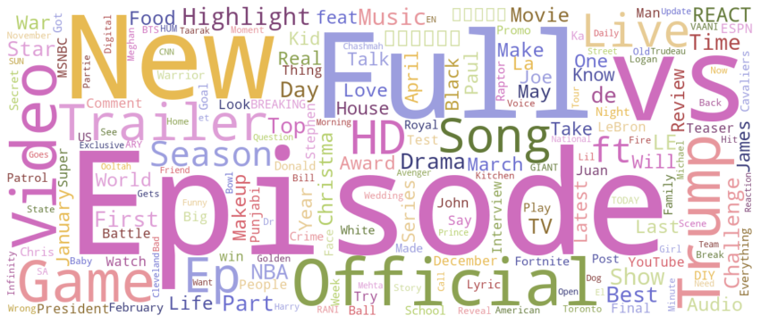
Most common Keywords in video titles

Slide 23

Natural Language Processing*
Content: Extract information from Tags & Description
Statistic & Preprocessing
The relationship between information from tag & description and the number of likes,dislikes,views and comments
The statistics of punctuation value
The correlation between the text and number of views
The visualization of titles, tags and descriptions by WordCloud
Sentiment Recognition
*Will be shown at ipynb File

Slide 24
Machine Learning Models*
Preprocessing
Prediction
Views: Polynomial Regression, Linear Regression, Random Forest
Likes: Linear Regression, Random Forest
Comments: Linear Regression, Random Forest
Classification
Conclusion
*Will be shown at ipynb file

Slide 25
Thank you for watching!

Slide 26
Reference
Covington, P., Adams, J., & Sargin, E. (n.d.). Deep Neural Networks for YouTube Recommendations. Retrieved April 15, 2020, from https://static.googleusercontent.com/media/research.google.com/zh-CN//pubs/archive/45530.pdf
Dataset Address: https://www.kaggle.com/datasnaek/youtube-new

