Slide 1
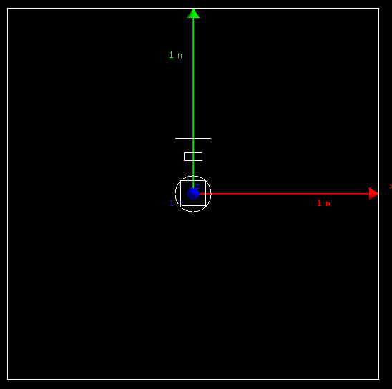
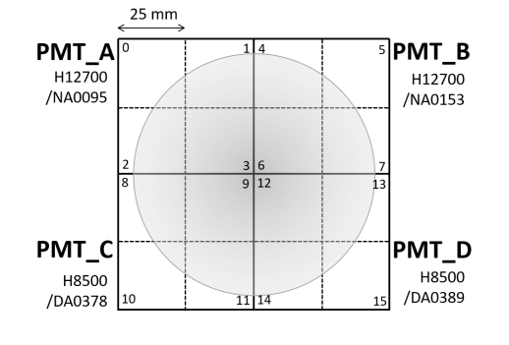
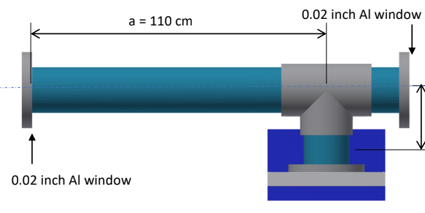
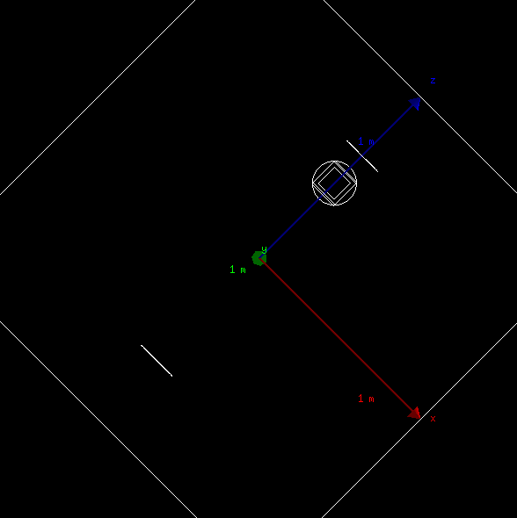
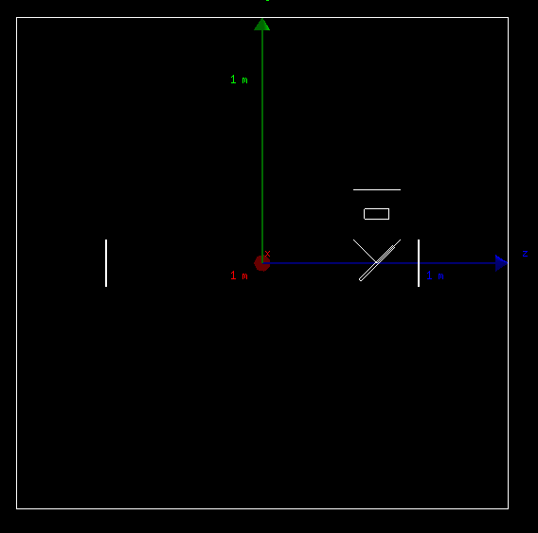
Cherkov prototype
CO2 Tub: d 0.1937*m
Mirror and PMT are put at 1.1*m(z)
PMT at 0.2(y)
Two 0.02inch Al window at each end of Tub
PMT size:0.1*m,0.1*m,0.02*m
Mirror:d/√2,d,0.005*m, rotate about x for 45 degree

Slide 2
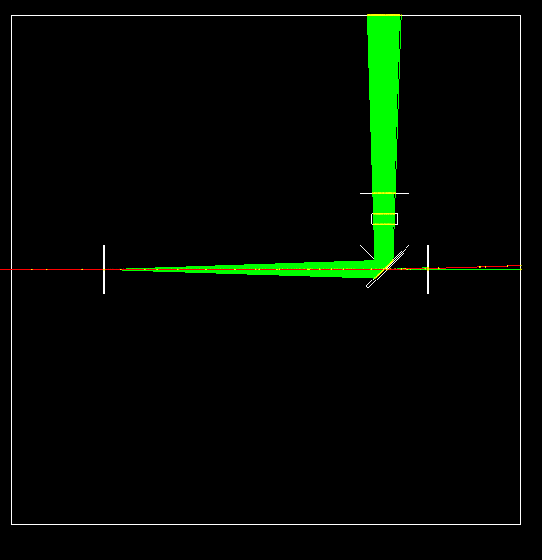
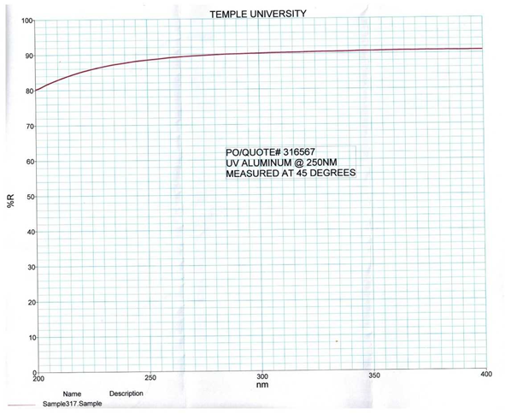
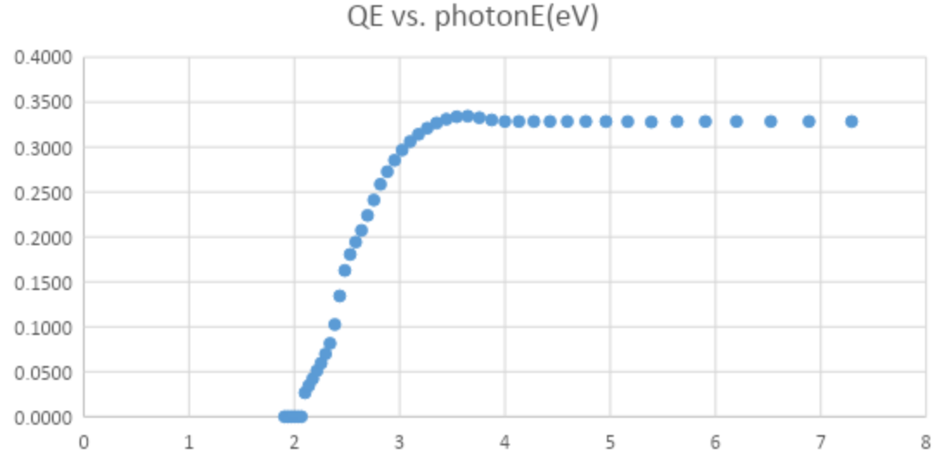
Shoot an electron
Shoot an electron at -10*m energy 3*GeV
Around 200 Cerenkov photons.
PMT recorded: around 50
PMT Quantum Efficiency
Mirror reflection

Slide 3
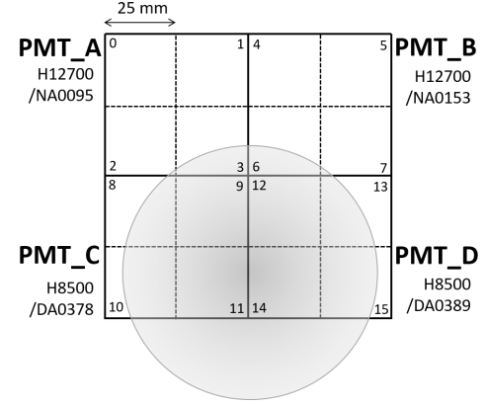
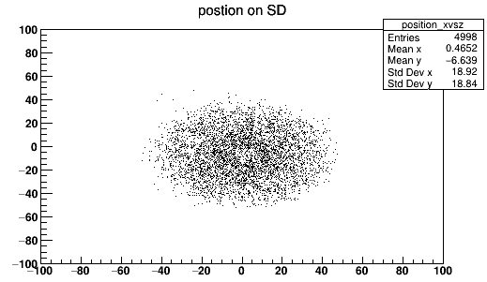
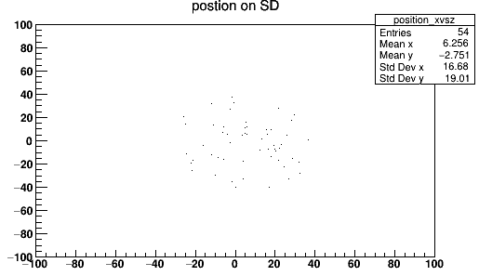
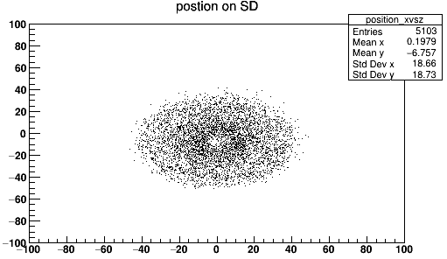
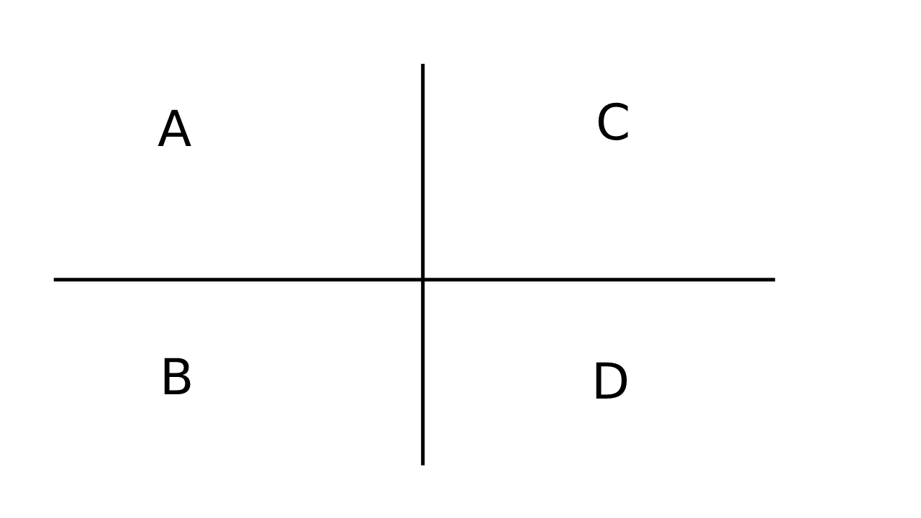
Position on PMT perfect condition
A
C
Shoot 1 electron at 3GeV
B
D
Shoot 100 electrons at 3GeV
Shoot 100 electron at 5GeV

Slide 4
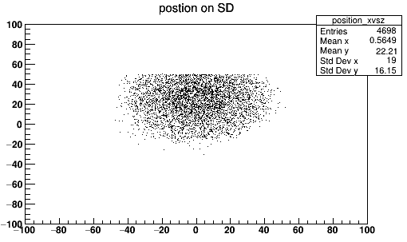
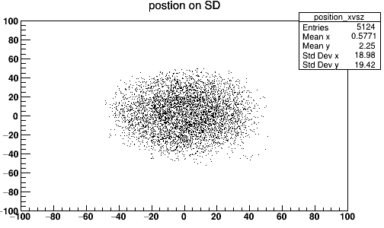
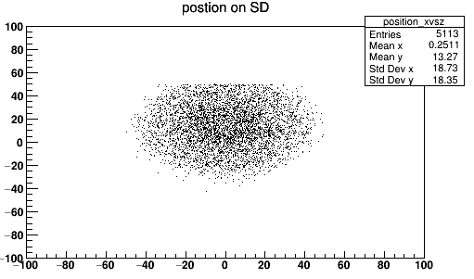
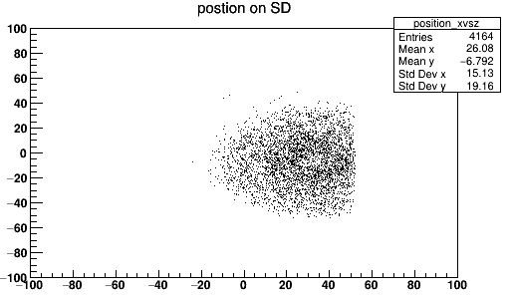
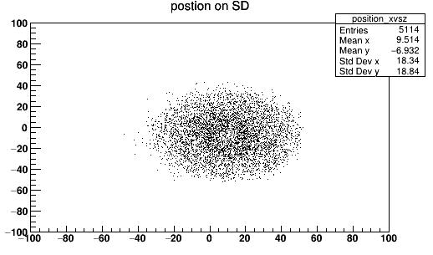
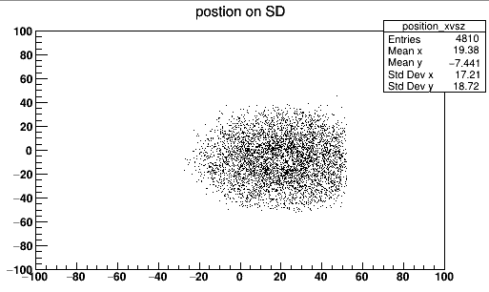
Reference:
Mean x: 0.46
Mean y: -6
Small angle for electron
along y
Shoot from 10*m away
Θ = 0.18degree
θ = 0.35degree
θ = 0.54degree
along x

Slide 5
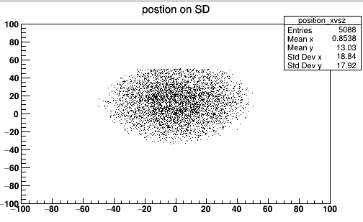
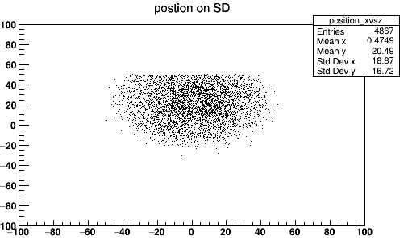
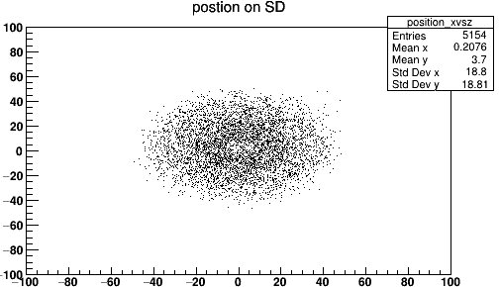
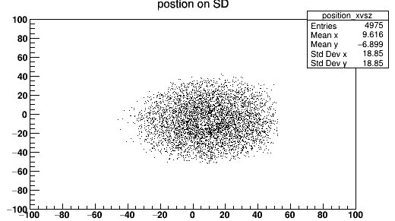
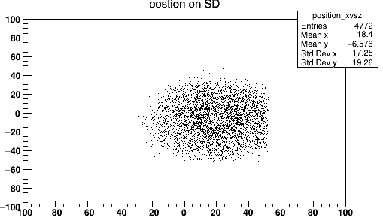
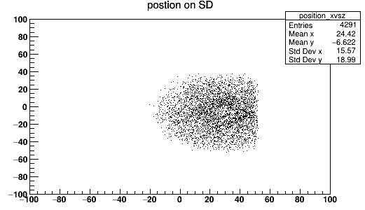
Reference:
Mean x: 0.46
Mean y: -6
Small offset for electron
along y
offset = 1*cm
offset = 2*cm
offset = 3*cm
along x

Slide 6
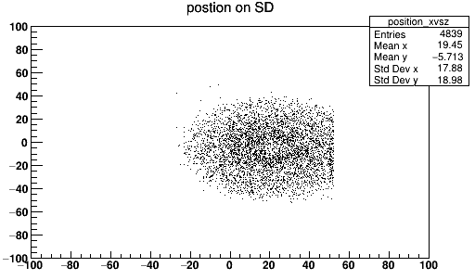
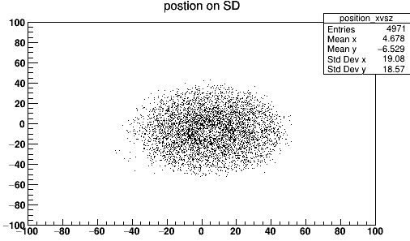
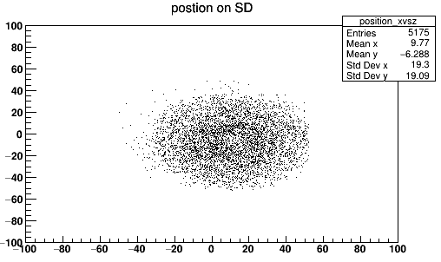
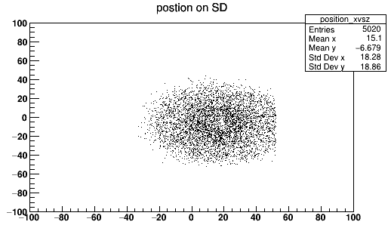
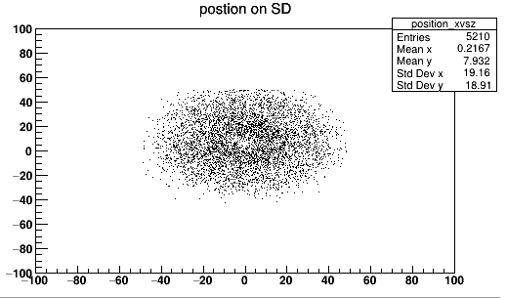
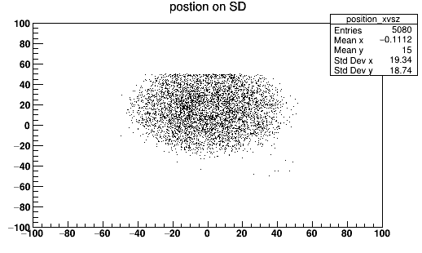
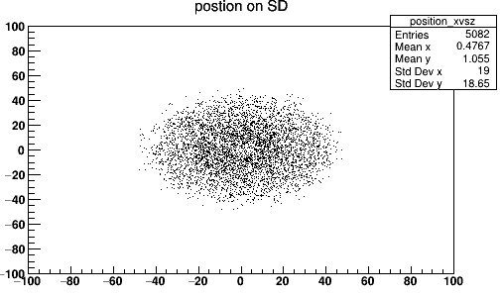
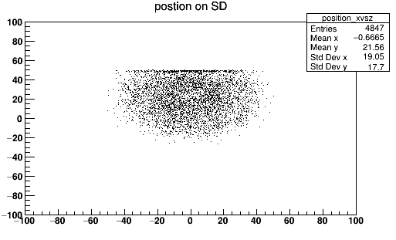
Reference:
Mean x: 0.46
Mean y: -6
Mirror angle
along y
angle = 1*degree
angle = 2*degree
angle = 3*degree
angle = 4*degree
along x

Slide 7
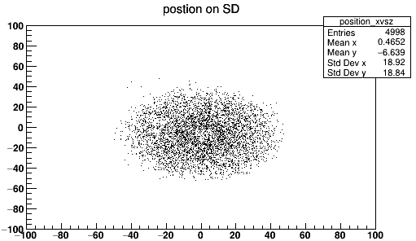
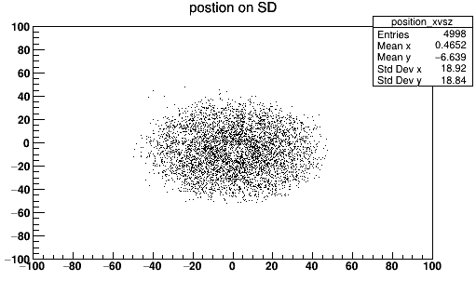
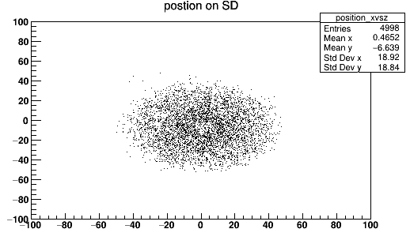

Mirror angle z

Slide 8
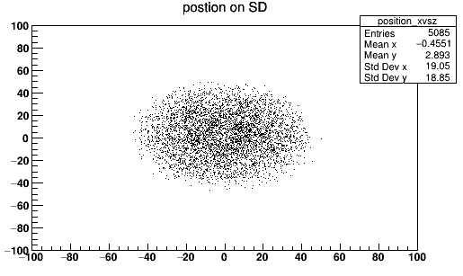
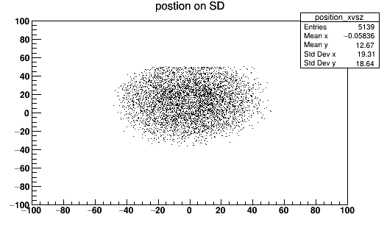
Mirror position z
Offset 1*cm
Offset 2*cm
Mirror position x and y shouldn’t matter

