Slide 1
Lecture Notes for Lecture 2 of CS 5007
(Computer Systems) for the Spring, 2018
session at the Northeastern University Silicon
Valley Campus.
Shells, System Commands, Scripting
Philip Gust,
Clinical Instructor
Department of Computer Science

Slide 2
Lecture 1 Review
l
l
l
l
l
In this lecture, we began exploring the most basic interface to a
computer system through its command line interface (CLI) and its
system commands.
We first looked at the high-level software architecture of a modern
computer system, with hardware at its core, then the OS kernel,
then utility functions and shells, and systems at the outer layer.
Next we learned about the Portable Operating System Interface, an
abstraction that can be implemented by many operating systems to
help support portability of utilities and applications
We also began studying bash command shell, and how it is used to
execute commands provided as part of the operating system.
Finally we looked at several of the commonly used POSIX
commands for interacting with the operating system, and a concept
called “software tools” for combining them.

Slide 3
Shells, System Commands, Scripting
l
l
l
In this lecture, we will continue exploring the capabilities of the
bash command shell, including how to apply the software tools
concept to usefully combine several tools to create a new one.
We will also continue exploring the many command line tools
available on POSIX compliant systems like Linux and MacOS and
through the CigWin POSIX layer on MS Windows.
Finally, we will briefly look at the command shell as a scripting
language, and how to write simple scripts with variables, control
flow and functions.

Slide 4
Shells, System Commands, Scripting
Listing Directory Content
To list the contents of a directory use the "ls" command:
list the contents of the current working directory
l
ls
ls -l dir_name
ls -al
ls *.jpg *.jpeg
ls -t
the contents of the directory “dir_name” in a long
(detailed) format
list all of the contents of the current working directory,
including "hidden" files (those that start with a '.'), in a
long (detailed format)
list the files ending with “.jpg” or “.jpeg” (presumably JPEG
image files) in the current working directory,
list the contents of the current working directory, sorted
from most recently created first, oldest last

Slide 5
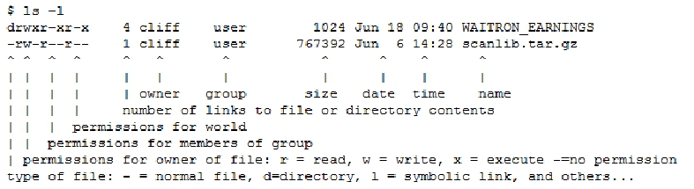
Shells, System Commands, Scripting
Listing Directory Content
Here's an annotated example of a listing command using the long
format:
l

Slide 6
Shells, System Commands, Scripting
Viewing and Editing Files
l
l
l
l
Here are commands used to view and edit files:
cat filename
Print the contents of the specified file to the screen (one or more files can
be specified and each will be printed to the screen - one concatenated
with the other
more filename
Print the contents of the specified file to the screen, but pause once the
contents have filled the available screen real estate before printing more;
when paused: ENTER = move one line down, SPACEBAR = page down, q =
quit printing
less filename
Like more, but you can move forwards and backwards throughout the file
using the arrow, page-up, and page-down keys (this utility is not available
on all systems)

Slide 7
Shells, System Commands, Scripting
Viewing and Editing Files
Here are commands used to view and edit files:
head filename
Print the first few lines of a file
head -n filename
Print the first n lines of a file
tail filename
Print the last few lines of a file
tail -n filename
Print the last n lines of a file
l
l
l
l
l

Slide 8
Shells, System Commands, Scripting
Viewing and Editing Files
l
l
l
Here are commands used to view and edit files:
vi filename
Edit a file using the vi editor (all POSIX systems will have vi in some form,
if using CYGWIN the "vim" package must be specified)
emacs filename
Edit a file using the emacs editor (not all systems will have emacs)

Slide 9
Shells, System Commands, Scripting
Moving, Renaming, and Copying Files
l
l
l
l
Here are commands used to move, rename, and copy files:
cp file1 file2
copy a file ("file1" is copied to a new file named "file2")
mv file1 newname
move or rename a file ("file1" is renamed to "newname")
mv file1 ~/AAA/
move "file1" into sub-directory "AAA" in your home directory

Slide 10
Shells, System Commands, Scripting
Moving, Renaming, and Copying Files
l
l
l
Here are commands used to move, rename, and copy files:
rm file
remove or delete a file (one of more files may be specified)
rm -r dir1
recursively remove a directory and its contents (one or more directories
may be specified) - BE CAREFUL!

Slide 11
Shells, System Commands, Scripting
Moving, Renaming, and Copying Files
Here are commands used to move, rename, and copy files:
mkdir dir1
create directories (one or more directories may be specified)
mkdir -p dirpath
create the directory path, including all implied directories necessary to
create the specified directory path
(e.g.: if "some/new_dir" is specified, the subdirectory "some" will be
created, if necessary, before creating "new_dir"; one or more directory
paths may be specified)
rmdir dir1
remove an empty directory (one or more directories may be specified)
l
l
l
l

Slide 12
Shells, System Commands, Scripting
Counting Lines, Words, and Characters
l
l
l
l
wc some_file
counts the number of lines, words, and characters in the file:
12 35 292 some_file
wc –l some_file
counts only the number of lines in the file:
12 some_file
wc –w some_file
counts only the number of words in the file:
12 some_file
wc –c some_file
counts only the number of characters in the file:
292 some_file

Slide 13
Shells, System Commands, Scripting
Interactive History
Bash keeps track of the recent commands you've issued.
Each time you press the up-arrow key, bash will place the next
newest command you issued on your command line for you.
You can then edit the command and re-execute it.
You can also use the history command to list the history
l
l
l
l

Slide 14
Shells, System Commands, Scripting
Command Completion
l
l
l
l
Another feature of bash is that you can use the TAB key to
complete something you've partially typed (e.g.: a command,
filename, environment variable, etc.).
Suppose you have a file named "constantine-monks-and-willy-
wonka.txt" in your directory and want to edit it.
You can type "vi const", hit the TAB key, and the shell will fill in the
rest of the name for you, assuming the completion is unique (i.e.:
no other items in the directory begin with "const").
If the completion is not unique, you can hit TAB twice and bash will
print out all the possible completions that are available.

Slide 15
Shells, System Commands, Scripting
Variables
l
l
l
l
You can teach the shell to remember things for later using
environment variables. For example:
MY_PROJECT=~/my_project
Defines the variable "MY_PROJECT" with the value "~/my_project"
MY_CLASSES=$MY_PROJECT/bin
Defines the variable "MY_CLASSES" with the value of "MY_PROJECT" with
"/bin" appended (this will be "~/my_project/bin" if "MY_PROJECT" is
defined as above)
CLASSPATH=$MY_CLASSES:$CLASSPATH
Prepends the value of "MY_CLASSES" to the existing definition of
"CLASSPATH"
Notes:
~/desktop
shorthand for your home directory

Slide 16
Shells, System Commands, Scripting
Variables
l
l
l
By prefixing a dollar sign, "$", to the variable name, you can
evaluate it in any command:
cd $MY_PROJECT
Changes your current working directory to the value of the
"MY_PROJECT" variable
echo $MY_PROJECT
Prints out the value of "MY_PROJECT" (this will be "~/my_project"
if "MY_PROJECT" is defined as above)
Notes:
$HOME -> /Users/Yoghurt

Slide 17
Shells, System Commands, Scripting
Pipes
l
l
The pipe symbol "|" (<shift>+backslash on most keyboards) is used
to direct the output of one command to the input of another.
This is an enormously powerful construct. You can chain together
utilities that each do a simple task in ways that allow you to
accomplish much more complex tasks.

Slide 18
Shells, System Commands, Scripting
Pipes
l
l
l
Here are some examples:
ls -l /etc | more
This command takes the output of the long format directory list
command "ls -l /etc" and pipes it through the "more" command. In
this case a very long list of files can be viewed a page at a time.
ls /etc | sort | tail –n 5
This command takes the output of the regular format directory list
command ”ls” and pipes it through the “sort” command that
outputs its input in sorted order, then lists the last 5 entries.
Notes:
ls |sort |tail -5

Slide 19
Shells, System Commands, Scripting
Pipes
l
l
Note that most commands that will accept a filename as an
argument can be used as a receiver of pipe data:
The command
head -n1 some_file
and
cat some_file | head -n1
will result in the same output, namely the first line of "some_file".

Slide 20
Shells, System Commands, Scripting
Pipes
l
l
l
ls some_directory | wc -l
The command counts the number of files and directories contained
in the directory some_directory.
Note that most commands that will accept a filename as an
argument can be used as a receiver of pipe data:
The command
head -n1 some_file
and
cat some_file | head -n1
will result in the same output, namely the first line of "some_file".

Slide 21
Shells, System Commands, Scripting
Redirection
l
l
l
The redirection directives, ">" and ">>" can be used on the output
of most commands to direct their output to a file.
head -n 10 some_file > new_file
Redirects the output of the head command (detailed above) to a
file "new_file"
head -n 10 some_file >> exist_file
Redirects the output of the head command to the end of
"exist_file"

Slide 22
Shells, System Commands, Scripting
Command Substitution
You can use the output of one command as an input to another
command in another way called command substitution.
Command substitution is invoked by enclosing a command as
$(command).
Here is an example of this in action:
l
l
l
l
cat $(head -n1 some_file)
This will read the first line from "some_file" and use it as the
filename argument to the cat tool, which will print the contents.

Slide 23
Shells, System Commands, Scripting
Command Substitution
Here is another example of this in action:
l
l
l
time_stamp=$(date)
This will set the shell variable ”time_stamp” to a string with the
current date and time: “Wed Mar 14 00:24:38 PDT 2018”
To print the date and time the variable was set, you can issue a
“echo $timestamp” command.
first_file=$(head -n1 some_file)
This will set the shell variable “first_file” to the first file name name
stored in file "some_file" .
To print the referenced file you could issue a "cat $first_file"
command.

Slide 24
Shells, System Commands, Scripting
Searching for Files by Name
l
l
l
l
To find files within the filesystem use the "find" command. This
will search a given directory and all it's subdirectories for items
specified by the arguments specified. For example:
find search_path -name some_name
This searches "search_path" for items named "some_name"
find . -name aaa.txt
Finds all the files named aaa.txt in the current directory or any
subdirectory tree
find / -name vimrc
Find all the files name 'vimrc' anywhere on the system

Slide 25
Shells, System Commands, Scripting
Searching for Files by Name
l
find /usr/bin -name "*svn*"
Find all files whose names contain the string "svn" which exist
within the "/usr/bin" directory tree.
Note the special syntax here for the specified search name.
The asterisks ('*') in a search string will be matched to any string,
including the empty string - this allows for the search to locate
items with "svn" anywhere in the name
This requires quoting the search string, or the shell will interpret
the string before passing it to the find command.

Slide 26
Shells, System Commands, Scripting
Searching for Strings in Files
l
l
l
l
l
To search within the contents of a file use the "grep" command.
For example:
grep "find me" some_file
prints all the lines in "some_file" that contain "find me"
grep “find me” some_directory
prints all the lines of files in some_directory that contain “find me”
grep –r “find me” some_directory
prints all the lines of files in some_directory or any of its direct or
indirect child directores that contain “find me”
ls /etc | grep “a”
prints all the files or directories in the "/etc" directory that have the
letter 'a' in their name

Slide 27
Shells, System Commands, Scripting
Looking for Help: man and apropos
l
l
l
l
This tutorial merely scratches the surface of the available tools and
features provided by the bash shell.
Fortunately, almost everything you can do at the command line is
well documented in manuals available from within the command
line interface.
When reading a manual page, navigation is the same as that when
using the "less" tool described earlier (e.g.: arrow keys, page
up/down move around the manual, and 'q' will exit).
These manuals can be displayed using the "man" command, and
the descriptions of each manual page can be searched using the
"apropos" command.

Slide 28
Shells, System Commands, Scripting
Looking for Help: man and apropos
l
l
l
l
l
Here are examples of accessing the built-in manual pages and their
descriptions :
man ls
Shows the manual page for the "ls" command
man bash
Shows the manual page for the "bash" shell (peruse this to get a
sense for just how deep the bash feature set truly is)
man strcpy
Shows the manual page for the strcpy() C language function
apropos build
Shows a list of all the man pages whose descriptions contain the
word "build"

Slide 29
Shells, System Commands, Scripting
Create a Script File
#!/bin/bash
# file name: “hello.sh”
echo Hello, you passed $# parameters
Parameters are accessed by position: $1 for the first parameter, $2
for the second one, etc. $# is the number of parameters.
You can run the script in one of two ways:
l
l
l
l
Run bash and pass in the script and parameters
Change the file permissions to “executable” to run it as a normal program:
chmod +x hello.sh

Slide 30
Shells, System Commands, Scripting
Create a Script File
l
l
l
Passed in to bash with parameters
bash ./hello.sh
bash ./hello.sh world
bash ./hello.sh from around the world
Run as executable
./hello.sh
./hello.sh world
./hello.sh from around the world
Output is
Hello, you passed 0 parameters
Hello, you passed 1 parameters
Hello, you passed 4 parameters

Slide 31
Shells, System Commands, Scripting
Basic If Statement
l
l
A basic if statement effectively says, if a particular test is true, then
perform a given set of actions. If it is not true then don't perform
those actions.
if [ <some test> ]
then
<commands>
else
<commands>
fi
Anything between then and else will be executed only if the test
(between the square brackets) is true, and between the else and
the fi (if backwards) if the test is false.

Slide 32
Shells, System Commands, Scripting
Basic If Statement
value=1000
if [ $value –gt 100 ]
then
echo Hey, $value is a large number
else
echo Hey, $value is too small
fi
Outputs “Hey, 1000 is a large number”
You can add “elif [ <condition> ]” for additional conditions
l
l

Slide 33
Shells, System Commands, Scripting
Tests
Operator | Description
!EXPRESSION | The EXPRESSION is false.
-n STRING | The length of STRING is greater Than zero.
-z STRING | The lengh of STRING is zero(ieit isempty).
STRING1=STRING2 | STRING1isequaltoSTRING2
STRING1!=STRING2 | STRING1isnotequaltoSTRING2

Slide 34
Shells, System Commands, Scripting
Tests
Operator | Description
INTEGER1-eqINTEGER2 | INTEGER1isnumericallyequalto INTEGER2
INTEGER1-gtINTEGER2 | INTEGER1isnumericallygreater thanINTEGER2
INTEGER1-ltINTEGER2 | INTEGER1isnumericallylessthan INTEGER2

Slide 35
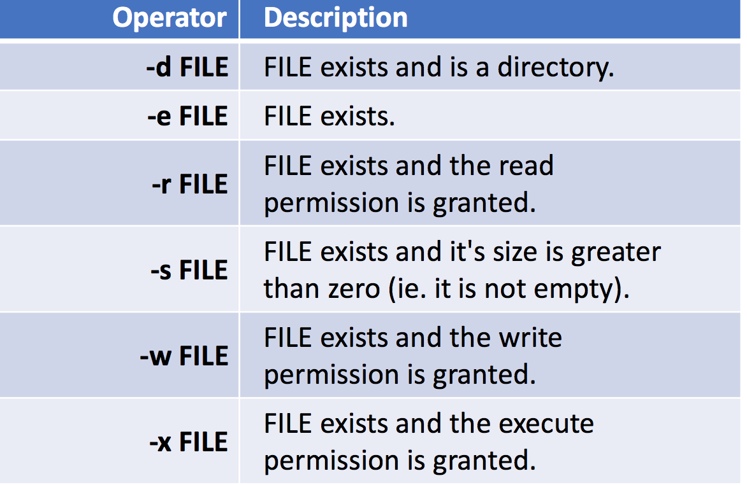

Slide 36
Shells, System Commands, Scripting
While Loop
One of the easiest loops to work with is while loops. They say,
while an expression is true, keep executing these lines of code.
They have the following format:
while [ <some test> ]
then
<commands>
done
Anything Between then and done will Be executed while the test
(Between the square Brackets) is true.
l
l

Slide 37
Shells, System Commands, Scripting
While Loop
counter=1
while [ $counter -le 10 ]
do
echo $counter
((counter++))
done
echo All done
Outputs the number 1 through 10, and then “All done”
l

Slide 38
Shells, System Commands, Scripting
For Loop
The for loop is a little bit different to the previous two loops. What
it does is say for each of the items in a given list, perform the given
set of commands. It has the following syntax.
for var in <list>
do
<commands>
done
Anything between do and done will be executed only once for each
item in the list.
l
l

Slide 39
Shells, System Commands, Scripting
For Loop
names='Stan Kyle Cartman'
for name in $names
do
echo $name
done
echo All done
l
Outputs
Stan
Kyle
Cartman
All done

Slide 40
Shells, System Commands, Scripting
For Loop
for value in {1..5}
do
echo $value
done
echo All done
l
Outputs
1
2
3
4
5
All done

Slide 41
Shells, System Commands, Scripting
For Loop
for name in *.pdf
do
echo $name
done
echo All done
Outputs list of PDF files in the current directory, one per line.
l

Slide 42
Shells, System Commands, Scripting
Function
l
l
A function can have one of two equivalent forms
function_name() {
<commands>
}
or
function function_name {
<commands>
}
Parameters are accessed by position: $1 for the first parameter, $2
for the second one, etc. $# is the number of parameters.

Slide 43
Shells, System Commands, Scripting
Function
function howdy {
if [ $# -eq 0 ]
then
echo howdy stranger
else
echo howdy $1
fi
}
howdy
howdy friend
l
Output is
howdy stranger
howdy friend

