Slide 1


[ViralMind Design System]
Kỷ nguyên Giao diện
Mới của ViralMind:
Nền tảng UI Kit 2026
Version 2.0 | Bản phát hành Mùa Xuân 2026
Notebook<LM

Slide 2


Slide 3
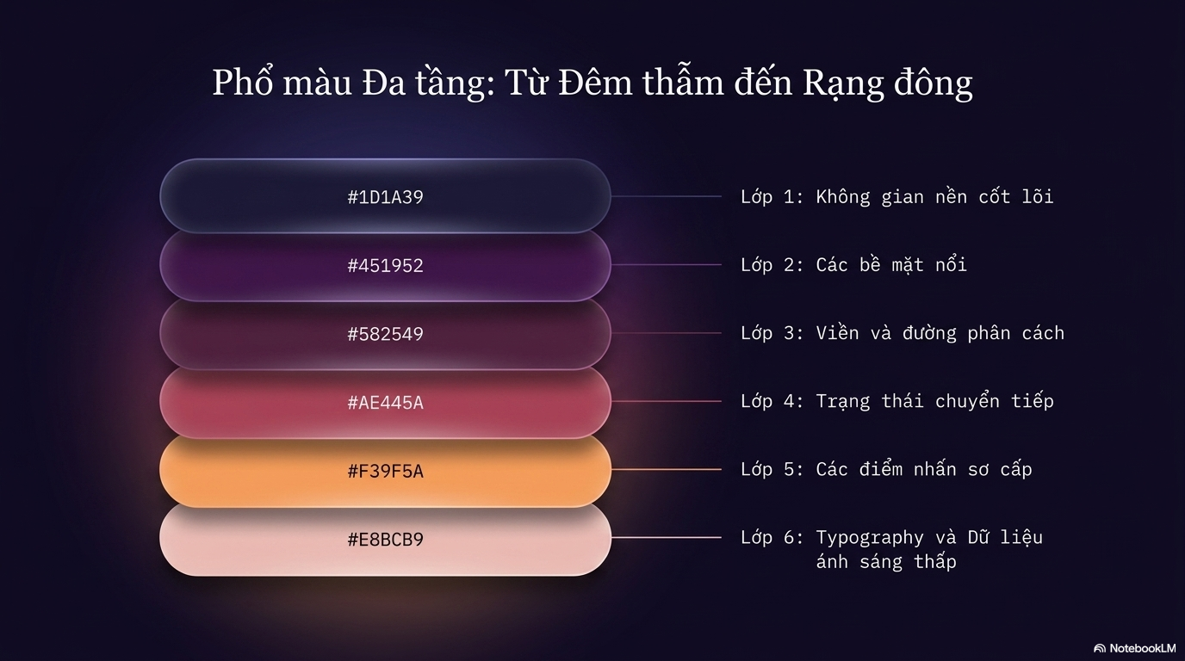

Slide 4
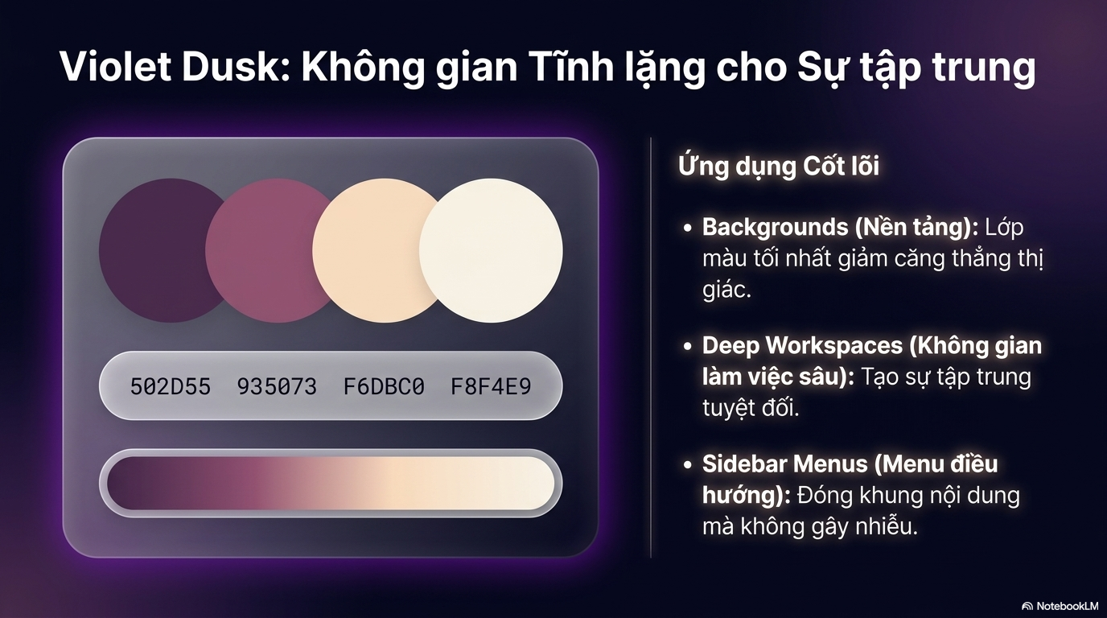

Slide 5
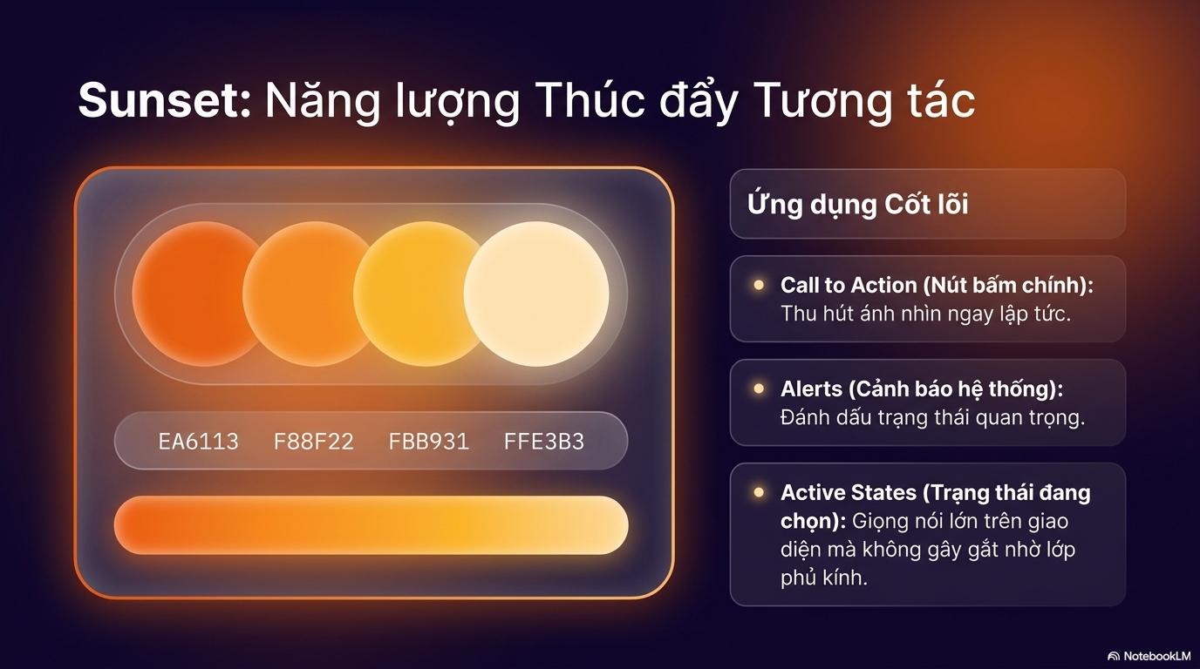

Slide 6
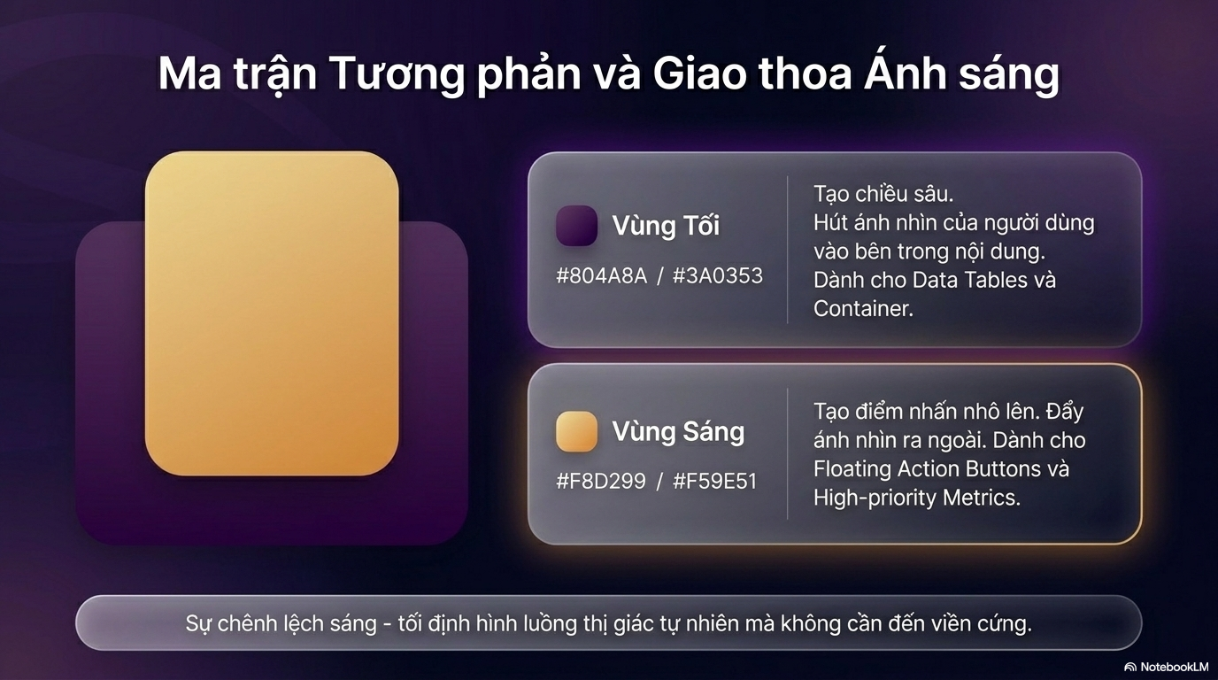

Slide 7
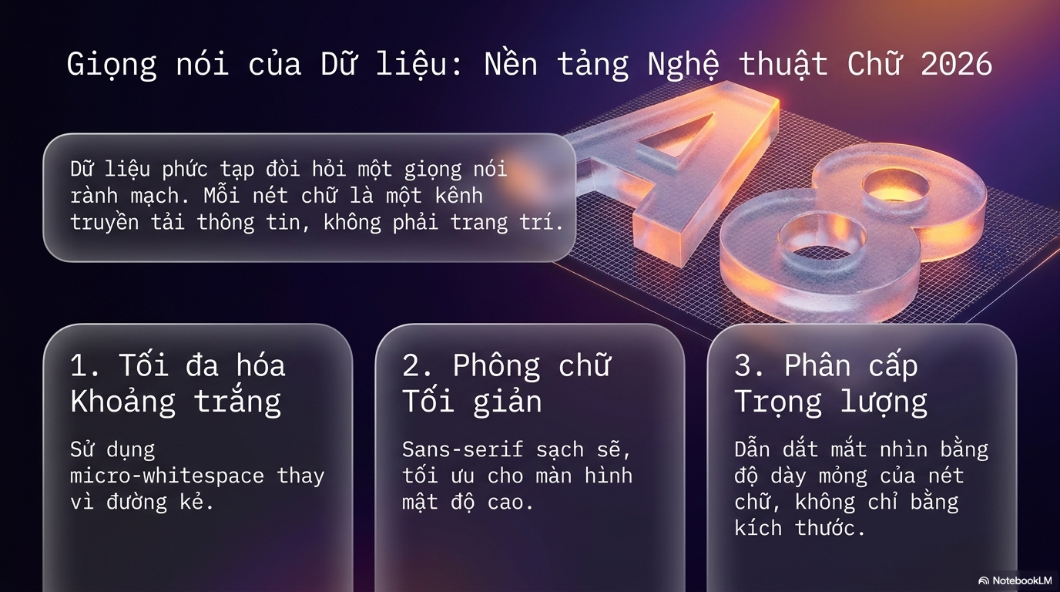

Slide 8
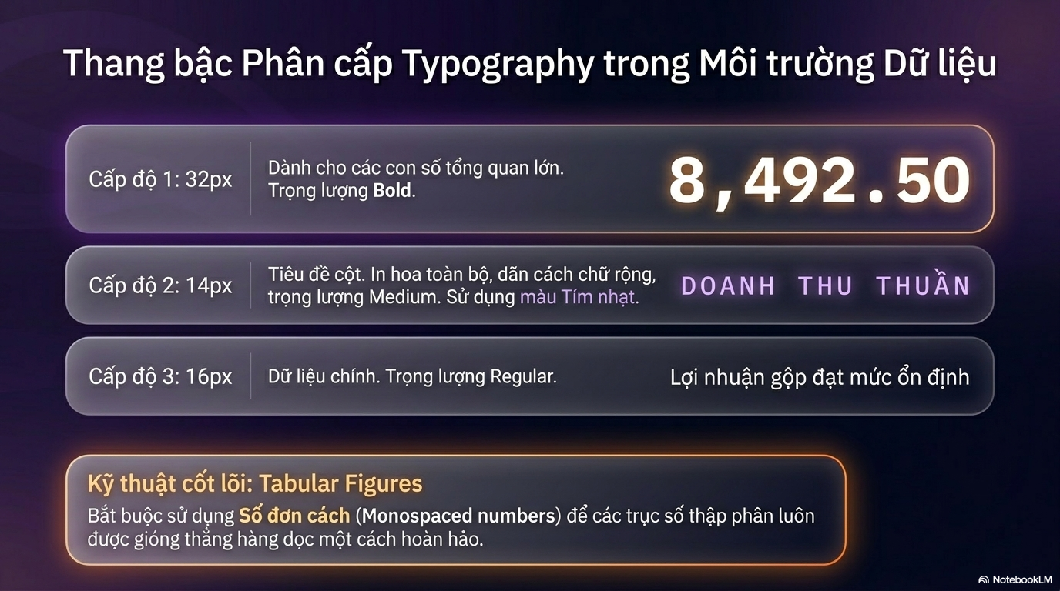

Slide 9
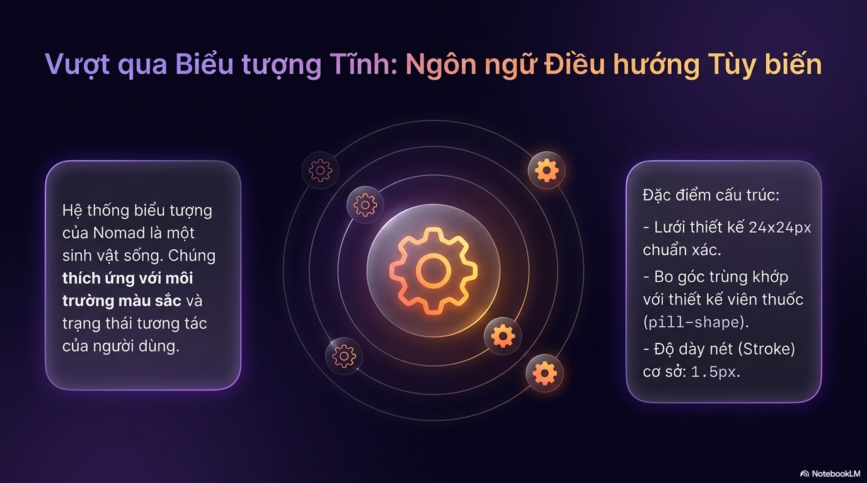

Slide 10
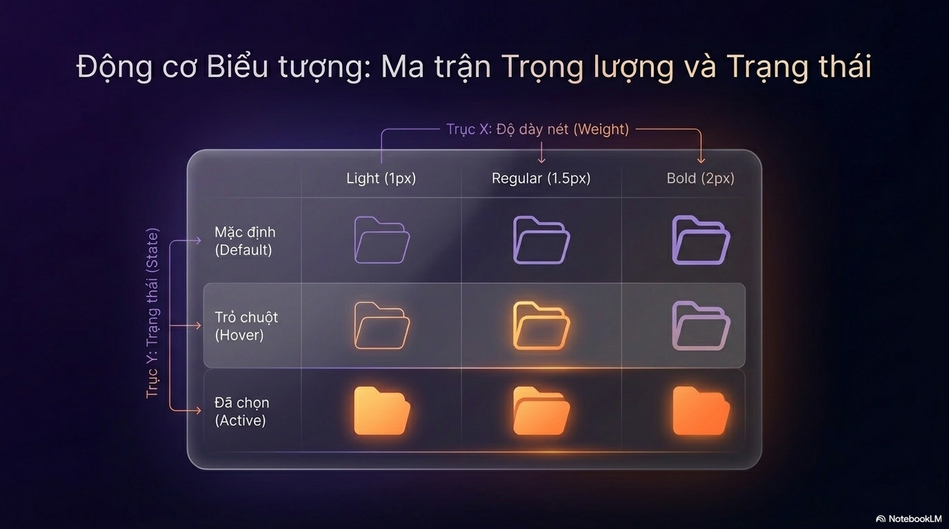

Slide 11


Slide 12


Slide 13
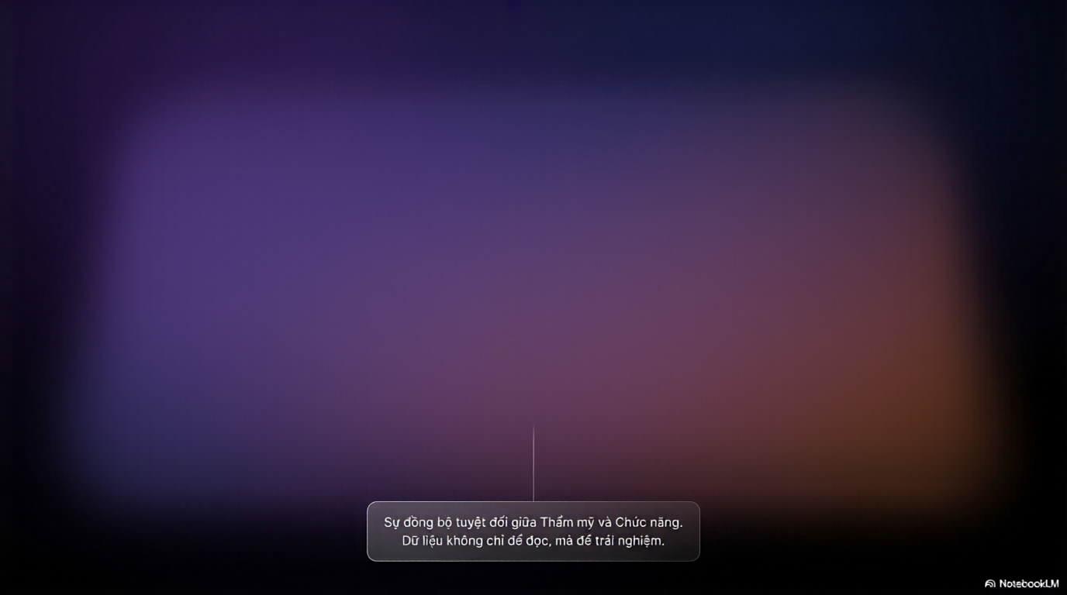
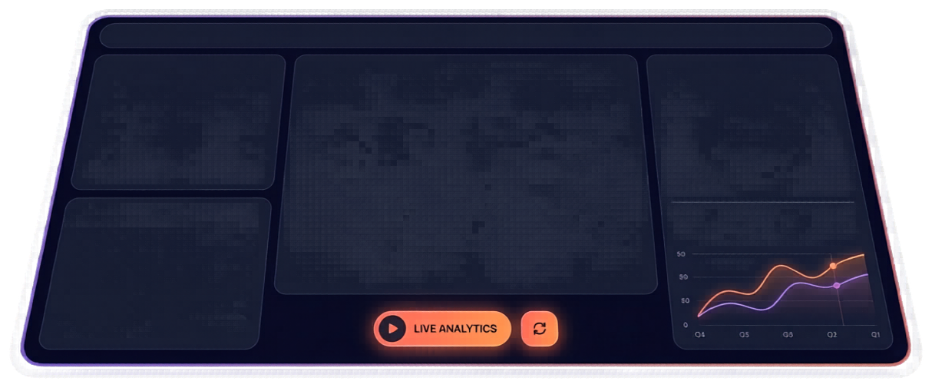

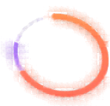
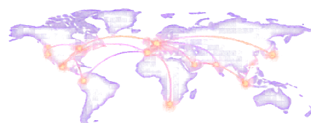


Định hình Tương lai: Bảng điều khiển ViralMind 2026
VIRALMIND
LAST UPDATE: 14:25 UTC
SYSTEM STATUS: OPTIMAL
ALERT: CYBERSECURITY PROTOCOL ALPHA
DATA TABLE
GLOBAL MOBILITY NETWORK
FINANCIAL PULSE
NUBE
NAME
%
ACTIVE NOMADS
NEW REGISTRATIONS (G3)
PRIMAVV HUBS
TOTAL ECOSYSTEM VALUE
Lisbon
2,450,000
+12.5%
2,450,000
+12.5%
LISBON, BALI, MEXICO CITY, CAPE TOWN, MEDELLIN
Mexico City
1,550,000
+12.5%
Cape Town
332,000
+12.5%
$145.8B
Cape Town
753,000
+12.5%
Medellin
330,000
+12.5%
RESOURCE ALLOCATION
Q4 REVENUE TREND
PROJECTED Q1 2027
SERVER CAPACITY
$18.2B
$20.1B
82%
BANDWIDTH USAGE
LAST UPDATE
SYSTEM STATUS
75%
14:25 UTC
OPTIMAL
ENERGY EFFICIENCY
94%

Slide 14


