Slide 1
LocalIn
An Interactive Visualisation for Social Integration in a New City
COMP/INFS 532
Individual Project
June 2026
Yanming Shao · ID 1682278
menhulu.github.io/LocalIn

Slide 2
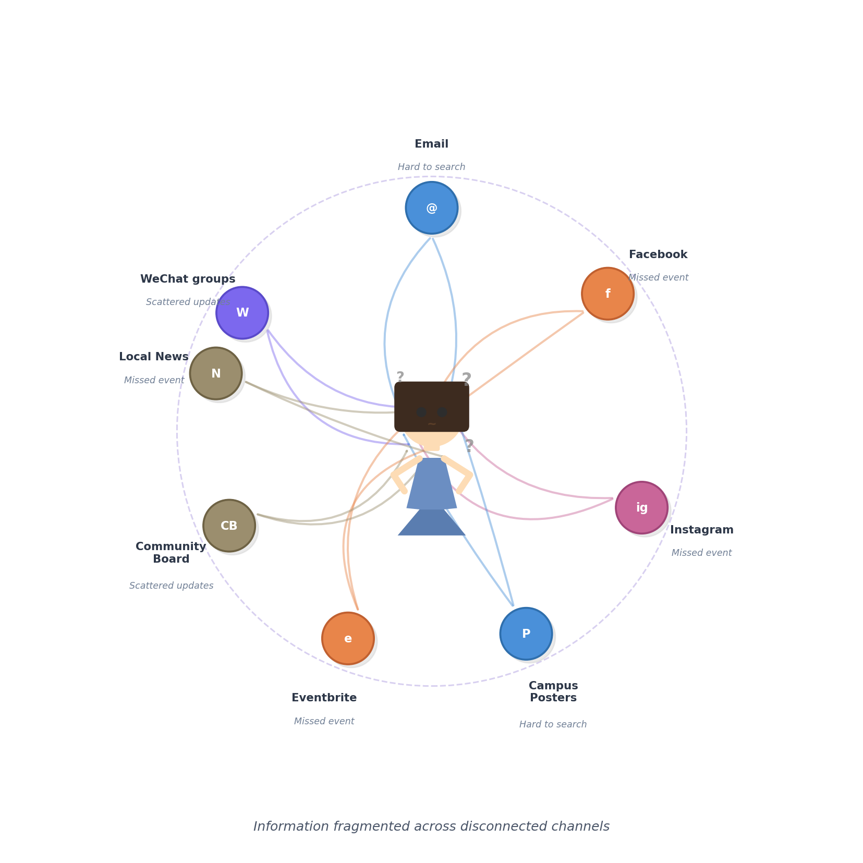
My Story
February 2026 — I arrived in Hamilton, New Zealand.
THE INFORMATION OVERLOAD PROBLEM
Newly arrived in a city like Hamilton, I faced a significant challenge in discovering local activities and connecting with people.
Information was severely fragmented across disparate channels: WeChat groups for the Chinese community were hard to track; university activities via email and posters were easy to miss; and local community events on Facebook, Instagram, and Eventbrite offered no clear discovery signals.
This diagram illustrates the overwhelming and uncoordinated nature of that experience.
February 2026 — I arrived in Hamilton, New Zealand.

Slide 3
So I ran a survey.
Before designing anything, I asked 17 newcomers in New Zealand
about their experience finding and joining community activities.
17
6
7
Survey Responses
Questions
Countries
China · India · Indonesia · Malaysia · Mongolia · Nepal · Sri Lanka · Bangladesh
6-question survey — Google Forms — May–June 2026

Slide 4
Survey Findings
17 newcomers · 6 questions · Hamilton, New Zealand
94.1%
82.3%
82.3%
missed an event simply
because they didn't know
it existed
said a map platform would
have been useful when
they first arrived
hesitated to go to an
event alone — even when
they knew about it
3+ channels
52.9%
Word of mouth, social media, Google — yet people still miss events. No single source is enough.
are from China — their main channel is WeChat, which can't be searched or discovered by outsiders.
LocalIn was designed to solve exactly this — one map, every event, zero channels to juggle.

Slide 5
Finding #1
Discovery is fragmented and unreliable
Q3 — How did you mainly find out about local activities?
Q2 — How easy to find activities?
52.9%
rated difficulty 3 / 5
(moderate, even after weeks of trying)
Only 23.5% found it easy (1/5)
Scattered: WeChat · Email · Facebook · Posters

Slide 6
Finding #2
Newcomers miss events — and hesitate to go alone
Q4
Q6
Q3
94.1%
52.9%
82.4%
missed a community event because they didn't know it existed
hesitated to attend because they didn't know anyone going
felt socially isolated sometimes or often in first 3 months

Slide 7
Finding #3
There is clear demand for a unified platform
"Would a single platform showing activities, community hotspots, and social connections on a map have been useful when you first arrived?"
Definitely
58.8%
Probably
23.5%
Not sure
11.8%
Probably not
5.9%
82.3% said Definitely or Probably

Slide 8
Introducing LocalIn
A web prototype combining geographic discovery, temporal analysis, and social network tracking — all in one integrated tool.
01
Interactive Map
02
Timeline & Calendar
03
Social Network Graph
Colour-coded pins, category & newcomer filters, click for details. Cross-view linked.
Heatmap calendar showing activity peaks. Seasonal trend chart for the full year.
D3 force-directed graph. Week 1 to 6 journey shows your growing connections.
04
Integration Dashboard
05
Post Your Activity
Personal tracker: days in city, activities, connections, integration score. Radar chart + progress bar.
Publish events as gold pins on the map. Your activity appears in the shared feed.

Slide 9
Data Sources
Real New Zealand data — collected and verified from public sources.
Local Event & Council Pages
01
Verified
Hamilton City Council, Auckland Council Welcoming Communities, Waikato Regional Council. Cross-referenced.
Parkrun NZ (parkrun.org.nz)
02
Real Data
Real locations and schedules for Hamilton Lake, Auckland, Wellington, Rotorua, Dunedin. 5 routes confirmed.
Cultural & Newcomer Organisations
03
Sourced
Hamilton Multicultural Centre, UoW International Student Association, Auckland Welcoming Communities.
Representative Dataset — 50 Activities, 7 Cities
04
7 Cities
Hamilton · Auckland · Wellington · Christchurch · Tauranga · Rotorua · Dunedin. Population-proportional.
User Survey — n=17 (Primary Research)
05
Primary
Original survey, May–June 2026. International students and recent migrants. Full instrument in appendix.

Slide 10
Design Rationale
Every view answers a specific question a newcomer would ask.
Interactive Map
"What's happening near me right now?"
01
Newcomers don't know the city — geographic context is essential. Leaflet clustering prevents clutter. Colour-coding enables instant category recognition. Cross-view linking makes it a central lens for all data.
Heatmap Calendar
"When are things busiest? What time of year should I plan?"
02
Time is a dimension most event finders ignore. The calendar heatmap (inspired by GitHub contributions) makes weekly patterns instantly visible. Click a cell to filter the map.
Network Graph
"Who have I met, and how is my social circle growing?"
03
A force-directed graph is the only layout that reveals structural relationships. Journey weeks (1/3/6) create a temporal narrative — the project's core thesis made visual.
Integration Dashboard
"Am I making progress? How do I compare to other newcomers?"
04
Radar chart + category bars give comparative context. Integration score synthesises multiple signals into one number — meaningful progress feedback in a single glance.

Slide 11
What Makes LocalIn Different
01
Cross-View Linking
02
Activity Density Heatmap
Heatmap cell or network node drives the map filter instantly — coordinated multiple views.
Canvas overlay answers which neighbourhood is most active. No external library.
03
Integration Progress Tracker
04
Participatory Activity Posting
Journey banner: days in city, activities, connections, score. Progress made tangible.
Post your own events as gold pins. Transforms the tool from passive to active.
05
Real User Testing
06
Accessibility
3 sessions with international students (May–June 2026). Findings shaped filters and design.
ARIA labels, keyboard navigation, skip-nav link, debounced cluster rendering.

Slide 12
LocalIn shows that integration
is not a feeling — it's a pattern.
And when that pattern is visible, newcomers can act on it.
50 Activities
7 NZ Cities
5 Linked Views
3 User Tests
17 Responses
Thank you
menhulu.github.io/LocalIn

