Slide 1
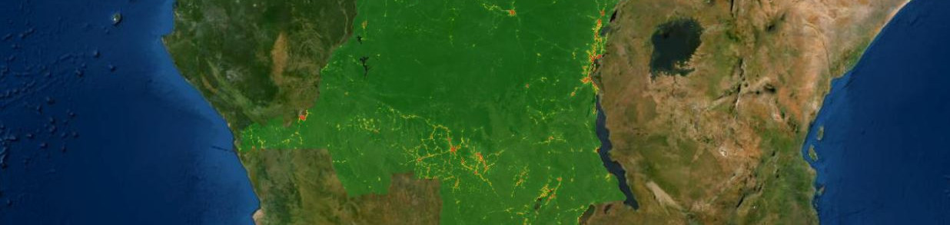


R and geospatial data
Linda Menk
University of Salzburg
Department of Geoinformatics - Z_GIS
26.10.2022

Slide 2
Who are you?
I am a regular R user
I have had some contact with R in the past, but have not used it much since
I had R open once and did something that I don‘t quite remember
I have never in my life opened R
I am not so much an R user, quite good with Python, though
I have no programming experience at all

Slide 3
Admit it!
Have you ever wished to access a certain geodataset from the internet, and you know that it exists because you have seen it before, but you just can‘t locate it anymore?
Have you ever found a geodataset on your file system with a cryptic name that you, or a colleague, have downloaded in the past and now you don‘t know what the data is about and where it came from?
Have you ever found a geodataset on your file system that you, or a colleague, have manipulated before, but you just can‘t remember what exactly you did?

Slide 4

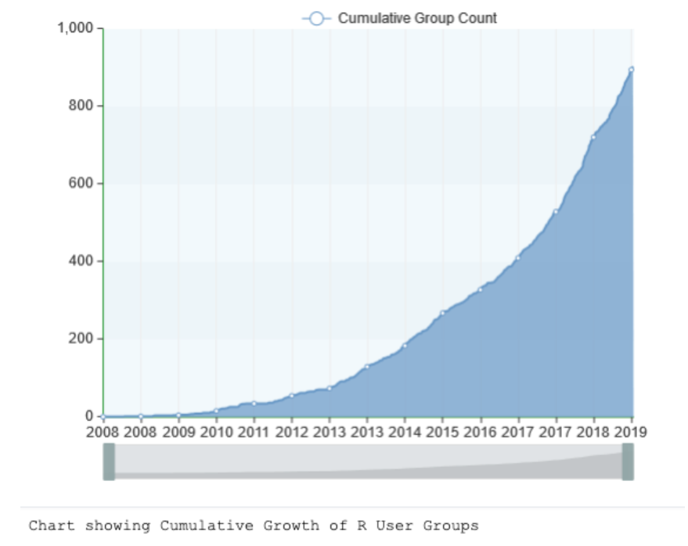
What is R and what is it used for?
R is a free software environment for statistical computing and graphics
Has a large community
Widely used among data miners, bioinformaticians and statisticians for data analysis
R users are mainly scholars and R&D professionals
R was developed over the last two decades and has one of the richest ecosystems to perform data analysis
Around 12.000 packages available on CRAN
If there is no package yet that suites your needs, no problem, just write your own.
R has cutting-edge tools to communicate results – trivial and elegant.
https://www.guru99.com/r-vs-python.html,
https://odsc.medium.com/data-driven-exploration-of-the-r-user-community-worldwide-57416018e958

Slide 5
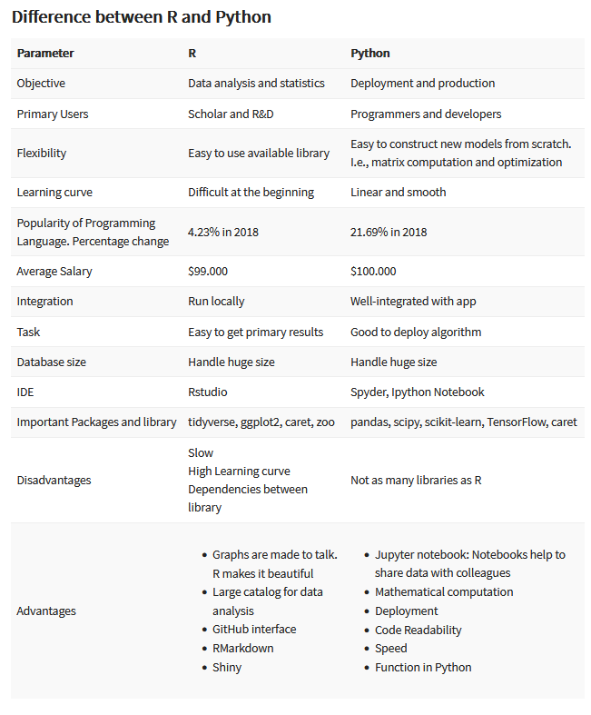
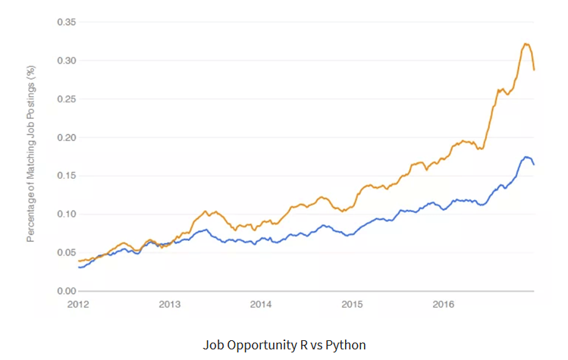
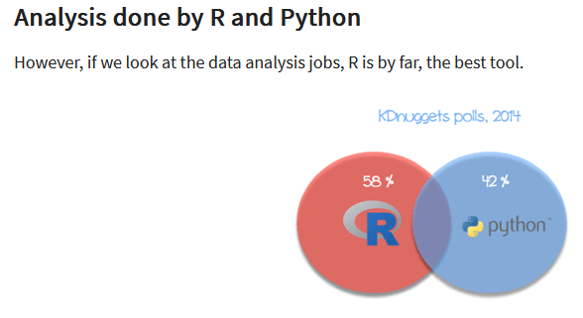
R vs. Python
https://www.guru99.com/r-vs-python.html

Slide 6
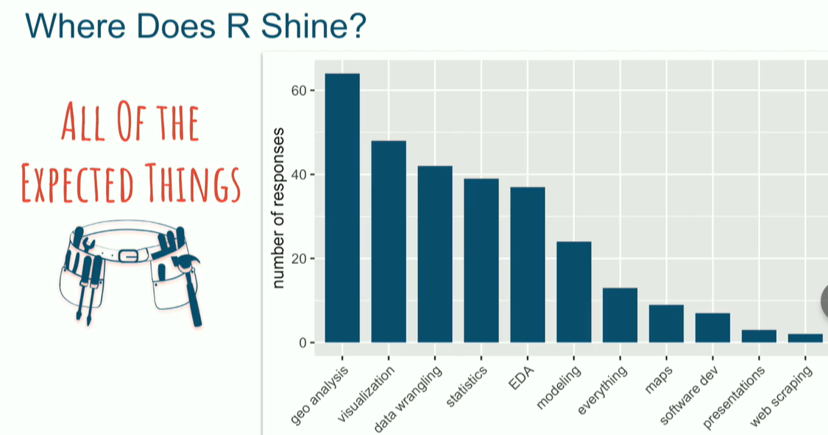
R in the geospatial community
https://www.rstudio.com/resources/rstudioconf-2020/embracing-r-in-the-geospatial-community/

Slide 7

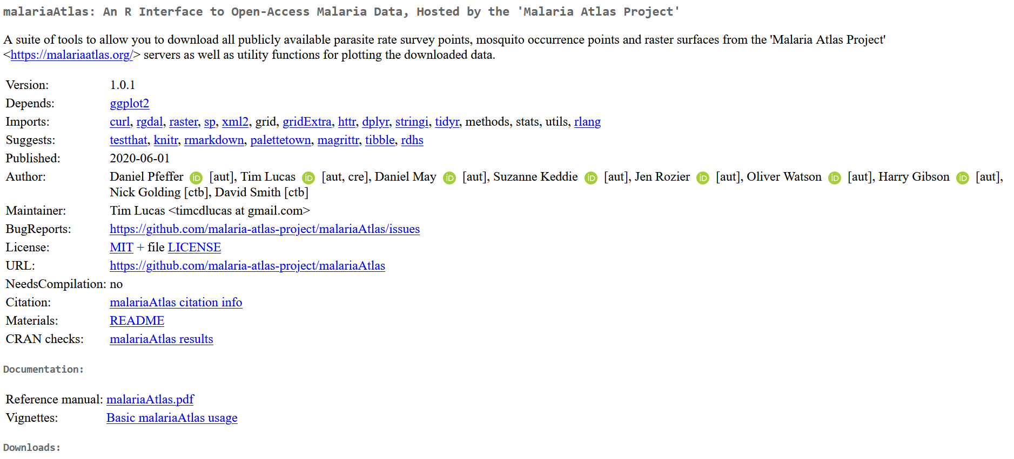
CRAN – Comprehensive R Archive Network
CRAN Task View: Analysis of Spatial Data
https://cran.r-project.org/web/views/Spatial.html

Slide 8
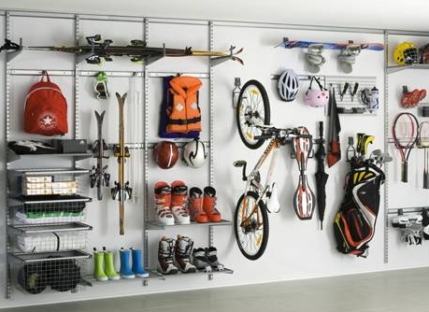
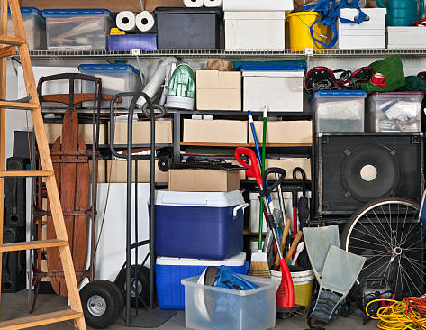

CRAN and Github
Packages hosted on CRAN fulfill quality criteria, e.g. full documentation, cross-platform usability
Everyone can share their code at every stage of development
Install package from Github: devtools::install_github(„xy“)
Install package from CRAN: install.package(„xy“)

Slide 9
On to the practical part
„Identifying vulnerable populations at risk“
We will perform a basic malaria risk assessment that has the components:
Automated data harvesting
Data processing and analysis
Visualization

Slide 10
Access exmple script
https://github.com/Menkli/GeOnG_workshop

Slide 11

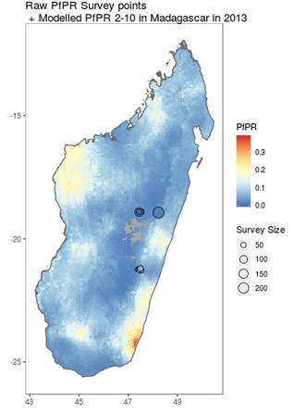
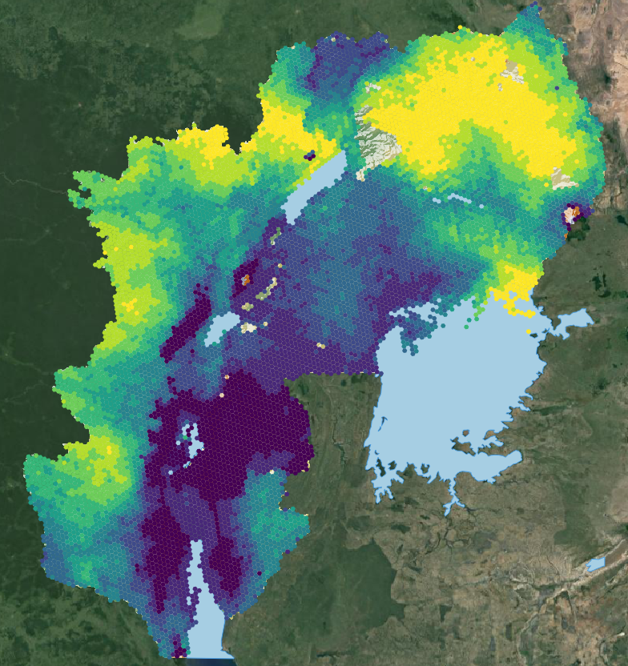
Malaria Atlas Project: malariaAtlas
Blood Disorders
Predicted Glucose-6-Phosphate Dehydrogenase (G6PD) deficiency frequency
Predicted Duffy negativity frequency
Predicted Haemoglobin S (HbS – sickle haemoglobin) frequency
Predicted Haemoglobin C frequency
Febrile Illness
Human Population
Accessibility: Travel-times to centres of population
Housing: Improved housing
Malaria Risk
Clinical burden
Endemicity
Intervention
Reproductive number
Temperature Suitability
Transmission Limits
Vector Occurrence
Zoonotic Malari
Plasmodium falciparum 2020, Malaria Atlas Project
https://github.com/malaria-atlas-project/malariaAtlas
https://cran.r-project.org/web/packages/malariaAtlas/index.html

Slide 12

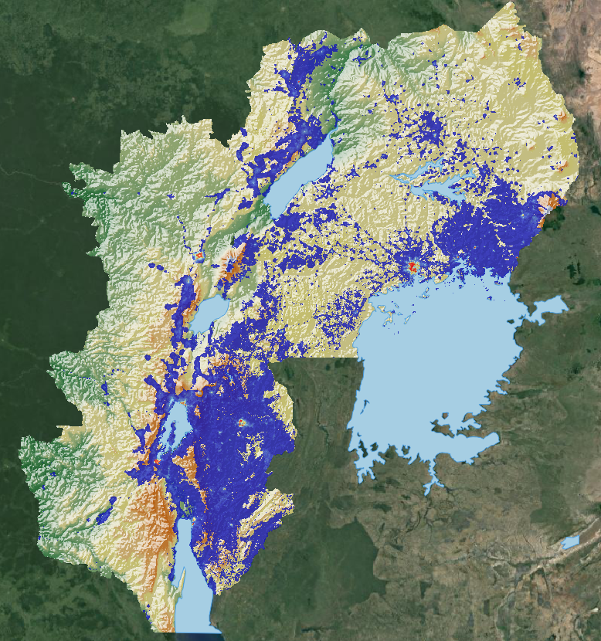
Worldpop
Age and sex structures
Constrained individual countries 2020
Constrained individual countries 2020 UN adjusted
School-Age Population
Unconstrained global mosaics 2000-2020
Unconstrained individual countries 2000-2020
Women of childbearing age (15-49 years old) in 2015 Births (Covariates) Dependency ratios
Development indicators (for a few countries)
Poverty
Literacy
Sanitation
Maternal and newborn health
Contraceptive use
Vaccination coverage (Measels, DTP)
Stunting children under 5 years Dynamic mapping (France & Portugal) Global flight data Global holiday data Global settlement growth Grid-cell surface areas
Migration flows
Internal Migration Whole COntinent
Sex-Disaggregated Internal and International Subnational Migration Population counts 2000-2020; 2020; 1km & 100m resolution Population density Population weighted density
Source: Worldpop
https://github.com/wpgp/wpgpDownloadR/

Slide 13
Vignettes

Slide 14
Vignettes

Slide 15

Important geospatial packages
Raster data: Terra and Raster
Raster = old, but many other
packages still rely on it
Terra = new, faster
https://cran.r-project.org/web/packages/raster/raster.pdf

Slide 16

Simple features for vector operations - sf
sf = implements OGC standards

Slide 17
Thank you for your attention
Linda Menk
Linda.Menk@plus.ac.at
University of Salzburg
Department of Geoinformatics - Z_GIS
Notes:
Working in close collaboration with MSF, they have patient data, know the situation on the ground, know their information needs – we know how to enrich their data with other spatial data to cater to their specific information needs – This way the work has a direct purpose and that is to support MSF to reduced malaria burden

