Slide 1


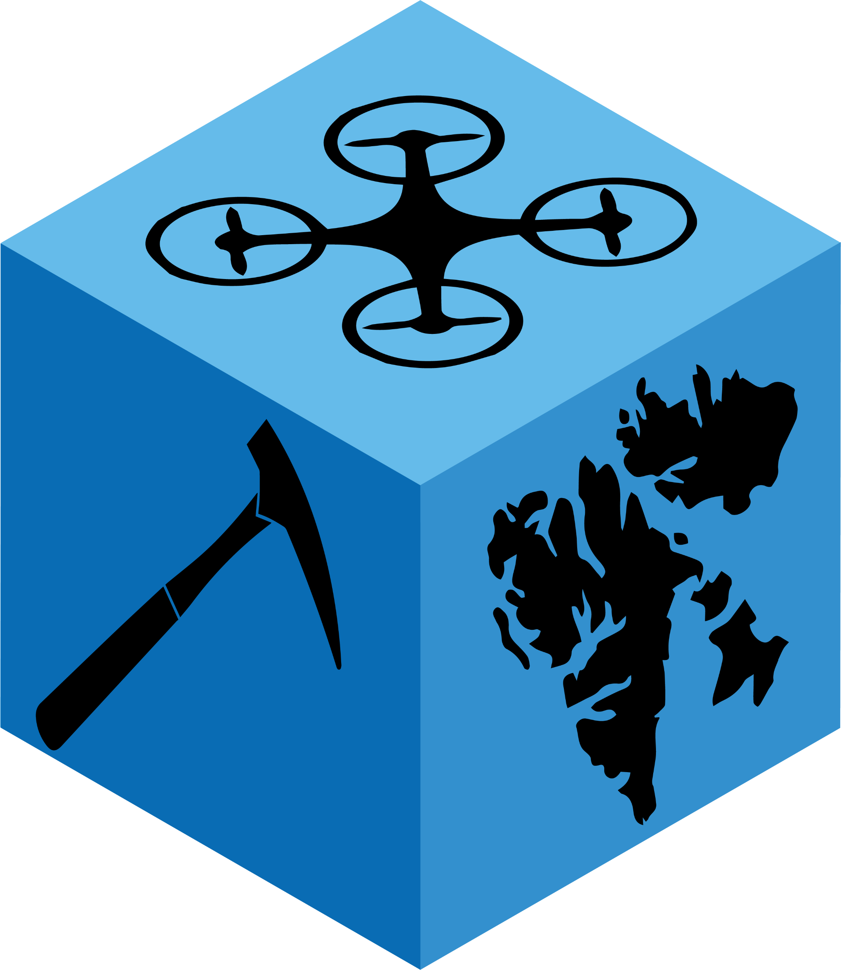
Geo-SfM:
Teaching multiview stereo structure-from-motion photogrammetry
Session 1: photogrammetry

Slide 2
What is photogrammetry?
photos = light
gramma = to drawn
metron = to measure
Photogrammetry = measuring with light (photographs)
Or: estimation of geometric and semantic properties of objects based on images

Slide 3
What is photogrammetry?
Optical Remote Sensing
Image processing/computer vision
Robotics
Machine learning
photos = light
gramma = picture
metron = measure
Photogrammetry = measuring with light (photographs)
Or: estimation of geometric and semantic properties of objects based on images

Slide 4
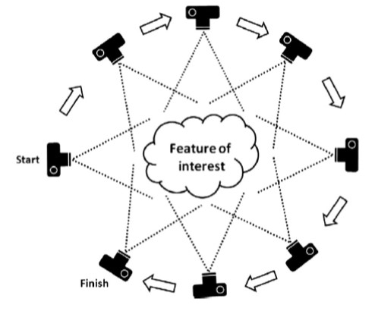
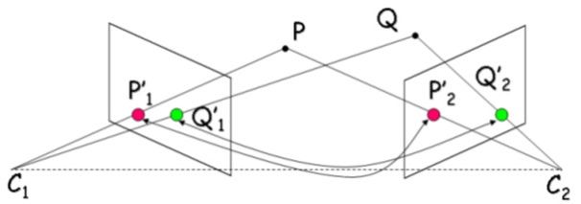
What is photogrammetry?
3D perception: Depth through different views
Humboldt State University. Structure from Motion (SfM). 2016.
M. J. Westoby et al., 2012. doi:10.1016/j.geomorph.2012.08.021

Slide 5
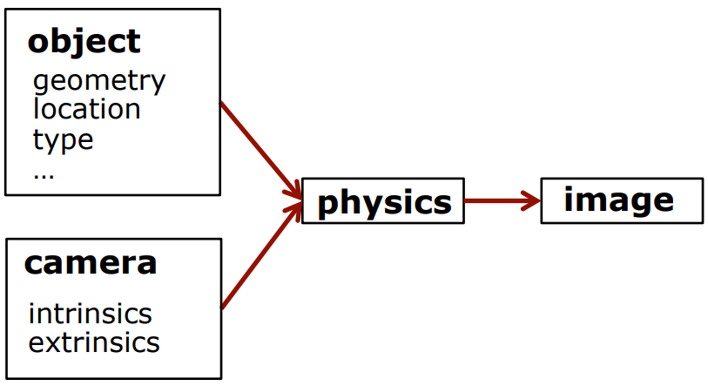
Image capturing principles
Photogrammetry I & II Course (2021/22) – Cyrill Stachniss, StachnissLab

Slide 6
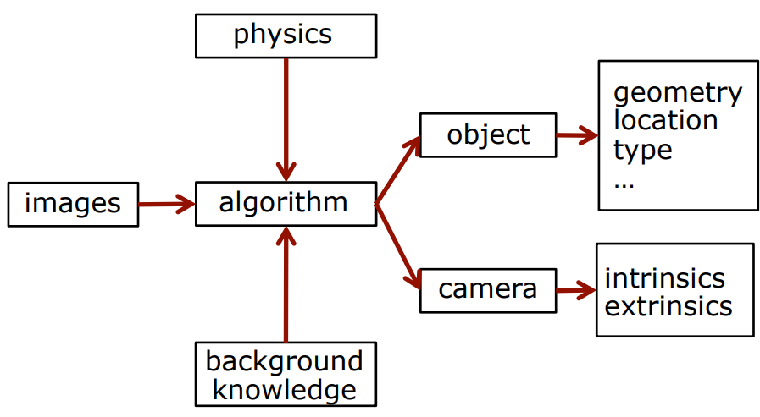
Processing: inverted mapping
Photogrammetry I & II Course (2021/22) – Cyrill Stachniss, StachnissLab

Slide 7
Processing: inverted mapping
- Algoritms are central
- Standardisation helps
- Programming is a useful tool
Photogrammetry I & II Course (2021/22) – Cyrill Stachniss, StachnissLab

Slide 8
Benefits?
Remote sensing technique
Relatively easy to acquire a lot of (digital) data (even over larger areas)
Flexible (resolution, scale, time: dynamic scenes)
Human & automatic data processing/interpretations
Cheap
Where is it important for?
Inaccessible areas? Sensitive material?

Slide 9
Disadvantages?
Need for light
Occlusions and visibility constraints
E.g. Can we get the object imaged from every angle?
3D world to 2D image projection
Distortions? Artefacts?
Lesser accuracy/details than other techniques

Slide 10
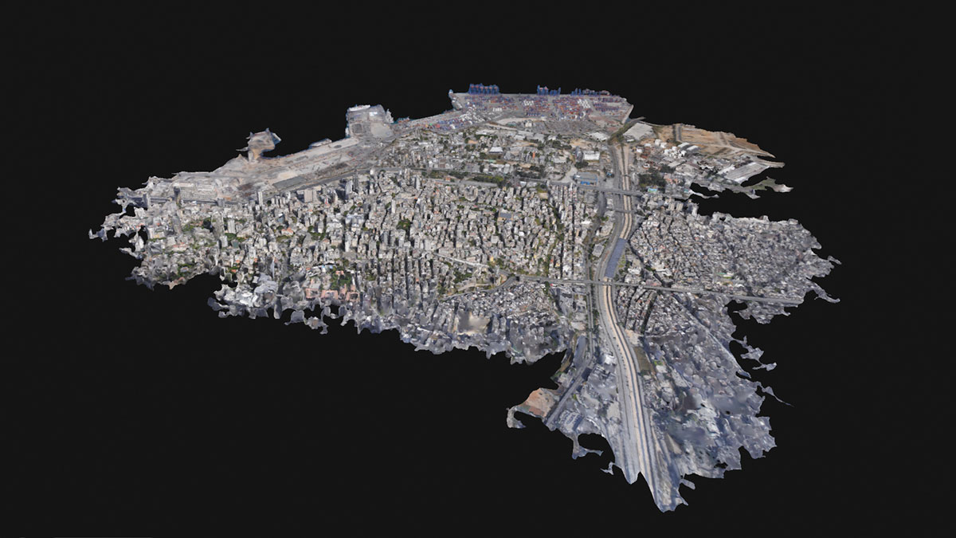
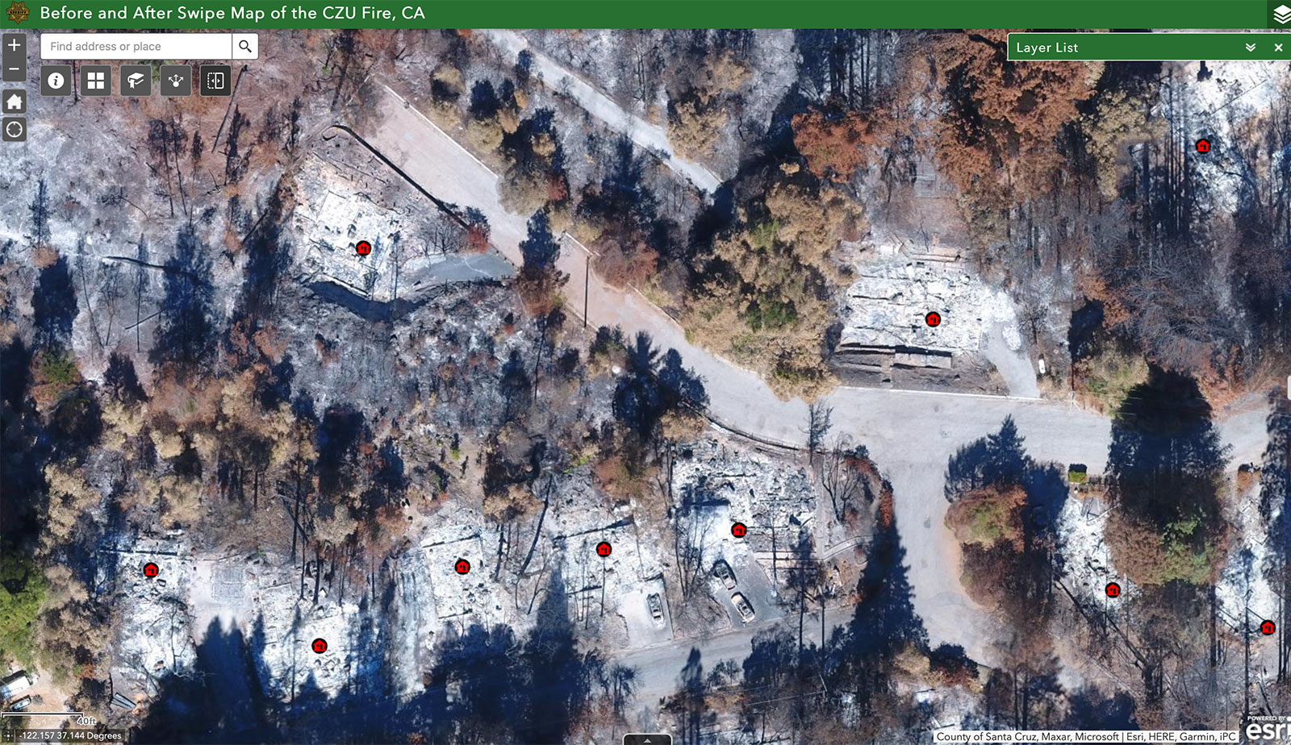
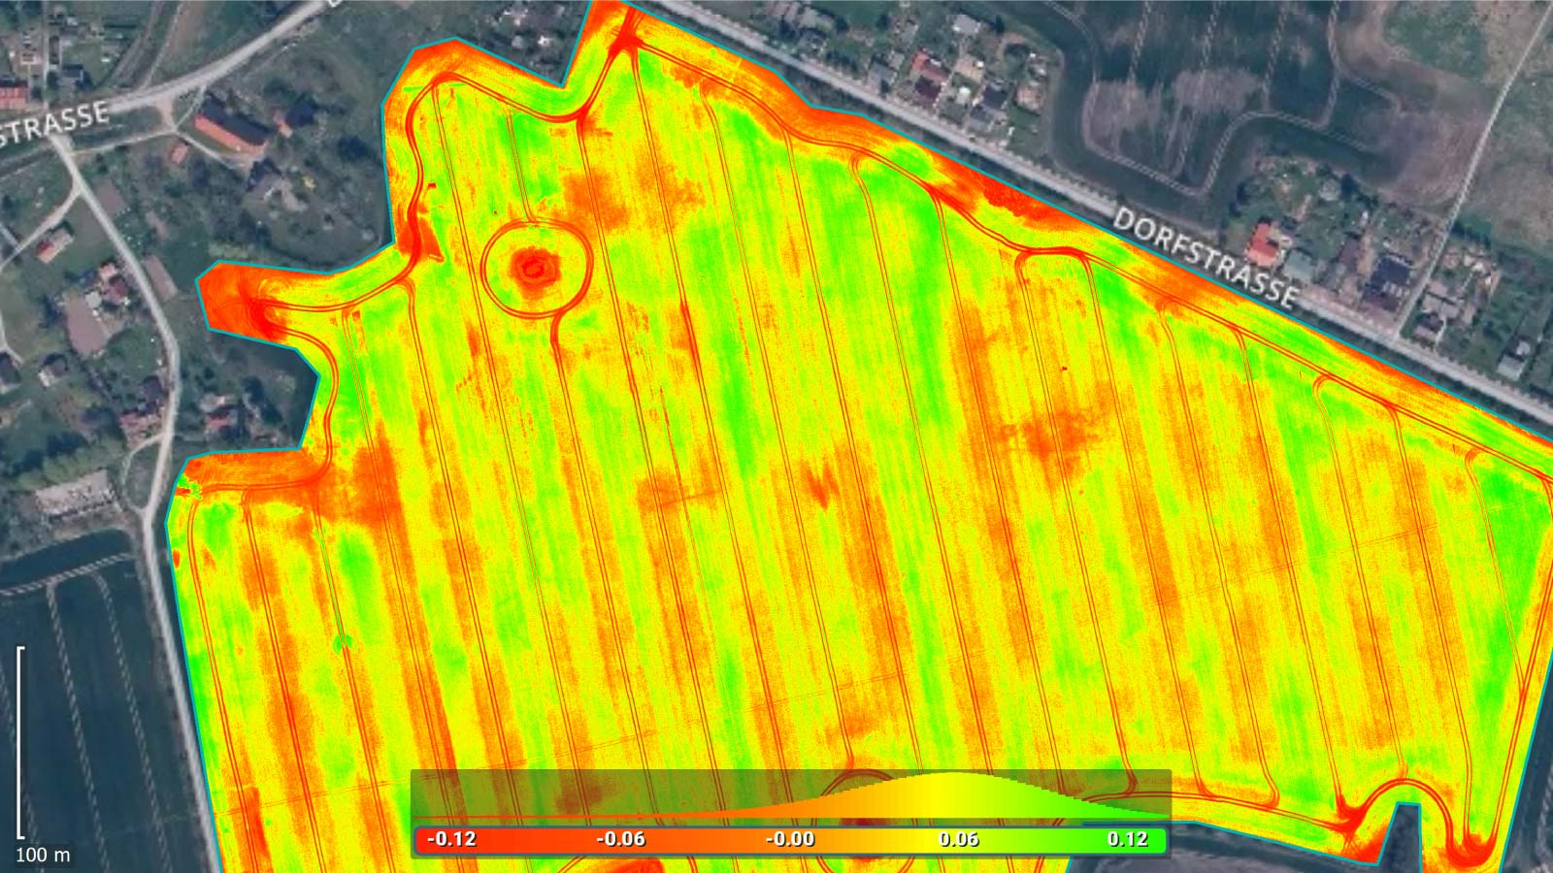
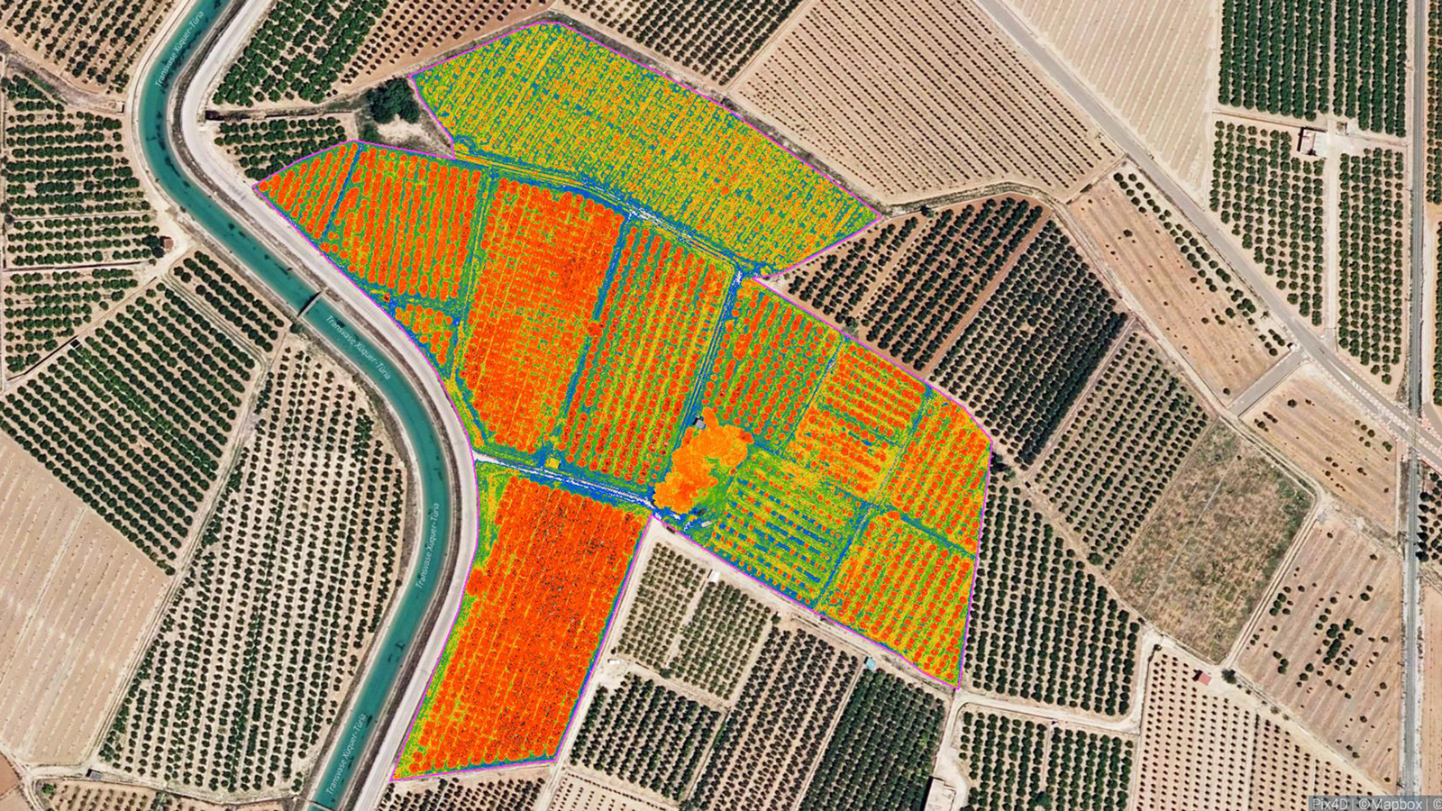
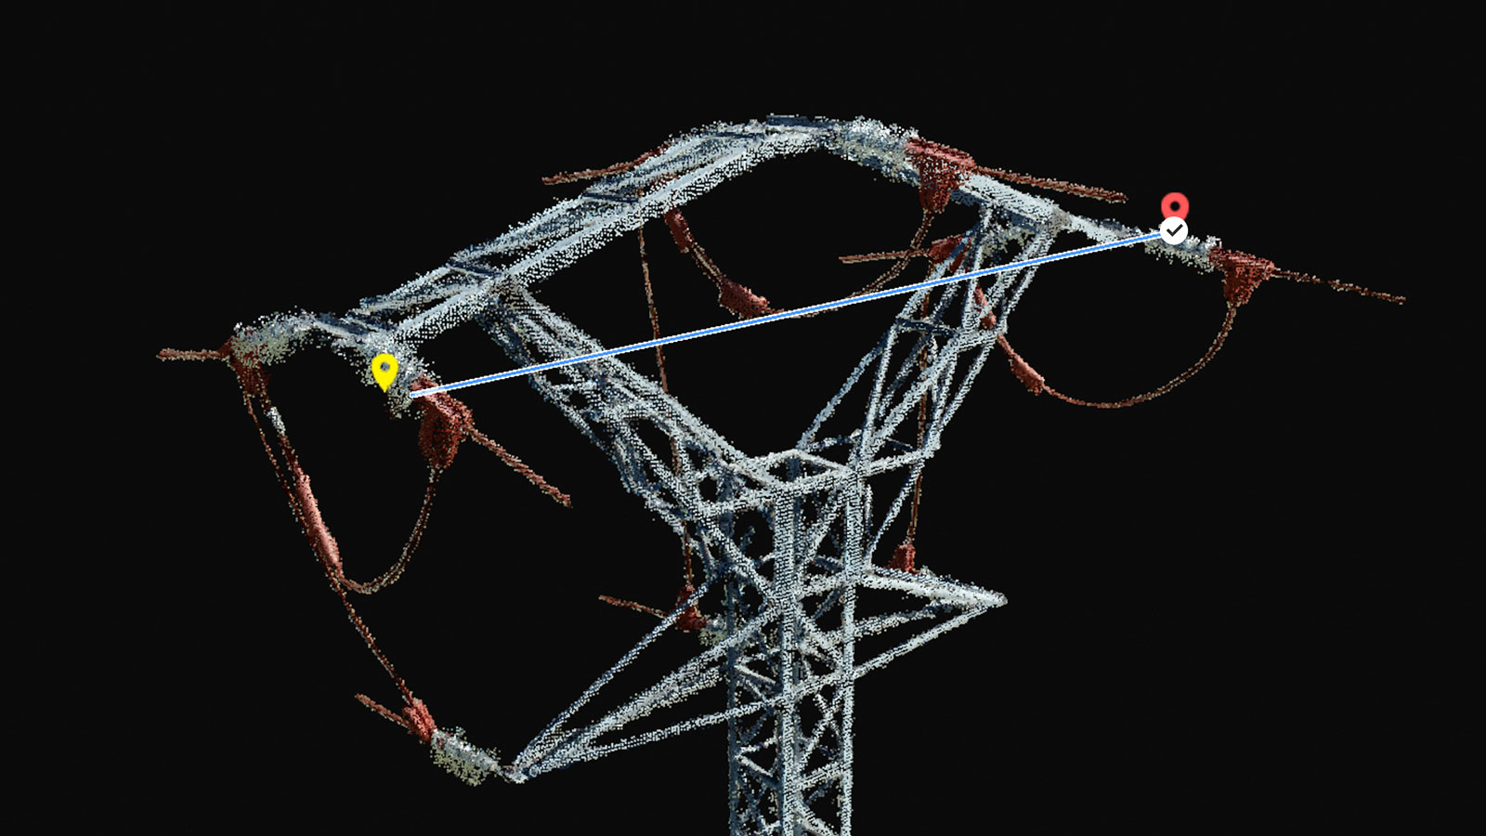

Uses?

Slide 11
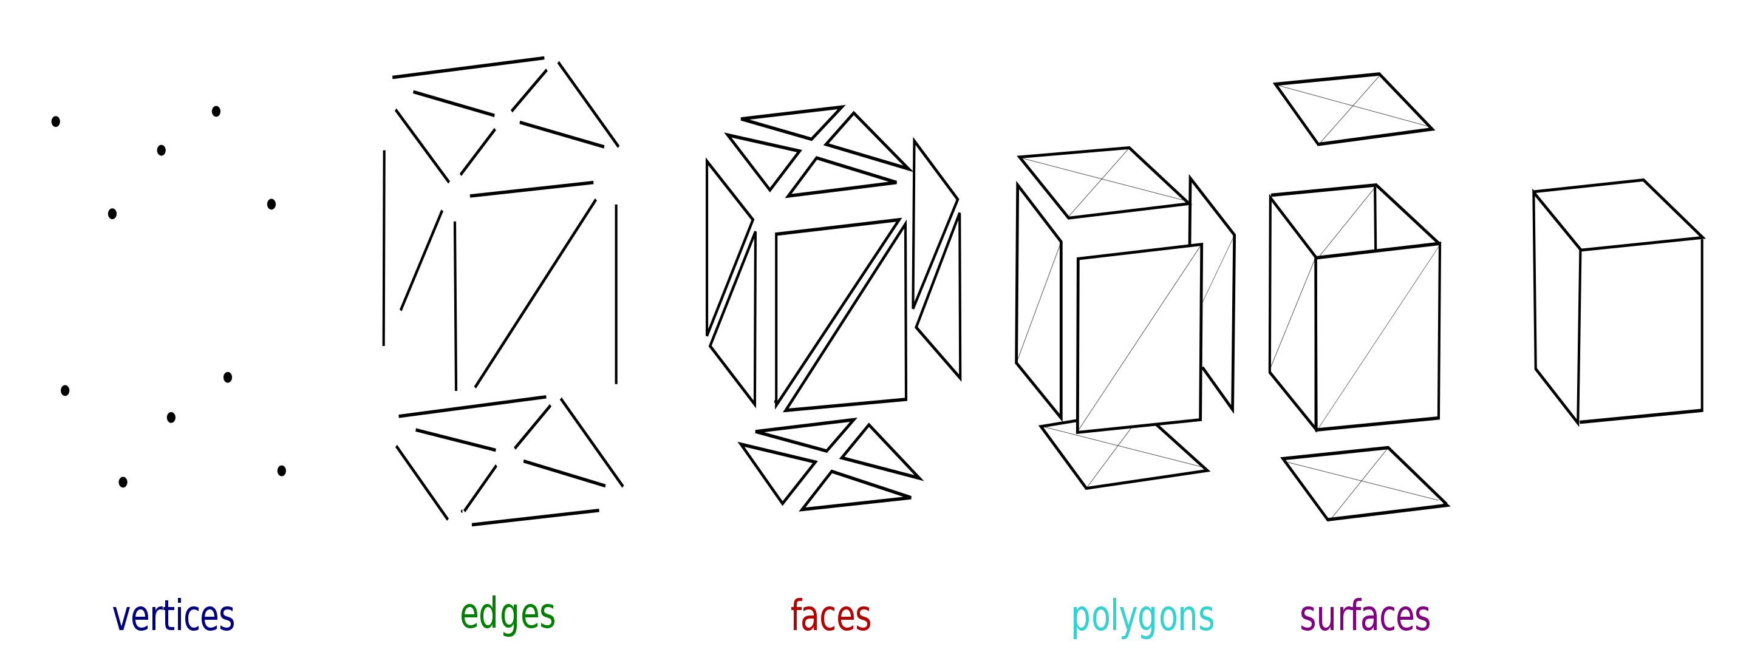
Photogrammetry workflow
Capture images
Identify similar points in images (tie points; vertices)
Densify point cloud (vertices)
Connect points to form edges (1D), faces, polygons, surfaces (2D) and mesh (3D)
Watch video ☺

