Slide 1

Coronavirus
a.k.a Covid-19

Slide 2
Covid-19 Analysis
This presentation analyzes COVID-19 data, focusing on trends, regional impacts, and actionable insights for public health strategies. It uses data from infection rates, vaccination progress, and demographic details to understand pandemic factors and identify improvement opportunities. The insights will guide decision-makers in mitigating the virus's impact and preparing for future public health challenges.

Slide 3
Introduction
This analysis examines the COVID-19 pandemic, focusing on key health metrics like cases, recoveries, and deaths. It explores the impact of health conditions by sex and age, filtering to inform public health responses and identify vulnerable demographics.

Slide 4


Microsoft Power BI

Slide 5
Objectives
1
Objective 1
Assess the overall impact of COVID-19 by examining key metrics: total confirmed cases, recoveries, active cases, and deaths, with a breakdown by demographic groups such as age and sex.
3
Objective 3
Examine the distribution of severe cases (such as those requiring ICU treatment) by sex and age, highlighting key risk factors that contributed to severe disease progression.
2
Objective 2
Analyze the relationships between COVID-19 and underlying health conditions, including Gastrointestinal, Respiratory, Cardiovascular diseases, and Immunocompromised status, to understand how pre-existing conditions influenced outcomes.
4
Objective 4
Provide actionable insights on how public health policies can be optimized to protect vulnerable populations and improve health outcomes in future pandemics, with a focus on targeted interventions for high-risk groups.

Slide 6
392K
Total Cases
77K
Total Deaths
111K
Total Active Cases
568K
Total Recovered Cases
392K
Total Confirmed Cases
Total Deaths The cumulative number of deaths attributed to COVID-19 during the analysis period, providing an important measure of the virus's fatal impact across different regions and demographics.
Total Active Cases The number of ongoing COVID-19 cases, representing individuals who are currently infected. This metric provides insight into the current strain on healthcare systems and the potential risk of further transmission.

Slide 7
392K
Total Cases
77K
Total Deaths
111K
Total Active Cases
568K
Total Recovered Cases
392K
Total Confirmed Cases
Total Recovered Cases The recovery rate, indicating the success of treatment efforts, also provides insight into the resilience of different population groups in overcoming the virus.
Total Confirmed Cases The total number of confirmed COVID-19 infections provides a baseline understanding of the pandemic's reach and allows for assessment of infection trends over time and by factors like age, sex, and region.
Total Confirmed Cases by Key Demographics Analyzing confirmed cases by age and sex helps identify vulnerable populations, enabling targeted health interventions to support the most affected groups.

Slide 8
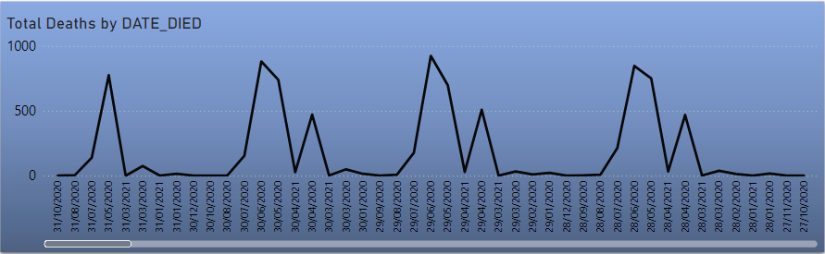
Death Trend Analysis
A time-based death data analysis revealed significant fluctuations and potential causes for spikes. Periodic fluctuations, seasonal impact, and anomalous peaks indicate potential external factors or events. Large spikes indicate sharp increases in death occurrences, requiring further investigation. Seasonal patterns suggest higher death rates during certain periods, aiding in preparing preventive measures. Anomalous peaks suggest outliers or unusual events.

Slide 9
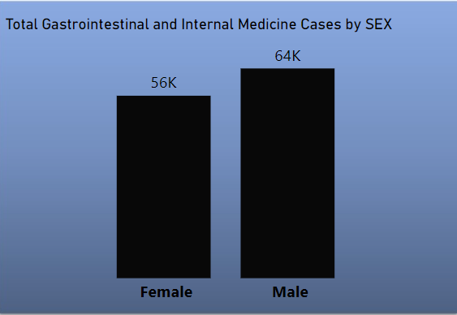
Gastrointestinal and Internal Medicine Cases
The bar chart reveals a gender difference in gastrointestinal and internal medicine cases, with males reporting 64,000 cases and females slightly fewer, suggesting a need for tailored healthcare interventions.

Slide 10
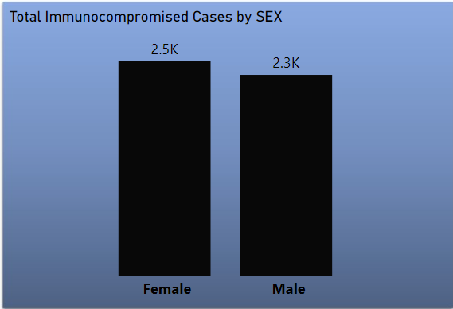
Total Immunocompromised Cases
This chart shows the number of immunocompromised cases for females and males. According to the chart, there are 2,500 cases in females and 2,300 cases in males. This indicates that females have a slightly higher number of immunocompromised cases compared to males.

Slide 11
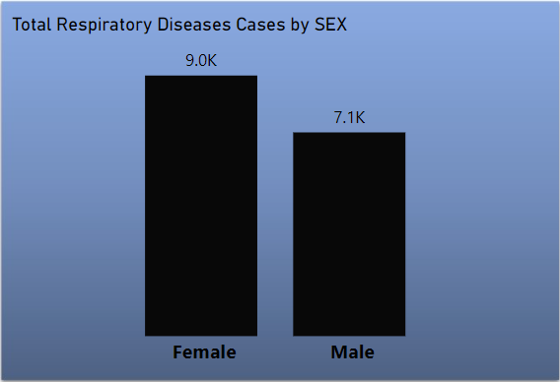
Total Respiratory Diseases Cases
This chart shows the number of respiratory disease cases for females and males. According to the chart, there are 9,000 cases in females and 7,100 cases in males. This indicates that females have a higher number of respiratory disease cases compared to males.

Slide 12
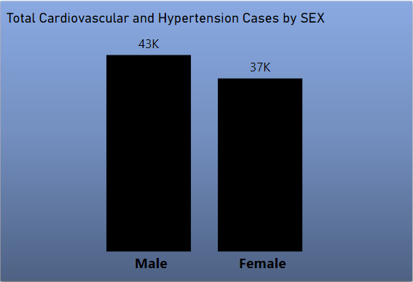
Total Cardiovascular and Hypertension Cases
The chart shows the number of cardiovascular and hypertension cases for males and females. According to the chart, there are 43,000 cases in males and 37,000 cases in females. This indicates that males have a higher number of cardiovascular and instances of hypertension compared to females.

Slide 13
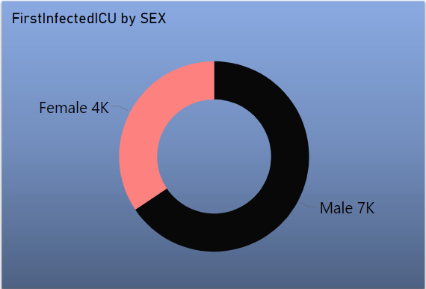
First Infected ICU
The donut chart shows the distribution of first infected ICU cases by sex. According to the chart, 4,000 cases were females and 7,000 cases were males. This indicates that more males were admitted to the ICU as the first infected compared to females.

Slide 14
Key Insights and Findings
Insight 1: Correlation Between Demographics and Infection Rates
The study reveals a significant age correlation with COVID-19 infection rates, suggesting that targeted interventions like vaccination campaigns and health education should be prioritized for older adults.
Insight 2: Seasonal Trends in COVID-19 Cases
The analysis reveals seasonal COVID-19 cases spikes, possibly due to increased social interactions, holiday gatherings, or environmental factors, aiding in future public health strategies and resource allocation.
Insight 3: Regional Disparities in Health Outcomes
Geographical analysis reveals regions with high infection and mortality rates, highlighting issues like healthcare access, public health compliance, and socioeconomic factors requiring targeted intervention strategies.
Insight 4: Impact of Pre-existing Conditions
COVID-19 cases are categorized by underlying health conditions, with cardiovascular and respiratory diseases being more prevalent, emphasizing the need for monitoring and support during health crises.

Slide 15


Team
Menna Wesam Alsaeed
Walaa Hamdi Sheta

