Slide 1

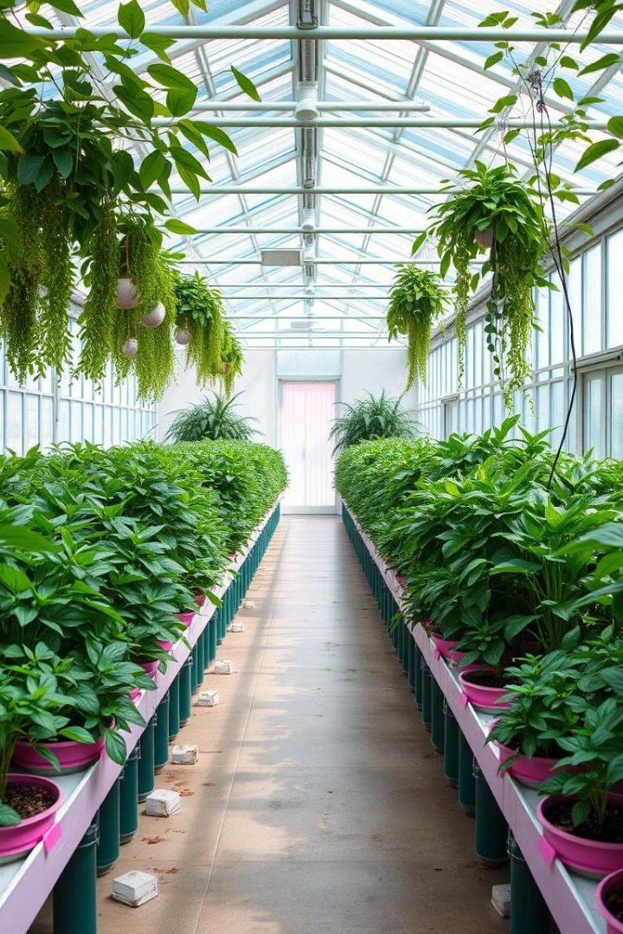
Greenhouse Monitoring System
Affiliated to: DR/ El-Shimaa Nabil
Team Members:
1- Ebraheem Mohamed Said
2- Alaa Ameen Ali
3- Alaa Samy Esmail (Team leader)
4- Eman Atef Khodary
5- Tasneem Ashraf Elsayed
6- Menna Tallah Hesham Ebied
7- Maha Adel Mohamed
Electronics and Communication Department
27 April 2025
Notes:
1.7.2013
1
‹#›

Slide 2
Abstract
The Greenhouse Monitoring and Controlling System using Arduino is an innovative solution designed to automate the management of environmental conditions within a greenhouse. The system utilizes sensors to monitor critical parameters such as temperature, humidity, soil moisture, and light intensity. An Arduino microcontroller processes the sensor data and controls actuators like fans, heaters, water pumps, and lights to maintain optimal growing conditions for plants. This project aims to reduce manual intervention, improve plant health, and increase agricultural productivity. The system is cost-effective, scalable, and can be adapted for various types of greenhouses. By leveraging Arduino's flexibility and the integration of sensors and actuators, this project provides a practical and efficient approach to modern greenhouse management.
Notes:
1.7.2013
3
‹#›

Slide 3
Introduction
Greenhouses play a vital role in modern agriculture by providing controlled environments for plant growth. They protect crops from adverse weather conditions, pests, and diseases, while also enabling year-round cultivation. However, maintaining optimal conditions within a greenhouse requires constant monitoring and adjustment of environmental parameters such as temperature, humidity, soil moisture, and light intensity. Traditional methods of greenhouse management often involve manual intervention, which can be inefficient and inconsistent
The advent of microcontroller-based systems has revolutionized the way greenhouses are managed. Arduino, an open-source electronics platform, has emerged as a popular choice for developing automated systems due to its simplicity, affordability, and extensive community support. By integrating sensors and actuators with an Arduino microcontroller, it is possible to create a system that can autonomously monitor and control greenhouse conditions
Notes:
1.7.2013
4
‹#›

Slide 4



Project Objectives
The system provides real-time feedback on the state of the greenhouse environment. This helps small-scale farmers without the cost of mobile application development.
1
Optimal Conditions
2
Real-time Monitoring
3
Cost-Effective Solution
Maintain optimal environmental conditions for plant growth.
Monitor temperature, humidity, and soil moisture in real-time.
Implement a cost-effective and efficient solution using Arduino.
Notes:
1.7.2013
5
‹#›

Slide 5
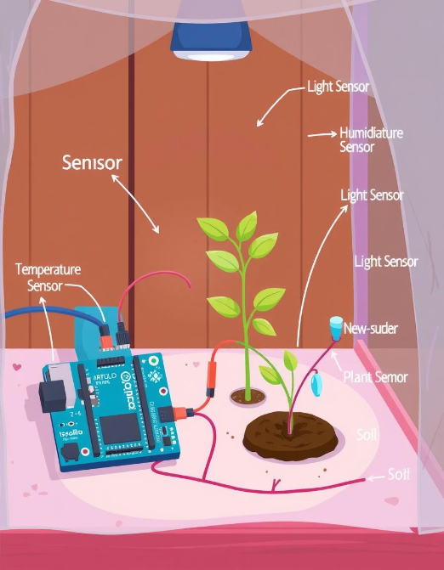
Theory
Formal Design:
Sensors: DHT11 (Temp & humidity),LDR (light), soil moisture.
Actuators: Virtual fans, LEDs, water pumps.
LCD Screen
Mathematical Models:
Sensor equations (voltage-to-light intensity conversion for
Light Intensity Sensor and conversion for Soil Moisture sensor).
Threshold-based control logic (e.g., if light < 20 → activate LED ).
Notes:
1.7.2013
6
‹#›

Slide 6
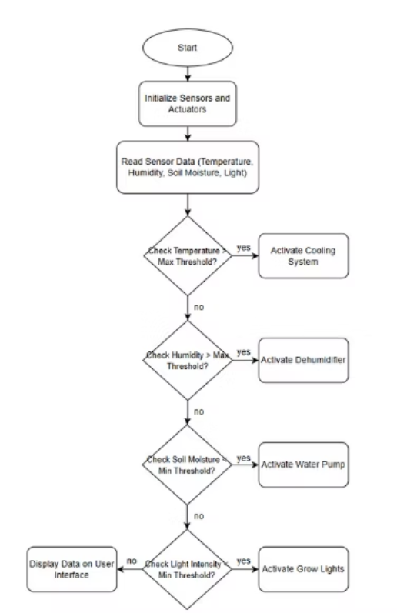
System Flowchart
pseudo code
Setup:
Initialize DHT, LCD, SD card, relays.
Loop:
Read temperature, humidity, soil moisture, light.
Display data on LCD.
Save data to SD card.
If temperature > threshold: Activate cooling system.
If light < threshold: Active Grow Lights
Notes:
1.7.2013
7
‹#›

Slide 7
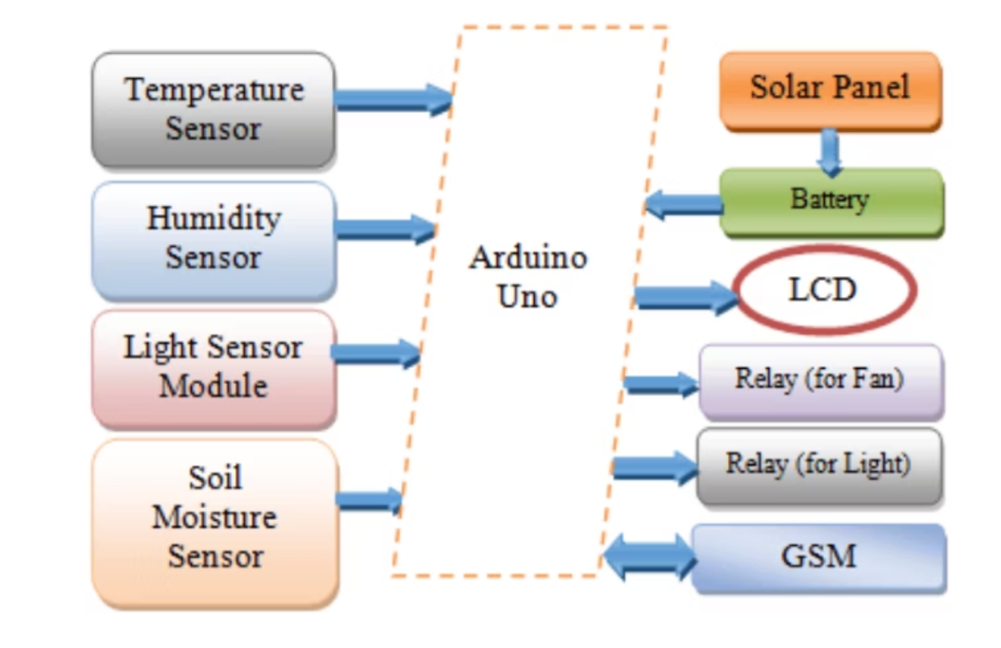
Circuit Diagram
Notes:
1.7.2013
8
‹#›

Slide 8


Implementation
Simulation Setup:
Hardware Components:
Tools: Proteus + Arduino IDE.
Sensors : Soil moisture sensors , DHT11 (Temperature & Humidity) sensor,Light dependent resistor
Code Structure: Modular functions for sensors, actuators, and thresholds.
Software: Arduino IDE, simulation platform, DHT library.
Actuators: Relays for fans/pumps, LED grow lights.
Arduino UNO
LCD Screen
Notes:
1.7.2013
9
‹#›

Slide 9
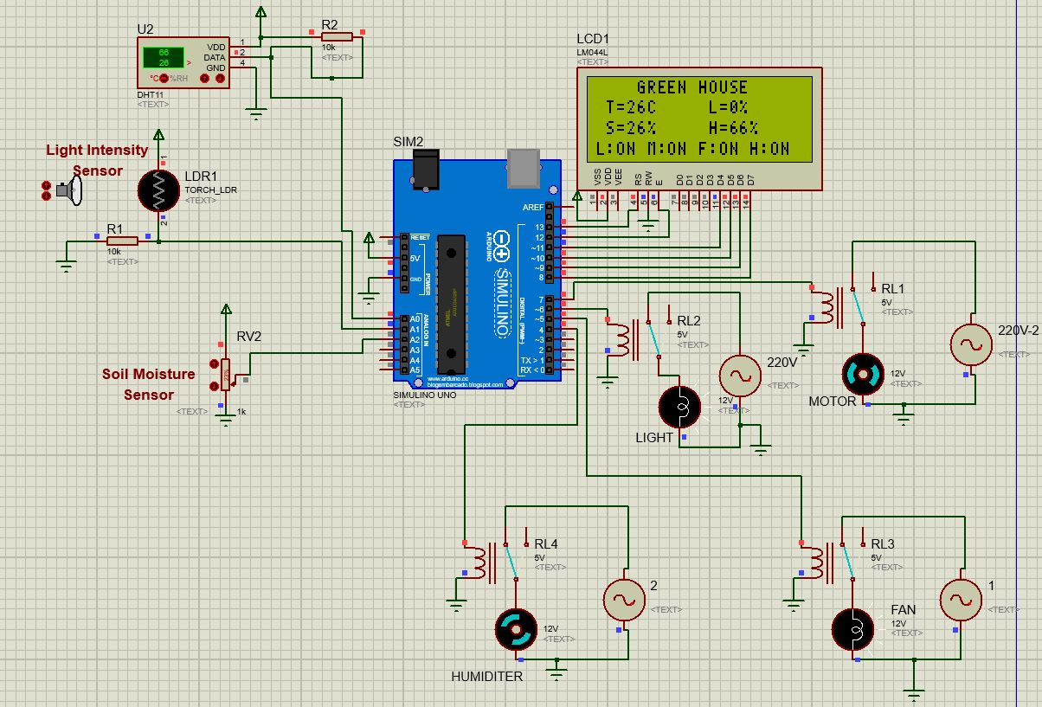
Simulation on Proteus
Notes:
1.7.2013
10
‹#›

Slide 10
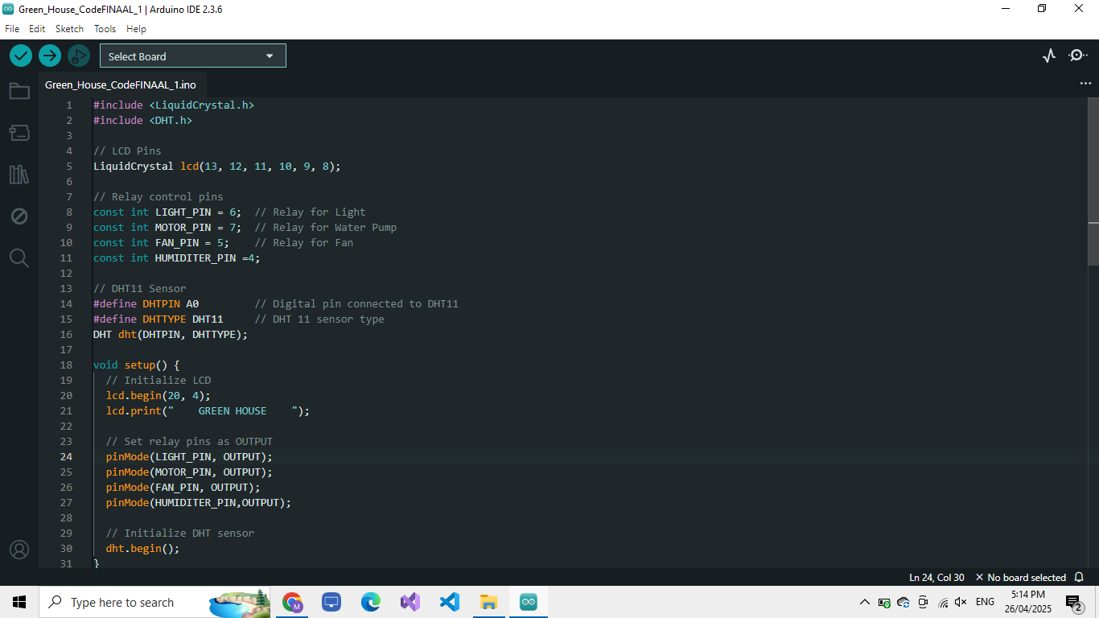
Arduino Code
Notes:
1.7.2013
11
‹#›

Slide 11
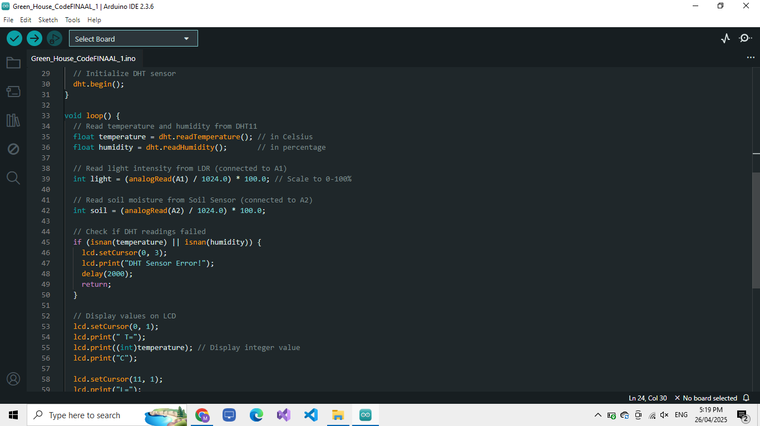
Notes:
1.7.2013
12
‹#›

Slide 12
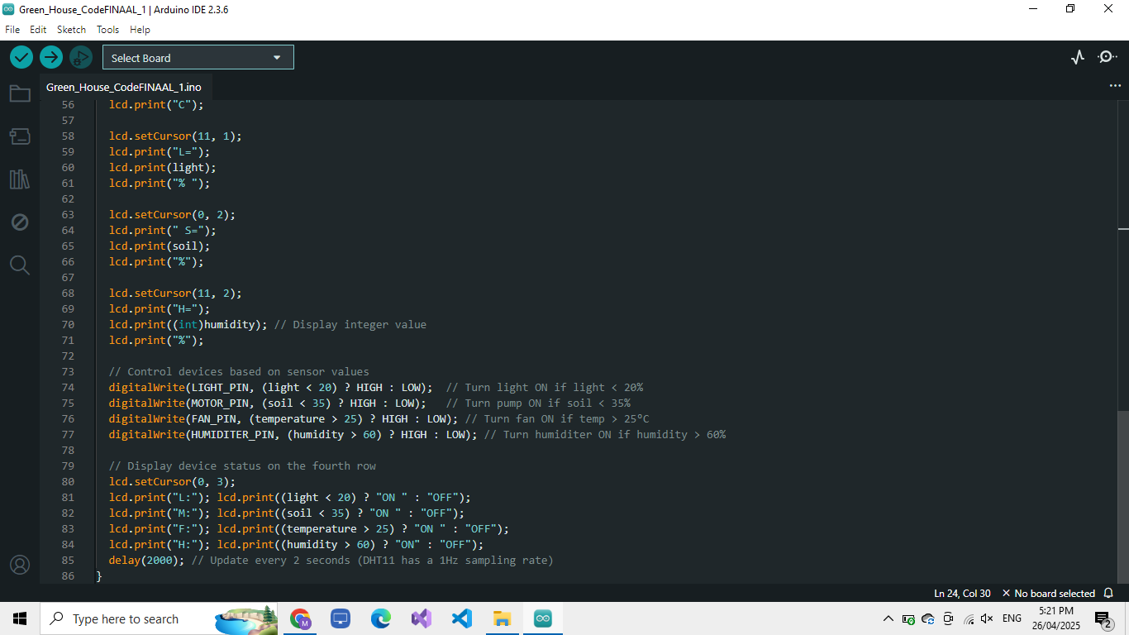
Notes:
1.7.2013
13
‹#›

Slide 13
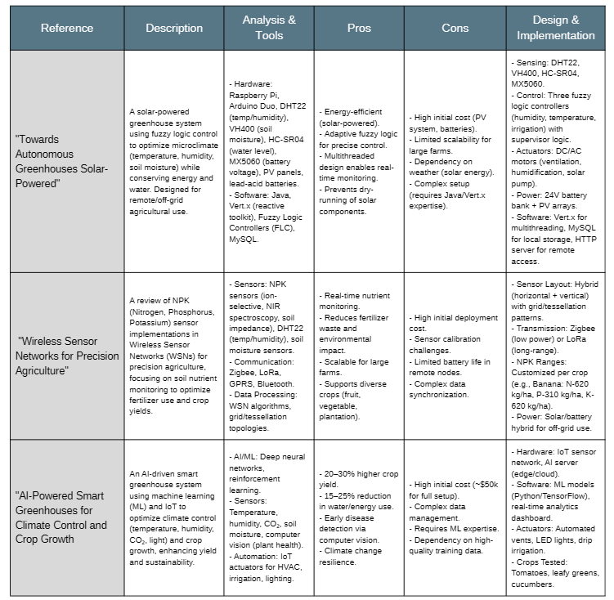
Literature Review

Slide 14
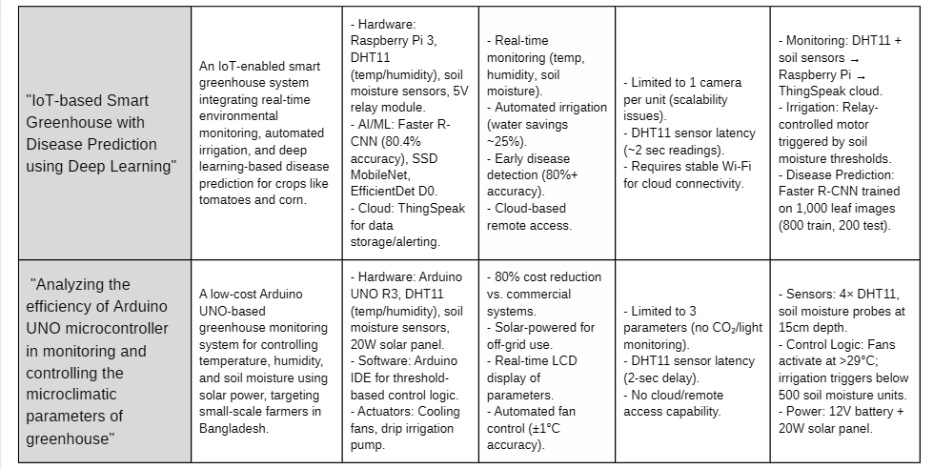

Slide 15
"Monitoring of Smart Greenhouse" | A ZigBee-based wireless monitoring system for greenhouses that tracks temperature, humidity, and light intensity, with remote control via Android app. Targets precision agriculture with real-time adjustments. | - Hardware: LM35 (temp), LDR (light), capacitive humidity sensors, ZigBee XBee modules. - Software: Android app for remote control, RS232 serial communication. - Protocol: ZigBee (802.15.4) for WSN. | - Low-cost (~$100 per node). - Long battery life (years). - 300m range (outperforms Bluetooth/Wi-Fi). - Real-time alerts and actuator control (fans, curtains, sprinklers). | - Limited to 250 Kbps data rate. - No AI/ML for predictive control. - Requires manual intervention via app. - No cloud storage (local PC only). | - Sensing: Analog sensors → ADC → Microcontroller. - Communication: ZigBee mesh network → PC (RS232) → Android app. - Control: Threshold-based fan/curtain/sprinkler activation.
"Greenhouse Monitoring and Control System Using IoT" | The project focuses on developing a Greenhouse Monitoring and Control System using IoT to automate and optimize plant growth conditions. It replaces manual supervision with sensors (temperature, humidity, light, soil moisture) and an Arduino UNO microcontroller. Data is stored in the cloud and can be monitored/controlled via an Android app. | -Sensors: Light, temperature, moisture, and humidity sensors collect environmental data. -Microcontroller: Arduino UNO processes sensor data and triggers actuators (fans, LEDs, water pumps). -Cloud/App: Data is stored in the cloud; an Android app provides real-time monitoring and control. -Power Supply: 5V DC powers the system. | -Automation: Reduces manual labor and human error. -Efficiency: Optimizes plant growth conditions (light, water, temperature). -Remote Access: Cloud and app enable monitoring from anywhere. -Cost-Effective: Low operational costs and energy-efficient. | -Dependence on Connectivity: Requires stable internet for cloud/app functionality. -Initial Setup Cost: Hardware (sensors, Arduino) may be expensive for small-scale farmers. -Maintenance: Sensors need calibration; system may fail if not maintained. | -Sensors detect deviations → Arduino triggers adjustments (e.g., fan cools if temperature rises). -Data is logged in the cloud; users override settings via the app.

Slide 16
Testing and Results
Performance: The system effectively monitors and controls the greenhouse environment.
Complexity: The algorithms used are efficient with low time and space complexity.
Robustness: The system is reliable and can handle variations in environmental conditions
Parameter | Measured Value | Control Action
Temperature | 25°C | None
Light Intensity | 20% | Light ON
Soil Moisture | 35% | Pump ON
Humidity | 60% | None
Notes:
1.7.2013
14
‹#›

Slide 17
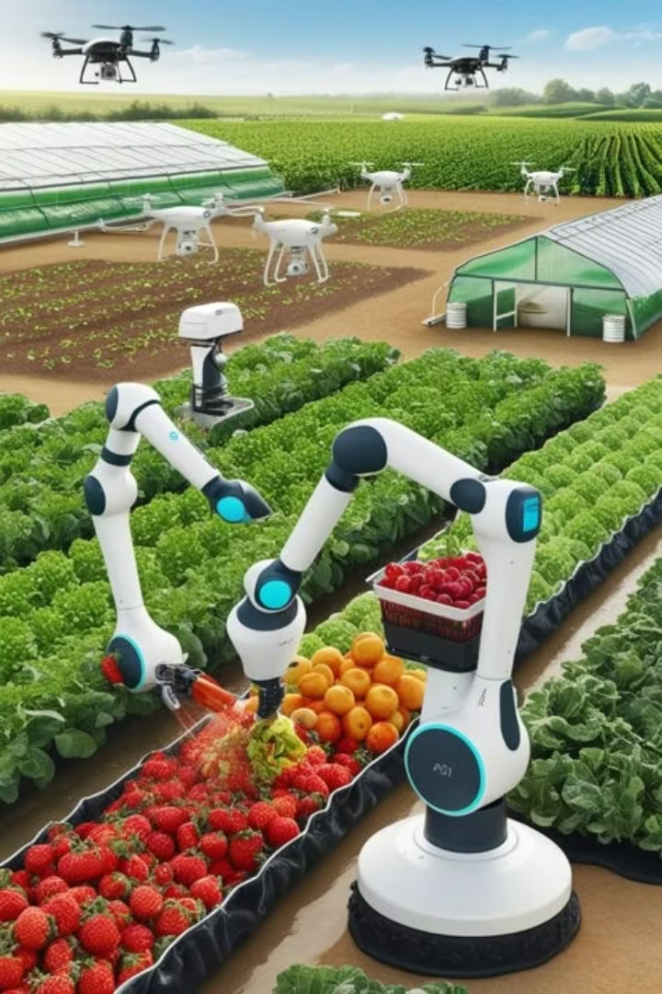
Conclusion
The system successfully automates greenhouse monitoring, reducing dependency on manual checks. Local data display and logging eliminate the need for mobile apps, making it ideal for remote areas. Future iterations could integrate solar power or GSM modules for alerts.
Future Work
Wireless Connectivity: Add LoRa or ZigBee for long-range data transmission.
Solar Integration: Power the system using renewable energy.
Advanced Analytics: Predict trends using machine learning on logged data.
Notes:
1.7.2013
15
‹#›

Slide 18
Bibliography
Arduino Official Documentation (https://www.arduino.cc/)
Wireless Sensor Networks for Precision Agriculture (Springer, 2018)
Analyzing the efficiency of Arduino UNO microcontroller in monitoring and controlling the microclimatic parameters of greenhouse (ResearchGate, 2019)
IoT-based Smart Greenhouse with Disease Prediction using Deep Learning ((IJACSA) International Journal of Advanced Computer Science and Applications)
Towards autonomous greenhouses solar-powered
AI-Powered Smart Greenhouses for Climate Control and Crop Growth Optimizatio (ResearchGate)
Monitoring of Smart Greenhouse(International Research Journal of Engineering and Technology (IRJET))
Green House Monitoring System using IOT (International Research Journal of Modernization in Engineering Technology and Science )
Notes:
1.7.2013
16
‹#›

Slide 19
Thank you
Notes:
1.7.2013
17
‹#›

