Slide 1
pharma
Pharmacy management system

Slide 2
Outlines
Introduction.
Why Pharma?
Tools.
Design.
Further Developments.

Slide 3
Introduction
Our system is developed for established medical store.
Manual system, it requires the pharmacist to manually monitor each drug in the store, expiry data, quantity of drugs.
This usually leads to mistakes as the workload of the pharmacist increases.

Slide 4
Why Pharma?
User-Friendly.
Minimize time and resource.
Enhance safety and efficiency.
Manage all medicine operations.
Online order.
List of products expiry.
Improving good outcomes.

Slide 5
Tools
PHP.
MYSQL server.
Laravel.
HTML5.
jQuery.
Bootstrap.

Slide 6
Design
ACTORS:
User.
Pharmacist.
Manager.

Slide 7
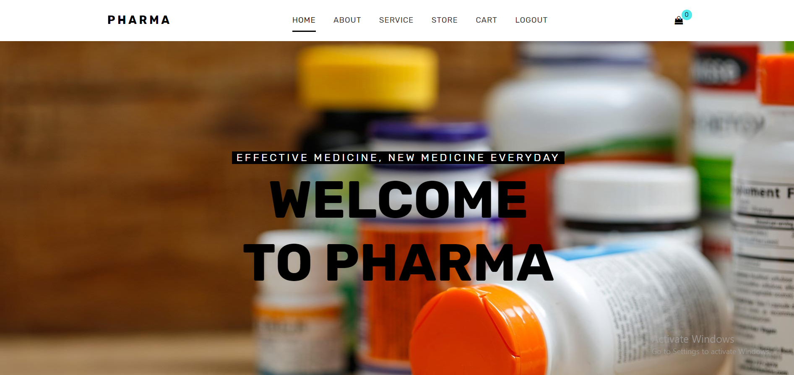
Design – User Panel – Home

Slide 8
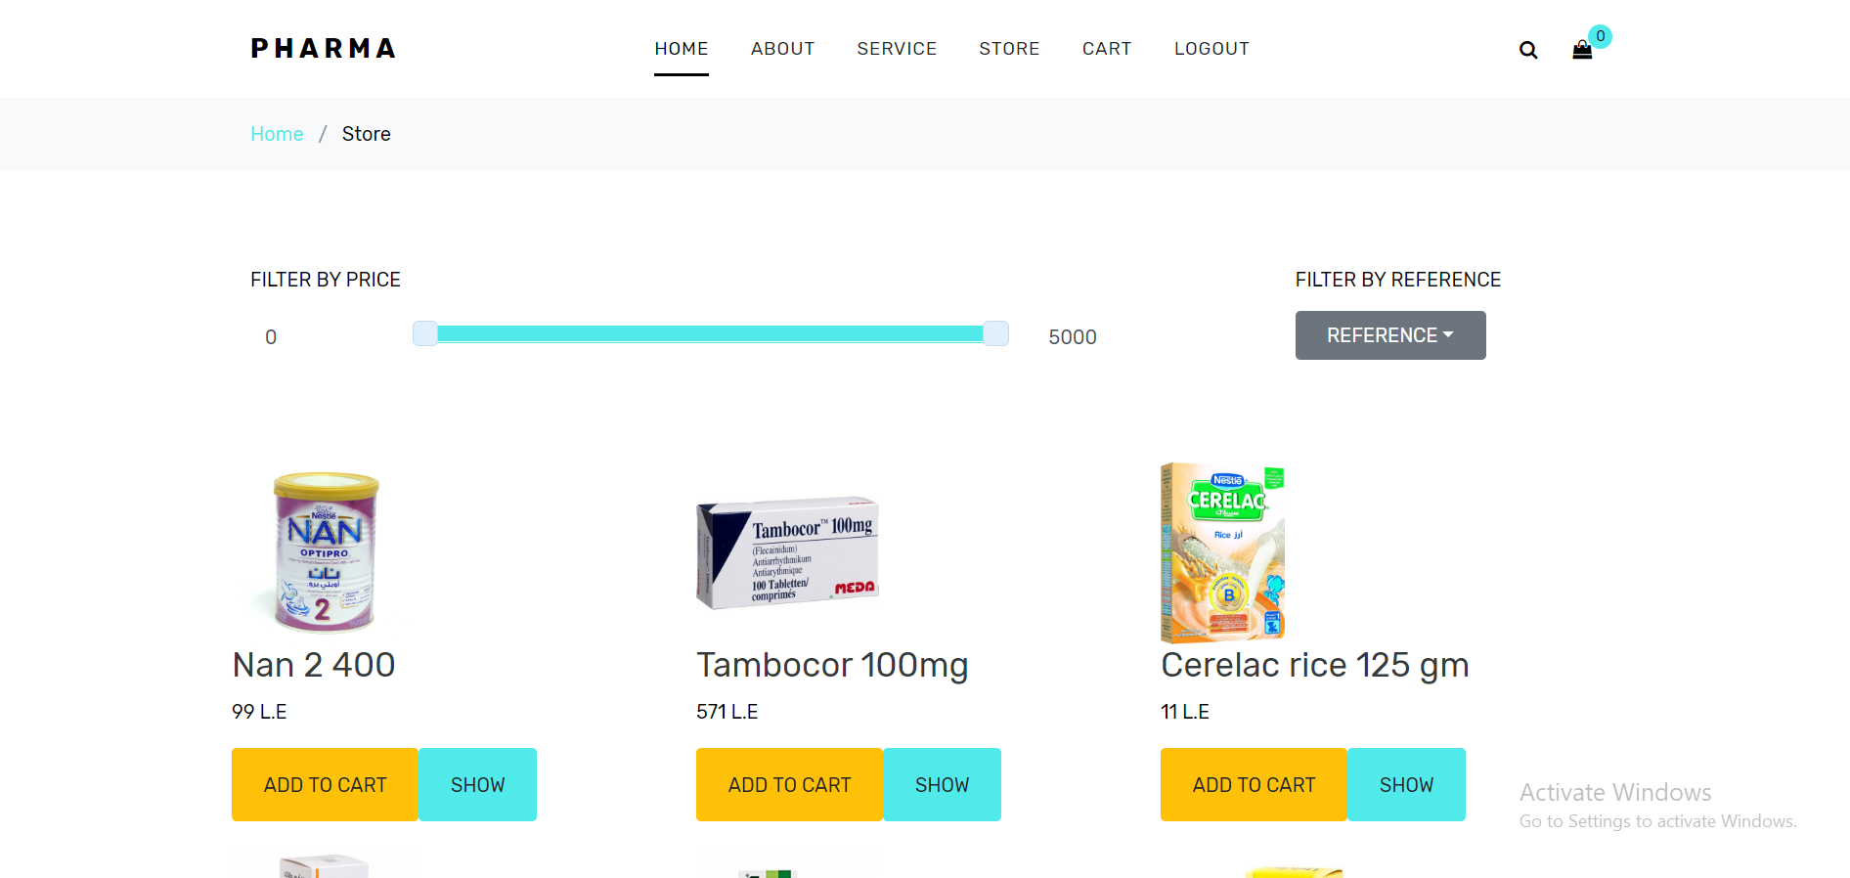
Design – User Panel – Store

Slide 9
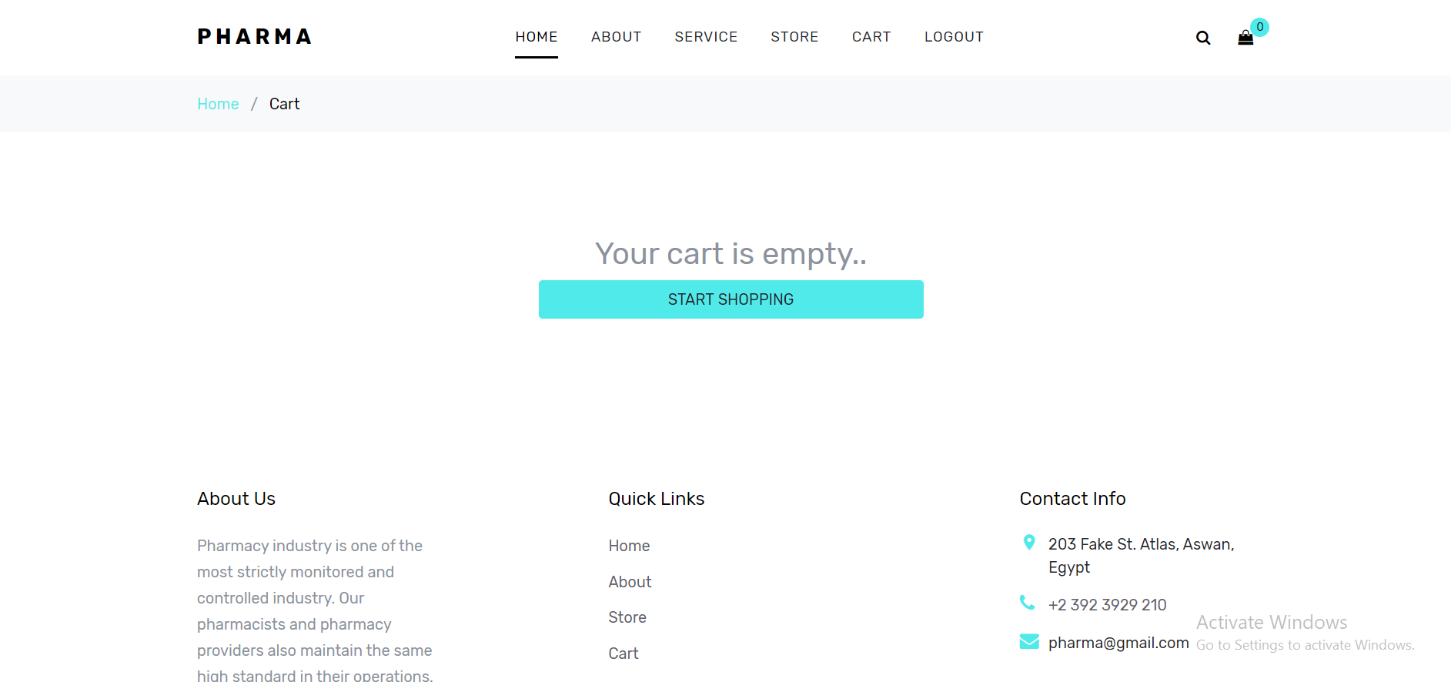
Design – User Panel – Cart

Slide 10
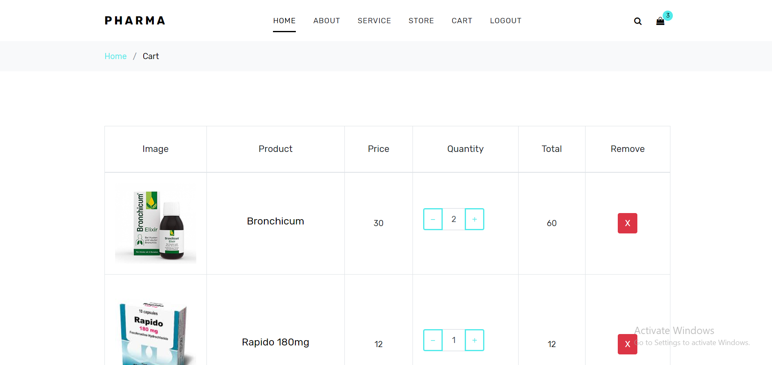
Design – User Panel – Cart

Slide 11
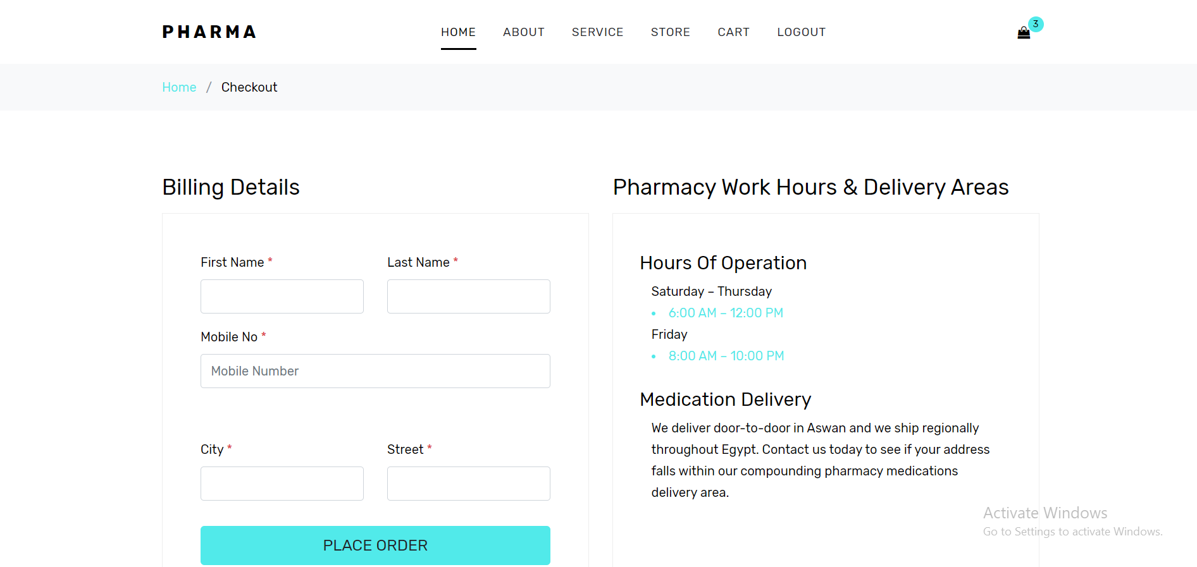
Design – User Panel – Checkout

Slide 12
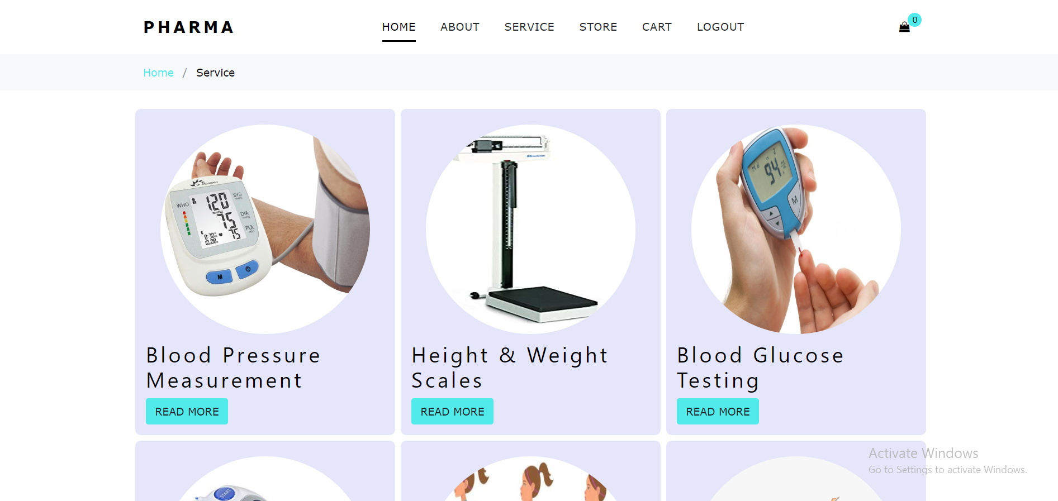
Design – User Panel – Service

Slide 13
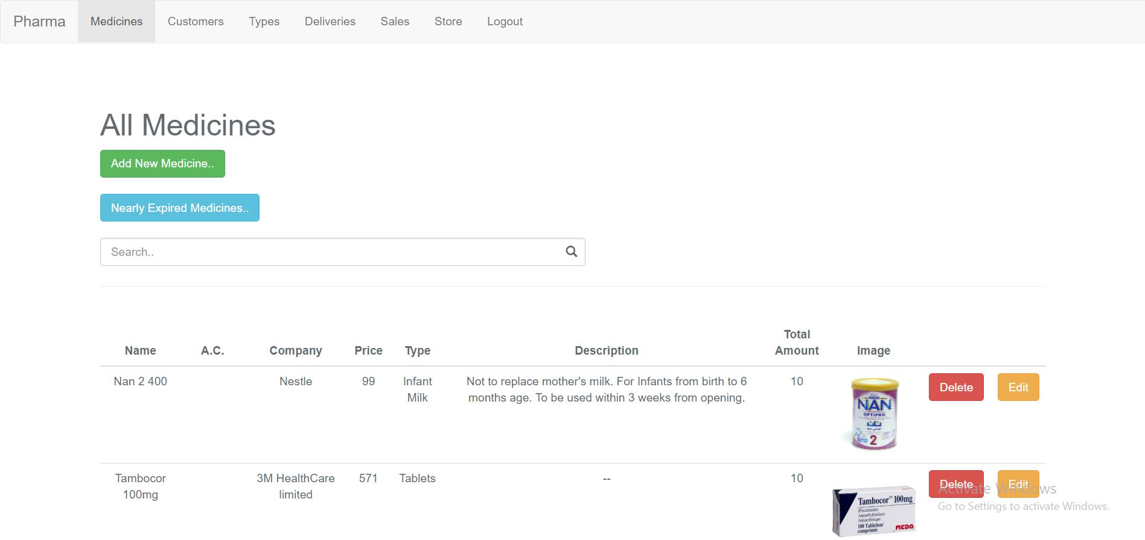
Design – Admin Panel – Medicines

Slide 14
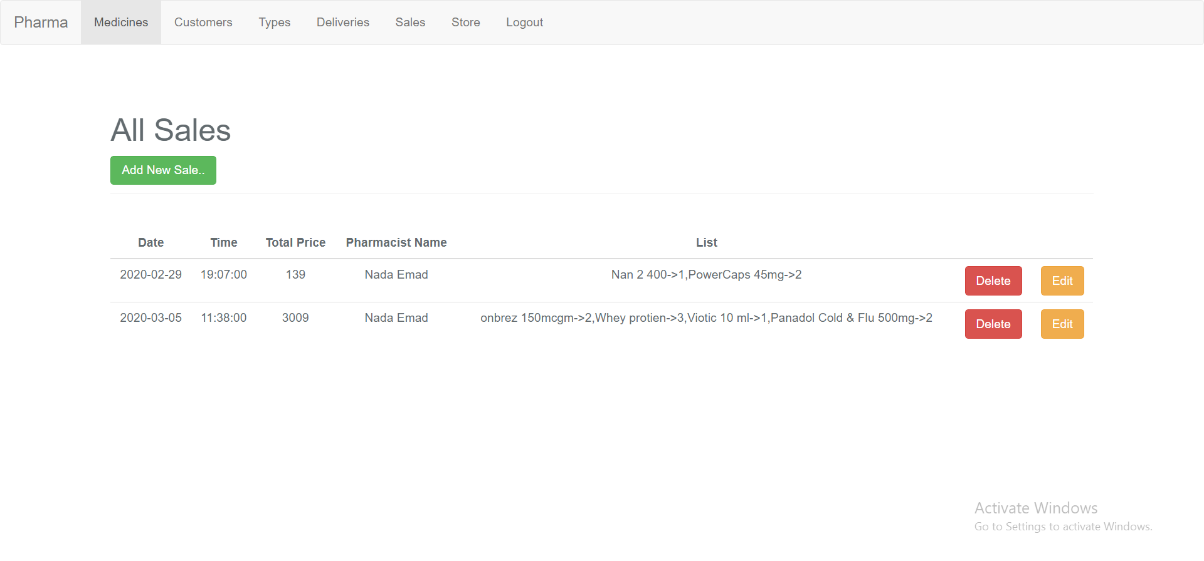
Design – Admin Panel – Sales

Slide 15
Further developments
Convert into mobile application.
Barcode for medicine operations.
Operate for multiple pharmacies.
Coupon.
Credit.

Slide 16
Supervised by:
Aya Gebreel.
Submitted by :
Rahma Mamdouh.
Menna Emad.
Walaa Ahmed.

Slide 17
Thank you..

