Slide 1
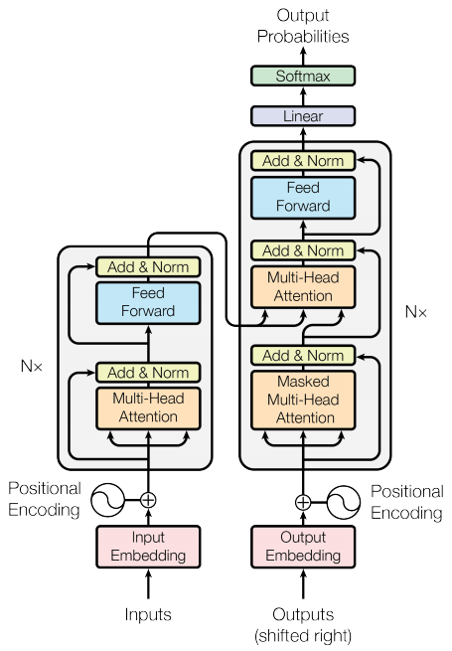
Introduction to Minimum Wage in Egypt
Definition of minimum wage
Importance of minimum wage
Egyptian labor law

Slide 2

Current Minimum Wage in Egypt
Current minimum wage rate
Applicability to different sectors
Exceptions and exemptions

Slide 3
History of Minimum Wage in Egypt
Evolution of minimum wage over time
Key milestones and changes
Impact on economy and workforce

Slide 4
Benefits and Challenges of Minimum Wage
Benefits to employees and economy
Challenges to employers and government
Potential solutions and recommendations

Slide 5
Comparison with International Standards
Minimum wage rates in other countries
Comparison with regional and global averages
Implications for Egyptian economy and competitiveness

