Slide 1
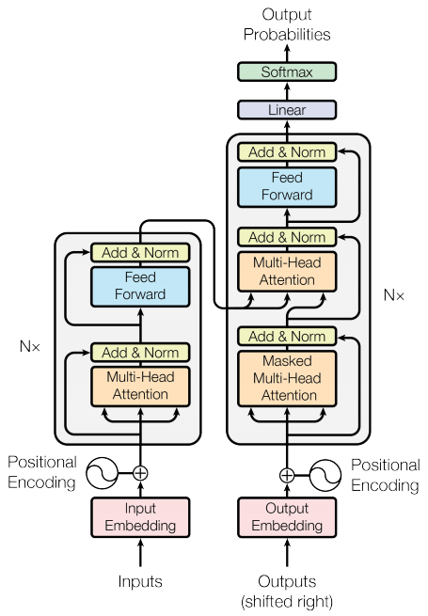
Introduction to Machine Learning
Definition of Machine Learning
Brief history of ML
Core components of ML

Slide 2

Types of Machine Learning
Supervised learning
Unsupervised learning
Reinforcement learning

Slide 3
Machine Learning Algorithms
Linear Regression
Decision Trees
Neural Networks

Slide 4
Applications of Machine Learning
Image recognition
Natural Language Processing
Predictive analytics

Slide 5
Machine Learning Best Practices
Data preprocessing
Model evaluation
Hyperparameter tuning

