Slide 1
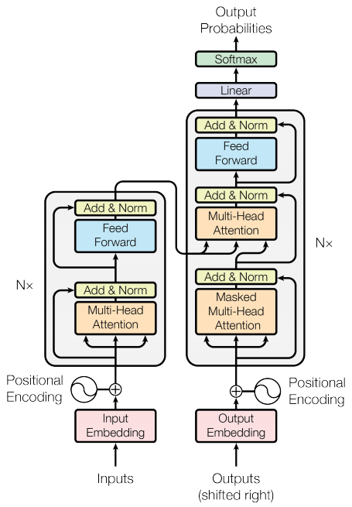
Introduction to Queue
Queue is a linear data structure
Queue is a homogeneous collection of elements
Queue follows First-in-First-out (FIFO) principle

Slide 2

Queue Characteristics
New elements are added at the rear or tail
Existing elements are deleted from the front or head
Queue is a non-primitive data structure

Slide 3
Queue Examples
Toll Station
Check-out in Big supermarket
Printer

Slide 4
Queue Implementation
Linked list implementation
Array-based implementation
Queue implementation from scratch

Slide 5
Linked List and Queue
Difference between linked and array-based queues
Implementing queue based on linked concept
Building queue based on linked list library

