Slide 1
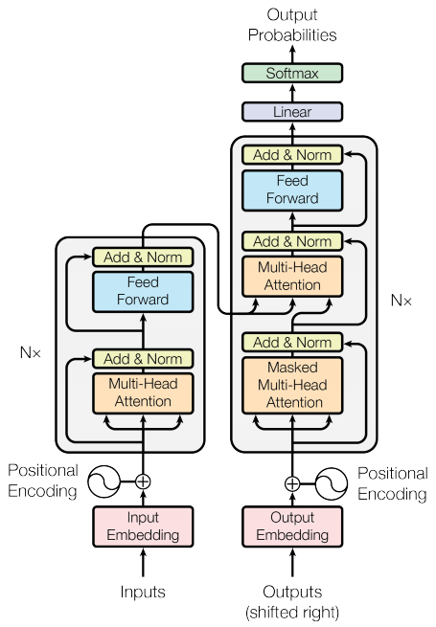
Introduction to Queue
Queue is a linear data structure
Homogeneous collection of elements
Follows First-in-First-out (FIFO) principle

Slide 2

Key Characteristics of Queue
New elements are added at the rear
Existing elements are deleted from the front
Examples include toll stations and printers

Slide 3
Queue Properties
Queue is a non-primitive data structure
Elements are added and removed from specific ends
Queue is a homogeneous collection

Slide 4
Linked List and Queue Implementation
Difference between linked and array-based implementation
Implementing queue based on linked concept
Building queue from scratch

Slide 5
Queue Applications and Examples
Toll stations
Check-out in supermarkets
Printers and function calls

