Slide 1
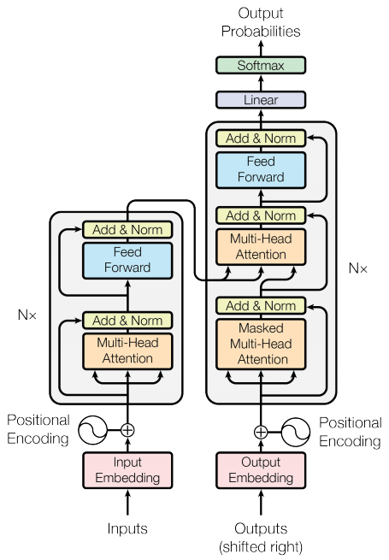
Introduction to Reading
Definition of reading
Importance of reading in daily life
Benefits of reading

Slide 2

Benefits of Reading
Improves concentration
Reduces stress
Enhances thinking skills
Strengthens memory

Slide 3
Types of Reading
Academic reading
Recreational reading
Digital reading
Skimming and scanning techniques

Slide 4
Reading for Students
Improves subject understanding
Enhances writing skills
Leads to better academic performance
Develops critical thinking

Slide 5
Building a Reading Habit
Set a daily reading time
Start with interesting books
Keep a reading list
Avoid distractions

Slide 6
Overcoming Reading Challenges
Lack of time
Distractions like phones and social media
Difficulty in understanding
Starting small with 10-15 minutes daily

Slide 7
Conclusion
Reading as a tool for success
Improves personal and academic life
Starting a reading habit today

