Slide 1
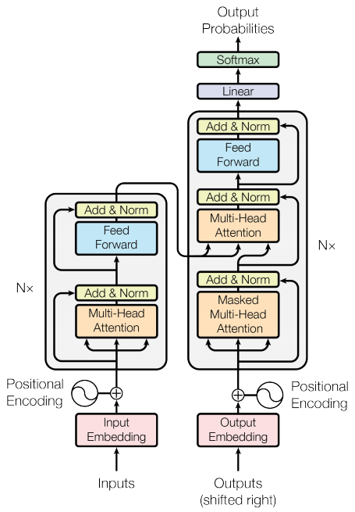
Introduction to Queue
Queue is a linear data structure
Queue is a homogeneous collection of elements
Queue follows First-in-First-out (FIFO) principle

Slide 2

Characteristics of Queue
New elements are added at the rear or tail
Existing elements are deleted from the front or head
Queue is a non-primitive data structure

Slide 3
Examples of Queues
Toll Station
Check-out in a big supermarket
Printer

Slide 4
Queue Implementation
Linked list implementation
Array-based implementation
Queue operations: enqueue and dequeue

Slide 5
Linked List and Queue
Difference between linked and array-based queues
Implementing queue based on linked concept
Building queue from scratch

