Slide 1
Queue Data Structure
Introduction to Queues
1 / 6
Notes:
Welcome to the presentation on queues, a fundamental data structure in computer science.

Slide 2
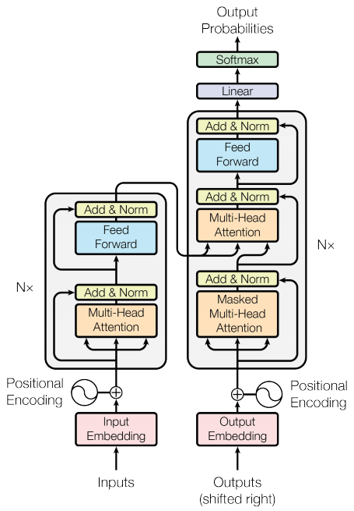
Queue Basics
◆ Linear non-primitive
◆ Homogeneous collection
◆ FIFO data structure
◆ Rear and front ends
2 / 6
Notes:
Explain the basic characteristics of a queue, highlighting its linearity and homogeneity.

Slide 3

Queue Operations
◆ Add: rear end
◆ Remove: front end
◆ Examples: toll stations
◆ Examples: printers
3 / 6
Notes:
Describe the primary operations that can be performed on a queue, along with some common examples.

Slide 4
Queue Properties
◆ First-in-first-out
◆ Homogeneous elements
◆ Linear structure
◆ Non-primitive type
4 / 6
Notes:
Discuss the key properties of a queue, including its FIFO nature and homogeneous composition.

Slide 5
Queue Implementations
◆ Linked list implementation
◆ Array-based implementation
◆ Stack-based implementation
◆ Library-based implementation
5 / 6
Notes:
Explore the different ways to implement a queue, including linked lists and arrays.

Slide 6
Key Takeaways
Queue is a FIFO data structure
Queue has rear and front ends
Queue can be implemented using linked lists or arrays
6 / 6
Notes:
Summarize the main points of the presentation and provide a final thought on the importance of queues in computer science.

