Slide 1
AMIT’s Graduation Project Smart home project Bluetooth controlled
Prepared by : Menna Allah Khaled FADEL

Slide 2
Project Description:
• This project is Smart Home Bluetooth-based project where we want to control home appliance wirelessly using Mobile App via Bluetooth.
• Two ECU’s Communicate with each other the first is a control ECU (ATmega32 MCU) which takes the input from Bluetooth (implemented in the proteus as virtual termina) and send it to the Sink (Actuator) ECU (ATmega32 MCU) via SPI to interpret which action should be taken ( in proteus we toggle 3 LEDS).

Slide 3
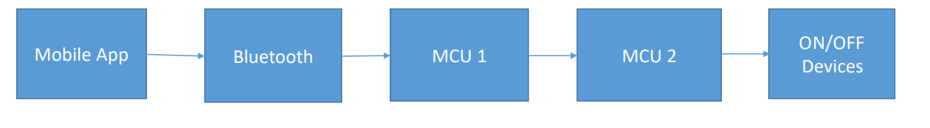
DEECRIPTION:

Slide 4
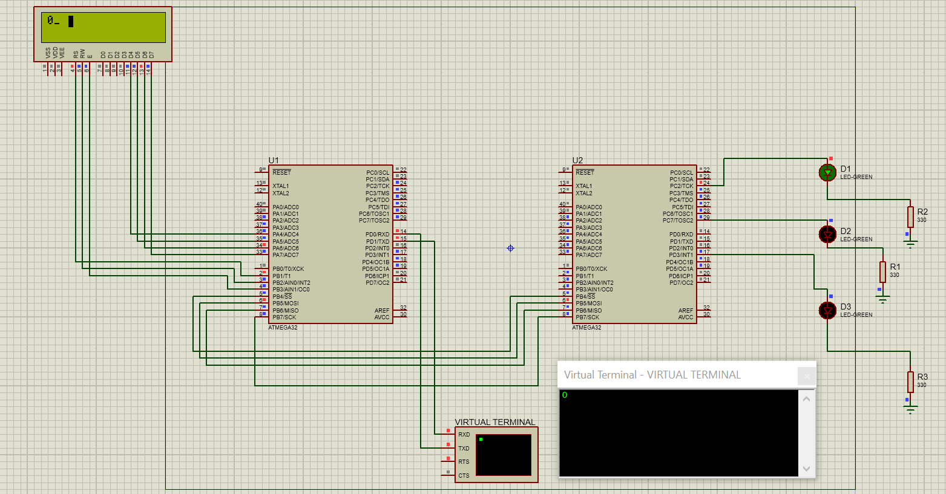
Schematic:
Note: LCD here is showing the input from the Bluetooth ( virtual terminal here in proteus).

Slide 5
Thank you

