Slide 1



Virtual Quiz Game
?
?
?

Slide 2

Team 3
MOHAMED OSAMA
ABDULLAH HUSSIN
MENNATULLAH MOHAMED
YARA ADEL ELSHAMLY

Slide 3
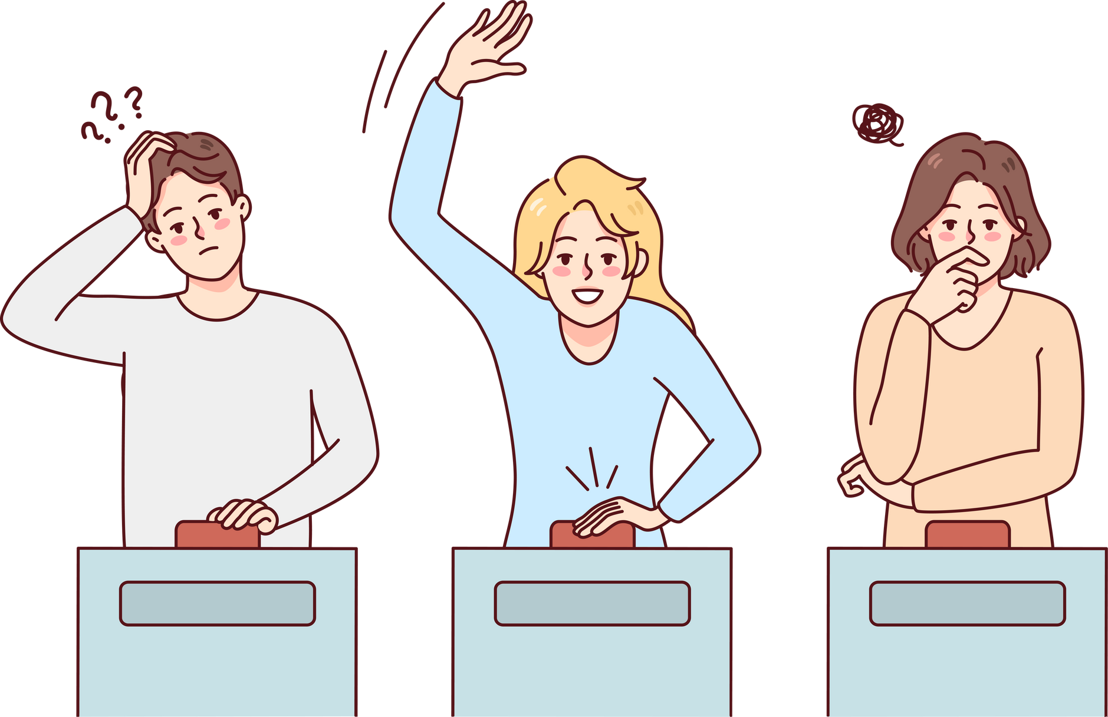
It is a game with interactive questions that helps create an atmosphere of challenge among students to solve the largest number of questions related to their course.
overview

Slide 4


1.
2.
# Import csv file data
# Create Object for each MCQ
Steps
3.
4.
?
# Draw Progress Bar
# final

Slide 5


?
algorithm
Hand Tracking Algorithm
Euclidean Distance Calculation

Slide 6


dataset link
https://drive.google.com/drive/folders/1g-zaL7BLiGKar1NloFYk0U1UqYfVbGHb

Slide 7

code
?

