Slide 1


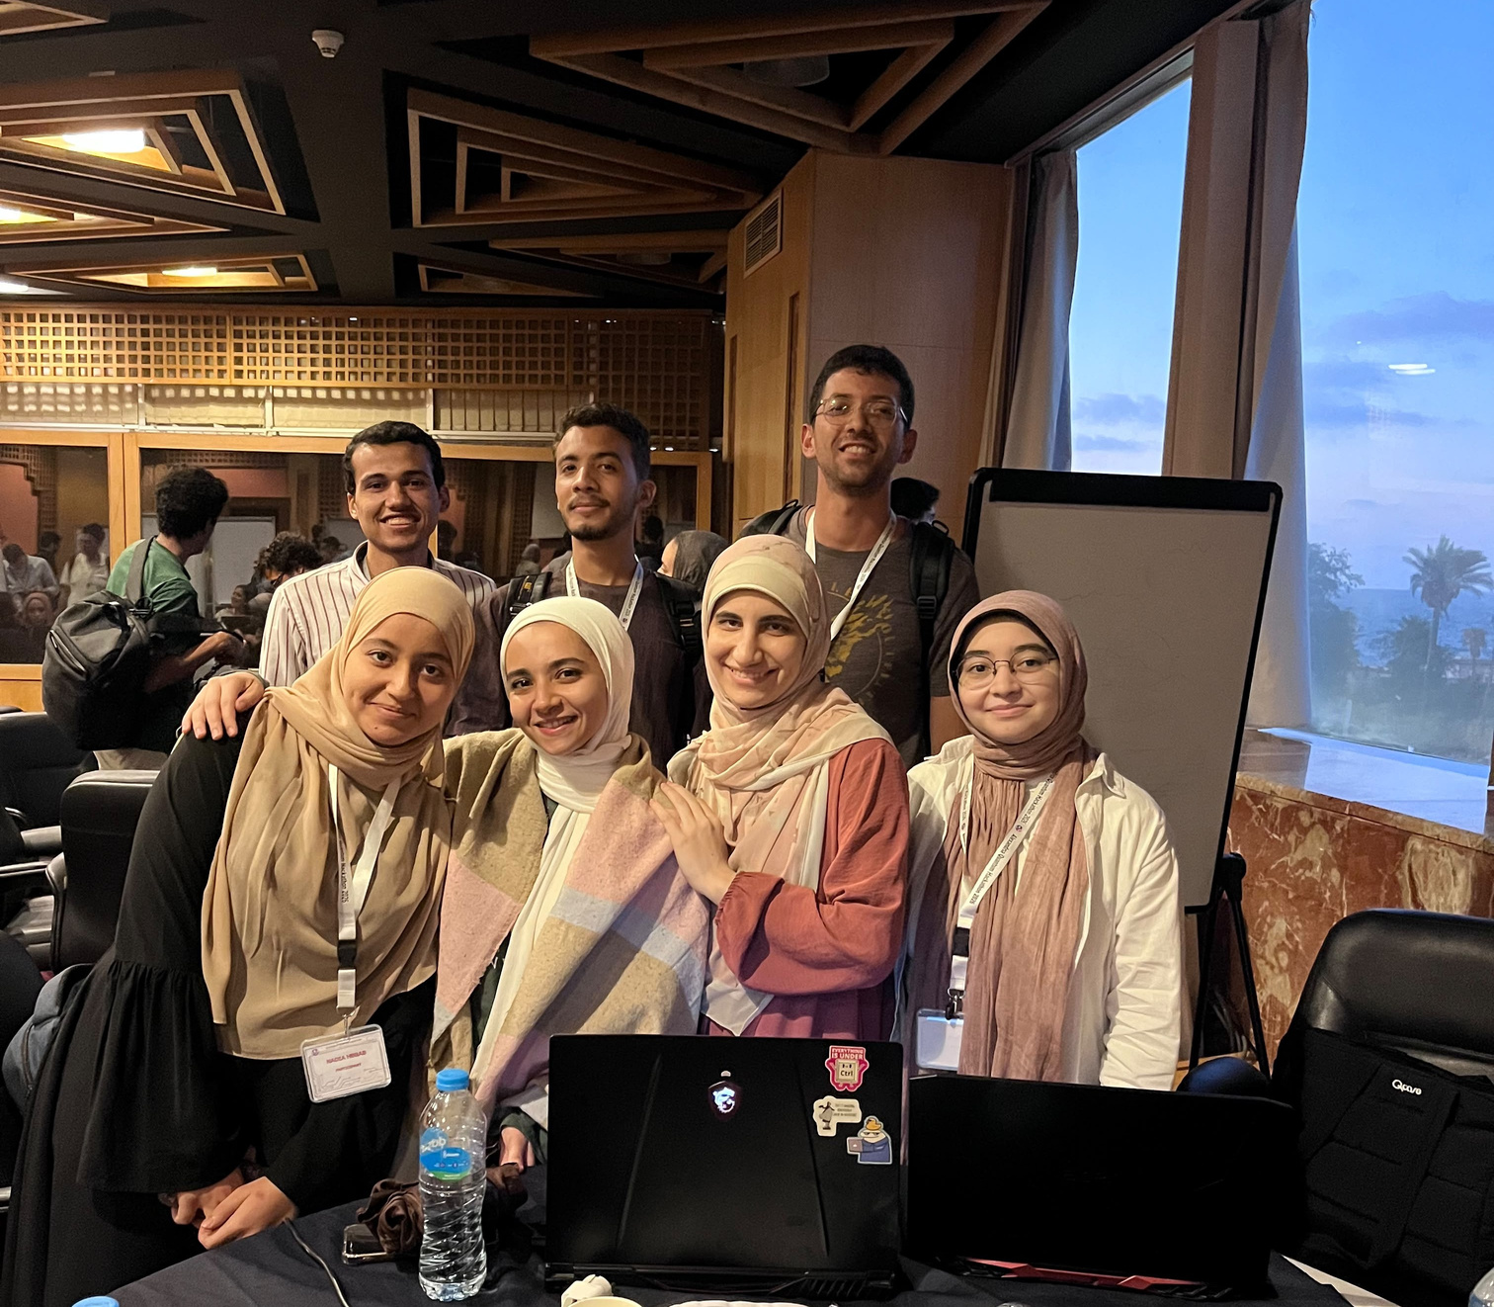

TEAM BEYOND64
Quantum Phase Recognition from Scarce, Noisy Measurements
64
→
16
→
4
→
0
COPY BUDGET PER HIDDEN STATE — EACH MEASUREMENT DESTROYS THE STATE
Nadia Walid · Menna Magdy · Basmala Azab · Omar Ayman · Shady Hany
Notes:
1

Slide 2
Quantum Data Is Scarce - By Design
THE CORE CONFLICT
✗
Full state tomography is impossible
✓
We get 64 copies per hidden state
Reconstructing a 16-qubit state exactly would require an exponentially growing number of copies — far beyond what any oracle can offer.
A hard limit enforced by the oracle. One measure() call consumes one copy — the state is destroyed the instant it's read.
THE TECHNICAL DILEMMA
Classical baselines are strong — even in the starved regime k ∈ {4, 8, 16}. That's exactly where any quantum protocol has to earn its keep, under the same 64-copy budget as every classical comparison.
02
Notes:
2

Slide 3
Our Focus: Three Targets
TEAM BEYOND64
01
02
03
Sample Efficiency
Size Independence
Impostor Detection
Maximize macro-F1 accuracy while spending as few of the 64 copies as possible.
Zero-shot transfer to unseen system sizes — no growth in trainable parameters.
Flag UNKNOWN states drawn from a different Hamiltonian family (Fermi-Hubbard).
Also required: high accuracy near the critical phase transition (hardest region) and robustness to depolarizing noise whose strength is never announced at evaluation time.
03
Notes:
3

Slide 4
THE BENCHMARK
METHODOLOGY
Dataset & Feature Extraction
Classical Approach
Quantum Approach
Ablation Studies & Conclusion
04
Notes:
4

Slide 5
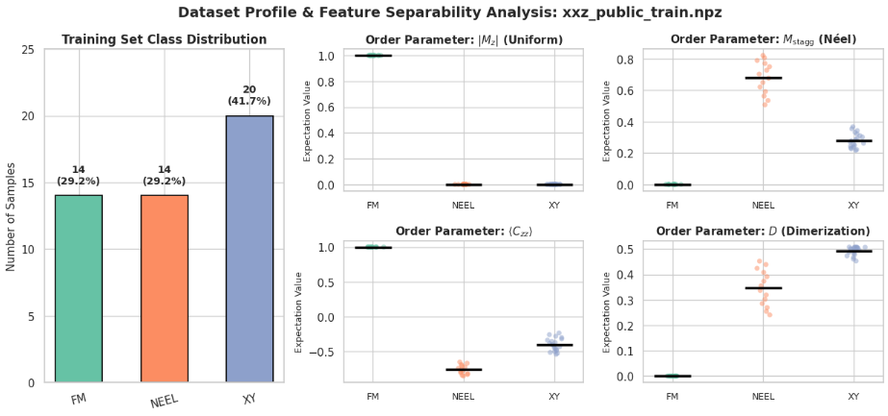
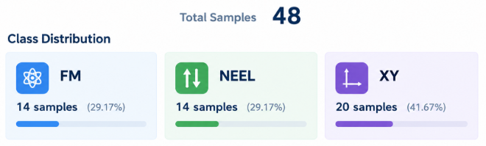
Dataset: Quantum State
& Classification Task
THE BENCHMARK
★ critical point
Challenge: Only k<=64 copies are available → extract informative features withouth full state tomogrophy
04
Notes:
4

Slide 6
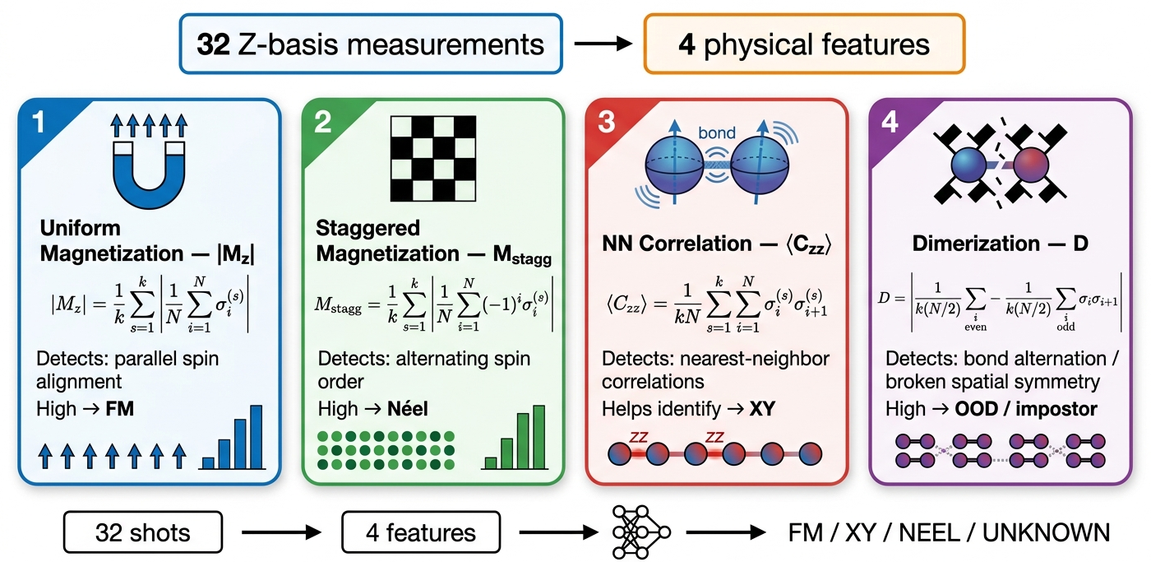
From Raw States to Physics Features
04
Notes:
4

Slide 7
From Raw States to Physics Features
SCALING PROBLEM SOLVED :)
04
Notes:
4

Slide 8
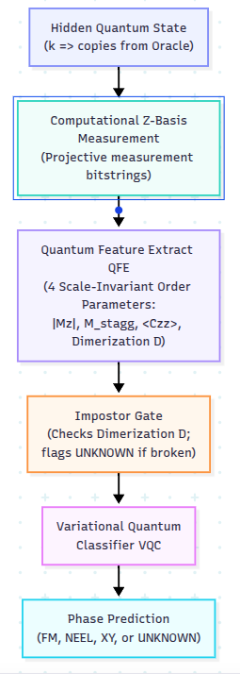
Impostor...????
?
?
04
Notes:
4

Slide 9
Impostor...????
IMPOSTER PROBLEM SOLVED :)
?
?
04
Notes:
4

Slide 10
THE BENCHMARK
METHODOLOGY
Dataset & Feature Extraction
Classical Approach
Quantum Approach
Ablation Studies & Conclusion
04
Notes:
4

Slide 11
CLASSICAL-SIDE SOLUTION
The 64-Copy Problem
Budget-honest, physics-informed phase classification of the XXZ spin chain
1
Converting Quantum Data to Classical Data Using Measurement
Every sample is drawn through oracle.measure() — 64 copies per state, fixed depolarizing noise p = 0.02. The state vector is never touched directly.
2
Depolarization Noise Injection
Every sample is drawn through oracle.measure() — 64 copies per state, fixed depolarizing noise p = 0.02. The state vector is never touched directly.
3
Classical Models
SVM (RBF), Random Forest, and Logistic Regression compared with 5-fold CV across copy budgets k = 4 → 64.
final_merged_data.npz • 48 labeled states (FM / NEEL / XY) + 12 UNKNOWN
Notes:
8

Slide 12
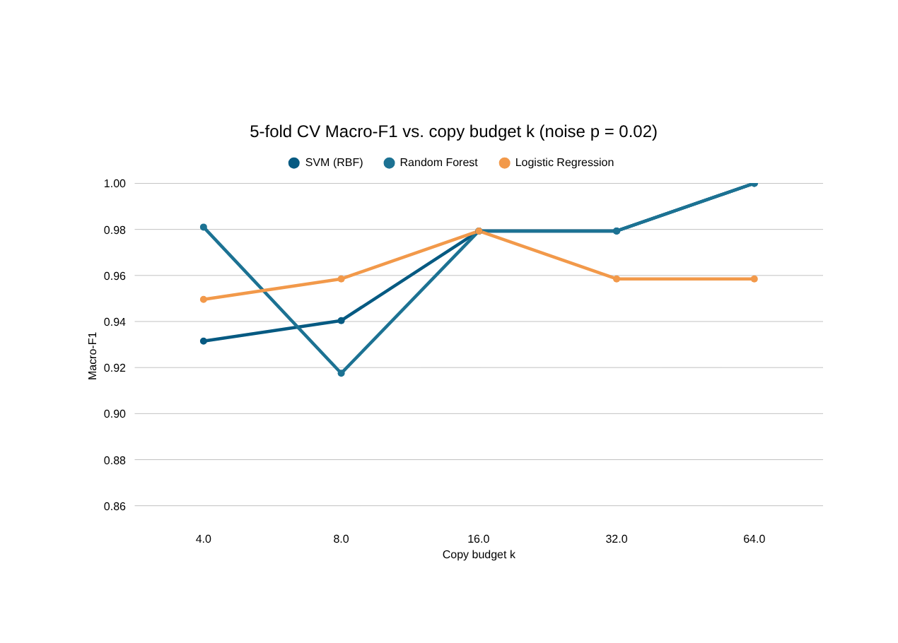
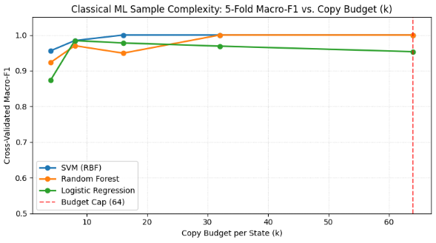
RESULTS
Accuracy vs. Copy Budget & Noise
100%
Macro-F1 (SVM & RF) once k ≥ 32 copies — vs. ≤93% already at k = 4
p ≤ 0.16
Depolarizing noise tolerated with little F1 loss once k ≥ 16 copies
12 / 12
UNKNOWN states (δ = 0, the Heisenberg point) classified as XY phase
Every measurement drawn strictly through the copy-metered oracle — 64 copies/state, budget verified after every run.
Notes:
8

Slide 13
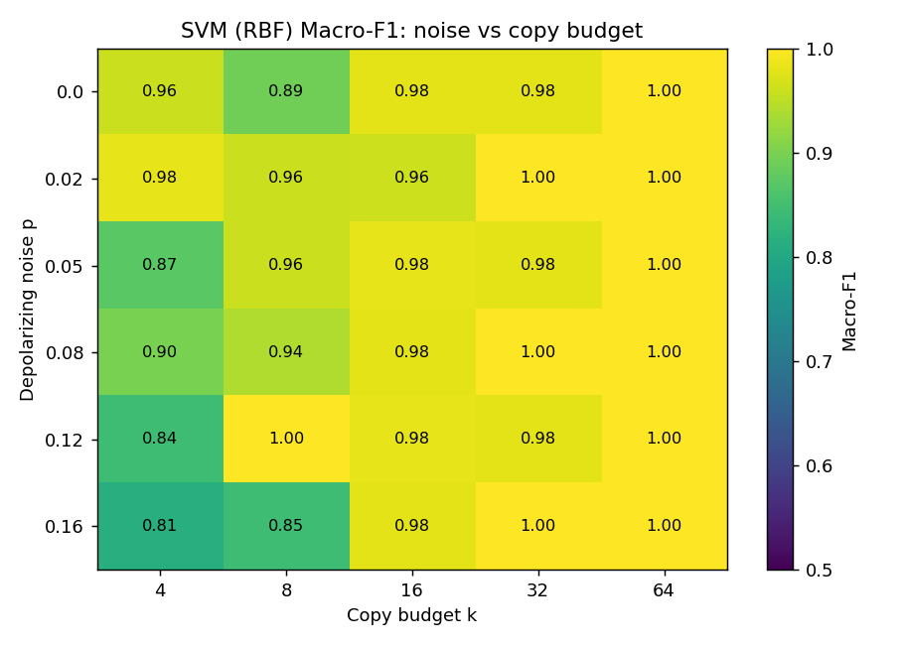
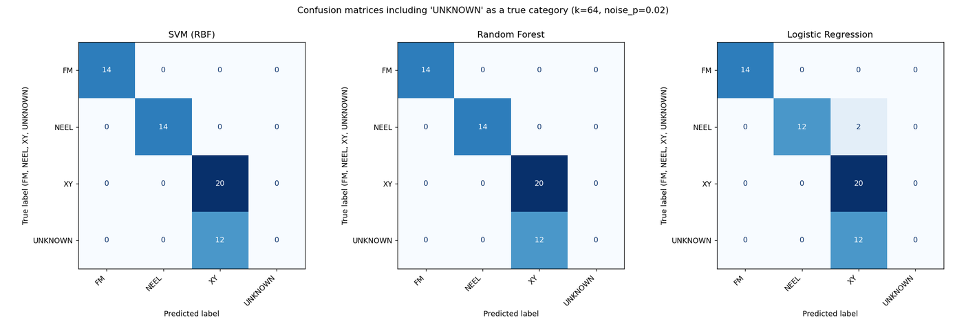
Classical Approach
Best Model(SVM)

Slide 14
CLASSICAL BASELINES
Classical Performance vs. Copy Budget
Budget (k) | SVM (RBF) | Random Forest | Logistic Reg.
4 | 0.9559 | 0.9232 | 0.8737
8 | 0.9844 | 0.9702 | 0.9844
16 | 1.0000 | 0.9492 | 0.9778
32 | 1.0000 | 1.0000 | 0.9689
64 | 1.0000 | 1.0000 | 0.9533
WINNING MODEL — FULL-DATA SVM
Class | Precision | Recall | F1
FM | 1.000 | 1.000 | 1.000
NEEL | 1.000 | 0.857 | 0.923
UNKNOWN | 1.000 | 1.000 | 1.000
XY | 0.909 | 1.000 | 0.952
5-fold cross-validated macro-F1, using the 4 physics features (extract_features_at_budget).
0.969
0.966
macro-avg F1
(48 states, full fit)
overall
accuracy
09
Notes:
9

Slide 15
THE BENCHMARK
METHODOLOGY
Dataset & Feature Extraction
Classical Approach
Quantum Approach
Ablation Studies & Conclusion
04
Notes:
4

Slide 16
QUANTUM Approach
Variational Quantum Classifier (VQC)
2 APPROACHES
physics-based Quantum Feature Extraction (QFE)
Quantum-Native Measurement, Classically Read Out
10
Notes:
10

Slide 17
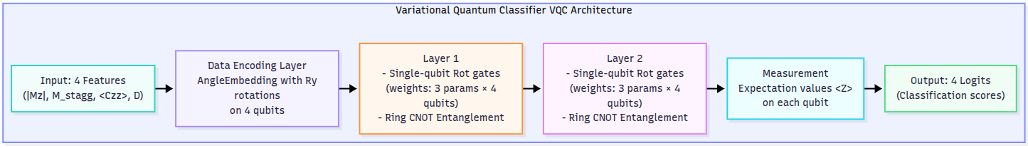
BEST APPROACH "WHY US :)”

Slide 18
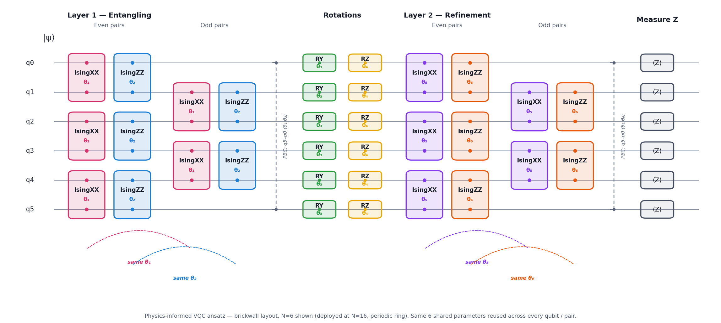
APPROACH 02
Variational Quantum Classifier Architecture
10
Notes:
10

Slide 19
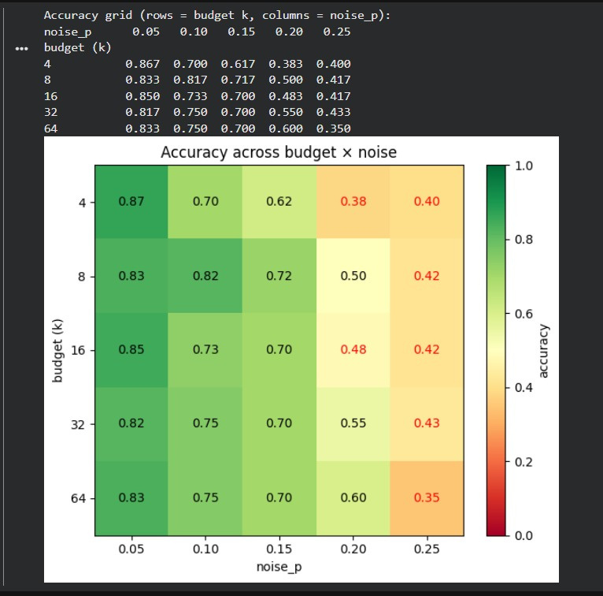
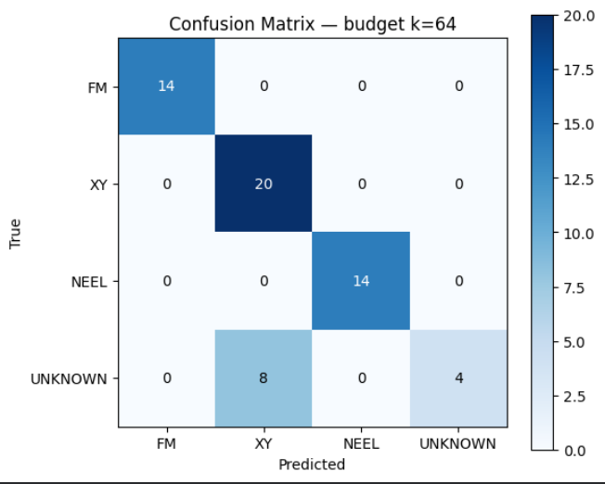
QUANTUM Approach
10
Notes:
10

Slide 20
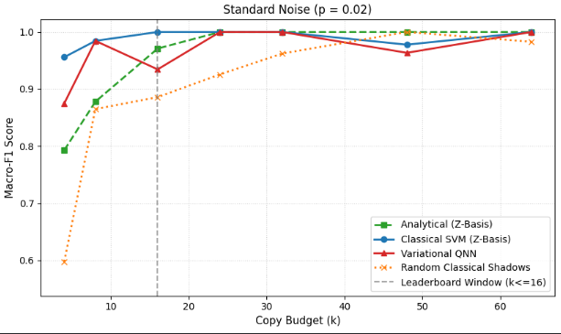
Starvation Curve

Slide 21
THE BENCHMARK
METHODOLOGY
Dataset & Feature Extraction
Classical Approach
Quantum Approach
Ablation Studies & Conclusion
04
Notes:
4

Slide 22
FULL PIPELINE
04
Notes:
4

Slide 23
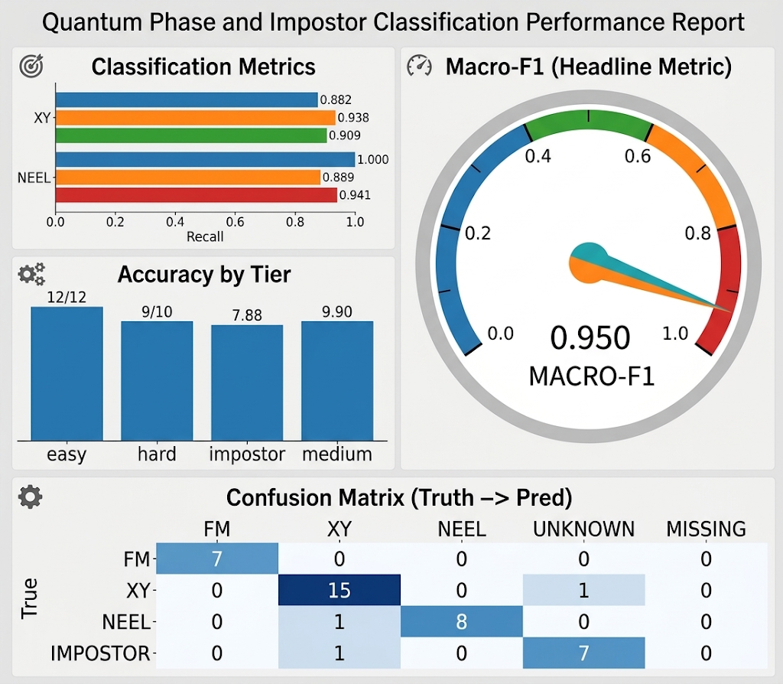
Test Results on k =16
04
Notes:
4

Slide 24
Test Results on k =16
GOOD RESULTS, VOTE FOR US!! :)
04
Notes:
4

Slide 25


Thank You
“Quantum data is scarce — but we showed it's enough.”
Team Beyond64 — Nadia · Menna · Basmala · Omar · Shady
Notes:
16

