Slide 1
Machine Translation
Name : Menna Allah Mohammed Refai Instructors: Saher Ghanem
ID:202102210 TA : Esraa Habiba

Slide 2
Table of Contents
01
02
03
04
Overview
What is machine Translation?
Why ? and what Languages
Models
What model used ?
Two approaches
Flutter App
UI , Features , Dependencies
And API Integration
Challenges and Advans
Challenges and
Advanced Feature

Slide 3
01
Overview

Slide 4
Understanding the Application
01
02
What is Machine Translation ?
Why Machine Translation ?

Slide 5
Applied Languages
03
English
Arabic

Slide 6
02
Models

Slide 7
Divide into two Approaches
01
02
LSTM
Transformers
Seq2Seq Model
Enoder 2 Decoder
Many to many
Sequential
AttentionMecham
Enoder 2 Decoder
Many to many
Parallelism

Slide 8
Main Competitors
01 . Approache
Model | Accuracy | loss | Data | Embedding
Lstm_1 | 1.0000 | 0.0075 | Hugging Face | Vectorizer
Lstm_2 | 0.9593 | 0.7043 | manyThing | OneHotEncoding
n_parameters_1
75,504,872
n_parameters_2
1,438,910

Slide 9
Transformers
Attention is All You need !
MarianMTModel

Slide 10
MarianMTModel
02 . Approache
01
02
What is MarianMTModel
Why MarianMTModel

Slide 11
About Model
Model Name
Model Tokenizer
Data Set
Helsinki-NLP/opus-mt-en-ar
MarianTokenizer
OPUS
N_parameters
BLEU Metric
chr-F
110 million
14.0
0.437

Slide 12
03
Flutter_App

Slide 13
Our Process
The Blue, smooth ,
Light and Friendly UI
Converting the model
Into API
UI
Libaries
API
FastAPI
TTS
Http
Convert
Uvicorn Server
FastAPI Endpoint
FastAPI Bind

Slide 14
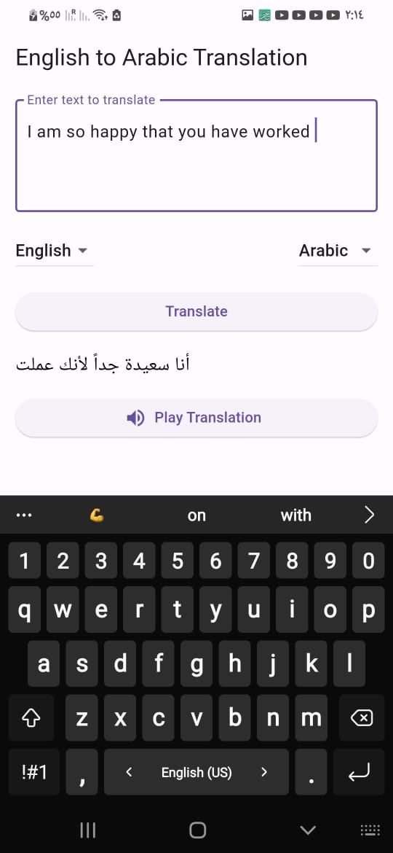
App Sample

Slide 15
04.1
Challenges

Slide 16
Models Overfitting
Model Overfitting
FastApI Binding
And Connection Lose

Slide 17
04.2
Advanced

Slide 18
Inverse Translation
STT
OCR
earths is the sun’s mass
is Jupiter’s rotation period
is the distance to the Moon

Slide 19
Any Question?
Thanks!
Feel Free To Ask !
Please keep this slide for attribution

Slide 20


