Slide 1
Store Sales Forecasting
±12%
Predicting 6 weeks of daily sales for 1,115 Rossmann stores
typical error
per store-day
NextGen Institute · Machine Learning Final Project
Menna Ali Abdelrahman

Slide 2
The problem: planning blind
Every store must plan staff and stock six weeks ahead
1,115
6 weeks
1M+
stores in the chain
planning horizon
daily sales records, 2013–2015
Too little stock means empty shelves; too much means waste
Too few staff means lost sales; too many means wasted cost
Decision supported: staffing, stock orders and promotion timing

Slide 3
The data and how it was split
Rossmann Store Sales (Kaggle): daily sales + store metadata
1,017,209
17%
3
rows before cleaning
closed days removed (sales = 0)
time-based blocks: train / validation / test
Train until 8 May 2015 · Validation until 19 Jun · Test 20 Jun – 31 Jul 2015 (kept untouched)
No random split: the model never sees the future
Customers column excluded: not known at forecast time (leakage)
180 stores have a gap in Jul–Dec 2014; it was not imputed

Slide 4
What the data says
Exploratory analysis on the training period only
+39%
December
10.2K
average sales on promo days (8,205 vs 5,907)
yearly peak in both 2013 and 2014
avg sales of store type b vs ~6.8K for others
Weekly rhythm: Monday highest, Saturday lowest; sales trend up in 2015
Competition distance and school holidays have a weak effect

Slide 5
How the model was built
Everything inside one scikit-learn Pipeline, fitted on training data only
1
2
3
4
Clean
Features
Models
Tune
remove closed and zero-sales days
competition age, Promo2, calendar, store average
Ridge, Random Forest, HistGB, XGBoost
random search + time-series CV
Three folds of 42 days each: train on the past, validate on the following 6 weeks

Slide 6
Comparing the models
Validation RMSPE, lower is better
XGBoost (tuned) wins: best validation score and a 12 MB model; Random Forest is 141 MB
Ridge is far behind, so the relationships are non-linear (for example promo × weekday)
Tuning improved XGBoost from 0.143 to 0.136 and HistGB from 0.156 to 0.138

Slide 7
Final result on the untouched test set
20 June – 31 July 2015 · model retrained on train + validation
0.1231
12.3%
RMSPE (store-mean baseline: 0.3041)
error per store-day, down from 30.4%
0.908
635
R²: explains 91% of daily sales variance
MAE per store-day (baseline: 1,441)

Slide 8
What a promotion is worth
Same store, same day, promotion on vs off (model estimate, weekdays only)
About +33% on weekdays (raw averages: +42%)
Largest on Monday, smallest on Friday
Promotions never run on weekends in the data, so a weekend effect cannot be estimated
An association, not proven causation: test before moving budget

Slide 9
The app: try scenarios before acting
Live on Streamlit Community Cloud
You choose
4,492 → 6,183
A store (1–1115)
First day and 7–42 days
Promotions on weekdays: on / off
Store 1, Monday 3 Aug 2015: without vs with a promotion
You get
Weekends are always forecast without a promotion
Sundays show as closed (forecast 0)
Shows the ±12% typical error with every forecast
Forecast total and open days
Gain vs. no promotion
Daily chart and table
rossmann-forecast-menna.streamlit.app

Slide 10
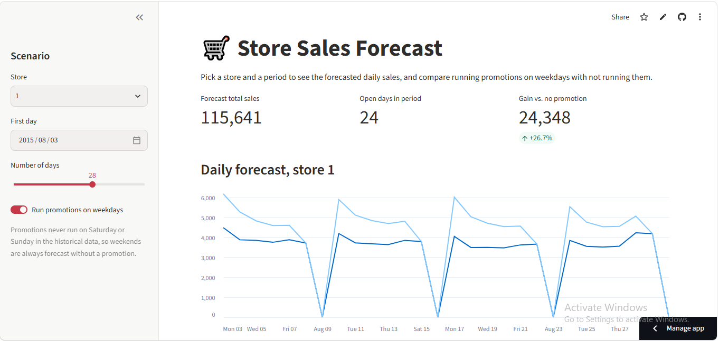
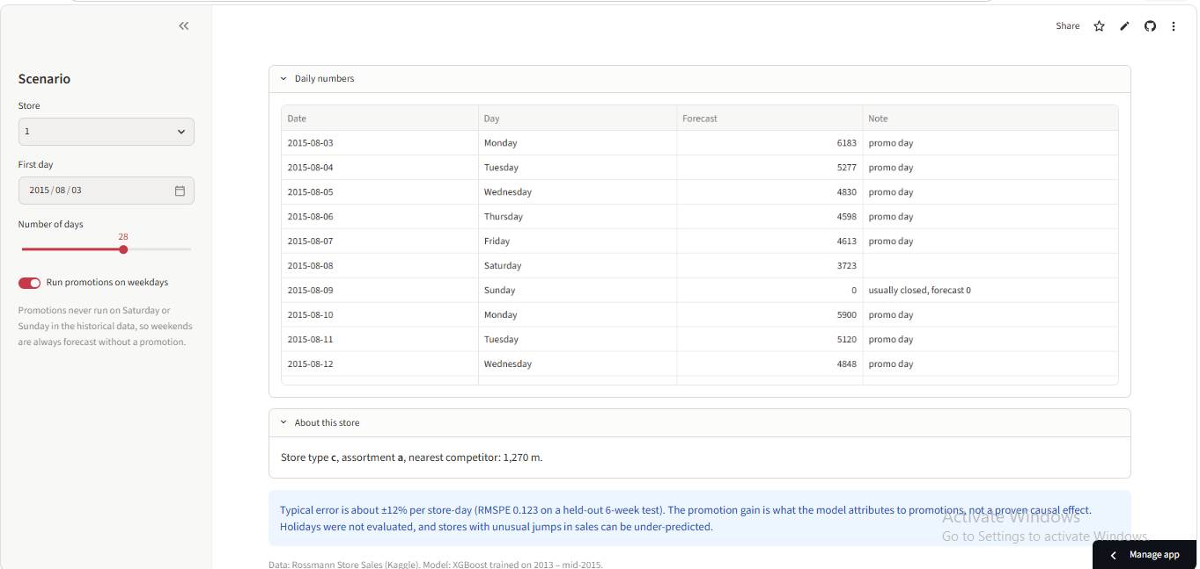
The app in action
Screenshots from the deployed Streamlit app (Store 1, 3 Aug 2015, 28 days)
Forecast total, open days, gain vs. no promotion, and the daily chart with and without promotions
Daily numbers table, store details, and the typical-error note shown with every forecast
Sundays show as closed (0), weekends have no promotion, and the Forecast column reflects the chosen scenario

Slide 11
What the company should do next
And what to keep in mind
Recommendations
Limitations
Use the forecast for staffing and stock on a 6-week horizon, with a safety buffer on peak days
Review the ~29 stores with RMSPE above 0.20 manually
Run a controlled promo experiment before shifting budget
Retrain monthly as new sales arrive
One 6-week test window with no state holidays
No December peak evaluation
No lag, weather or local-event features: sales jumps at stores 292, 909, 876 are missed
The app assumes no holidays in the chosen dates

Slide 12
Thank you
Live app: rossmann-forecast-menna.streamlit.app
Code: github.com/Mennaali30/rossmann-sales-forecasting
Data: Rossmann Store Sales (Kaggle) · Python, scikit-learn, XGBoost, Streamlit
NextGen Institute · Machine Learning

