Slide 1
HealthCare Provider Fraud Detection
Lojean Kasem
Aya Mostafa
Menna Kurdi
Habiba

Slide 2
The Problem
Why Detect Healthcare Fraud?
Fraud drains millions yearly
Hard to catch manually
Fraudulent providers mimic normal behavior
Need a smarter detection system

Slide 3
Data Sources
4 Datasets
Beneficiary data
Inpatient claims
Outpatient claims
Provider fraud labels
Merging Keys:
BeneID
Provider

Slide 4
Data Cleaning
Cleaning Steps Performed
Converted date strings → datetime
Computed ClaimDuration = End − Start
Replaced missing numeric fields with 0
Standardized column formats
Removed unused ID-level columns

Slide 5
Feature Engineering
Provider-Level Aggregation
For Inpatient & Outpatient claims:
Total Amount Reimbursed
Total Deductible Paid
Number of Claims
Mean Claim Duration
Goal:
Capture unusual spending behavior

Slide 6
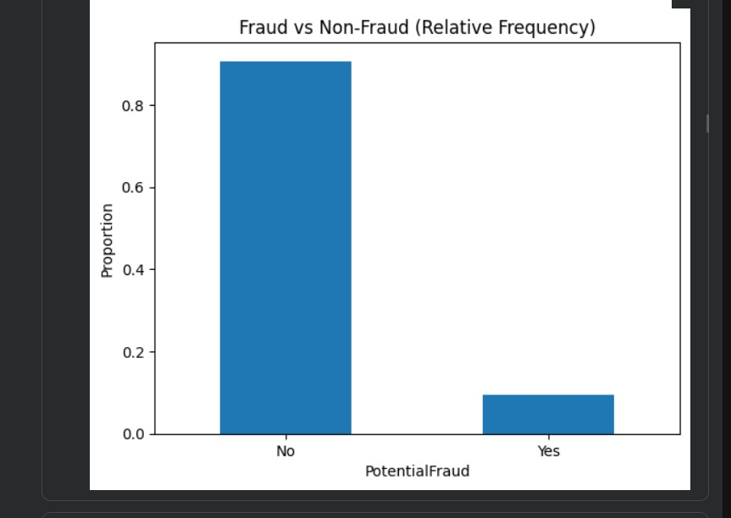
Handling Imbalance
Fraud Cases = Only ~10%
Very imbalanced
Used SMOTE to oversample the fraud class
Applied only to training set

Slide 7
Model Training
Models Implemented
Logistic Regression
Random Forest
Gradient Boosting
Training Details:
Train/Test split: 80/20
SMOTE applied on X_train, y_train
All models trained on same feature set

Slide 8
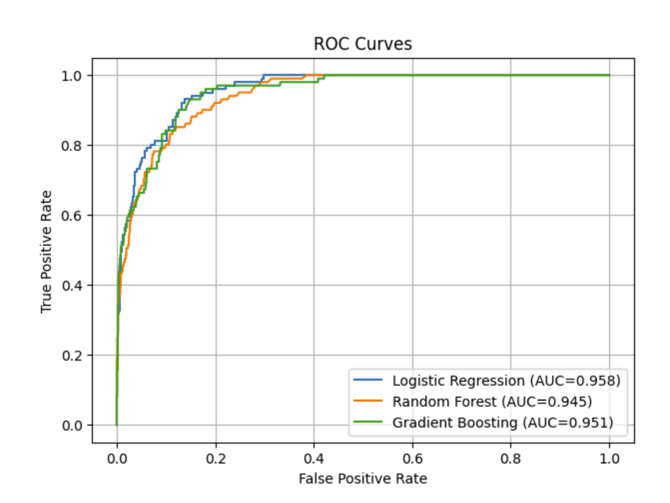
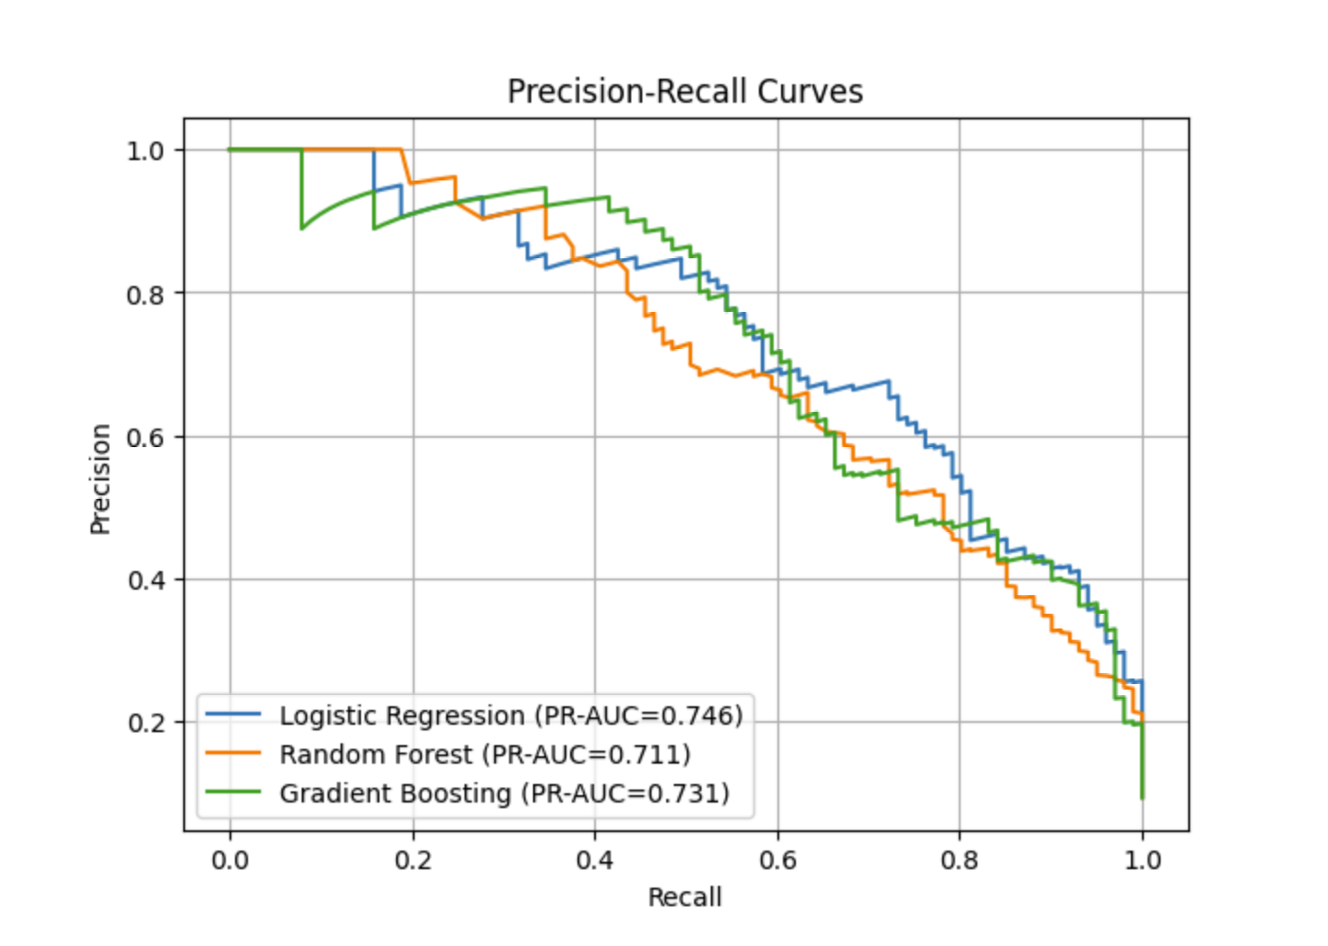
Evaluation Metrics
Metrics Used
Precision, Recall, F1-score
Confusion Matrix
ROC-AUC
PR-AUC

Slide 9
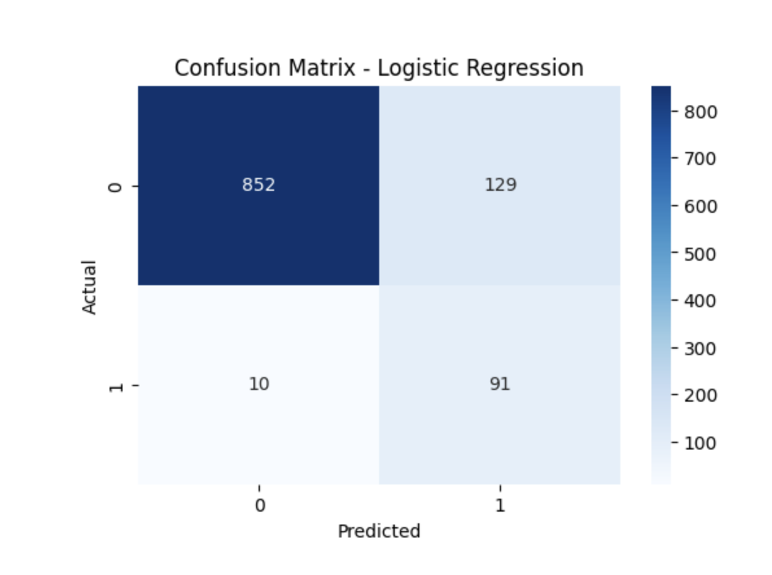
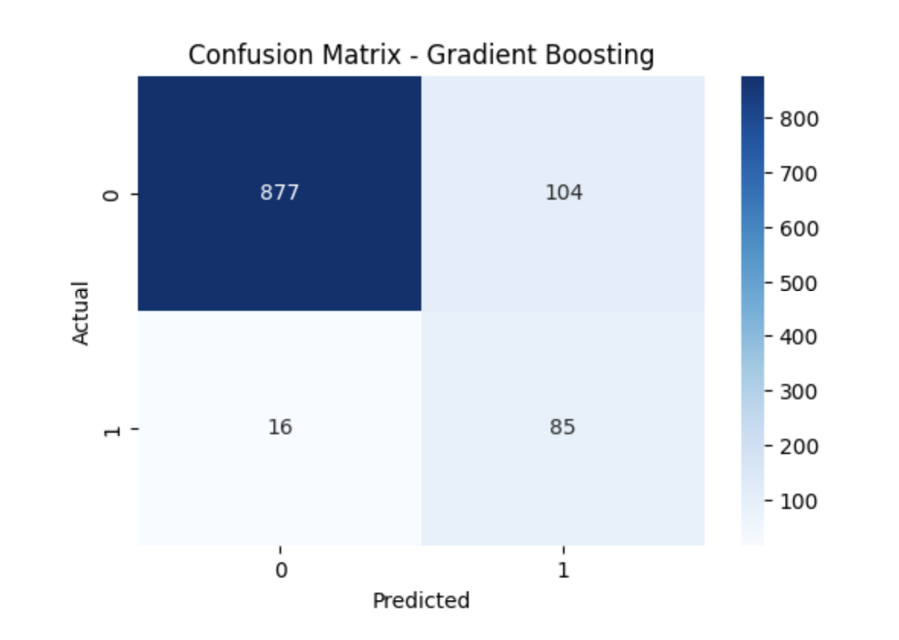

Confusion Matrices
Model Confusion Matrices
Logistic Regression
Random Forest
Gradient Boosting

Slide 10
Numerical Results
Your Actual Results
LR: AUC = 0.958 | High FP
RF: AUC = 0.945 | Balanced
GB: AUC = 0.951 | Best FN performance

Slide 11
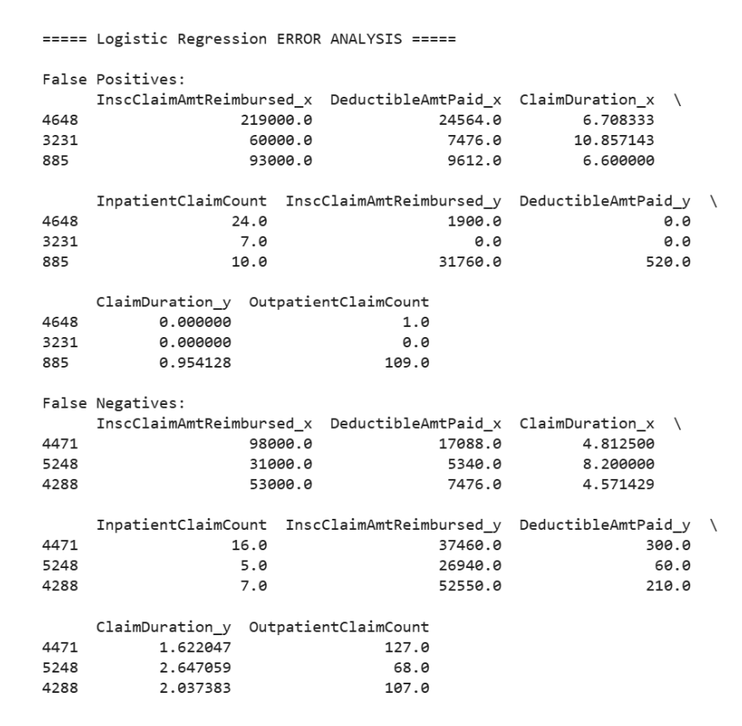
Logistic Regression Error Analysis
Logistic Regression — Error Analysis
Highest false positives = 129
Misclassified many legitimate providers
Often triggered by:
• high deductibles
• long claim durations

Slide 12
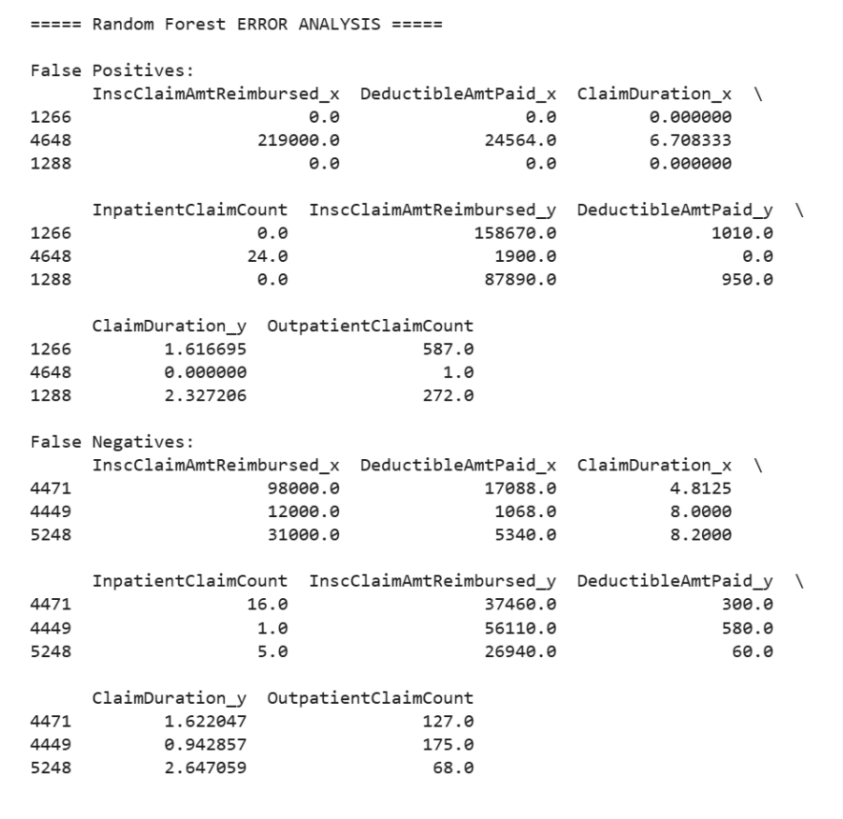
Random Forest Error Analysis
Random Forest — Error Analysis
Balanced performance
Moderate false positives
Moderate false negatives
Errors often caused by:
• mixed patterns
• overlapping claim behaviors

Slide 13
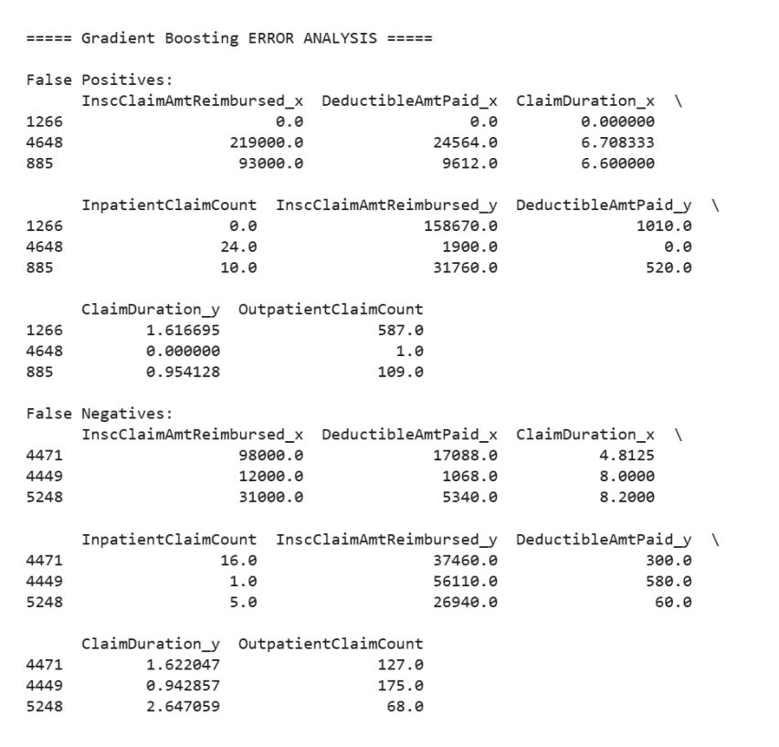
Gradient Boosting Error Analysis
Gradient Boosting — Error Analysis
Lowest false negatives = 16
Best at catching actual fraud
Mistakes mostly in:
• borderline providers
• low-value claims

Slide 14
Numerical Results
Your Actual Results
LR: AUC = 0.958 | High FP
RF: AUC = 0.945 | Balanced
GB: AUC = 0.951 | Best FN performance

Slide 15
Error Analysis
Why Models Made Mistakes
False Positives: unusually high deductibles or claim durations
False Negatives: subtle patterns or low claim frequency
GB had lowest FN = 16
LR had highest FP = 129

Slide 16
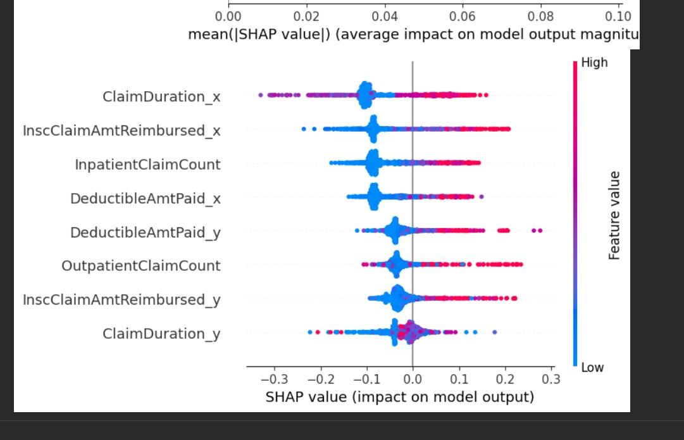
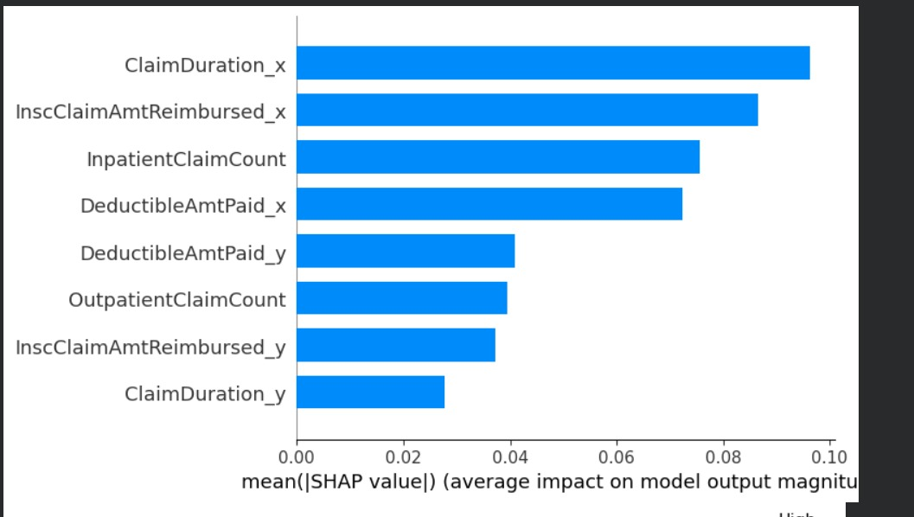
SHAP Results
Why does the model predict fraud?
ClaimDuration_x is the strongest fraud indicator
High reimbursement & deductible amounts push predictions toward fraud
High inpatient claim counts increase fraud likelihood
SHAP shows feature impact → improves trust & interpretability

Slide 17
Business Impact
How This Helps Medicare
Detect fraud earlier
Reduce financial losses
Prioritize investigations
Improve audit efficiency
Support evidence-based decisions

Slide 18
Final Recommendation
Recommended System
Use Gradient Boosting as main model
Use Random Forest for interpretability
Integrate with fraud investigation workflow

