Slide 1
Parallelized Kendall’s Tau Coefficient Computation via OpenMP
Matteo Penco
Emanuele Torelli

Slide 2
Outline
Kendall’s tau coefficient: context
Computation of Kendall’s tau coefficient
Different algorithm implementations
Naïve algorithm
GSE algorithm
OpenMP parallelization and vectorization
Performance evaluation
Other info

Slide 3
Kendall’s tau coefficient: context
Pairwise association measure is an important operation in data analytics.
Kendall’s tau coeﬃcient (τ coeﬃcient for short) measures the ordinal correlation between two vectors of ordinal variables.
Ordinal data is a categorical, statistical data type where the variables have natural, ordered categories and the distances between the categories is not known.
One typical application is used in bioinformatics and computational biology, in order to mine gene co-expression relationship via gene expression data.

Slide 4
Computation of Kendall’s tau coefficient
Given two ordinal vectors u={u₁,u₂,...,u_{n}} and v={v₁,v₂,...,v_{n}}, where variables u_{i} and v_{i} are both ordinal (0 ≤ i < n), the τ coeﬃcient computes the correlation by counting the number of concordant pairs n_{c} and the number of discordant pairs n_{d} by treating u_{i} and v_{i} as a joint ordinal variable (u_{i},v_{i}).
For the τ coeﬃcient, a pair of observations (u_{i},v_{i}) and (u_{j},v_{j}), where i≠j, is considered as concordant if u_{i}>u_{j} and v_{i}>v_{j} or u_{i}<u_{j} and v_{i}<v_{j}, and discordant if u_{i}>u_{j} and v_{i}<v_{j} or u_{i}<u_{j} and v_{i}>v_{j}. Note that if u_{i}=u_{j} or v_{i}=v_{j}, this pair is considered neither concordant nor discordant.

Slide 5
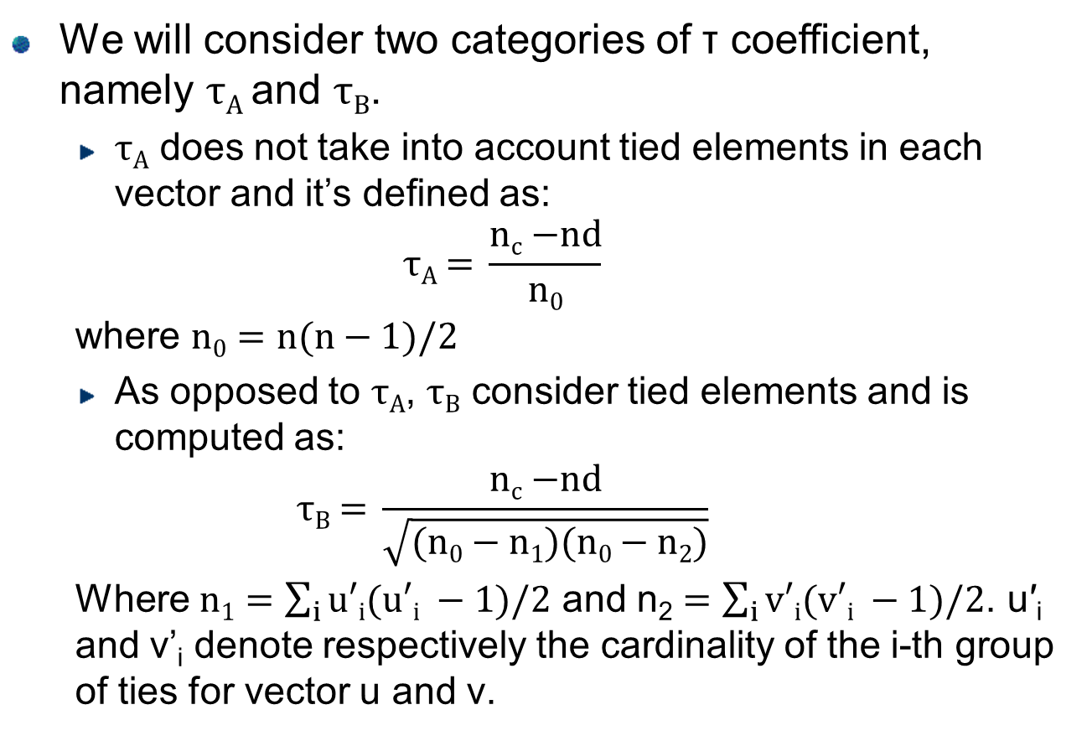
Computation of Kendall’s tau coefficient
We will consider two categories of τ coeﬃcient, namely τ_{A} and τ_{B}.
τ_{A} does not take into account tied elements in each vector and it’s deﬁned as:
$$\text{τ}\text{A}\text{ = }\frac{\text{n}\text{c}\text{ −}\text{nd}}{n0}$$
where $\text{n}\text{0}=n(n−1)/2$
As opposed to τ_{A}, τ_{B} consider tied elements and is computed as:
$$\text{τ}\text{B}\text{ = }\frac{\text{n}\text{c}\text{ −}\text{nd}}{\sqrt{(n0−n1)(n0−n2)}}$$
Where $\text{n}\text{1}=\sum_{i}{u′i(u′i −1)/2}$ and $\text{n}\text{2}=\sum_{i}{v′i(v′i −1)/2}$. u′_{i} and v’_{i} denote respectively the cardinality of the i-th group of ties for vector u and v.

Slide 6
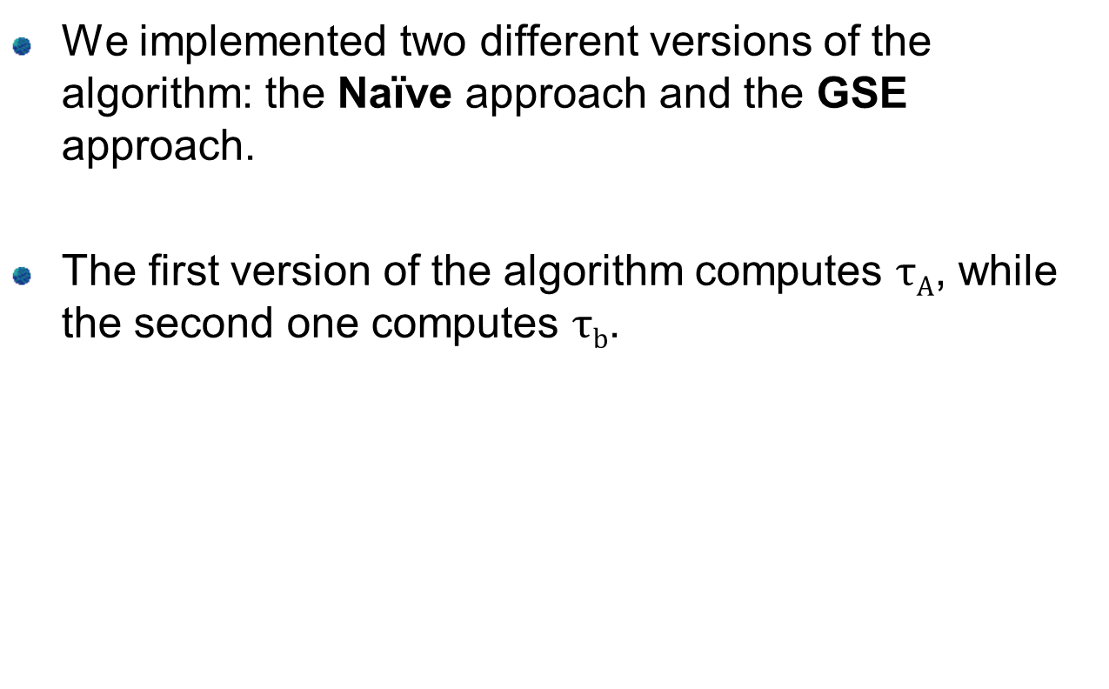
Different algorithm’s implementations
We implemented two different versions of the algorithm: the Naïve approach and the GSE approach.
The first version of the algorithm computes $\text{τ}\text{A}$, while the second one computes $\text{τ}\text{b}$.

Slide 7
Naïve algorithm
We can observe that the two joint variables are concordant if and only if the value of (u_{i}−u_{j})×(v_{i}−v_{j}) is positive; discordant if and only if the value of (u_{i}−u_{j})×(v_{i}−v_{j}) is negative; and neither concordant nor discordant if and only if the value of (u_{i}−u_{j})×(v_{i}−v_{j}) is equal to zero.
Neither concordant
nor discordant
Discordant
Concordant
U:
V:
1
3
4
2
3
2
1
1
2
2
1
4
3
1
2
2

Slide 8
Naïve algorithm
Given vectors u and v of n elements each, the naïve approach consists of enumerating all possible pairs of joint variables (u_{i},v_{i}) (0 ≤ i < n) to obtain n_{c} and n_{d}, resulting in O(n²) time complexity.
U:
V:
1
3
4
2
3
2
1
1
2
2
1
4
3
1
2
2

Slide 9
GSE algorithm
The general idea is a merge-sort-like divide-and-conquer approach, working in the following five steps.
The elements with the same index are “packed” in a vector of joint variables
The time complexity of the whole algorithm is O(nlogn).
U:
V:
1
2
3
2
4
1
2
4
3
3
2
1
1
2
1
4

Slide 10
GSE: Step1
First of all, the algorithm sorts the list of joint variables (u_{i},v_{i}) in ascending order (sorting first by u_{i} and secondarily by v_{i}). Quicksort has been used for this step, resulting in O(nlogn) time complexity on average.
U:
V:
1
2
1
2
1
4
2
1
2
4
3
2
3
3
4
1

Slide 11



GSE: Step2
In Step2 the algorithm performs a linear-time scan over the sorted list to compute n₁ by counting the number of tied u elements in each group. Meanwhile it’s also computed a value n₃ for tied couples.
$\text{n}\text{1}=\sum_{i}{u′i(u′i −1)/2}$ $\text{n}\text{3}=\sum_{i}{wi(wi −1)/2}$
Tied couple ($wi$=1)
Tie-group ($u^{′}2$=2)
U:
V:
1
2
1
2
1
4
2
1
2
4
3
2
3
3
4
1

Slide 12
GSE: Step3
The vector sorted obtained in Step1 is sorted again in ascending order of all elements in v with a merge-sort procedure that can additionally accumulate the number of discordant joint pairs each time two adjacent sorted subarrays are merged. Time complexity is O(nlogn).
U:
V:
2
1
4
1
1
2
1
2
3
2
3
3
1
4
2
4

Slide 13
GSE: Step3
Since we already ordered the vector by u in Step1, every element in the left sub-vector (with smaller indexes) is smaller or equal to the elements in the right sub-vector. A discordancy occurs when the left element v is greater or equal to the right element v.
The left u is always smaller than the right u
2
4
3
2
3
2
2
4
Sorted vector
The left v is greater than the right one -> n_{d} = n_{d} +1

Slide 14
GSE: Step3
3
2
2
4
4
1
3
3
3
2
2
4
4
1
3
3
n_{d}++
n_{d}++
Sorted vector
n_{d}++
No increment
4
1
3
2
3
3
2
4

Slide 15


GSE: Step4
In Step4 the algorithm performs again a linear-time scan over the sorted list obtained in Step3 to compute n₂, in a similar way to Step2.
$\text{n}\text{2}=\sum_{i}{v′i(v′i −1)/2}$
U:
V:
2
1
4
1
1
2
1
2
3
2
3
3
1
4
2
4
Tie-group ($u^{′}2$=3)

Slide 16
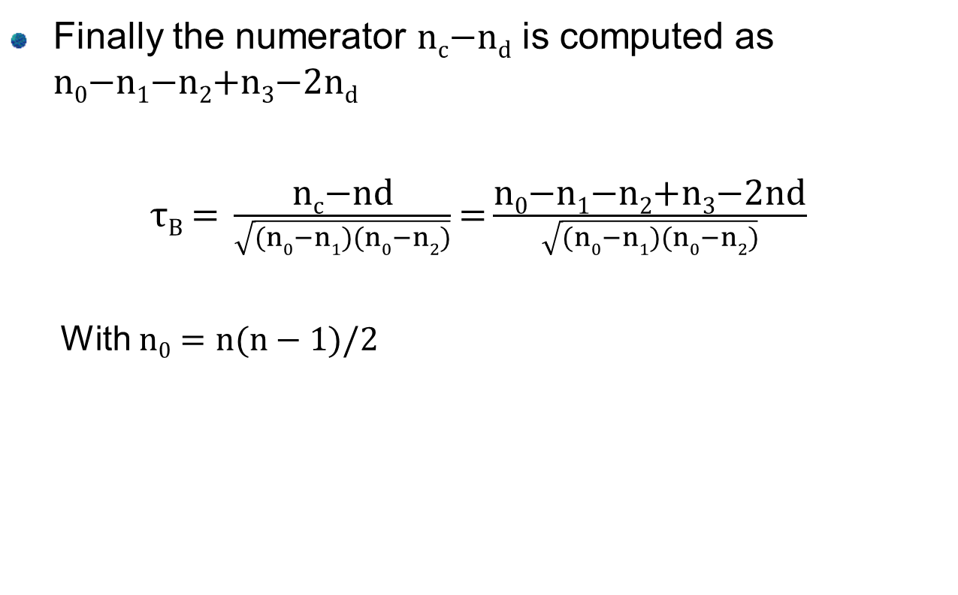
GSE: Step5
Finally the numerator n_{c}−n_{d} is computed as n₀−n₁−n₂+n₃−2n_{d}
$\text{τ}\text{B}\text{ = }\frac{\text{n}\text{c}\text{−}\text{nd}}{\sqrt{(n0−n1)(n0−n2)}}$ $\text{=}\frac{\text{n}\text{0}\text{−}\text{n}\text{1}\text{−}\text{n}\text{2}\text{+}\text{n}\text{3}\text{−2}\text{nd}}{\sqrt{(n0−n1)(n0−n2)}}$
With $\text{n}\text{0}=n(n−1)/2$

Slide 17
Parallelization and vectorization with OpenMP
For the naïve variant, we parallelized the for loops
The outer loop has been parallelized using omp for directive
The inner loop has been vectorised using omp simd directive
For the GSE variant, we parallelized the two sorting operations of the algorithm, which are the bottlenecks
Quicksort algorithm has been parallelized using omp sections directive within a parallel region
Merge-sort algorithm has parallelized using omp for directive which parallelizes the inner loop

Slide 18
Performance evaluation
We compared the performances of the algorithm implementations, using inputs of different lentghs, and we also tested the multithreading scalability of each variant.
Furthermore we can notice that the Naive_simd variant can exploit both the multithreading parallelization and the SIMD vectorization at the same time.

Slide 19
Performance evaluation
 | Naive | Naive_simd | GSE
700000 | 445 s | 130 s | 0,776 s
500000 | 216 s | 63,6 s | 0,561 s
300000 | 79,8 s | 22,7 s | 0,315 s
100000 | 9,21 s | 2,67 s | 0,102 s
Length of input vector
Time to compute KendallTau coefficient
These measures are referred to single-thread execution.

Slide 20
Naive and Naive_simd multithreading scalability
Time (s)
We used an input of 5x10⁵ elements for this evaluation.

Slide 21
Naive speedup
Speedup
We used an input of 5x10⁵ elements for this evaluation.

Slide 22
Naive_simd speedup
Speedup
We used an input of 5x10⁵ elements for this evaluation.

Slide 23
Naive_simd speedup normalization
Speedup
The normalization has been realized referring to the single-thread execution of naive algorithm. The length of the input is 5x10⁵ as before.

Slide 24
GSE multithreading scalability
Time (s)
We used an input of 3x10⁸ elements for this evaluation.

Slide 25
GSE speedup
Speedup
We used an input of 3x10⁸ elements for this evaluation.

Slide 26
Other info
We tested our algorithm on a Debian GNU/Linux 9 machine, compiling the source code with GCC version 6.3.0.
The project is also available to be imported on Visual Studio 2017 (but only with OpenMP compatibility up to the 2.0 version!).
Source code is available at: https://github.com/Menne/Parallelized-Kendall-s-Tau-Coefficient-Computation

