Slide 1
BAFI 508
Data-Driven Investments
Class 1: Intro
Adlai Fisher
UBC MBAN
February 25, 2025

Slide 2
Outline for Today
People introductions, myself & TA’s
The Class: syllabus, assignments, etc. + topic overview
  Calculation and properties of stock returns, individual and portfolio
  Asset allocation: bond, stock, t-bill
  Quantitative finance topics: portfolio sorts and factor models; performance evaluation
  Other topics as time permits, as final group projects, or as optional individual work: macro factors, unstructured finance data, machine learning
Today: finance preliminaries
  Types of securities and issuers
  Players and participants
  Measurement and data
  Concepts
  Resources
Homework for next class (ungraded, to provoke thought and discussion for next class and beyond)
  Finance conference browsing and contemplation of group project goals
  Download data from two stocks and form portfolio returns (details below)

Slide 3
Syllabus Key Points: 1) Topics
Weeks 1-2: Background (homework 1)
  Financial market basics: market participants, securities, returns, etc.
  Key concepts: efficient markets, arbitrage, CAPM, multi-factor pricing models
  Finance data: Yahoo Finance, CRSP, Compustat, WRDS
  Properties of stock returns and portfolio returns
Weeks 2-3: Asset allocation (homework 2)
  Stocks, bonds, bills, and other asset classes
  Tools: mean-variance analysis, simulation/bootstrapping
Weeks 3-5: Cross-section of stock returns
  Multi-factor pricing models and cross-sectional trading strategies: portfolio sorts, Fama-French model, momentum, other empirical factors; performance evaluation
Week 5: Group project proposals and additional topics as time permits
  Macro factors; predictability of market risk premium; unstructured data

Slide 4
Syllabus Key Points: 2) Work
Due Weight
Homework, two are graded Weeks 2 & 3 25
Group project proposal Week 5, class 9 15
Group project final memorandum end of exam period 50
Participation 10
Optional individual essay end of exam period (replace 25% optimally)
Homework groups, 2-3
Project groups, 5
Choose your own groups
Please note that we will need extra class time on Tuesday March 25, provisionally planned for 12-1pm.

Slide 5
Homework Topics
Calculating stock and portfolio returns using Yahoo Finance and Python and properties of returns (mean, variance, etc.)
Asset allocation optimization (stock, bond, and t-bill)

Slide 6
Final Project Possible Topics
(proposals in week 5)
Portfolio sorts and construction of long-short portfolios on characteristics (size, B/M, momentum, etc.) and performance evaluation (factor models)
  Most groups will choose this option. We will give sample code that you can modify and it gives great experience with a range of finance data.
Alternative projects
  The TA’s and I are always open to alternative projects if student groups are motivated to pursue. Examples of possibilities would be using unstructured data (e.g., scraping Twitter, Glassdoor, or other sources) or machine learning application. Projects in this vein would require meaningful self-direction.

Slide 7
Materials & Resources
Code: Python and Excel
Data (URLs and logins at end of slide deck)
  Yahoo Finance for current prices
  Wharton Research Data Services: stock and accounting data, analyst forecasts, other
  Federal Reserve Economic Data: macro data
  Ken French’s website: portfolio sorts (size, B/M, momentum, etc.)
  Other data can be scraped (e.g., SEC for 10Ks, Twitter for attention/sentiment, GlassDoor for employee outlook, etc.)
Journal articles
  Use Google scholar to search topics, search forward using works cited, backward using journal references
  We have access through library to all top journals! But off campus you must activate UBC VPN
  Top finance journals (most credibility): Journal of Finance, Review of Financial Studies, Journal of Financial Economics, Journal of Financial and Quantitative Economics, Review of Finance, Management Science
Top finance conferences (for recent work)
  Western Finance Association, American Finance Association
Notes, code, and assignments: on Canvas

Slide 8
Background Reading
Basic concepts: any edition of any introductory finance textbook
Ross, Westerfield, and Jaffee, Corporate Finance
Brealey, Myers, and Allen, Principles of Corporate Finance
Berk and DeMarzo, Corporate Finance
Bodie, Kane, and Marcus, Investments
Pierre Vernimmen, Corporate Finance: Theory and Practice, (I have not used this book previously, but it was the only relevant book I could find available electronically through the UBC library)
Perspective on finance and quant finance:
Robert Shiller, Finance and the Good Society (great book about why finance matters)
Jeremy Siegel, Stocks for the Long Run (very good introduction to thinking about the relevance of long histories of data)
Roger Lowenstein, When Genius Failed (as the title suggests, what can go wrong with quant finance)
Ph.D. level treatment of some topics we discuss:
John Cochrane, Asset Pricing
John Campbell, Financial Decisions and Markets
Campbell, Lo, and MacKinlay, The Econometrics of Financial Markets

Slide 9
Quantitative Finance Preliminaries
Securities and issuers
Players and participants
Measurement and data
Concepts

Slide 10
Issuers and Securities
Governments: bills (<= 1 year maturity) and bonds (> 1 year maturity)
  Promise to pay face value (e.g., 10,000 at maturity date, plus coupons along the way, e.g., 3% annual coupon of face paid semi-annually)
  Riskless (or near-riskless) for some, credit risk, also called sovereign credit risk for others.
  Implied average return is called yield-to-maturity, varies with time to maturity and sovereign credit risk
  Yield curve is plot of maturity against yield
Corporations (privately held and publicly held, i.e., exchange-traded)
  Issue commercial paper (short-term borrowing against assets)
  Issue bonds
  Also borrow from banks
  Issue stock, also called equity
  Valuation identity for the corporation: Asset value V = B + S
    B is value of all borrowing, S is value of stock
    Stock holders are “residual claimants,” have claims over value of assets once borrowers are paid
    Stockholders can gain from dividends, and gains in value of stock (capital appreciation)
    Corporations can issue new securities and repurchase securities, sometimes requiring shareholder approval

Slide 11
Issuers and Securities
Trusts and funds: e.g., ETF, REIT, mutual fund
  Hold securities of other companies, and/or real assets and issue other securities which are claims against the trust or fund and whose value moves (or tends to move) with the value of the underlying asset
Side bets between market participants: e.g., options, futures, etc.
  Contracts written between two market participants whose payoff depends on value of some underlying security
  Market-traded (e.g., CBOE, CME) and “over-the-counter” or OTC (e.g., many swaps)

Slide 12
A View of Players and Participants
Corporate Finance/ “Sell Side”
Investments/
Asset Pricing/
“Buy Side”
Financial Markets & Intermediaries
Background drivers
Macro
IO: “Industrial Organization”
Everything else: technology, demographics, politics & international relations, health, climate, etc.

Slide 13
Another View of Players/Participants
Types of Market Participant by Horizon
  Low Frequency / Long-term horizon
  Medium-term horizon
  High Frequency / short-term horizon
Where does quantitative finance fit in?

Slide 14
Financial Markets: Many Types of Participants Using a Variety of Tools
Long Horizon
Investor Horizon
Short Horizon
Types of Tools
Quant/
Big Data
Qualitative /
Conceptual

Slide 15
Some Investment Categorizations/Tools
Active / passive
Quantitative
Macro / global macro
Long-short
Arbitrage
High-frequency
Style-focus (value vs. growth, size, quality)
Fundamental
Long-term
Activist
Thematic

Slide 16
Conflict Between Practice of Investment Management and Finance Theory?
Efficient Markets: Assets priced “fairly” given available information
  No free lunch
Arbitrage pricing / absence of arbitrage: If I can replicate the payoffs on asset A using assets B and C, then I must be able to get the price of A from the prices of B and C
  Example: Coupon-paying bond from zero-coupon “strips”
  Cross-listed securities (e.g., US and Canadian)
  Berkshire A and B shares
  Futures prices from spot prices
  Under some assumptions, option prices from underlying security prices
These theories are often misinterpreted, and do not mean we cannot make money in finance
  “Fair” pricing includes compensation for risk, and no theory of finance says that risk or appetite for risk cannot change over time
  Investor heterogeneity: differences in information, willingness to take risk, and willingness to take different types of risks
  Market imperfections: Slow-moving capital and divergence between capital and knowledge of how to use it; behavioral biases

Slide 17
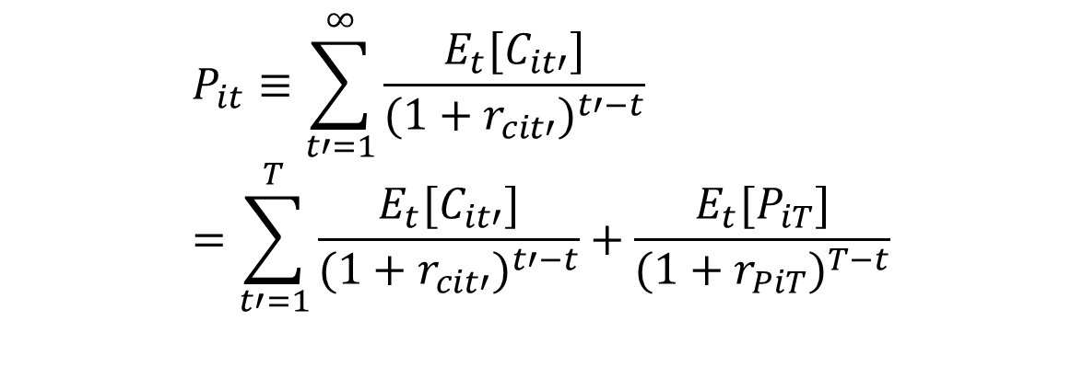
Concept: Valuation
Any asset i with future cash flows c_it has a current price P_it that is determined by expected future cash flows and current risk-adjusted discount rates appropriate to those cash flows
$$P_{it}≡\sum_{t′=1}^{∞}{\frac{E_{t}[C_{it′}]}{(1+r_{cit′})^{t′−t}}} \\ =\sum_{t′=1}^{T}{\frac{E_{t}[C_{it′}]}{(1+r_{cit′})^{t′−t}}}+\frac{E_{t}{[P}_{iT}]}{(1+r_{PiT})^{T−t}}$$
There are an infinite number of assets i in the economy and t extends out infinitely as well.
The name of the game in investments/asset pricing is to try to condense this infinite-dimensional problem to something manageable: Can we characterize all of those discount rates r_it (which are also future expected returns) with something of smaller dimension? ➔ leads to factor models

Slide 18
Valuation Simplifications
Example: dividend discount model
  One period:
  Infinite horizon:
Stocks can also be valued by their expected cash flows, bonds by their expected coupons, etc.
The simplifications lie in how we model expected cash flows and discount rates

Slide 19

Measurement: Stock Returns
Total returns include capital gains and dividend yield
Stock returns must also account for splits
Where a_t is an adjustment factor for a split, e.g., 2 if a 2:1 split occurs at time t.
$$R_{t}=\frac{a_{t}P_{t}+D_{t}}{P_{t−1}}$$

Slide 20
Yahoo Finance Adjusted Close
Yahoo Finance makes our life easier by providing an “adjusted close” series that accounts for both dividends and stock splits.
That is, we can calculate returns directly from the Yahoo adjusted close series P*_t, without needing to account for splits and dividends (Yahoo has done this for us)

Slide 21
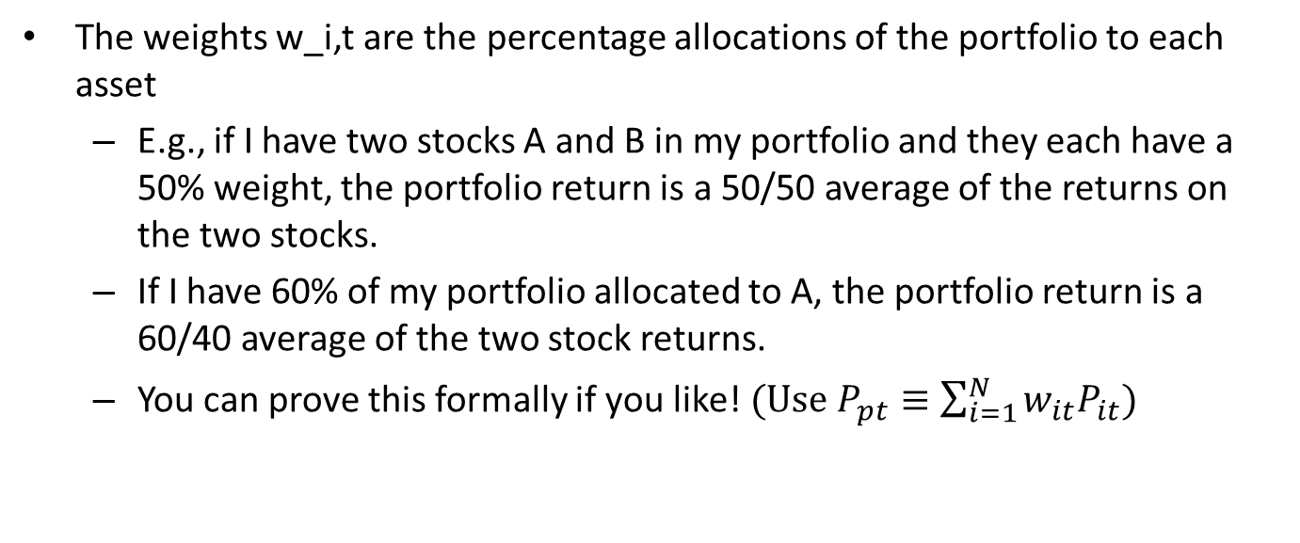
Calculating Portfolio Returns
Assume Yahoo Finance adjusted close series:
Portfolio Return:
The weights w_i,t are the percentage allocations of the portfolio to each asset
  E.g., if I have two stocks A and B in my portfolio and they each have a 50% weight, the portfolio return is a 50/50 average of the returns on the two stocks.
  If I have 60% of my portfolio allocated to A, the portfolio return is a 60/40 average of the two stock returns.
  You can prove this formally if you like!$(Use{ P}_{pt}≡\sum_{i=1}^{N}{w_{it}P_{it}})$

Slide 22
Initial weighting, buy-and-hold, and rebalancing
When we hold a portfolio for multiple periods, the initial weights w_i0 are determined by our desired allocation
  Equal-weighting
  Value (market capitalization) weighting
  Something else
If we buy-and-hold, subsequent weights are determined by fluctuations in each asset’s value
  If an individual asset’s returns are high relative to others in the portfolio, its weight in the portfolio will go up, and vice versa
  We have to follow the values of each asset, and the weights are determined by the values at the beginning of the period
If we rebalance in some period t, we reset the weights w_it to some desired value by following some rule (again, equal-weight, value-weight, or something else)
  To achieve the new weights, we have to buy and sell amounts of each asset at the beginning of the period to achieve the desired weights

Slide 23
Finance Data Sources
Yahoo Finance for current stock prices
  -- now asks for an account for csv downloads, but we will provide an example of API for first homework
Wharton Research Data Services (https://wrds-web.wharton.upenn.edu/wrds/ )
  Will send an announcement with instructions for class account
2) Federal Reserve Economic Data (FRED, https://fred.stlouisfed.org/ )
3) Ken French’s website (http://mba.tuck.dartmouth.edu/pages/faculty/ken.french/data_library.html )
Lots of other sources…

Slide 24
Homework for Next Class
(Not graded, to stimulate thought and discussion)
Go to Yahoo Finance and observe how you may request historical data. Since Yahoo has made it difficult to do simple csv downloads, I have provided on our course website the data for calendar year 2020, for XOM and ZM.
  Calculate their returns using the Yahoo adjusted close
  Form a portfolio that is initially equal-weighted at the beginning of the year. You may assume any initial investment (e.g. $100) you like, but it will not affect any following results. Neither do the initial prices. Assume you buy-and-hold (no rebalancing). Calculate each day your portfolio value, portfolio weights, and portfolio returns. Observe that you do not need the weights to calculate returns.
  Now assume you rebalance to initial weights at the beginning of each month and calculate the same. How do your results change?
  Calculate individual stock and portfolio mean return, standard deviation, skewness, and kurtosis.
Go to the websites of the Western Finance Association and the American Finance Association and browse the programs of their annual conferences. See if you can identify any sessions that fit in the category of “data-driven investments”. Can you understand their methods? Do they interest you?

Slide 25
Extras
Players and participants and some current Sauder research…

Slide 26
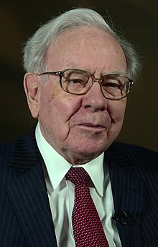
Warren Buffet / Berkshire Hathaway
“Oracle of Omaha,” long-term value investor
Berkshire is an insurer and huge conglomerate, approaching 1 trillion mkt cap
Bought many companies (Geico, BNSF)
Large stakes in others (KO, KHC)
Sold huge number of put options in trough of financial crisis
Diversification: “Don’t put all your eggs in one basket”
Buffet: “Put all your aggs in one basket, and watch that basket carefully”

Slide 27
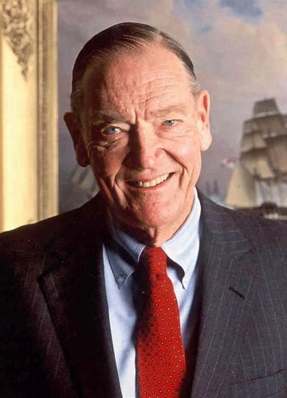

John Bogle / Vanguard
Vanguard founder, first index fund 1976
Wrote college thesis on how most active managers underperform the market
“Don’t look for the needle in the haystack, just buy the haystack”
Now 7 trillion aum, largest managers with Blackrock and State Street
Fees now zero for many funds (made possible by payment for order flow)

Slide 28
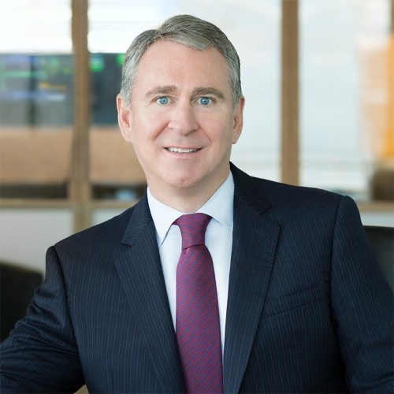

Ken Griffin / Citadel
Citadel is both a large hedge fund (38 bill aum)
And the largest market maker in U.S. (40% of trades executed)
Gained notoriety during meme stock episode
  Payment for order flow with Robinhood
  Investment/bailout of short seller Melvin Capital
Citadel Securities would buy Robinhood if regulators crack down on this one money-maker: Interactive Brokers founder (yahoo.com)
https://nypost.com/2021/01/25/this-short-seller-just-got-a-2-75-billion-bailout/

Slide 29
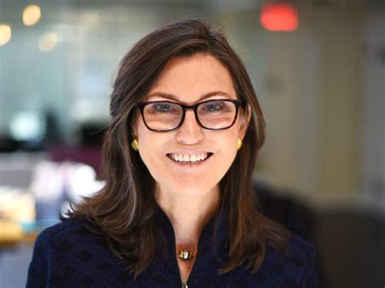
Cathie Wood / ARK Innovation
Huge proponent of thematic
She focuses on tech, but ideas apply to other themes
“Research departments are not set up correctly. They give their analysts a sector or an industry and the idea is to the index and pick the best ones. We don’t do that. We have a white sheet of paper and we say ‘ How is the world going to work?’”
► ARK Invest’s Wood: Asset management analysts are doing it wrong on thematics - Citywire
Ark’s Cathie Wood locks horns over Tesla with value manager – Citywire
ARK’s Cathie Wood turns focus to deflation, ‘stay connected’ stocks - The Globe and Mail

Slide 30
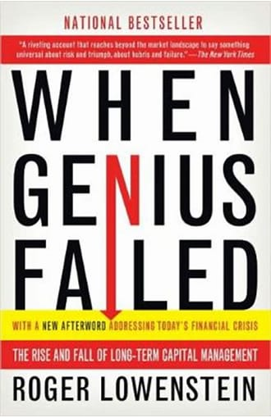
Long Term Capital Management
Founded by John Merriwether in 1994
Board of directors included Robert Merton and Myron Scholes, Nobel prize winners for option pricing theory
Engaged in absolute return / arbitrage trading strategies, e.g.,
  Carry trade
  On-the-run / off-the-run
  Derivatives
Failed in 1998, following the Asian financial crisis and the Russian financial crisis
Subject of the book “When Genius Failed”

Slide 31
T. Boone Pickens / Activist investor
An original “corporate raider” of the 1980’s
Originally CEO of Mesa Petroleum in the 1970s, became famous for going after much larger companies that he thought were run inefficiently, and making hostile takeover attempts or other attempts to influence corporate activity (Gulf Oil)
Other activist investors
  Carl Icahn
  Bill Ackman
  Greg Boland, founder of Westface Capital in Toronto and Sauder grad

Slide 32
Michael Burry / Scion Capital Management
The Big Short and the financial crisis
Large stake in Gamestop and activist role prior to “meme stock” phenomenon.

Slide 33
Retail I

Slide 34
Retail II

Slide 35
Data-Driven Investment Research at Sauder

