Slide 1
Asset Allocation
BAFI 508: Data-Driven Investments
Class 4
Adlai Fisher

Slide 2
Course Progress: Topics
Portfolio formation and properties of stock returns / HW1 (done)
  Data: Yahoo Finance daily stock returns
Asset allocation (today and next week)
  Asset classes: broad categories such as bonds, stocks, etc.
  Long-term allocations to those categories
  Pension funds, endowments, individual investors
  Data: Long time-series of annual stock, bond, T-bill, inflation, and other returns
  Second homework given today, due end of next week: groups of 2-3
Cross-sectional trading strategies
  Value, size, momentum, etc., typical hedge fund and quant fund strategies
  Group project (6 per group): Investigate a known trading strategy or design and test your own, including performance evaluation
  Data: CRSP and Compustat on WRDS, plus the possibility of any other data you get interested in

Slide 3
Outline
Asset allocation framework and general discussion
Data and first empirical analysis in Excel:
  Direct calculation of historical returns and return properties for different portfolio rules
More detail on mean-variance analysis and “modern portfolio theory”
  Two-asset case, three-asset case, N-asset case
  Numerical optimization vs analytical solutions
  Critiques
Assignment 2 implements in Python, again modifying sample code

Slide 4
Asset Allocation: General Approach
Consider a long-term investor thinking about how to put together a portfolio
  Individual investor with a retirement account
  Pension fund
  Endowment
Classic finance view of this problem: The first step, and quantitatively the most important, is deciding on long-run allocations to broad asset classes, E.g.:
  Treasury bills (e.g., 1-, 3-, 12-month, no coupons) -- “riskless”
  Long-term government bonds (e.g., 10 year, coupons) – “risky”
  Stocks (Typically represented by a passive investment in a broad index) – ‘’risky”
A T-bill with zero probability of default is riskless at the horizon of its maturity, since its payoff is known at that horizon; everything else is risky (payoff and return not known in advance)
  Other common asset classes used: corporate bond, real estate, private equity, international, hedge fund, etc.

Slide 5
Asset Allocation in Context
A classical view of portfolio management describes three steps
  Strategic asset allocation: Deciding the long-run allocation to different asset classes
  Tactical asset allocation: Deciding a rule for when and how much to deviate from long-run allocations (also called market timing)
  Security selection: Deciding how to manage the portfolio within an asset class, i.e., active management within an asset class versus passive holding of an index or benchmark to represent the asset class
Research on pension-fund performance shows that the strategic asset allocation decision has by far the largest impact on portfolio performance
  Today we focus on strategic asset allocation

Slide 6
Data in General
We will start by focusing on the three most basic asset classes: T-Bills, T-bonds, and stocks
  We will use long time-series of annual returns (can also consider monthly, quarterly)
  Your homework adds one risky asset class (real estate)
Many possible data sources
  St. Louis Fed (FRED – “Federal Reserve Economic Data”) has government bond yields of different maturities going back many years
  CRSP on WRDS, stock returns going back to the 1920’s
  Individual researchers have synthesized and added to these data:
    Bob Shiller (adds stock returns going back to 1870’s)
    Ken French (we will use his website later for cross-sectional strategies)
    Aswath Damodaran

Slide 7
Data and Assignment 2
We will use Aswath Damodaran’s data for Assignment 2 and in class discussion.
The reason for using Damodaran’s data is that he does a favor for us by collecting the data all in one place
Damodaran gives good documentation of the original sources of the data and calculations you can follow if interested.

Slide 8
A First Analysis of the Data
Put together in a separate tab: t-bill returns, t-bond returns, stock returns
  For each, calculate the mean, variance, skewness, kurtosis, first-order autocorrelation coefficient, and each of the three cross-correlations
  You may find it easier to work in percentages
  Discuss results
Calculate the excess returns on stocks and bonds (R_i – r_f) (discuss concept)
  Calculate the same statistics as above
  Additionally, calculate the Sharpe ratio, which is the mean excess return divided by the standard deviation of returns (discuss concept)
Form eleven different portfolios based on different asset allocations, with the percentage in stocks varying as 0%, 10%, …, 100%
  Calculate returns on each date for each allocation rule
  Calculate the same statistics as in (1) plus the Sharpe ratio for each portfolio
  Find the minimum variance portfolio (discuss concept)
  The tangency portfolio achieves the highest Sharpe ratio (discuss concept)

Slide 9
Real vs Nominal
The prior slide used nominal returns. If you wanted to redo with real returns you would need to adjust all of the nominal returns for bills, bonds, and stocks, using the formula given below.
This must be applied at the previous slide’s step 1, with the analysis in the previous slide’s steps 2 and 3 carried out on the derived real returns.

Slide 10
Assignment 2
Once you have solved for three risky assets, the approach can be generalized for n assets.
Other extensions: positive portfolio weights, different borrowing and lending rates, etc.
Observe that with mean-variance analysis, we can use two equivalent approaches
  Optimizing portfolio weights on historical returns (histret spreadsheet)
  Taking only sample moments (means and covariance matrix) from historical returns and optimizing using portfolio mean and variance formulas (mv3 spreadsheet, sample python code and assignment 2)

Slide 11
Asset Allocation: Mean-Variance Approach
Also called “Modern Portfolio Theory” (origins in 1960’s): a backbone of institutional asset management and personal finance for many years.
Requires: define asset classes, expected returns, and a covariance matrix.
Math: gives efficient frontier, which maximizes mean for a given variance/sd
According to individual risk tolerance: select a desired point on the frontier, giving the asset allocation.
Important to understand, pinpoint potential flaws.

Slide 12
Investment Vehicles / Asset Classes
How do we identify an “asset class”? Are these stable over time?
What do people use now?
  Bonds (domestic, foreign, Government, private, junk)
  Stocks (domestic, US, EAFE, Emerging, big cap, small cap, mid-cap)
  Alternative investments (real estate, private equity, ethical funds)
What are the tradeoffs in a few large simple asset classes versus a proliferation of finer categorizations?

Slide 13
The “Modern Portfolio Theory” Recipe
Define and select asset classes [not obvious, big tradeoffs in number of assets]
Gather inputs: expected returns, expected risk (or standard deviation of returns) and expected “co-movements” (or correlations) of returns for each asset class [seems easy, but actually probably the most difficult part, once we acknowledge that historical sample moments are not the same as forward looking expectations]
Minimize expected risk, given desired expected returns or maximize expected returns, given desired expected risk level [pretty easy math/optimization, the MPT part]

Slide 14
Required Formulas
To carry out the basic mean-variance analysis, we need formulas for:
  Portfolio Means
  Portfolio Variance / Standard deviation

Slide 15
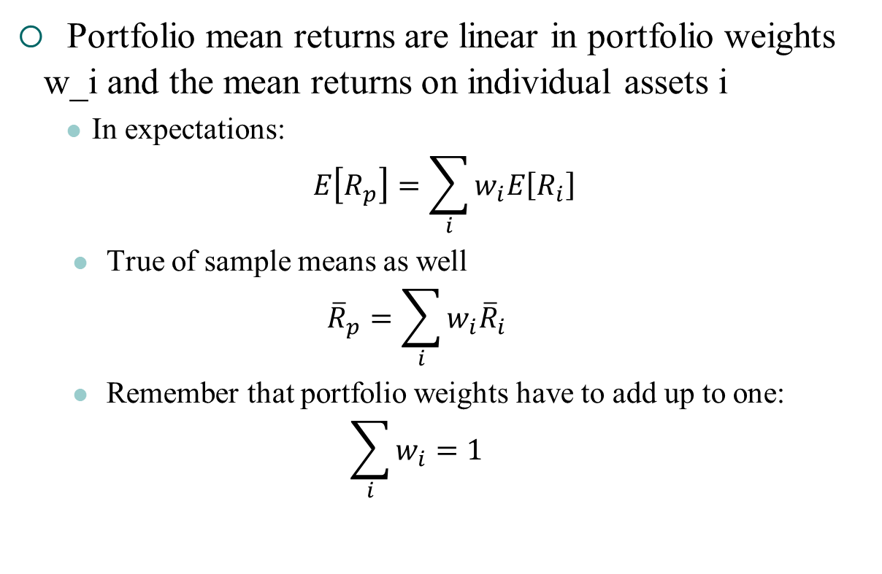
Portfolio Mean Returns
Portfolio mean returns are linear in portfolio weights w_i and the mean returns on individual assets i
  In expectations:
$$E\left[R_{p}\right]=\sum_{i}{w_{i}E\left[R_{i}\right]}$$
  True of sample means as well
  $${\overline{R}}_{p}=\sum_{i}{w_{i}{\overline{R}}_{i}}$$
  Remember that portfolio weights have to add up to one:
  $$\sum_{i}{w_{i}=1}$$

Slide 16

Portfolio Variances
Portfolio variances build on the rule that Var(X+Y)=Var(X)+Var(Y)+2cov(X,Y)
  In population or sample moments:
$$Var\left[R_{p}\right]=\sum_{i}{w_{i}^{2}Var\left[R_{i}\right]+2\sum_{i≠j}{w_{i}w_{j}Cov\left[R_{i},R_{j}\right]}}$$

Slide 17
Two Asset Example
Find combinations of assets that
  Minimize risk for a given expected return, or
  Maximize expected return for a given volatility
In class: Assume two asset classes as shown below. Vary weights by 10% and calculate expected returns and volatility of the 11 portfolios.
  Stock: E(r) = .08, σ_{S} = .15
  Bonds: E(r) = .04, σ_{B} = .10
  Correlation: ρ_{S,B} = .30
Remember E[Rp]=w1E[R1]+w2E[R2]
And Var(Rp) = (w1^2)*Var(R1) + (w2^2)*Var(R2) + 2*w1 * w2 * Cov(R1,R2)
Note that all of these inputs can be estimated empirically from our spreadsheet histretSP.

Slide 18
Example - Portfolios
 |  |  | Portfolio | Portfolio
Portfolio | Weight(1) | Weight(2) | return | StdDev
1 | 100% | 0% | 4.00% | 10.00%
2 | 90% | 10% | 4.40% | 9.56%
3 | 80% | 20% | 4.80% | 9.35%
4 | 70% | 30% | 5.20% | 9.39%
5 | 60% | 40% | 5.60% | 9.67%
6 | 50% | 50% | 6.00% | 10.19%
7 | 40% | 60% | 6.40% | 10.89%
8 | 30% | 70% | 6.80% | 11.75%
9 | 20% | 80% | 7.20% | 12.74%
10 | 10% | 90% | 7.60% | 13.83%
11 | 0% | 100% | 8.00% | 15.00%

Slide 19
Diversification
Investing in bonds has an expected return of 4% and a volatility of 10%
But, a 50-50 mix of stocks and bonds has a volatility of 10.2% (about the same as bonds), but an expected return of 6%
The 50-50 mix is better because of the correlation of stocks and bonds

Slide 20
“Efficient” Portfolio and “Efficient Frontier”
An “efficient” portfolio maximizes expected return for any level of risk (standard deviation)
  Note that “efficient” here has nothing to do with market efficiency, different use of word
The “efficient frontier” is the set of all efficient portfolios

Slide 21
The Efficient Frontier in the Example
MVP
The efficient frontier includes only points on the curve above the
“minimum variance portfolio” (MVP)

Slide 22
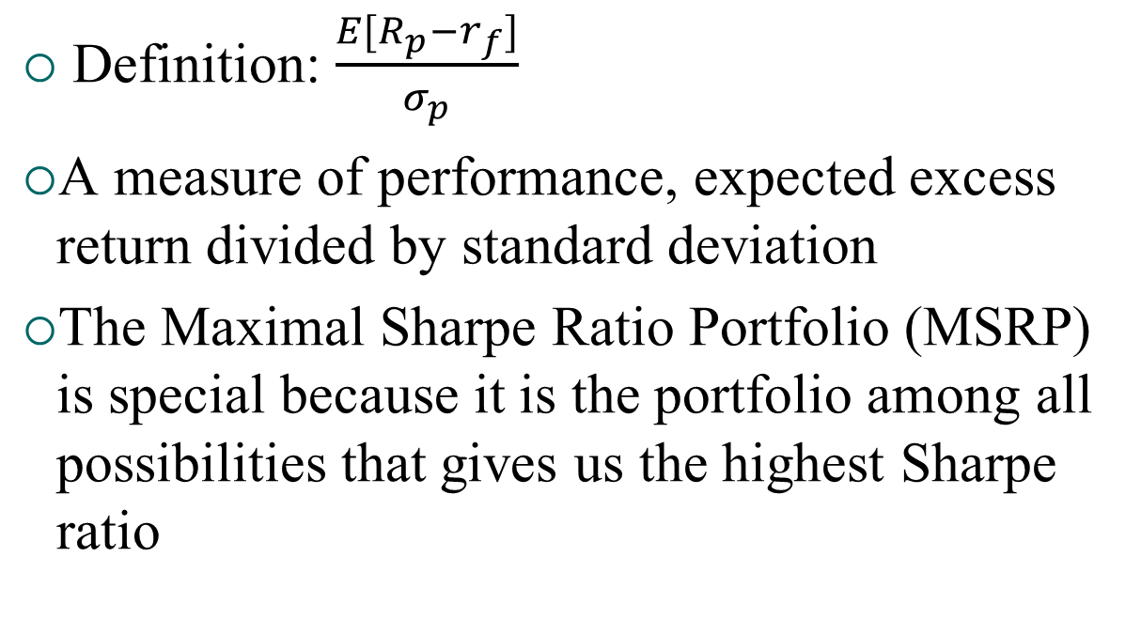
Sharpe Ratio
Definition: $\frac{E[R_{p}−r_{f}]}{σ_{p}}$
A measure of performance, expected excess return divided by standard deviation
The Maximal Sharpe Ratio Portfolio (MSRP) is special because it is the portfolio among all possibilities that gives us the highest Sharpe ratio

Slide 23
Adding a risk-free asset
If we add a risk-free asset to any risky asset efficient frontier, we end up improving the efficient frontier
The new efficient frontier is a line, linear combinations of risk-free asset with a single portfolio, the Maximal Sharpe Ratio Portfolio
  (We can show this by calculating means and standard deviations of any asset with a risk free asset, both are linear in weights on the risk-free and risky asset, so we get a line in the mean vs standard deviation graph.)

Slide 24
Efficient Frontier with Riskless Asset
MSRP / tangency
With a riskless asset, the new “efficient frontier” is the black arrow.
Single contact point with risky efficient frontier is the MSRP, or “tangency portfolio”
The MSRP or “tangency portfolio” plays a special role in asset pricing
Under strong assumptions, all investors hold combination of riskless asset and tangency portfolio
Then, the tangency portfolio would have to be the “market portfolio”
Leads to CAPM

Slide 25
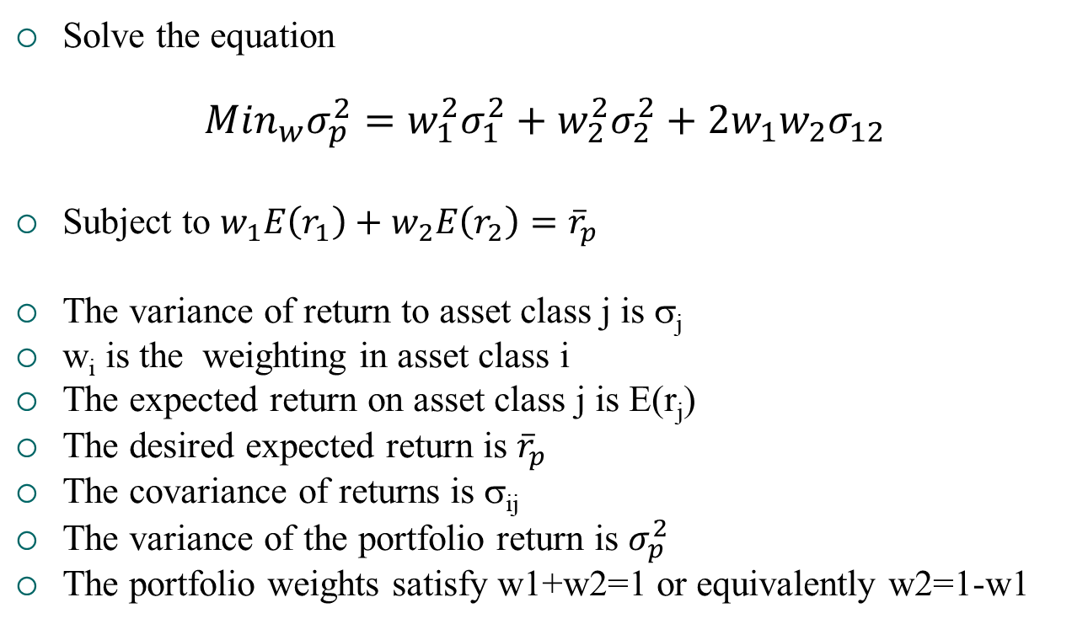
General Statement of Mean-Variance Objective Function with Two Assets
Solve the equation
$${Min}_{w}σ_{p}^{2}=w_{1}^{2}σ_{1}^{2}+w_{2}^{2}σ_{2}^{2}+2w_{1}w_{2}σ_{12}$$
Subject to $w_{1}E\left(r_{1}\right)+w_{2}E\left(r_{2}\right)={\overline{r}}_{p}$
The variance of return to asset class j is σ_{j}
w_{i} is the weighting in asset class i
The expected return on asset class j is E(r_{j})
The desired expected return is ${\overline{r}}_{p}$
The covariance of returns is σ_{ij}
The variance of the portfolio return is $σ_{p}^{2}$
The portfolio weights satisfy w1+w2=1 or equivalently w2=1-w1

Slide 26
Constructing the Mean-Variance Efficient Frontier: Three assets
Suppose the client allows three risky asset classes:
(1) government bonds, (2) stocks and (3) corporate bonds.
How would you develop the M-V frontier?
To construct the M-V efficient frontier, first find the minimum variance portfolio.
This is the mix that is as far to the left in the M-V graph as possible, regardless of expected return.
This comes from choosing the weights, w₁ on T-bonds, w₂ on stocks and w₃ = 1 - w₁ - w₂ in stock, to minimize the portfolio return variance (in Excel can use solver)
Again, all of the required inputs (means, variances, and covariances) can be estimated empirically from our spreadsheet histretSP

Slide 27
Constructing the Mean-Variance Efficient Frontier: Three assets
The portfolio variance is:
σ_{p}² = (w₁)²σ₁² +(w₂)²σ₂² + (1-w₁-w₂)²σ₃² +2w_{1w2}σ_{1,2} +2w₁(1-w₁-w₂)σ_{1,3} + 2w₂(1-w₁-w₂)σ_{2,3}
Where σ_{i,j} is the covariance of the returns of asset classes i and j and σ_{j} is the standard deviation of returns of asset j

Slide 28
Constructing the Mean-Variance Efficient Frontier: Three assets
We now solve a constrained minimization.
We choose w₁ and w₂ to minimize σ_{p}² subject to the portfolio having a specified expected return,
r_{p} = w₁E(r₁) + w₂E(r₂) +w₃E(r₃)
We set r_{p} at different levels, starting a little bigger than the expected return on the minimum variance portfolio, and then getting bigger.
For each r_{p} we solve the constrained minimization, getting the optimal asset class weights and the portfolio’s expected return and standard deviation.
We can then plot these, to get the mean-variance efficient frontier.

Slide 29
Simplification with two-fund separation
It turns out that any linear combination of portfolios on the efficient frontier is also an efficient portfolio, and all efficient portfolios can be obtained as a linear combination of any two efficient portfolios
This is called “two fund separation” and what it means is that to trace out the entire efficient frontier, we need only obtain two efficient portfolios, and then take linear combinations of those two portfolios to trace out the rest of the frontier
See the three-asset example in the spreadsheet MV3.xlsx
You will do this in Python in Assignment 3

Slide 30
In Practice: Where Do We get (1) Expected Return, (2) Expected Variance and (3) Correlation?
Three critical inputs to mean-variance portfolio optimization. Where do these come from?
  Repeat of history?
  Tempered repeat of history?
  Other?
What are the issues with each?

Slide 31
General Mean-variance Math (see appendix)
General formulas can be developed when the number of asset classes becomes large…
But, more importantly, how do the general problems/limitations of using this approach become magnified as the number of assets grows?

Slide 32
Asset Allocation in Practice
60/40, 70/30 “rules”
Life-cycle portfolios, 100-age in stocks, etc.
As implemented by institutional investors in recent times, from 3-12 asset classes
Forbes on Practical Asset Allocation
Charles Schwab
TIAA life-cycle funds
Couch potato portfolio

Slide 33
Strategic Asset Allocation as first step in bigger picture
Strategic Asset Allocation – the decision of what portfolio weights to assign to each asset class
Tactical Asset Allocation – shifting weights in asset classes when you think returns will be low or high in that asset class (requires timing ability to succeed)
Active vs. Passive management of each asset class – performance relative to asset class benchmark
Performance evaluation often tries to break down performance of a portfolio into these elements

Slide 34
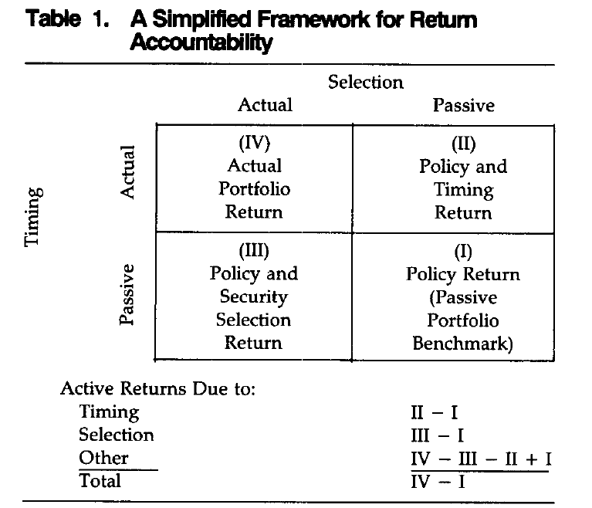
Strategic Asset Allocation as first step in bigger picture
Performance evaluation with SAA, TAA, and active management (Brinson et al. 1995, FAJ)

Slide 35
Critiques of MPT
1) The objective function: why maximize mean for given variance? What about skewness, kurtosis, other considerations like nontradeable labor income?
CPPIB statement of investment objectives (mandate):
“to invest in the best interests of Canada Pension Plan contributors and beneficiaries and to maximize investment returns without undue risk of loss”
How does this differ from mean-variance objective function?
How can we implement objective functions besides mean-variance? (e.g., utility of wealth and simulation)

Slide 36
Additional Critiques of MPT
2) Proliferation of asset classes, difficulty of estimating parameters, and instability of parameters (even seemingly simple ones like bond-stock correlation) but also volatilities and means,
For large N difficulty of estimating covariance matrix and sensitivity to small errors (too many parameters) ➔ robustness of “1/N” investing strategies

Slide 37
Adding more realism to asset allocation…
A branch of the finance literature that tries to put the asset allocation problem into greater context is the “lifecycle portfolio choice” literature.
Consider an investor of a given age, with a time to retirement (known or random), and a time to death (known or random)
  The investor has an income stream (known or random)
  Some fraction allocated to a retirement account (set to a constant to simplify the problem, solve for optimal to make more realistic)
  Allocates retirement account to different asset classes
  A utility of wealth at retirement simplifies the problem, solving for consumption and investment through retirement to death makes it harder
  Specify a utility function, need not be mean-variance
  Allow for variation in strategic asset allocation based on time to retirement? Allow market timing strategies using predictor variables? Both make the solution more complex but are doable.
  If you allow randomness, can solve using simulation (drawing paths)
  Could also just look at expected returns

Slide 38
Appendix: Mean-variance math

Slide 39
The Efficient Frontier
Efficient investments
μ
All possible (σ, μ) pairs that an investor can attain by holding risky securities.
r_{f}
σ
All possible (σ, μ) pairs that an investor can attain by holding any security lie in this cone.

Slide 40
Calculating Means and the Covariance Matrix
Means
Covariances
T rows

Slide 41
The Covariance Matrix

Slide 42
Calculating Portfolio Means and Returns
Given any set of portfolio weights (ω) the portfolio mean and variance can be easily calculated:

Slide 43
A Formal Description of the Efficient Frontier
The portfolio on the efficient frontier with mean return E solves the following constrained optimization problem:
Subject to:

Slide 44
Calculating Efficient Risky Portfolios Without Constraints
Any two efficient risky portfolios (mutual funds) can be combined to generate the entire efficient frontier.
Formulas for the minimum variance and tangency portfolios are given by:

Slide 45
The Efficient Frontier
Tangency portfolio
μ
All efficient risky portfolios are combinations of the minimum variance and tangency portfolio
r_{f}
σ
Minimum variance portfolio

Slide 46
Efficient Portfolios with Constraints
In general, the efficient set will contain short positions in some assets.
In many applications, no short-sale constraints may be enforced.
To find efficient portfolios in this case a numerical solution technique is required.

Slide 47
Efficient Portfolios with Short Sales Constraints
The portfolio on the efficient frontier with mean return E solves the following constrained optimization problem:
Subject to:

