Slide 1
Asset Allocation, CAPM, Factor Models
BAFI 508: Data-Driven Investments
Class 6
Adlai Fisher

Slide 2
Course Update
The asset allocation homeworks are due Sunday midnight
  Further discussion today.
Today, finish asset allocation, second big topic in the course.
  Leads to the Capital Asset Pricing Model (CAPM), a big finance theory
  Leads to implementation of general factor models and cross-sectional portfolio strategies, which is the third and final major course topic.
  We introduce this new topic today, and get into big data empirical implementation next week.
Over weekend, signup for final project groups. Groups of six.
  Diversity of projects, should be a good way to get a broad exposure to many different aspects of data and empirical facts
  We will also post sample code and readings over weekend to generate final project topics, and continue next week.

Slide 3
Outline for Today
Finish asset allocation
  Further develop / emphasize key concepts
    Role of risk-free asset
    Excess returns, and relation to total return
    Two fund separation
  Some finer points
    Different ways of solving
    Portfolio constraints (e.g., short sales)
    Other objective functions
  MPT leads to the CAPM! (big finance theory)
  Critiques of MPT leading to more general factor models
Begin to introduce general factor models
  Empirical factors and macro factors,
  Ken French’s website as starting place; next week and for your project you will be constructing your own cross-sectional trading strategies using CRSP and Compustat data and python
  The idea of performance evaluation (alpha and beta(s))

Slide 4
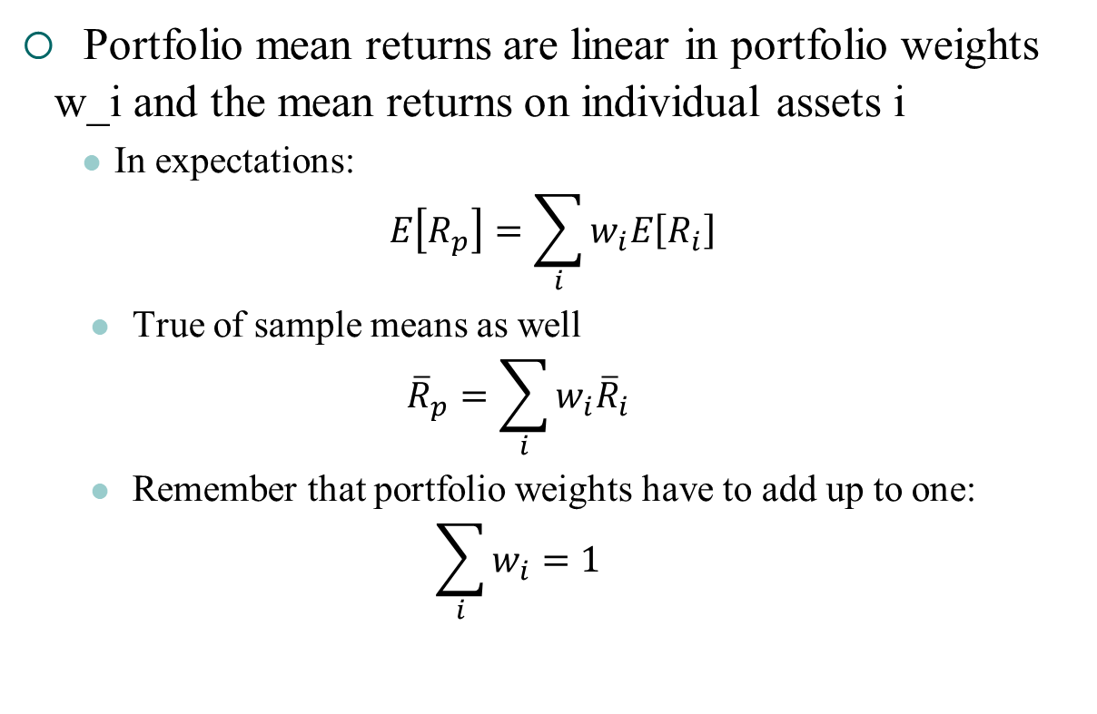
Portfolio Mean Returns
Portfolio mean returns are linear in portfolio weights w_i and the mean returns on individual assets i
  In expectations:
$$E\left[R_{p}\right]=\sum_{i}{w_{i}E\left[R_{i}\right]}$$
  True of sample means as well
  $${\overline{R}}_{p}=\sum_{i}{w_{i}{\overline{R}}_{i}}$$
  Remember that portfolio weights have to add up to one:
  $$\sum_{i}{w_{i}=1}$$

Slide 5

Portfolio Variances
Portfolio variances build on the rule that Var(X+Y)=Var(X)+Var(Y)+2cov(X,Y)
  In population or sample moments:
$$Var\left[R_{p}\right]=\sum_{i}{w_{i}^{2}Var\left[R_{i}\right]+2\sum_{i≠j}{w_{i}w_{j}Cov\left[R_{i},R_{j}\right]}}$$

Slide 6
Two Asset Example
Find combinations of assets that
  Minimize risk for a given expected return, or
  Maximize expected return for a given volatility
In class: Assume two asset classes as shown below. Vary weights by 10% and calculate expected returns and volatility of the 11 portfolios.
  Stock: E(r) = .08, σ_{S} = .15
  Bonds: E(r) = .04, σ_{B} = .10
  Correlation: ρ_{S,B} = .30
Remember E[Rp]=w1E[R1]+w2E[R2]
And Var(Rp) = (w1^2)*Var(R1) + (w2^2)*Var(R2) + 2*w1 * w2 * Cov(R1,R2)
Note that these inputs could be estimated from our spreadsheet histretSP!

Slide 7
The Efficient Frontier in the Example
MVP
The efficient frontier includes only points on the curve above the
“minimum variance portfolio” (MVP)

Slide 8
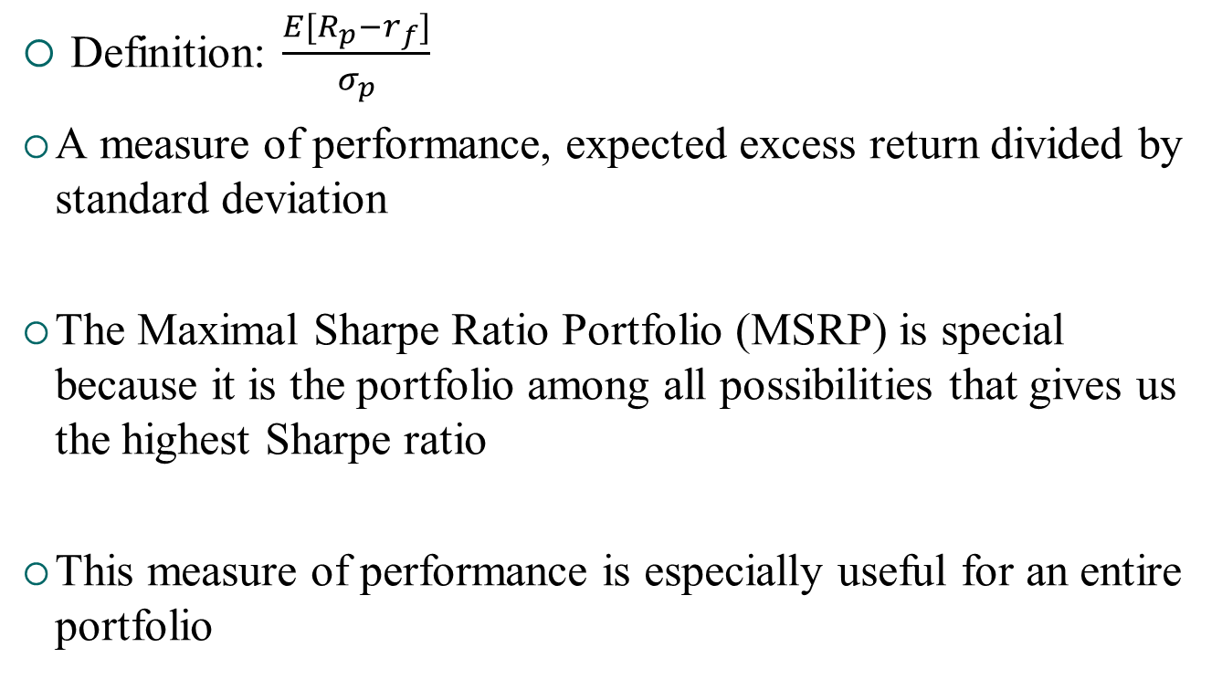
Sharpe Ratio
Definition: $\frac{E[R_{p}−r_{f}]}{σ_{p}}$
A measure of performance, expected excess return divided by standard deviation
The Maximal Sharpe Ratio Portfolio (MSRP) is special because it is the portfolio among all possibilities that gives us the highest Sharpe ratio
This measure of performance is especially useful for an entire portfolio

Slide 9
Adding a risk-free asset
If we add a risk-free asset to any risky asset efficient frontier, we end up improving the efficient frontier
The new efficient frontier is a line, linear combinations of risk-free asset with a single portfolio, the Maximal Sharpe Ratio Portfolio
  See next slide…

Slide 10
Combining risky asset and risk-free
Using our formulas (assume excess returns, so risk-free excess is by def zero always)
E[w1*r1+w2*0]=w_1*E(r1)
Var[w1*r1+w2*0]=w1^2*Var(r1)
Therefore s.d.[w1*r1+w2*0]=w1*sigma1
Both mean and standard deviation are linear in w, varying w traces a line in mean-sd graph.

Slide 11
Efficient Frontier with Riskless Asset
MSRP / tangency
With a riskless asset, the new “efficient frontier” is the black arrow.
Single contact with risky frontier is MSRP, or “tangency portfolio”
All M-V investors hold combination of riskless asset and tangency portfolio!
Tangency portfolio is “market portfolio”!
Leads to CAPM

Slide 12
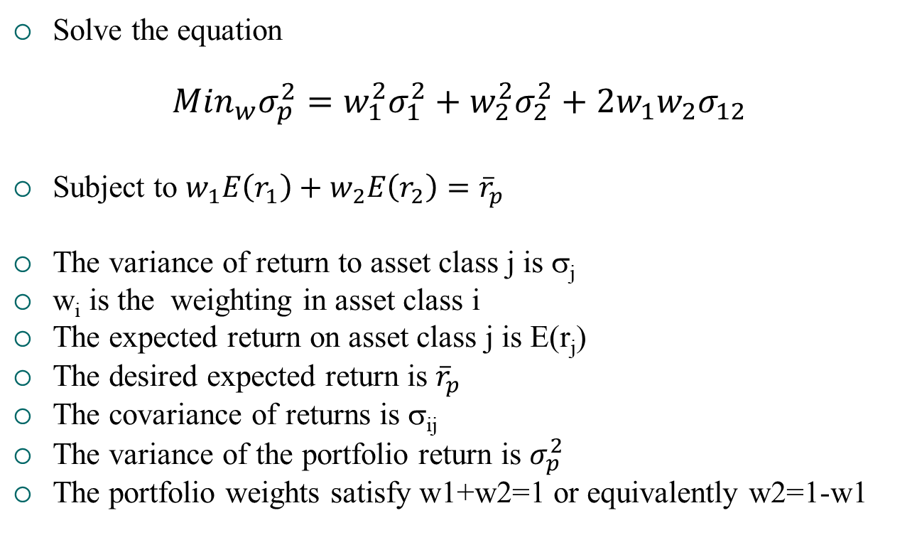
General Statement of Mean-Variance Objective Function with Two Assets
Solve the equation
$${Min}_{w}σ_{p}^{2}=w_{1}^{2}σ_{1}^{2}+w_{2}^{2}σ_{2}^{2}+2w_{1}w_{2}σ_{12}$$
Subject to $w_{1}E\left(r_{1}\right)+w_{2}E\left(r_{2}\right)={\overline{r}}_{p}$
The variance of return to asset class j is σ_{j}
w_{i} is the weighting in asset class i
The expected return on asset class j is E(r_{j})
The desired expected return is ${\overline{r}}_{p}$
The covariance of returns is σ_{ij}
The variance of the portfolio return is $σ_{p}^{2}$
The portfolio weights satisfy w1+w2=1 or equivalently w2=1-w1

Slide 13
Constructing the Mean-Variance Efficient Frontier: Three assets
Suppose the client allows three risky asset classes:
(1) government bonds (2) stocks and (3) corporate bonds.
In class: How would you develop the M-V frontier?
To construct the M-V efficient frontier, first find the minimum variance portfolio (MVP).
This is the mix that is as far to the left in the M-V graph as possible, regardless of expected return.
This comes from choosing the weights, w₁ on government bonds, w₂ on stocks and w₃ ( = 1 - w₁ - w₂ ) in corporate bonds, to minimize the portfolio return variance (in Excel can use solver)

Slide 14
Constructing the Mean-Variance Efficient Frontier: Three assets
The portfolio variance is:
σ_{p}² = (w₁)²σ₁² +(w₂)²σ₂² + (1-w₁-w₂)²σ₃² +2w_{1w2}σ_{1,2} +2w₁(1-w₁-w₂)σ_{1,3} + 2w₂(1-w₁-w₂)σ_{2,3}
Where σ_{i,j} is the covariance of the returns of asset classes i and j and σ_{j} is the standard deviation of returns of asset j

Slide 15
Three assets: Any desired portfolio return
We solve a constrained minimization.
We choose w₁ and w₂ to minimize σ_{p}² subject to the portfolio having a specified expected return,
r_{p} = w₁E(r₁) + w₂E(r₂) +w₃E(r₃)
We set r_{p} at different levels, starting a little bigger than the expected return on the minimum variance portfolio, and then getting bigger.
For each r_{p} we solve the constrained minimization, getting the optimal asset class weights and the portfolio’s expected return and standard deviation.
We can then plot these, to get the mean-variance efficient frontier.

Slide 16
Simplification with two-fund separation
It turns out that any linear combination of portfolios on the efficient frontier is also an efficient portfolio, and all efficient portfolios can be obtained as a linear combination of any two efficient portfolios
This is called “two-fund separation” and what it means is that to trace out the entire efficient frontier, we need only obtain two efficient portfolios, and then take linear combinations of those two portfolios to trace out the rest of the frontier
See the three-asset example in the spreadsheet MV3.xlsx
You can use this in your homework!

Slide 17
In Practice: Where Do We get (1) Expected Return, (2) Expected Variance and (3) Correlation?
Three critical inputs to mean-variance portfolio optimization. Where do these come from?
  Repeat of history?
  Tempered repeat of history?
  Other?
What are the issues with each?

Slide 18
Extensions and Relation to Homework
Once you have solved for three risky assets, the approach can be generalized for n assets.
Other extensions: positive portfolio weights, different borrowing and lending rates, etc.
Observe that with mean-variance analysis, we can use several approaches
  Optimizing portfolio weights on historical returns (histret spreadsheet)
  Taking only sample moments (means and covariance matrix) from historical returns and optimizing using portfolio mean and variance formulas (mv3 spreadsheet, sample python code and assignment 2)
    We can grind explicitly through the optimization problem for any desired level of return (big for loop)
    We can use two-fund separation to find two efficient portfolios and trace out entire frontier.

Slide 19
General Mean-variance Math (see appendix)
General formulas can be developed when the number of asset classes becomes large…
Tradeoffs: How do problems/limitations become magnified as the number of assets grows?

Slide 20
Asset Allocation in Practice
60/40, 70/30 “rules”
Life-cycle portfolios, 100-age in stocks, etc.
As implemented by institutional investors in recent times, from 3-12 asset classes
Forbes on Practical Asset Allocation
Charles Schwab
TIAA life-cycle funds
Couch potato portfolio

Slide 21
Strategic Asset Allocation as first step in bigger picture
Strategic Asset Allocation – the decision of what portfolio weights to assign to each asset class
Tactical Asset Allocation – shifting weights in asset classes when you think returns will be low or high in that asset class (requires timing ability to succeed)
Active vs. Passive management of each asset class – performance relative to asset class benchmark
Performance evaluation often tries to break down performance of a portfolio into these elements

Slide 22
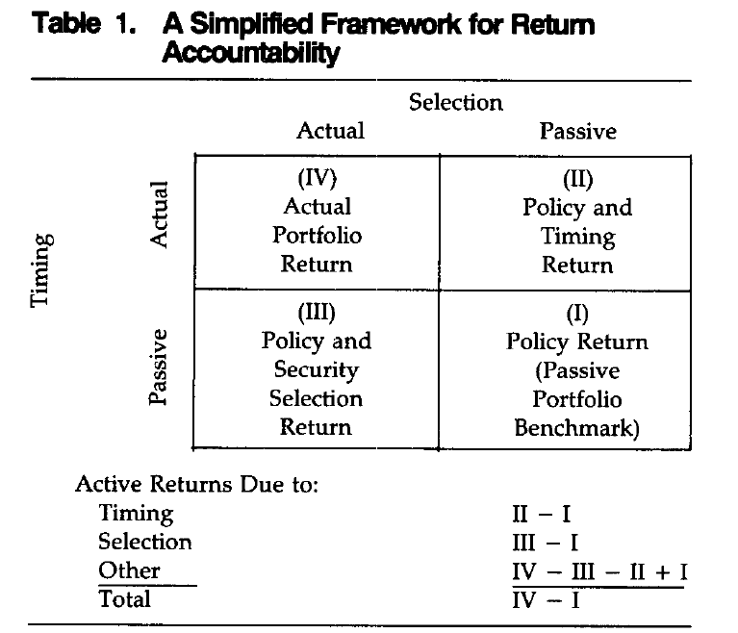
Strategic Asset Allocation as first step in bigger picture
Performance evaluation with SAA, TAA, and active management (Brinson et al. 1995, FAJ)

Slide 23
Critiques of MPT
The objective function: why minimize variance for given mean?
CPPIB statement of investment objectives (mandate):
“to invest in the best interests of Canada Pension Plan contributors and beneficiaries and to maximize investment returns without undue risk of loss”
How does this differ from mean-variance objective function?
How can we implement objective functions besides mean-variance? (e.g., utility of wealth and simulation)

Slide 24
Additional Critiques of MPT
2) Proliferation of asset classes, difficulty of estimating parameters, and instability of parameters (even seemingly simple ones like bond-stock correlation, see also here) but also volatilities and means,
For large N difficulty of estimating covariance matrix and sensitivity to small errors (too many parameters) ➔ robustness of “1/N” investing strategies

Slide 25
Adding more realism to asset allocation…
A branch of the finance literature that tries to put the asset allocation problem into greater context is the “lifecycle portfolio choice” literature.
Consider an investor of a given age, with a time to retirement (known or random), and a time to death (known or random)
  The investor has an income stream (known or random)
  Some fraction allocated to a retirement account (set to a constant to simplify the problem, solve for optimal to make more realistic)
  Allocates retirement account to different asset classes
  A utility of wealth at retirement simplifies the problem, solving for consumption and investment through retirement to death makes it harder
  Specify a utility function, need not be mean-variance
  Allow for variation in strategic asset allocation based on time to retirement? Allow market timing strategies using predictor variables? Both make the solution more complex but are doable.
  If you allow randomness, can solve using simulation (drawing paths)
  Could also just look at expected returns

Slide 26
Alternative: Factor Investing
Might be better to focus on sources of risk, K perhaps less than N, more importantly, provides structure theoretically and empirically
Used and advocated by CPPIB, Norway Pension Fund, Black Rock, MSCI
Theory: expand CAPM to APT, multiple risk factors, “empirical” or “macro” factors
CAPM can be motivated by mean-variance analysis, APT by other risk factors, see following…

Slide 27
Capital Asset Pricing Model (CAPM)
With a risk-free asset, and mean-variance focused investors, all investors would choose a point on the mean-variance efficient line, some combination of riskless asset and tangency portfolio
If a world like this existed, the tangency portfolio must be the “market portfolio,” which is the basket of all risky assets that exist
A mean-variance investor evaluates the risk of any asset according to how that asset contributes to the variance of the portfolio of risky assets they hold. If all investors hold this same portfolio of risky assets, this leads to agreement about what is risk and to the CAPM…

Slide 28
Efficient Frontier with Riskless Asset
MSRP / tangency
With a riskless asset, the new “efficient frontier” is the black arrow.
Single contact with risky frontier is MSRP, or “tangency portfolio”
All M-V investors hold combination of riskless asset and tangency portfolio!
Tangency portfolio is “market portfolio”!
Leads to CAPM

Slide 29
Capital Asset Pricing Model (CAPM)
In the mean-variance asset allocation problem with a risk-free asset, all investors hold some combination of the risk-free asset and the tangency portfolio, which must be the market portfolio
So the “risk” of any individual asset, and its expected return “reward” depends on its covariance with the market portfolio

Slide 30
Testing the CAPM with the “Market Model” Regression
If the CAPM holds, we should have alpha_i is equal to zero for all assets, and we can test that empirically
For example, you could run this regression using any portfolio constructed using the code from homework 1, and we will run this regression for many portfolios next week, and in your final project
This is called “performance evaluation” using the CAPM as a benchmark. Alpha is a measure of performance (higher is better). Beta is systematic risk.

Slide 31
Empirical Facts About the CAPM
Starting in the 1980’s increasing findings of “anomalies” (or nonzero alphas) relative to CAPM
  Size, B/M, E/P, etc.
  Fama and French (1992, 1993) are two papers that really consolidated knowledge in this area
  Now a vast array of “anomalies” have been presented in the finance literature
  Look at Ken French’s website, which we will explore next week, to get an idea of the portfolios used to beat the CAPM.

Slide 32
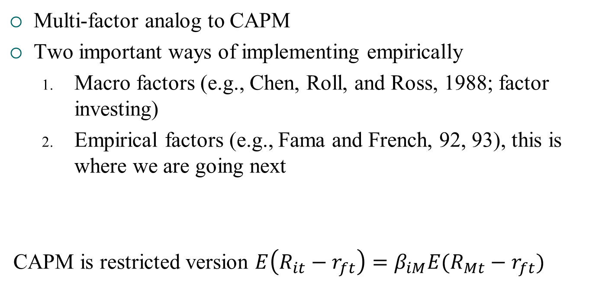
Arbitrage Pricing Theory
Multi-factor analog to CAPM
Two important ways of implementing empirically
  Macro factors (e.g., Chen, Roll, and Ross, 1988; factor investing)
  Empirical factors (e.g., Fama and French, 92, 93), this is where we are going next
CAPM is restricted version $E\left(R_{it}−r_{ft}\right)=β_{iM}E(R_{Mt}−r_{ft})$

Slide 33
Empirical Implementation of Factor Models
Multi-factor analog to market model regression
The alpha or measure of performance is now with respect to a multi-factor benchmark, the factors F_kt, and the betas measure exposure to those factors
For example, the Fama-French 3-factor model where the three factors are the excess return on the market, a “size” factor that is long small stocks and short big stocks (SMB), and a “value” factor that is long value stocks and short growth stocks (HML)

Slide 34
“Factor Investing” as Alternative to Traditional Asset Allocation
Establish a “reference portfolio” – simple portfolio of stock, bond, and t-bill, easily traded at low cost
Think about where you have special competencies as an investor to be able to outperform reference portfolio, or take risks others cannot
  Identify your special competencies: ability to bear liquidity risk, long time-horizons, proprietary strategies
  Identify key risks (macro risk factors and/or empirical risk factors) and your ability to carry exposures to those risk factors
Replace parts of reference portfolio investments with exposures to risk factors or special strategies as appropriate, with an eye toward risk management (here the multi-factor model of risk is important, and identifying exposures to those risks)
Examples: CPPIB (see “strategy”), Black Rock link 1, MSCI link1 link 2

Slide 35
Next Steps, Next Week
Cross-sectional trading strategies
Application to final project

Slide 36
Appendix: Mean-variance math

Slide 37
The Efficient Frontier
Efficient investments
μ
All possible (σ, μ) pairs that an investor can attain by holding risky securities.
r_{f}
σ
All possible (σ, μ) pairs that an investor can attain by holding any security lie in this cone.

Slide 38
Calculating Means and the Covariance Matrix
Means
Covariances
T rows

Slide 39
The Covariance Matrix

Slide 40
Calculating Portfolio Means and Returns
Given any set of portfolio weights (ω) the portfolio mean and variance can be calculated:

Slide 41
A Formal Description of the Efficient Frontier
The portfolio on the efficient frontier with mean return E solves the following constrained optimization problem:
Subject to:

Slide 42
Calculating Efficient Risky Portfolios Without Constraints
Any two efficient risky portfolios (mutual funds) can be combined to generate the entire efficient frontier.
Formulas for the minimum variance and tangency portfolios are given by:

Slide 43
The Efficient Frontier
Tangency portfolio
μ
All efficient risky portfolios are combinations of the minimum variance and tangency portfolio
r_{f}
σ
Minimum variance portfolio

Slide 44
Efficient Portfolios with Constraints
In general, the efficient set will contain short positions in some assets.
In many applications, no short-sale constraints may be enforced.
To find efficient portfolios in this case a numerical solution technique is required.

Slide 45
Efficient Portfolios with Short Sales Constraints
The portfolio on the efficient frontier with mean return E solves the following constrained optimization problem:
Subject to:

