Slide 1
BAFI 508
Data-Driven Investments
Class 3: Stock Pricing and Stock Returns
Individual Securities and Portfolios
Adlai Fisher
UBC MBAN

Slide 2
Outline for Today
Questions on homework? Due Thursday beginning of class.
Empirical properties of stock returns: individual stocks and portfolios
  Means, variances, skewness, kurtosis, autocorrelation
Stock valuation and interpreting stock prices and returns
  Dividend discount model
  Free cash flow model
  Multiples valuation
  Implications for cross-sectional trading strategies (week 3)
Next class: Asset Allocation (e.g., portfolios of stocks, bonds, t-bills)

Slide 3
Measures of Risk and Return: Forward looking
Mean
Variance
Std. Dev.
Covariance
Correlation

Slide 4
Measures of Risk and Return: Historical
Arithmetic Mean
Geometric Mean
Variance
Std. Dev.
Covariance
Correlation

Slide 5
Is Variance / Volatility the Only Measure of Risk that Matters?
Skewness – third moment, asymmetry
Kurtosis – fourth moment, tail thickness
  Often compared to normal (=3), leptokurtosis/excess kurtosis is kurt-3
Related concepts
  Tail Risk
  Downside Risk
  Disaster Risk
  Black Swan events
Other measures of risk: Exposure to Specific “Systematic” Risks, e.g., macro risks

Slide 6
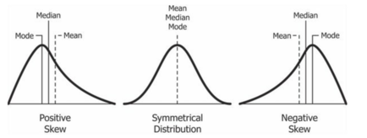
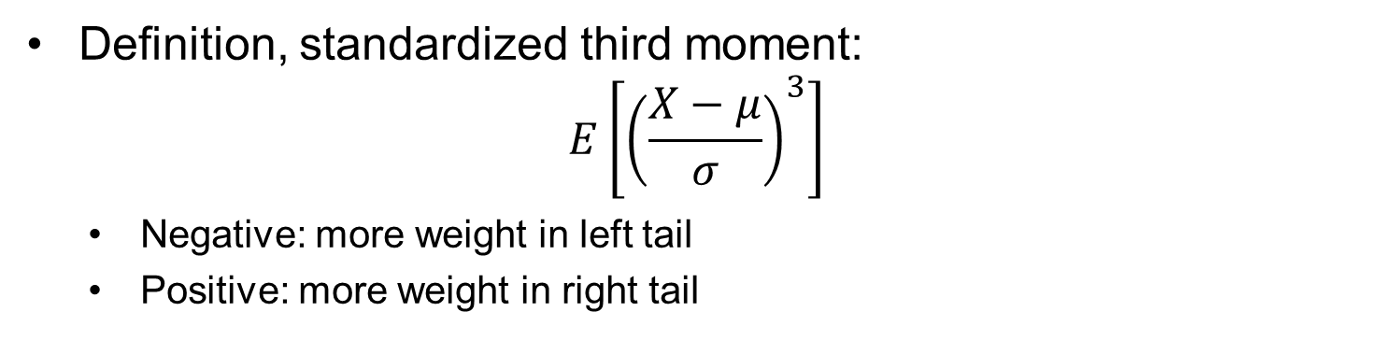
Skewness
Definition, standardized third moment:
$$E\left[{\left(\frac{X−μ}{σ}\right)}^{3}\right]$$
  Negative: more weight in left tail
  Positive: more weight in right tail

Slide 7
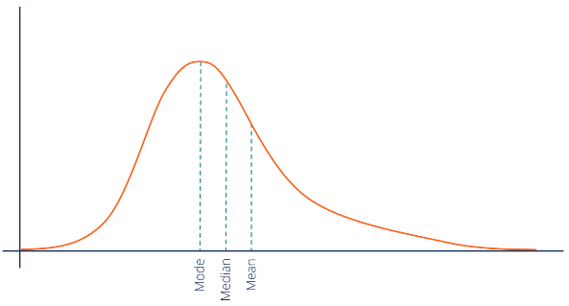
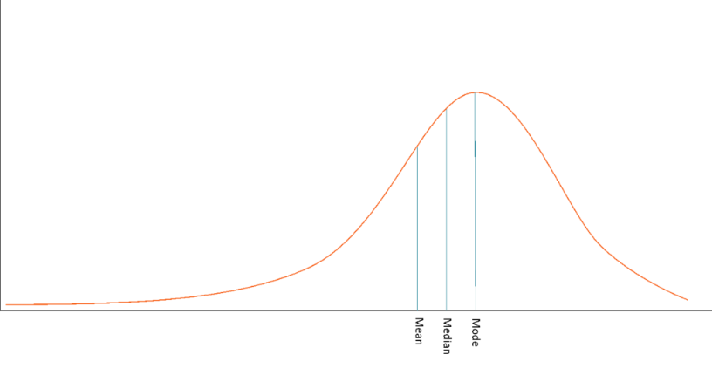
Skewness in Stocks and Portfolios
*An empirical “puzzle”: over long samples, individual stocks tend to have more positive skewness than portfolios; How can this be? Is it present in your homework results?

Slide 8
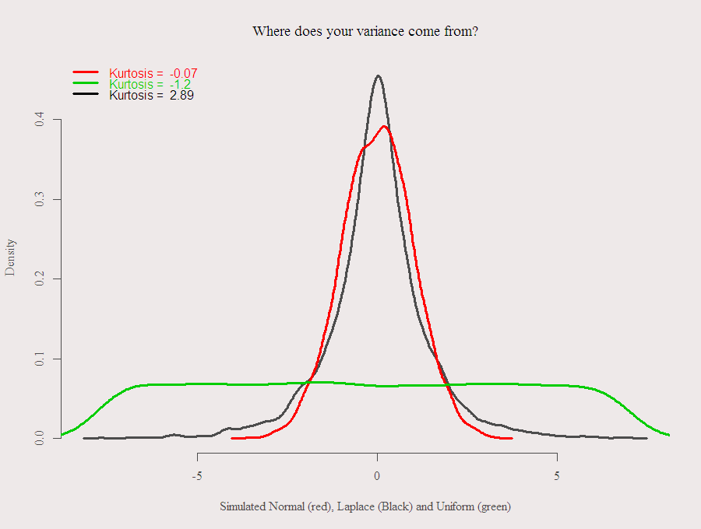
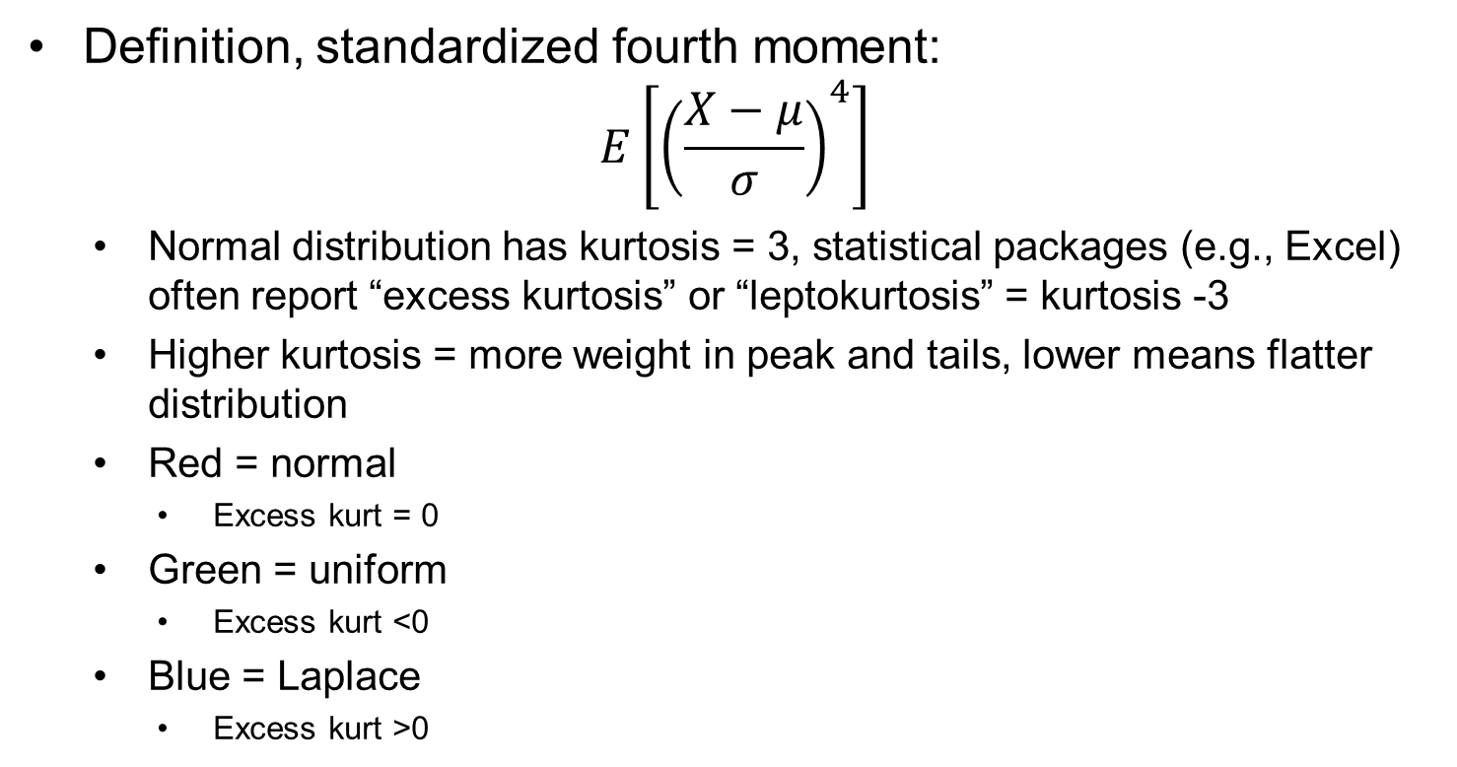
Kurtosis
Definition, standardized fourth moment:
$$E\left[{\left(\frac{X−μ}{σ}\right)}^{4}\right]$$
  Normal distribution has kurtosis = 3, statistical packages (e.g., Excel) often report “excess kurtosis” or “leptokurtosis” = kurtosis -3
  Higher kurtosis = more weight in peak and tails, lower means flatter distribution
  Red = normal
    Excess kurt = 0
  Green = uniform
    Excess kurt <0
  Blue = Laplace
    Excess kurt >0

Slide 9
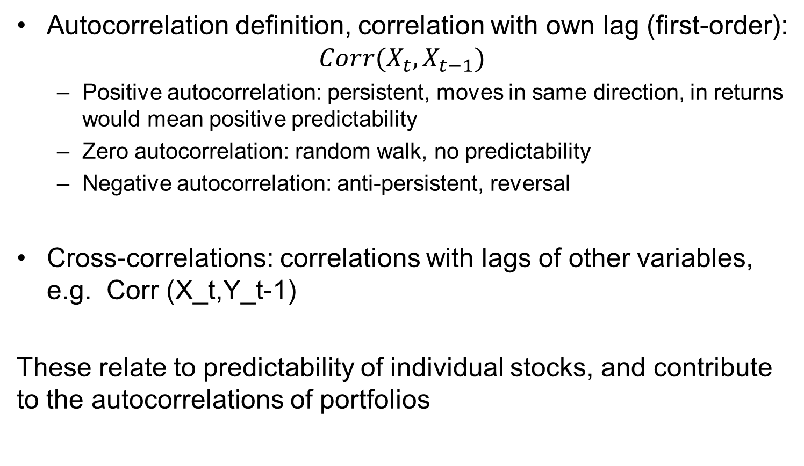
Autocorrelation
Autocorrelation definition, correlation with own lag (first-order):
$$Corr(X_{t},X_{t−1})$$
  Positive autocorrelation: persistent, moves in same direction, in returns would mean positive predictability
  Zero autocorrelation: random walk, no predictability
  Negative autocorrelation: anti-persistent, reversal
Cross-correlations: correlations with lags of other variables, e.g. Corr (X_t,Y_t-1)
These relate to predictability of individual stocks, and contribute to the autocorrelations of portfolios

Slide 10
Key Concept: Efficient Markets
In an efficient market, prices reflect available information
Strong form: all information (including inside information)
Semi-strong form: all publicly available information
Weak form: all information in past prices (technical analysis not abnormally profitable)
Does not imply unpredictable returns (frequent source of confusion)
Returns may be predictable, either in cross-section or time-series, due to differences in risk premia
Difficult (impossible?) to distinguish time varying risk premia from market irrationality…, frequent source of debate
In an efficient market, can one make a living in investment management?
Yes, to the extent that one is able to bring new information to the market at lower cost than other investors, or to better interpret complex information than other investors.

Slide 11
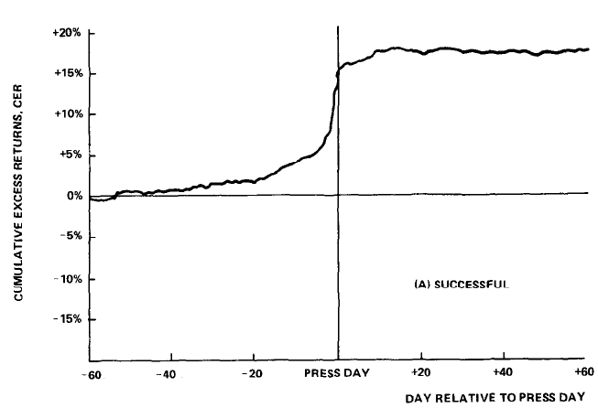
Implications of Efficient Markets
Prices should quickly incorporate new information
Example: Target returns in successful tender offers
Paul Asquith, “Merger Bids, Uncertainties, and Stock Returns”, Journal Financial Economics

Slide 12
Autocorrelation in Stocks and Portfolios
Common null hypothesis for stocks and portfolios: no autocorrelation = no predictability
Very small illiquid stocks tend to have small negative autocorrelation individually at short horizons, but not easily tradeable: noise, bid-ask bounce
  Blume and Stambaugh (1980)
Illiquid portfolios tend to have small *positive* autocorrelations at short horizons. Slow information diffusion (Lo and MacKinlay, 1990, 1991)
Versions of longer horizon predictability (again small and hard to trade: intermediate term momentum <1 yr, long-run reversal>3yrs)

Slide 13
Predictability and Market Efficiency
Market efficiency often misinterpreted to mean no predictability
  Instead, market efficiency says price is fair, does not prohibit that risk premia can be earned, and risk premia can be time-varying
  Further, limits to arbitrage imply that “mispricing” may be present in some markets at some times
Nonetheless, we should not expect to find very large positive or negative autocorrelations in tradeable stock portfolios over long periods of time
  Look for this in the moments of returns that you calculate and comment on it

Slide 14
Risk of a portfolio as securities are added
The standard deviation of a portfolio tends to decrease as more risky assets are added to the portfolio
Std. Deviation
Of Portfolio
Firm-specific Risk
Market Risk
Number of Securities

Slide 15
Benefits of Diversification in Practice
Example: 2011-2020 data
Stock/ Index | Daily Standard Deviation
Tesla | 3.5%
Biogen | 2.5%
Boeing | 2.3%
J.P. Morgan Chase | 1.8%
Google | 1.6%
Proctor & Gamble | 1.1%
Nasdaq 100 | 1.2%
Dow Jones Industrial Average | 1.1%
Standard & Poor’s 500 Index | 1.1%
Russell 2000 | 1.3%

Slide 16
Comparison with Older Data
Example: 1998-2002 data
Stock/ Index | Daily Standard Deviation
Yahoo | 5.3%
Sun Microsystems | 4.4%
Microsoft | 2.7%
Ford | 2.6%
Lockheed Martin | 2.4%
General Electric | 2.2%
Nasdaq 100 | 2.8%
Dow Jones Industrial Average | 1.3%
Standard & Poor’s 500 Index | 1.4%
Wilshire 5000 | 1.4%

Slide 17
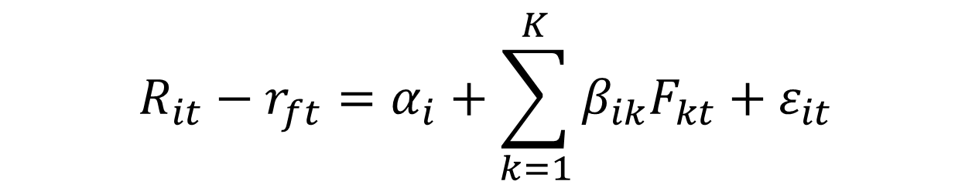
What causes diversification?
Market model:
$$R_{it}−r_{ft}=α_{i}+β_{i}\left[R_{Mt}−r_{ft}\right]+ε_{it}$$
General factor model:
$$R_{it}−r_{ft}=α_{i}+\sum_{k=1}^{K}{β_{ik}F_{kt}}+ε_{it}$$

Slide 18
Summary: Types of Risks
Total risk of any asset (portfolio or individual security) has two types of components:
  Systematic Risk:
    Risk factors common to the whole economy (e.g., market risk)
    Cannot be diversified away
  Idiosyncratic or firm-specific Risk:
    Risk factors that are specific to a company or asset
    Can be diversified away
*Make sure to observe and comment on the effects of diversification in your assignment

Slide 19
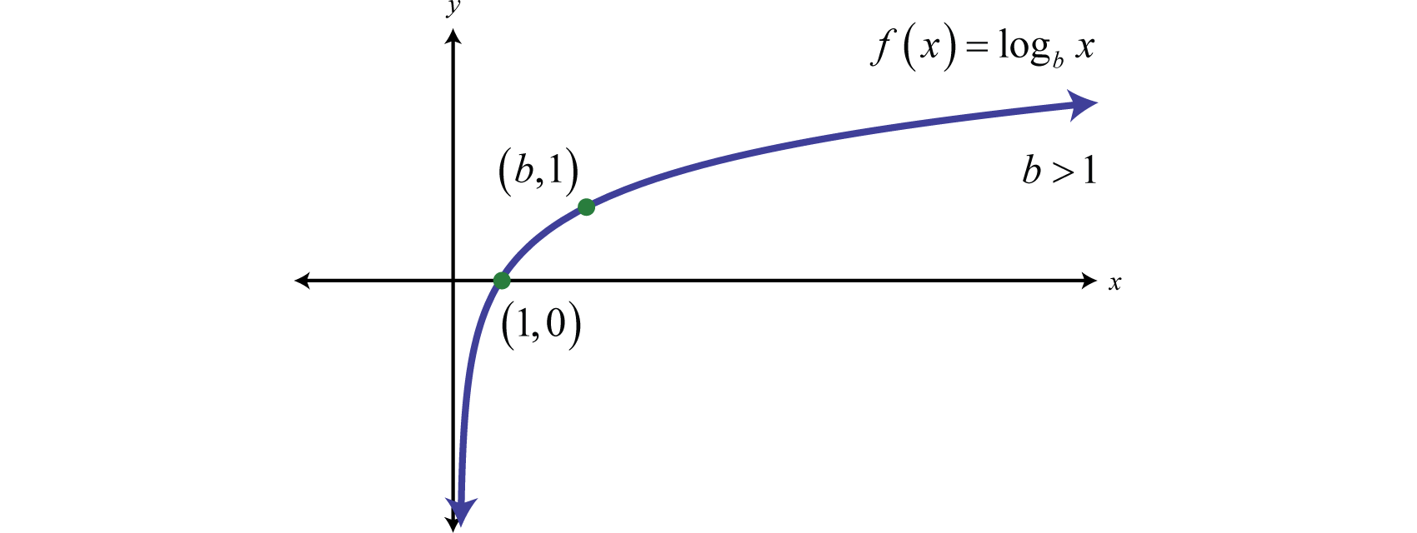
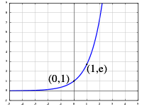
Simple returns vs log returns
Log returns
  Shrinks right tail
  Expands left tail
  Therefore reduces skewness
Conversely
  Expands right tail
  Shrinks left tail
  Increases skewness

Slide 20
Properties of log returns and simple returns
Log returns are additive:
  Implication: maximizing average log return maximizes long-run portfolio growth
  Convenient for statistical analysis
Relation between average simple and log returns requires a volatility adjustment, due to Jensen’s inequality (see spreadsheet from last class, or check yourself on any data)

Slide 21
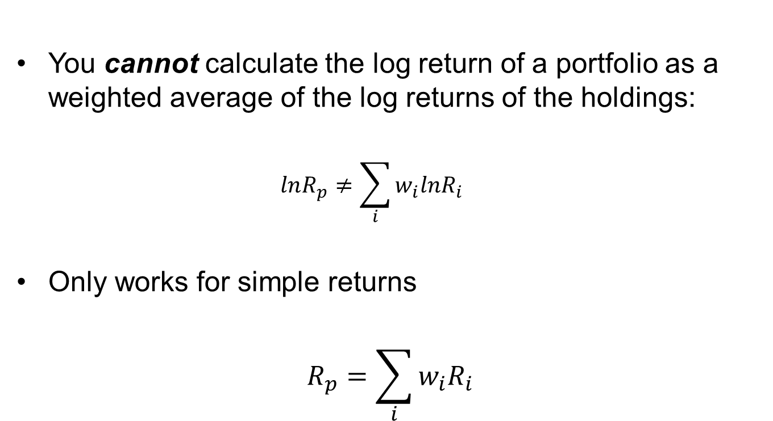
Warning about log returns
You cannot calculate the log return of a portfolio as a weighted average of the log returns of the holdings:
  $$lnR_{p}≠\sum_{i}{w_{i}lnR_{i}}$$
Only works for simple returns
$$R_{p}=\sum_{i}{w_{i}R_{i}}$$

Slide 22
Log and simple return summary
Need simple returns to calculate portfolio returns
Log returns are additive and convenient for time series: of an individual stock or a portfolio
  Also convenient for statistical analysis and because maximizing one period expected return also maximizes long-run expected growth
Log returns more negatively skewed than simple returns
Relationship between expected log returns and expected simple returns requires Jensen’s inequality adjustment related to volatility
  The more volatile the asset, the bigger the gap between mean simple and log returns.

Slide 23
Intro to Stock Pricing and Returns
Key concepts:
Dividend Discount Model
Discounted Free Cash Flow Model (a “DCF” model)
Multiples Valuation

Slide 24
Dividend Discount Model
One-period investor:
Return on equity, r_{s}, determined by firm risk, what investments of similar risk will yield (opportunity cost of capital)
Can be decomposed into expected dividend yield and capital gain
Two-period investor:
N-period investor:
Infinite Horizon:
In principle, all give same answer, investor horizon does not matter

Slide 25
Constant Dividend Growth Model
Also called the Gordon Growth Model:

Slide 26
Limitations of Dividend Discount Model
Some firms return cash to shareholders through share repurchases, which are not accounted for explicitly by the dividend discount model
  Use the total payout model to address this issue (to obtain same answer using DDM, would need to model the fact that repurchasing shares allows faster growth in per share dividends)
Dividend policy varies considerably across firms; dividends and other payouts are what ultimately matters to investors, but the ability to pay dividends is driven by deeper fundamentals, i.e., cash flows
  Discounted cash flow models address this issue

Slide 27
Discounted Free Cash Flow Model
  Enterprise Value (V or EV) = Market Value of Equity (S)
  + Market Value of Debt (D)
  - Excess Cash
  Excess Cash: Cash that could be taken out of the company without impacting the future operations of the firm on which the future cash flow forecasts are based

Slide 28
Discounted Free Cash Flow Model
  Definition of Free Cash Flows:
  FCF = UCF = EBIT (1-Tc) + Depreciation – CAPX – ΔNWC
  *simplify by combining depreciation and CAPX using
  Net investment = CAPX – Depreciation
  This can sometimes be confusing because another interpretation of Net investment is gross investment less asset sales.
  Enterprise value: V = PV(Future Free Cash Flows of Firm)
  Share price: P = (V – D + Excess Cash) / shares outstanding

Slide 29
Cash Flows vs. Earnings
Sales
Costs
Earnings Before Int., Tax, Dep, and Amm. | EBITDA
-Depreciation and Amortization
Earnings Before Interest and Tax | EBIT
-Taxes
Net Operating Profits Less Adjusted Tax | NOPLAT = (1-t) EBIT
+ Depreciation and Ammortization Net Capx Change in NWC
Free Cash Flow (Unlevered Cash Flow) | FCF = UCF

Slide 30
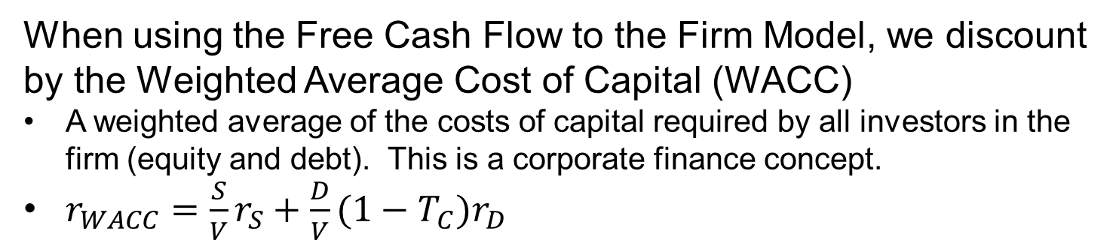
Discount Rate: WACC
  When using the Free Cash Flow to the Firm Model, we discount by the Weighted Average Cost of Capital (WACC)
  A weighted average of the costs of capital required by all investors in the firm (equity and debt). This is a corporate finance concept.
  $r_{WACC}=\frac{S}{V}r_{S}+\frac{D}{V}(1−T_{C})r_{D}$

Slide 31
Multiples Valuation
Basic idea: use prices of a peer group to build up an estimate of value for the firm you are analyzing (law-of-one-price)
Outline of typical steps:
  Choose a relevant peer group (e.g., firms in an industry)
  Propose a quantity (e.g., EBITDA) that you believe correlates to value (e.g., EV) among firms in the peer group
  Calculate the corresponding ratio (e.g., λ_{i}=EV_{i}/EBITDA_{i}) for all observations i in the peer group
  Designate the average multiple:
  Apply this multiple to the firm you are analyzing to estimate its value:

Slide 32
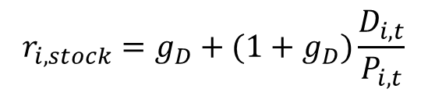
Multiples Valuation: Theory
There is theory behind some important multiples
E.g., the price-dividend (P/D) ratio:
  For a firm i with constant growth of dividends:
Gordon Growth Formula
  Hence:
$$r_{i,stock}=g_{D}+(1+g_{D})\frac{D_{i,t}}{P_{i,t}}$$
Thus, the P/D ratio is driven by equity risk (r_{s}) and the growth rate (g_{D}).
The stock return is driven by dividend yield (P/D) and growth (g_{D}).

Slide 33
Varieties of Multiples: Numerator and Denominator
In the numerator:
  Enterprise value, denoted V or EV
  Equity value, either per share (P) or total market cap (S)
In the denominator:
  Dividends (for P or S)
  Aggregate Dividends plus coupon payments (for EV)
  FCF=UCF (for EV)
  LCF (“Levered Cash Flow” or “Cash Flow to Equity”, per share for P, aggregate for S)
  EBIT (for EV, trailing or forecasted)
  EBITDA (for EV), or EBITDA less maintenance CAPEX
  Sales/Revenues (for EV)
  # of customers, web site hits, # of employees, R&D spending, … (EV)
  Book value (of assets for EV, of equity for S, of equity per share for P)
  …

Slide 34
Why do pricing models matter for quant finance?
The stock pricing models have stock price on the left, and on the right a required return with a variety of other variables
In quantitative finance, we invert the problem, we make inferences about returns (lhs) using stock characteristics and prices, often ratios as predictors (rhs)
We will see this when we look at cross-sectional trading strategies in week 3.

Slide 35
More on ratios…

Slide 36
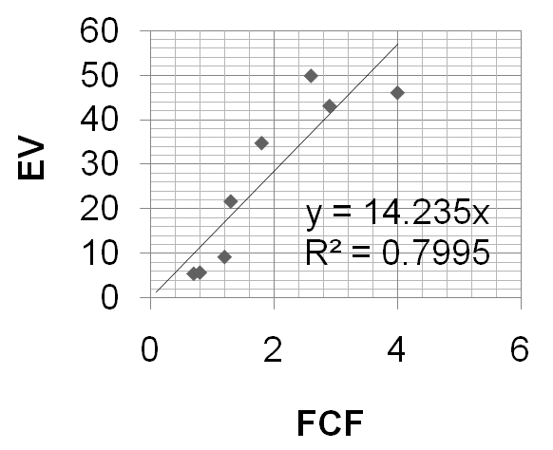
Choosing a Multiple to Use
For any industry/situation, there are often a number of potential multiples one could use
  EV/EBITDA, EV/FCF, EV/sales, EV/Assets, etc.
To compare accuracy of different multiples within peer group, interpret multiples valuation as a restricted (zero intercept) regression:

Slide 37
Combining Information in Different Multiples
Suppose we have several multiples that seem to work well
  One ad hoc way to combine information is to calculate implied values from each multiple, and average
  A more systematic way to approach the problem is to run a multiple regression, e.g.
Obtain estimates of regression coefficients using peers, and apply these coefficients to the corresponding variables for firm being analyzed:
Issues: collinearity? Overfitting? Seems like a candidate for machine learning applications!

Slide 38
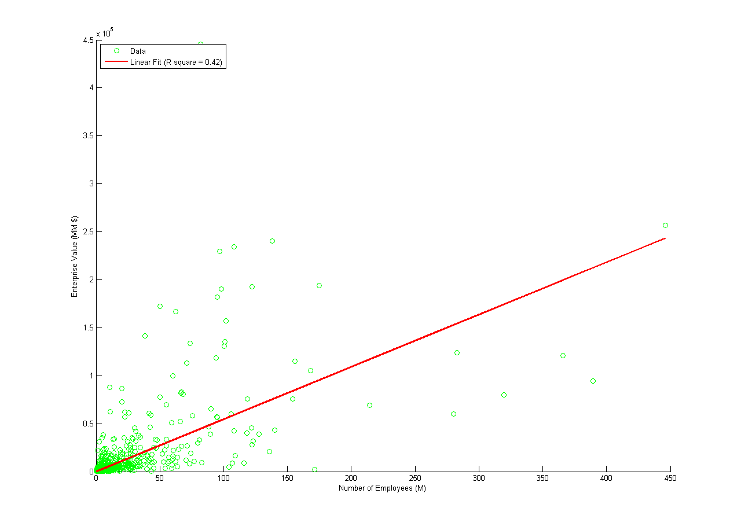
Multiples Using Number of Employees
This sample used for all plots in this file is all Compustat firms in manufacturing in year xxxx. Each dot represents a firm. The regression line is restricted to have an intercept of zero.

Slide 39
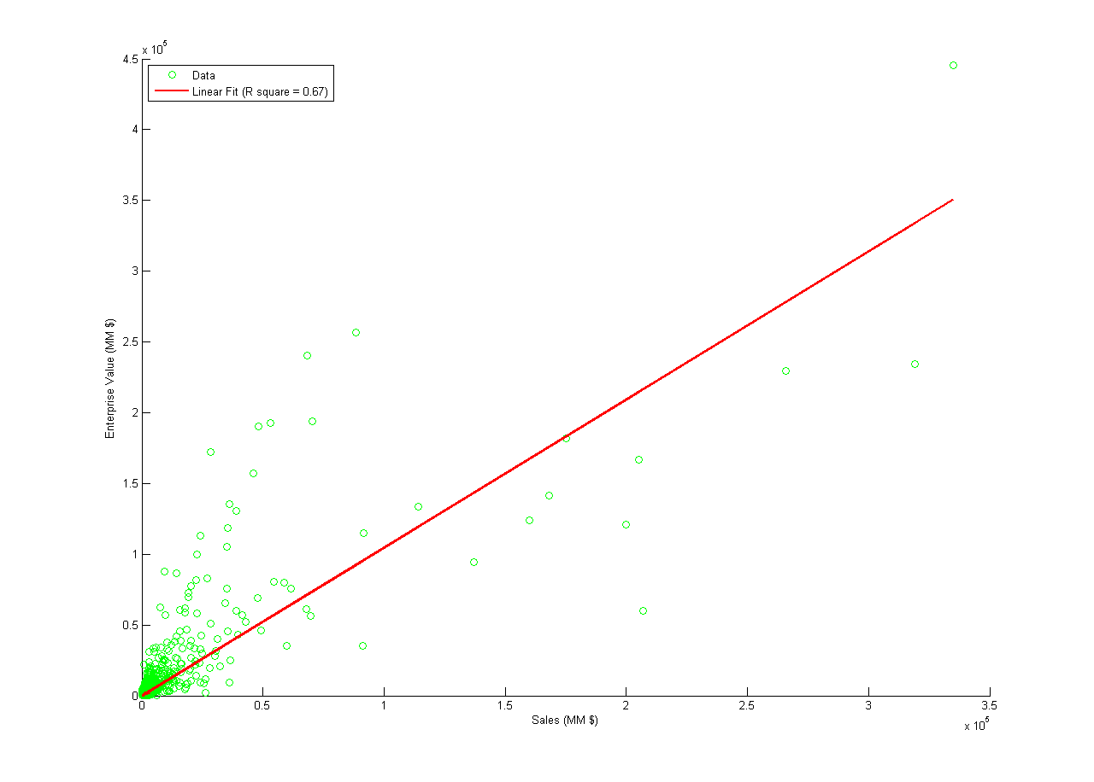
Multiples Valuation Using Sales

Slide 40
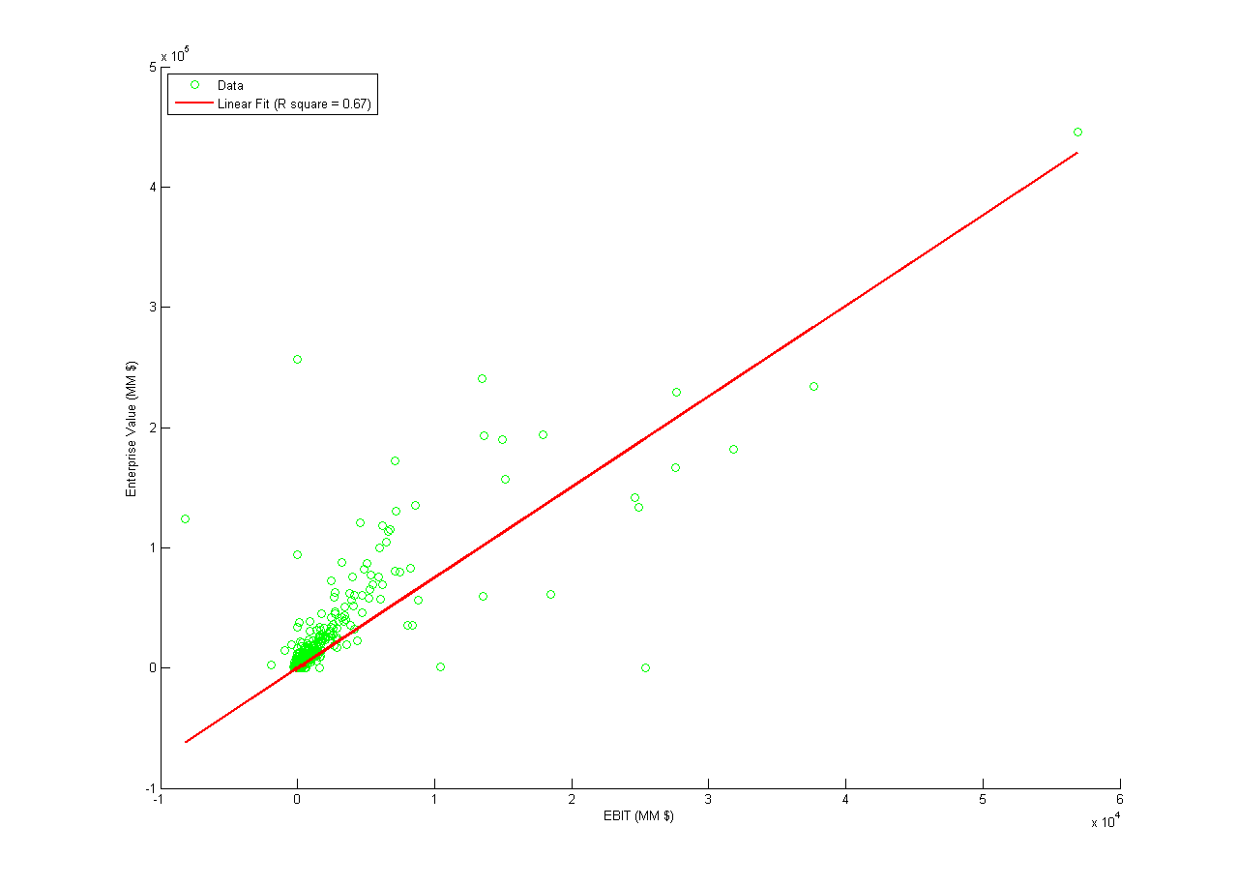
Multiples Valuation Using EBIT

Slide 41
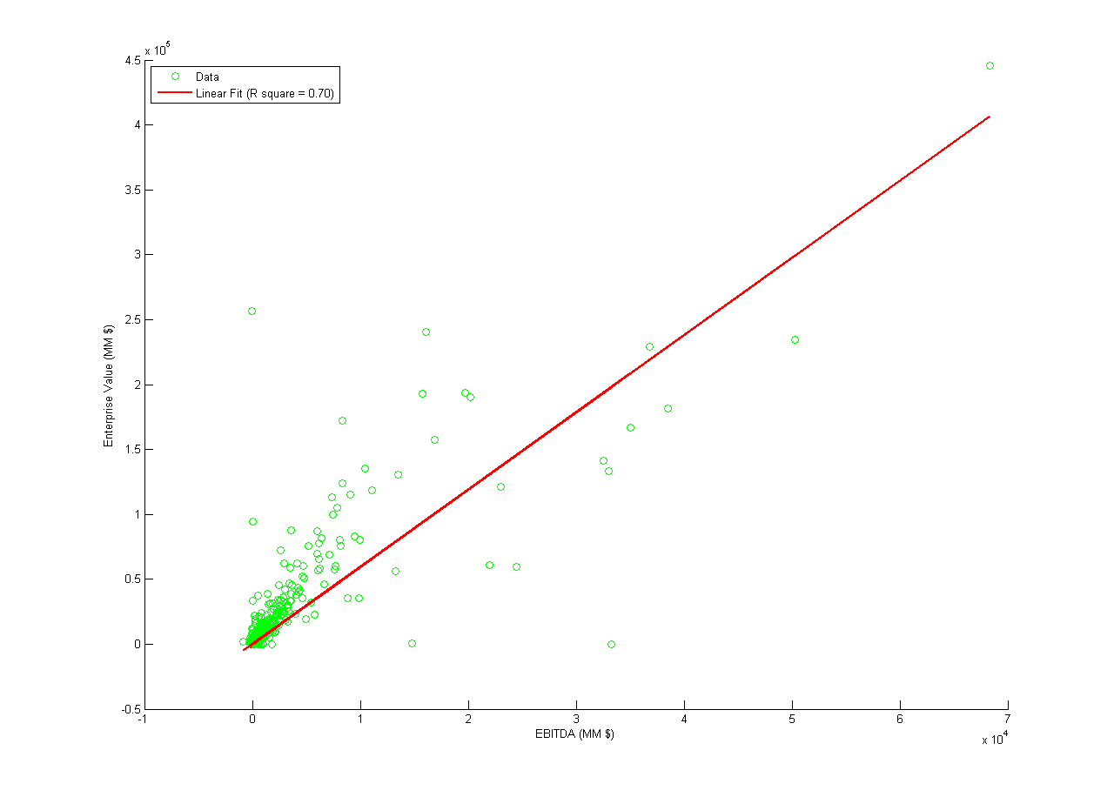
Multiples Valuation Using EBITDA

Slide 42
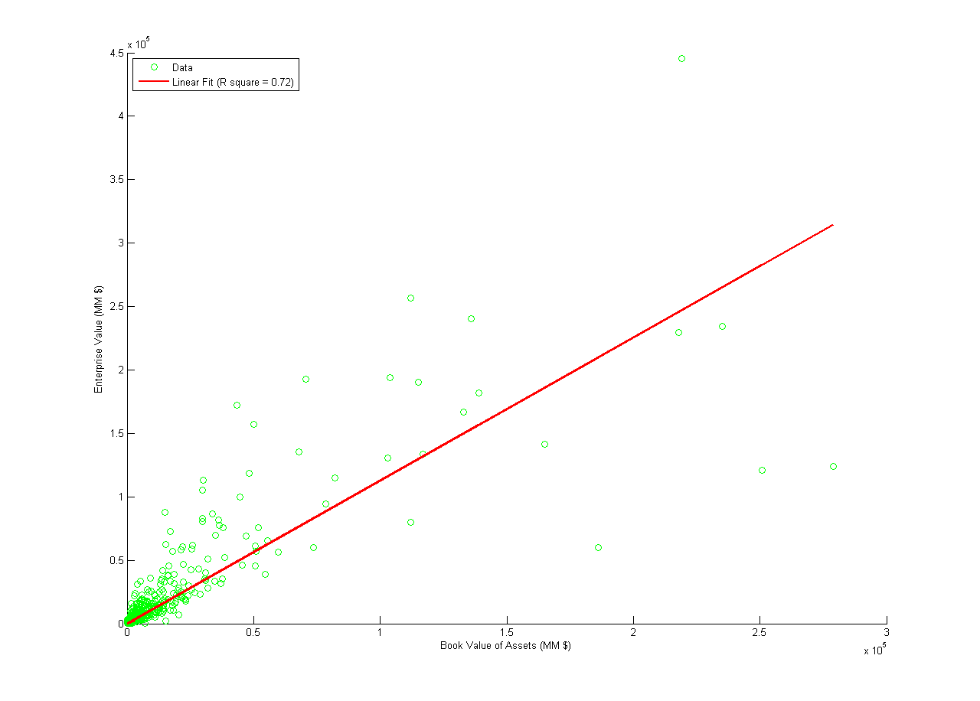
Multiples Valuation Using Book Value of Assets

Slide 43
Cross-Industry Comparison of R² from Regressions of EV on other variables
 | # of Employees | Sales | EBIT | EBITDA | Assets
Manufacturing | 0.42 | 0.67 | 0.67 | 0.70 | 0.72
Mining | 0.16 | 0.87 | 0.88 | 0.86 | 0.79
Retail | 0.90 | 0.92 | 0.97 | 0.97 | 0.94
Info. Tech. | 0.54 | 0.61 | 0.48 | 0.35 | 0.58
Finance and Insurance | 0.82 | 0.84 | 0.66 | 0.68 | 0.73
This table reports R2 from univariate regressions of enterprise value (EV) on each of the variables listed in the column headings. The initial sample is all Compustat firms in the year xxxx data, and in each row the sample is restricted only to firms in that industry.

Slide 44
Cross-Industry Comparison: Regression Coefficient
 | # of Employees | Sales | EBIT | EBITDA | Assets
Manufacturing | 545.7 | 1.05 | 7.53 | 5.95 | 1.13
Mining | 559 | 2.44 | 6.99 | 5.35 | 1.10
Retail | 106 | 0.57 | 10.20 | 7.90 | 1.26
Info. Tech. | 663.3 | 2.11 | 10.25 | 5.22 | 0.85
Finance and Insurance | 899 | 1.34 | 2.86 | 2.81 | 0.09
This table reports the regression coefficients from univariate regressions of enterprise value (EV) on each of the variables listed in the column headings. The initial sample is all Compustat firms in the year xxxx data, and in each row the sample is restricted only to firms in that industry.

Slide 45
Which to Use, DCF or Multiples?
Often, both are valuable
  Intuitively, DCF more accurate for projects with easy to forecast cash flows (e.g., infrastructure projects), and where the purchase will be buy and hold
  Multiples may tend to be more often used when cash flows are difficult to predict, and the asset will be sold at current market valuations (e.g., IPO)

Slide 46
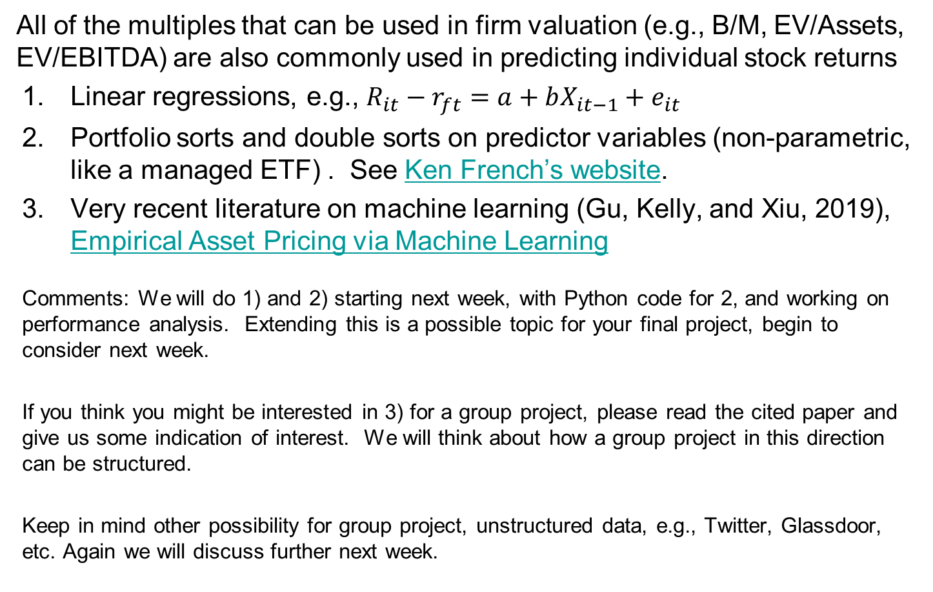
Multiples and Predictability of Stock Returns
All of the multiples that can be used in firm valuation (e.g., B/M, EV/Assets, EV/EBITDA) are also commonly used in predicting individual stock returns
Linear regressions, e.g., $R_{it}−r_{ft}=a+bX_{it−1}+e_{it}$
Portfolio sorts and double sorts on predictor variables (non-parametric, like a managed ETF) . See Ken French’s website.
Very recent literature on machine learning (Gu, Kelly, and Xiu, 2019), Empirical Asset Pricing via Machine Learning
Comments: We will do 1) and 2) starting next week, with Python code for 2, and working on performance analysis. Extending this is a possible topic for your final project, begin to consider next week.
If you think you might be interested in 3) for a group project, please read the cited paper and give us some indication of interest. We will think about how a group project in this direction can be structured.
Keep in mind other possibility for group project, unstructured data, e.g., Twitter, Glassdoor, etc. Again we will discuss further next week.

